Slide 1
YEAR 6 CLASS MASS

Slide 2
God’s greatest gift is the gift of love
Love, love, Jesus is love, God’s greatest gift is the gift of love,
All creation sings together, praising God for love.
Blest are you God’s children, God’s kingdom shall be yours,
Come sit now at the table, of Jesus the Lord.

Slide 3
Blest are you the gentle, great shall be your reward,
Come sit now at the table, of Jesus the Lord.
Blest are you the lowly, you shall be raised on high,
Come sit now at the table, of Jesus the Lord.

Slide 4
The Introductory Rites
Sign of the Cross and Greeting: Father Peter
In the name of the Father and of the Son and of the Holy Spirit.
Amen

Slide 5
Greeting
Father Peter: The grace of our Lord Jesus Christ, and the love of God and the communion of the Holy Spirit be with you all.
Response: And with your spirit.

Slide 6
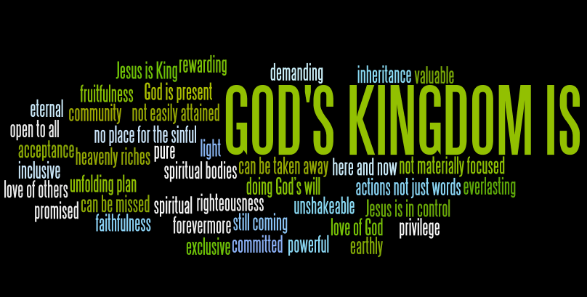
Introduction to the Mass

Slide 7
The Penitential Rite
Father Peter to lead: a suggestion
Father Peter: You were sent to heal those who are sorry for what they’ve done wrong:
Lord have mercy
ALL : Lord have mercy
Father Peter: You came to call those who have sinned:
Lord have mercy
ALL: Lord have mercy

Slide 8
Father Peter: You are seated at the right hand of the Father to intercede for us:
Lord have mercy
ALL: Lord have mercy

Slide 9
Glory to God, glory to God, Glory to God in the highest,
And on earth, peace on earth, peace to people of good will.
1 We praise you, we bless you,
we adore you, we glorify you,
We give you thanks
for your great glory,
Lord God heavenly King,
O God, almighty Father. (chorus)

Slide 10
Lord Jesus Christ, Only begotten Son,
Lord God lamb of God, Son of the Father,
You take away the sins of the world, have mercy on us.
You take away the sins of the world, receive our prayer,
you are seated at the right hand , the right hand of the Father,
Have mercy on us.

Slide 11
For you alone are the Holy One, you alone are the Lord,
You alone are the Most High, Jesus Christ,
With the Holy Spirit, in the glory of God, the Father.
Chorus
Amen.

Slide 12
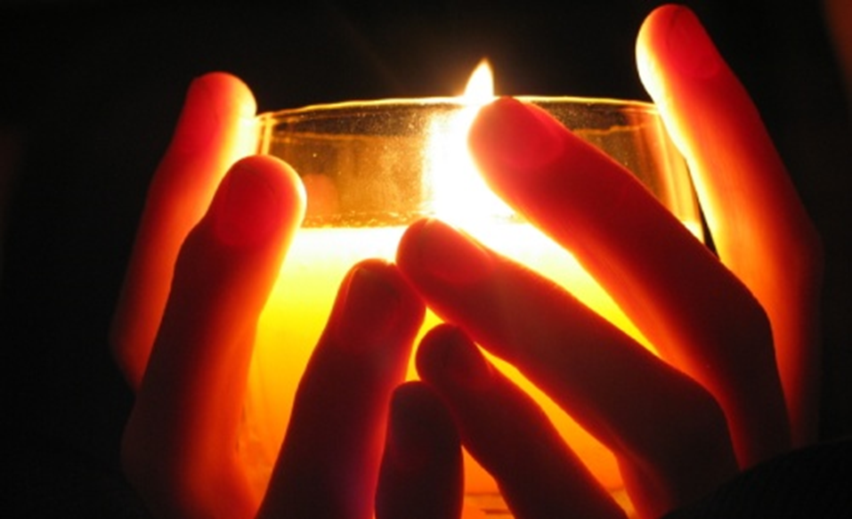
Opening Prayer

Slide 13

Liturgy of the Word

Slide 14
The word of the Lord
Response: Thanks be to God.

Slide 15
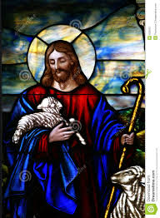
Introduction to the Gospel

Slide 16

Gospel Acclamation: Listen to Jesus

Slide 17
Alleluia, alleluia,
Alleluia, alleluia.
Listen to Jesus, do what he tells you,
Open your hearts today.
Alleluia, alleluia,
Alleluia, alleluia.
Listen to Jesus, do what he tells you,
Live in God’s love today.

Slide 18
Alleluia, alleluia,
Alleluia, alleluia.
Listen to Jesus, do what he tells you,
Love and forgive today.
CLAP, CLAP, CLAP.

Slide 19
The Gospel
Father Peter: The Lord be with you.
All: And with your spirit.
Father Peter: A reading from the Holy Gospel according to Luke
All : Glory to you, O Lord.

Slide 20
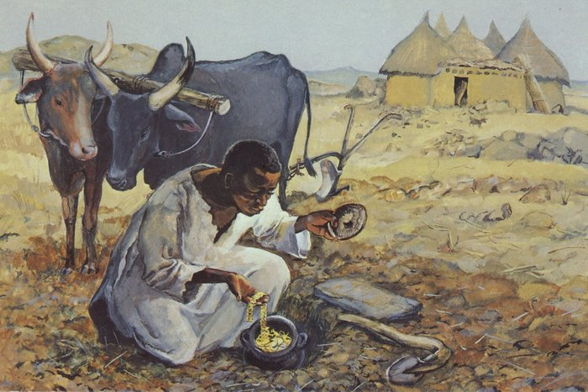

Slide 21
Father Peter: The Gospel of the Lord
All: Praise to you Lord Jesus Christ.

Slide 22

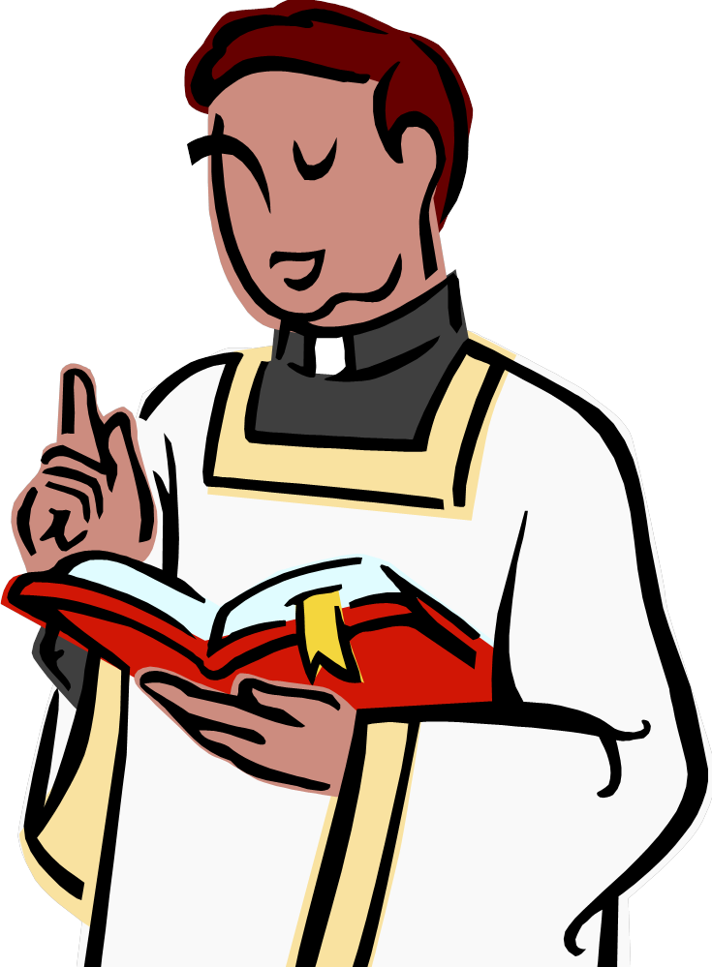
The Homily

Slide 23
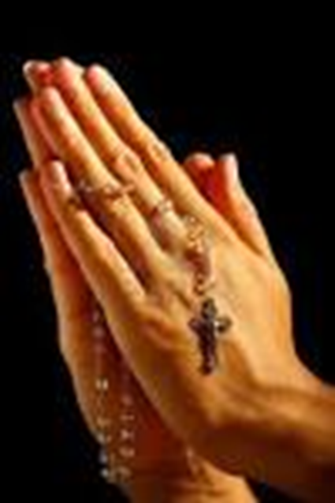
Prayers of Intercession

Slide 24

Preparation of the Gifts

Slide 25
Take our Bread
Take our bread we ask you,
Take our hearts we love you,
Take our lives, oh Father ,
We are yours, we are yours.
Yours as we stand at the table you set,
Yours as we eat the bread our hearts can’t forget.

Slide 26
We are the signs of your life with us yet,
We are yours, we are yours.
Your holy people stand washed in your blood,
Spirit-filled, yet hungry we await your food.
Poor though we are, we have brought ourselves to you. We are yours, we are yours.

Slide 27
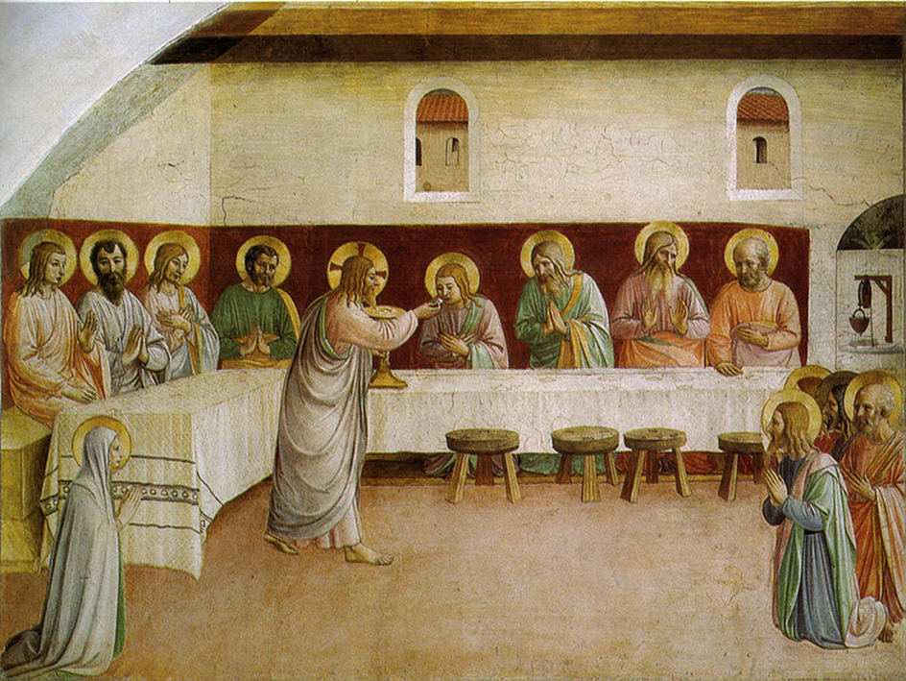
Liturgy of the Eucharist

Slide 28
Father Peter: Blessed are you, Lord God of all creation,
For through your goodness we have received the bread we offer you:
Fruit of the earth and work of human hands, it will become for us the Bread of Life.
All: Blessed be God for ever.

Slide 29
Father Peter: Blessed are you, Lord God of all creation,
For through your goodness we have received the wine we offer you:
Fruit of the vine and work of human hands, it will become our spiritual drink.
All: Blessed be God for ever.

Slide 30
Father Peter: Pray brethren that my sacrifice and yours may be acceptable to God the almighty Father.
All: May the Lord accept the sacrifice at your hands for the praise and glory of his name, for our good and the good of all his holy Church.
Amen.
Father Peter: The Lord be with you.
All: And with your spirit.
Father Peter: Lift up your hearts.
All: We lift them up to the Lord.
Father Peter: Let us give thanks to the Lord our God.
All: It is right and just.

Slide 31
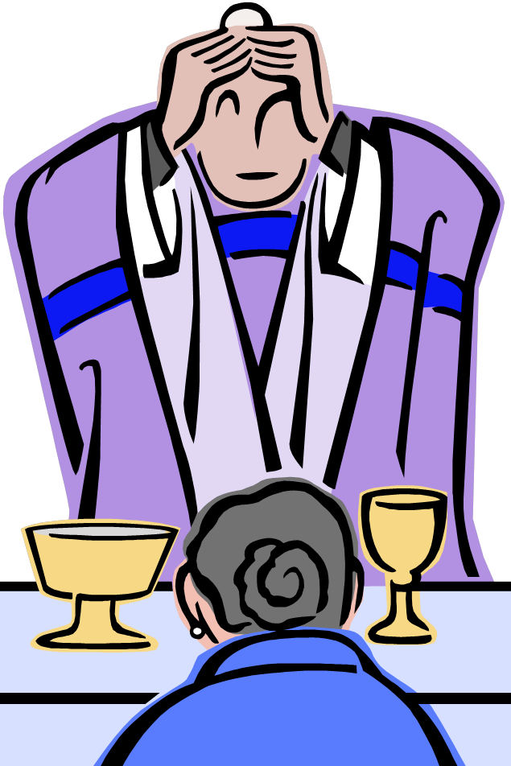
The Eucharistic Prayer

Slide 32
Holy, Holy, Holy Lord God of Hosts.
Heaven and earth are full, are full of your glory.
Hosanna ! Hosanna!
Hosanna in the highest.
Blessed is he who comes, who comes in the name of the Lord.
Hosanna ! Hosanna!
Hosanna in the highest.

Slide 33
Memorial Acclamation
The Mystery of faith:
We proclaim your death, o Lord,
And profess your resurrection
until you come again.

Slide 34
The Great Amen
Father Peter: Through him, and with him, and in him,
O God almighty Father,
In the unity of the Holy Spirit, all glory and honour is yours,
For ever and ever.
All: Amen. Amen. Amen.

Slide 35
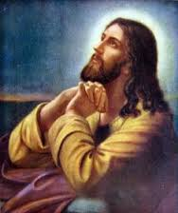
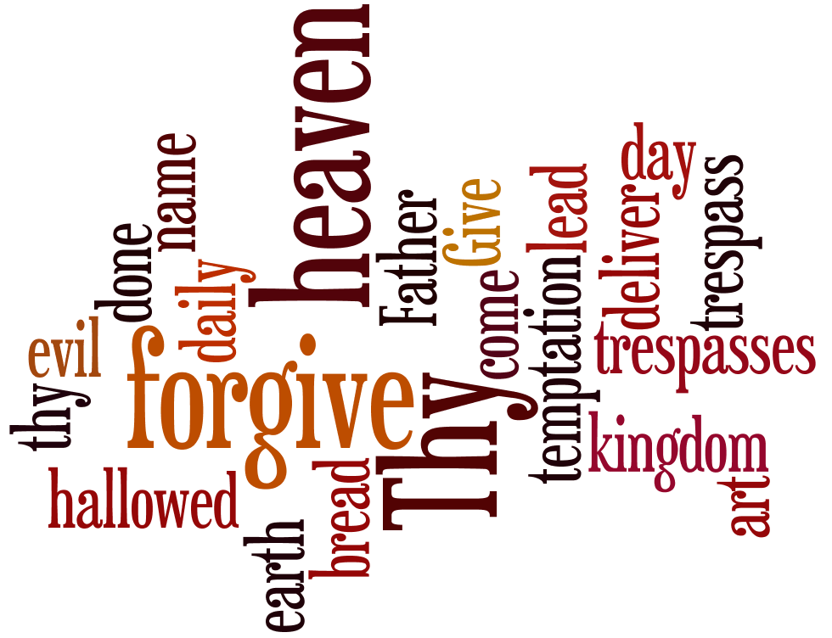
The Lord’s Prayer

Slide 36
Father Peter: Deliver us Lord we pray from every evil,
Graciously grant peace in our days,
That by the help of your mercy,
We may always be free from sin,
And safe from all distress,
As we await the blessed hope,
And the coming of our Saviour, Jesus Christ.

Slide 37
ALL: For the Kingdom, the power and the glory are yours now and for ever.

Slide 38
The Sign of Peace:
Father Peter: The peace of the Lord be with you always.
ALL: And with your spirit.
Father Peter: Let us offer each other a sign of peace.

Slide 39
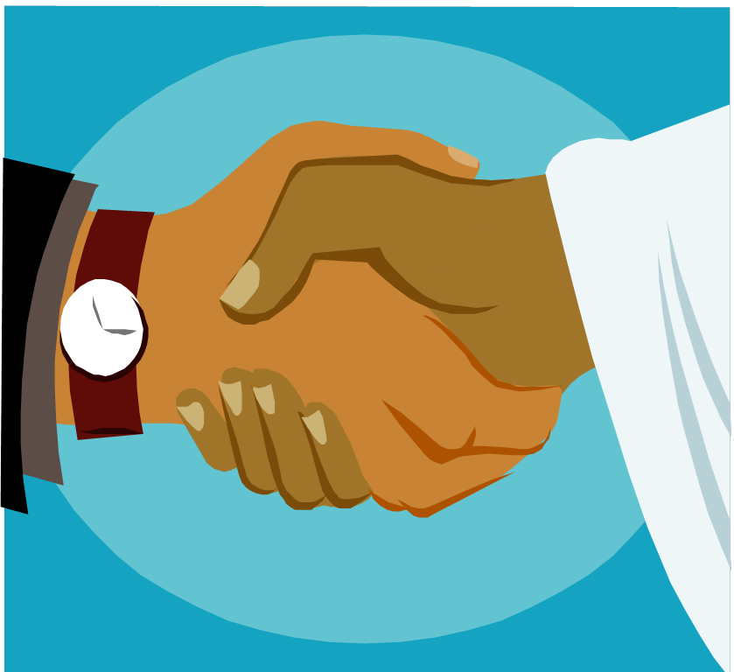
The Rite of Peace

Slide 40
Lamb of God, you take away the sins of the world,
Have mercy on us.
Lamb of God, you take away the sins of the world,
Have mercy on us.
Lamb of God, you take away the sins of the world,
Grant us peace.

Slide 41
Father Peter: Behold the Lamb of God. Behold him who takes away the sins of the world. Blessed are those called to the supper of the lamb.
All: Lord, I am not worthy that you should enter under my roof, but only say the word and my soul shall be healed.

Slide 42
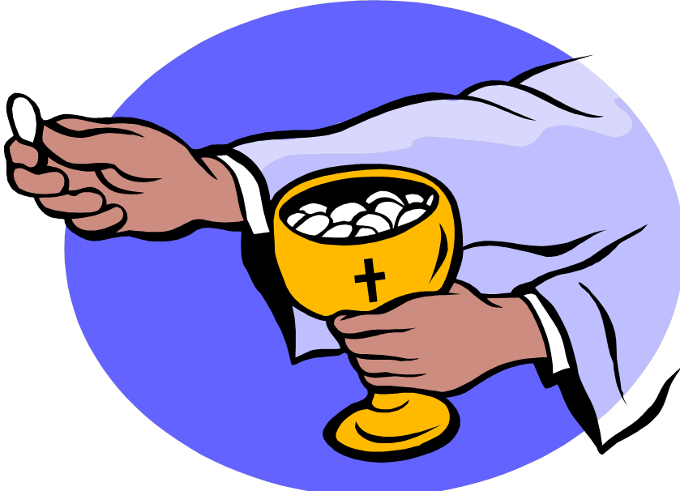
Holy Communion

Slide 43
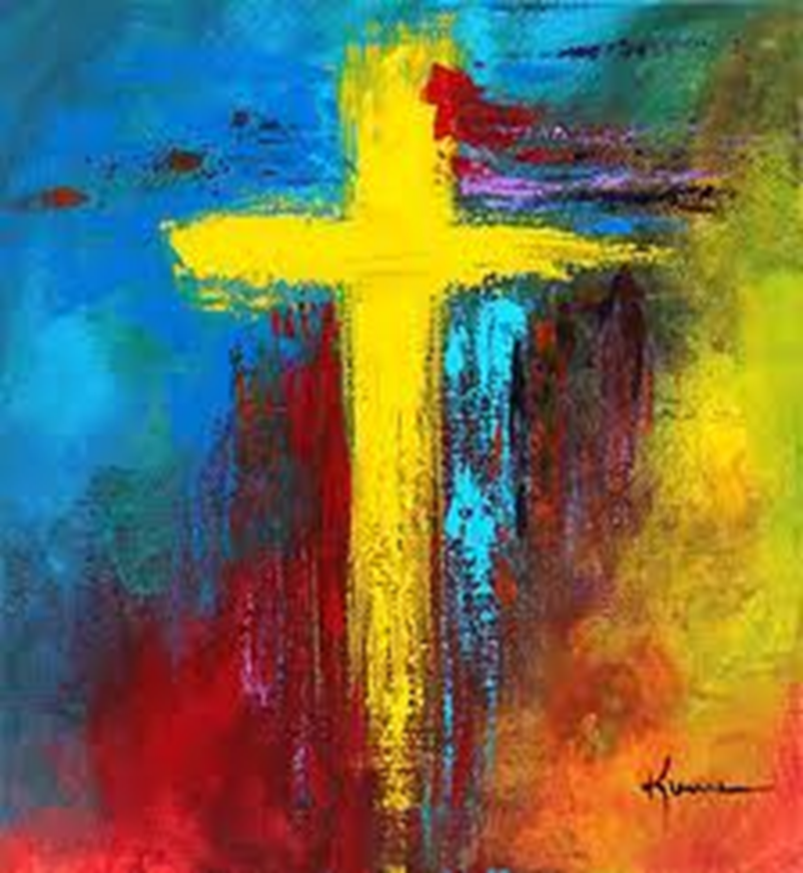
Prayer after Communion

Slide 44
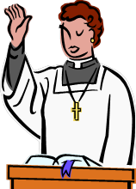
Concluding Rite
Father Peter: The Lord be with you.
All : And with your spirit.
Father Peter: May Almighty God bless you, in the name of the Father and of the Son and of the Holy Spirit.
All: Amen
Father Peter: Go in peace to love and serve the Lord.
All: Thanks be to God.

Slide 45
The Kingdom of Heaven
The Kingdom, the kingdom,
Of heaven, of heaven,
The kingdom of heaven is yours.
A new world, a new world,
In Jesus, in Jesus,
A new world in Jesus is yours.

Slide 46
Blessed are you who hunger for right:
For you shall be satisfied.
Blessed are you the merciful ones:
For you shall be pardoned too.
Blessed are you who suffer for right:
The Heavenly Kingdom is yours.
Blessed are you who suffer for me:
For you shall reap your reward.

Slide 47


