Slide 1

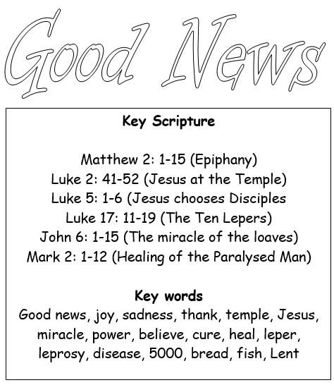
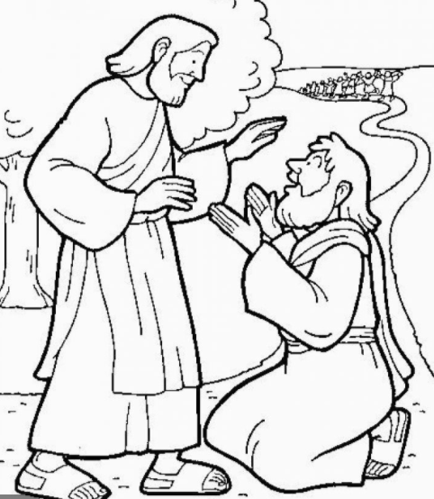
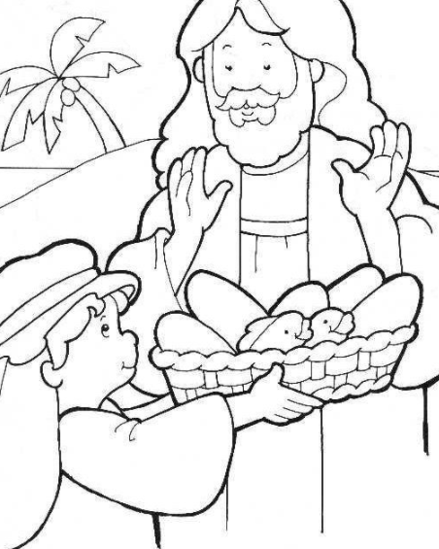
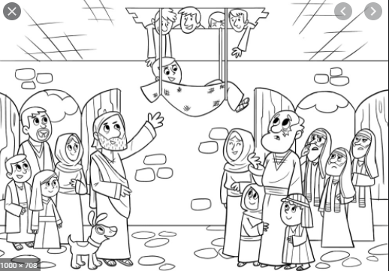

Slide 2
I can name a story about the Good News from the life of Jesus |  | I can talk about things that matter to me | I can recognise what God or Jesus is like | I can talk about my experience and feelings about following Jesus | I can use some religious words
I can retell one story about the Good News from the life of Jesus |  | I can answer questions about my own feelings. I can answer questions about characters in the stories | I can describe in a simple way what one story tells me about God or Jesus | I can give one example how I can bring good news to a person with no friends or who is sick | I can use some key religious words like Good News, Jesus, miracle, Ten Lepers, Feeding 5000
E X P E C T E D | I can retell two religious stories about the Good News | I can ask and answer questions about my own feelings and experiences. I can ask and answer questions about characters in the stories | I can describe in a simple way what these stories tells me about Jesus or God | I can give examples of how I can bring good news to the friendless or sick | I can use religious words like, Good news, Jesus, miracle, (Jairus), believe, heal, leper, Ten Leper, Feeding 5000, bread, fish, Lent

Slide 3
Collective Worship (Luke 17: 11-19)
When Jesus cured the ten men with Leprosy
Today you are going to lead your own Collective Worship using the script on the next slide.
1. Set up a focal point – use anything from your house to create a mini altar
(e.g. candles, beads, ornaments, lights, key words from the story, bible…)
2. Choose the Gather
3. Read the Word
4. Respond to the Word by drawing a thank you card in the space
5. Create your own prayer using the guide
6. Go Forth - Use the link to watch the reflection and think about the different people you could thank today

Slide 4

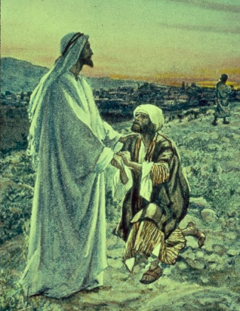
Class: | Date: |  | Leaders:
Add your focal point photograph: Set up by… |  |  | Gather: Google: ‘thank you song’ OR Sing our ‘after lunch prayer’ OR Sing ‘come and join the circle’
Word: Ten Lepers (Luke 17: 11-19) Read from your bible or go to: https://www.biblegateway.com/passage/?search=Luke%2017%3A11-19&version=NIV |  |  | Response to the Word: What was the message from the story? Draw a thank you card to someone you want to thank.
Prayer – Child led Dear Jesus, Thank you to …. Thank you for… Finish with the ‘Glory be’ together.
Go Forth: child led – who will you say thank you to today? Thank you reflection: https://www.youtube.com/watch?v=K44trVhtZX4

