Slide 1

Lower Key Stage 2 Prayer and Liturgy
10.11.21
A Gift Given With Love

Slide 2
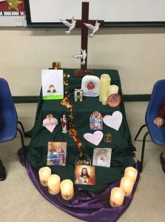
Gather:
Hymn – God’s Greatest Gift

Slide 3

Notes:
WORD

Slide 4
Hail Mary
Hail Mary, full of grace
The Lord is with thee.
Blessed art thou among women
And blessed is the fruit
Of thy womb, Jesus.
Holy Mary, mother of God,
Pray for us sinners now
And at the hour of our death.
Amen

Slide 5
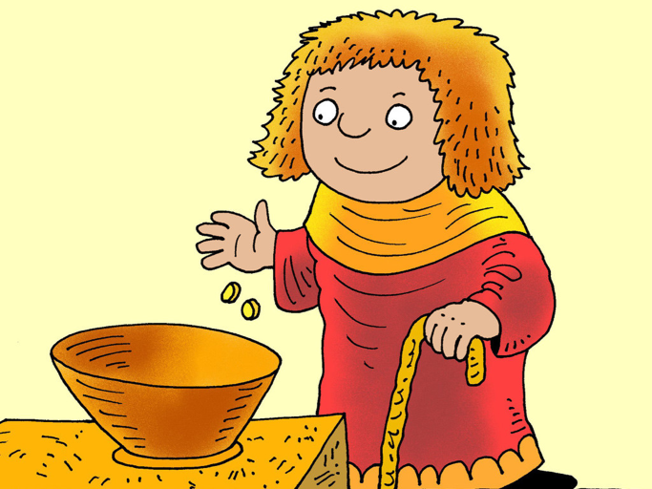
Word
During Monday’s Good News Assembly,
Mrs Cooke shared last Sunday’s Gospel reading which was about being generous and giving.
We were told of a lady who had very little but gave a lot. While you listen to the Gospel reading again, try to think about what Jesus is telling us about how we should live our lives.

Slide 6

Mark 12:38-44
The Lord be with you.
And with your spirit
A reading from the Holy Gospel according to Mark.
Glory to you, O Lord.

Slide 7
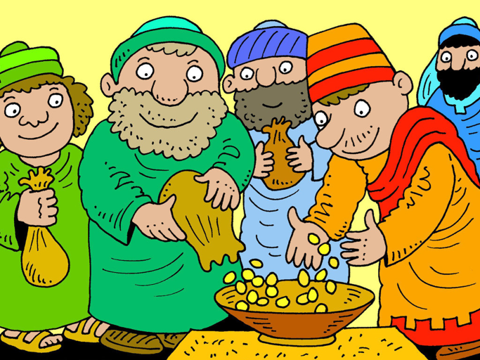
Jesus sat down opposite the treasury and watched the people putting money into the treasury, and many of the rich put in a great deal.

Slide 8
A poor widow came and put in two small coins, the equivalent of a penny.

Slide 9
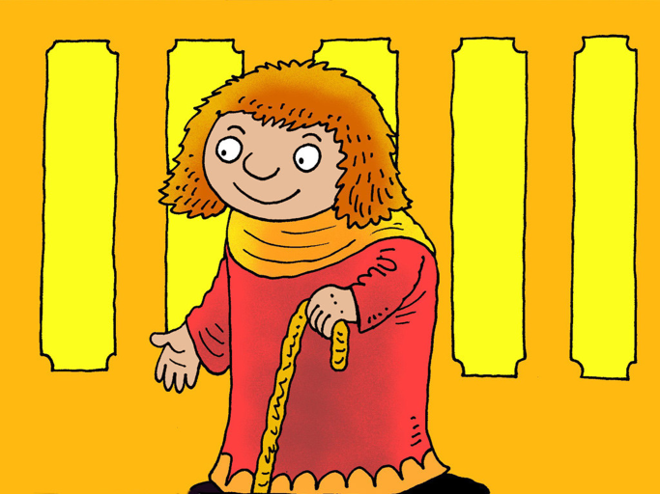
Then he called his disciples and said to them, “I tell you solemnly, this poor widow has put more in than all who have contributed to the treasury.”

Slide 10
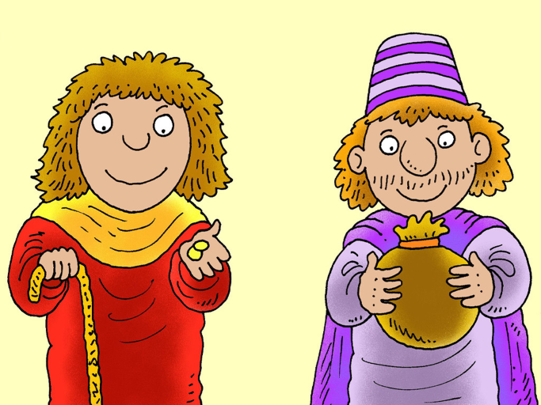
“For they have all put in money they had over but she, from the little she had, has put in everything she possessed, all she had to live on.”

Slide 11
Matthew 12:38-44
The Gospel of the Lord
Praise to you, Lord Jesus Christ.

Slide 12

Response to the Word
What do you think Jesus’ message is to us?

Slide 13
Response to the Word
The widow’s gift is her money. However, when we are talking about gifts we are talking about something that is ‘given with love’. The widow was showing her love of God.
Remember the gather music? The best gifts are ones that cannot be bought – friendship, kindness, forgiveness and patience

Slide 14


Slide 15
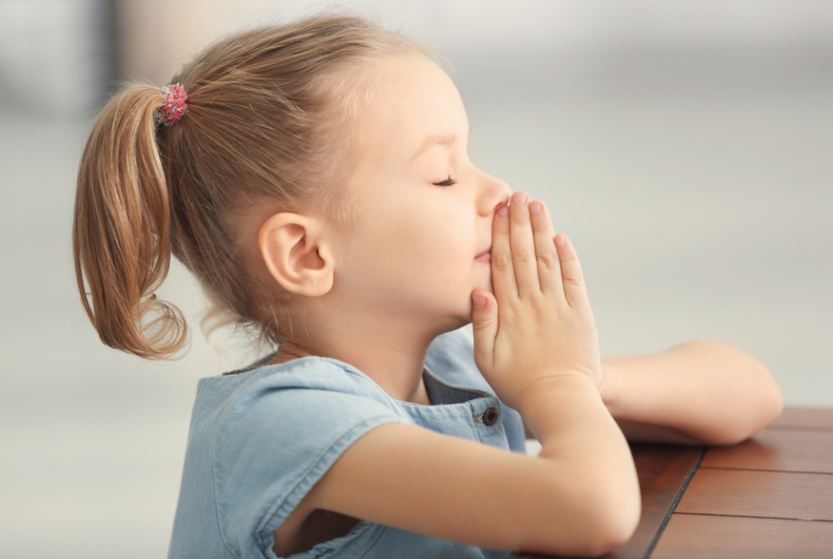

Prayer
Dear Lord
You provide us with everything we need.
Thank you for those, like Jesus and the widow, who set an example of true generosity.
Help us to trust you and choose to be generous with what we have.
Amen

Slide 16
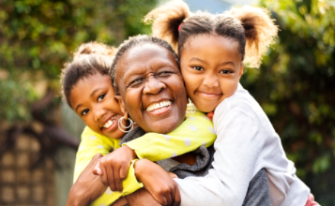
Go Forth
Offer a helping hand,
Smile at someone else,
Say something kind,
Share your gifts of love,
Friendship and kindness with others today!

Slide 17

Thank you for taking part in our Lower Key Stage 2 Assembly!

