Slide 1
Upper Key Stage 2
Prayer and Liturgy

Slide 2

Gathering:
Sign of the Cross
Our School Prayer

Slide 3

1. In this world we are bright lights,
in this world we are to shine.
We are called to be gracious,
we are children of God, we are the light!

Slide 4
Set the world on fire;
be who God made you to be!
Set this world alight -
take courage; burn bright!

Slide 5
2. Shine among them like bright stars,
lighting up the night sky.
Take the message of God’s love,
let it rule in your heart and your mind.

Slide 6
Set the world on fire;
be who God made you to be!
Set this world alight -
take courage; burn bright!

Slide 7
3. In this world there may be darkness,
- do not be afraid.
God will never leave you;
you are precious in his eyes, so shine bright!

Slide 8
Set the world on fire;
be who God made you to be!
Set this world alight -
take courage; burn bright!

Slide 9
Catherine of Siena, pray for us!
Catherine of Siena, pray for us!
(x2)

Slide 11
Can you think of a time when someone was really generous to you?
Or when you have been generous towards someone else?
What happened?
How did it make you feel?
How many different ways can you think of to be generous that don’t involve spending or giving money?

Slide 12
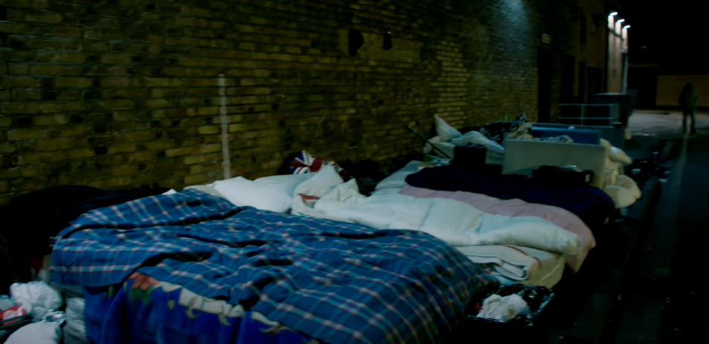
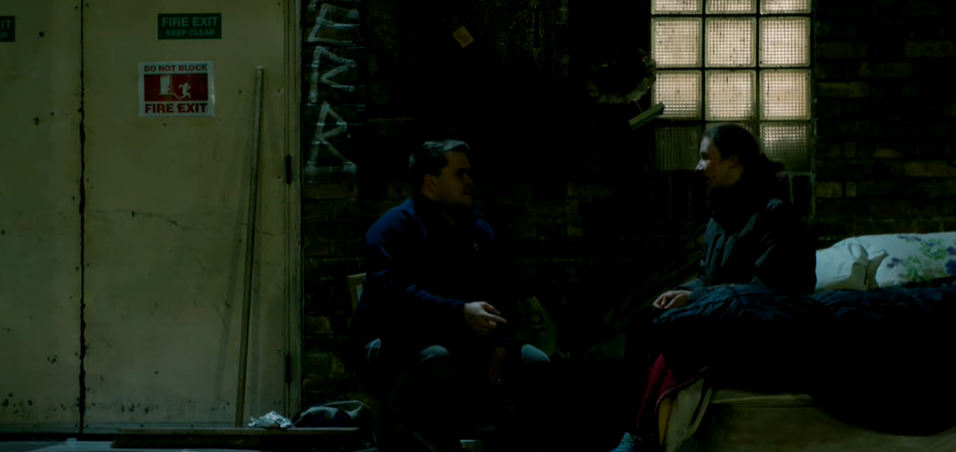
London 2017 Danute 28 years old

Slide 13
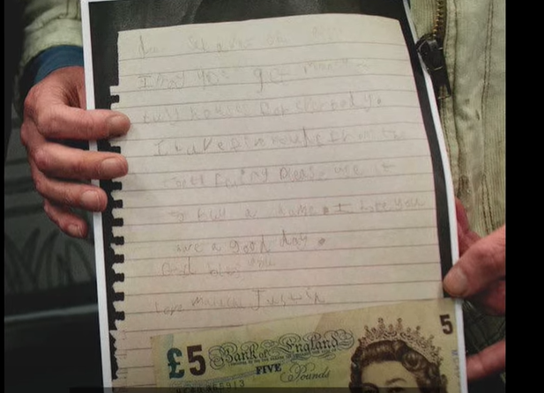
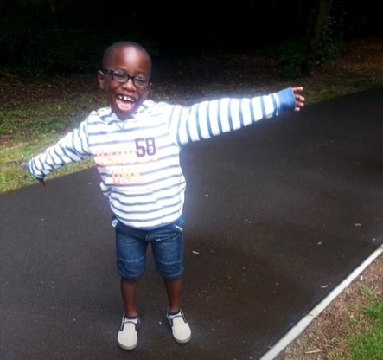
Malachi

Slide 14

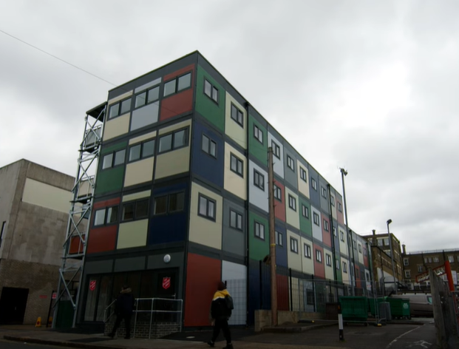
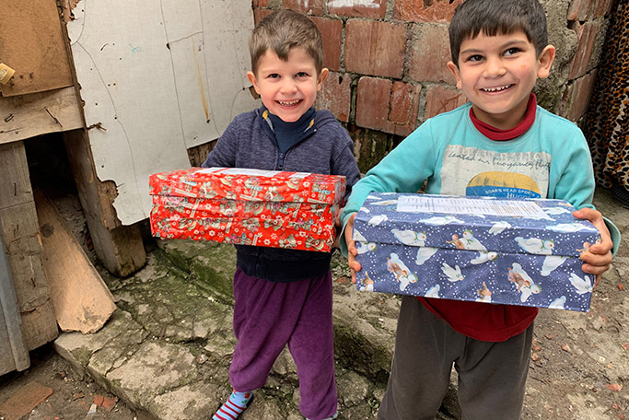

Slide 15
How is this an example of generosity?
Malachi, like the widow in the story, gave all he had, look at the difference it made.
I wonder how this story makes you feel?

Slide 16
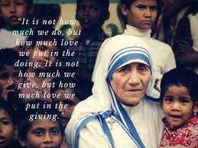
“The person who gives with a smile is the best giver because God loves a cheerful giver.” Mother Teresa

Slide 17
PRAY:
Lord Jesus, teach me to be generous;
teach me to serve you as you deserve,
to give and not to count the cost,
to toil and not to seek for rest,
to labour and not to seek reward,
except that of knowing that I do your will.
Amen
St. Ignatius Loyola

