Slide 1
Prayer and Liturgy
UKS2
Tuesday 5th October
Song: Staff Share
Hymns: One Life

Slide 2
1. I’m choosing who to follow,
a place to shelter from the sun.
As you will bring the joy, Lord,
you’ll bring the reason to the storm.
Create in me a longing, to be the best in all,
and I will be the person,
who will live life to the full.

Slide 3
Created in you, Lord,
created in you.
Created in you, Lord,
all things are rooted in you.

Slide 4
2. Lord if there are moments,
when my mind may stray away;
or sometimes when my purpose
isn’t lived out the best way;
Lord, you’ll be my stronghold,
where my roots are firmly bound,
I’ll turn to you in splendour,
where your glory will be found.

Slide 5
Created in you, Lord,
created in you.
Created in you, Lord,
all things are rooted in you.

Slide 6
(Bridge)
O, may my roots go down,
O, may my roots go down;
O, may my roots go down to you, Lord.
O, may my roots go down,
O, may my roots go down;
O, may my roots go down to you.

Slide 7
3. Lord, from when you formed me,
in your image of love and grace,
I have been a child of beauty, that you made.
So, Lord, when I am broken
or Lord, when I am sad,
you will be the reason
that makes my heart feel glad.

Slide 8
Created in you, Lord,
created in you.
Created in you, Lord,
all things are rooted in you.

Slide 9
(Bridge)
O, may my roots go down,
O, may my roots go down;
O, may my roots go down to you, Lord.
O, may my roots go down,
O, may my roots go down;
O, may my roots go down to you.

Slide 10
Created in you, Lord,
created in you.
Created in you, Lord,
all things are rooted in you.

Slide 11

Gather together

Slide 12


Slide 13
The Lord be with you.
And with your Spirit.
A reading from the Holy Gospel according to Luke.
Glory to you O Lord.

Slide 14
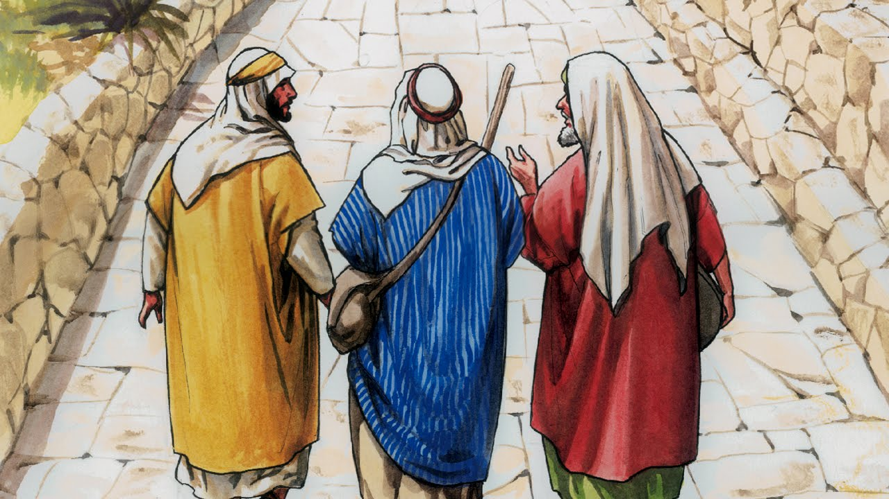
The disciples on the road to Emmaus
Now on that same day two of them were going to a village called Emmaus, about seven miles from Jerusalem, and talking with each other about all these things that had happened.

Slide 15
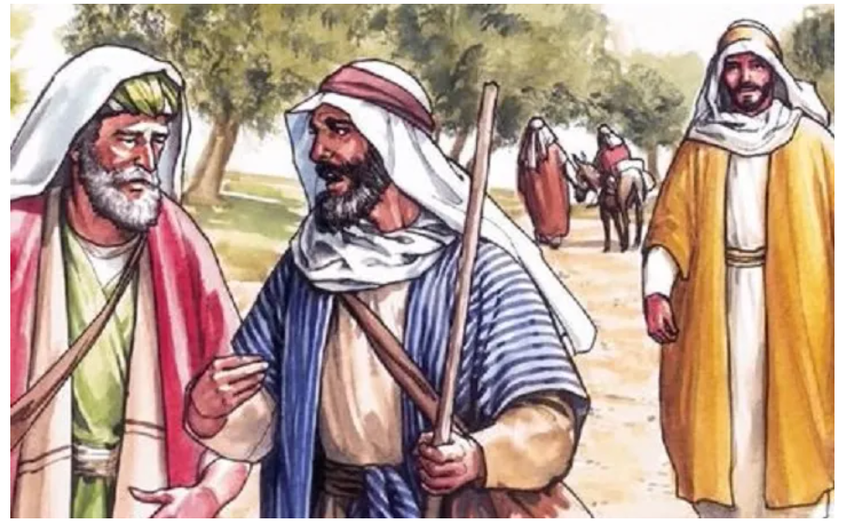
While they were talking and discussing, Jesus himself came near and went with them, but their eyes were kept from recognizing him.

Slide 16
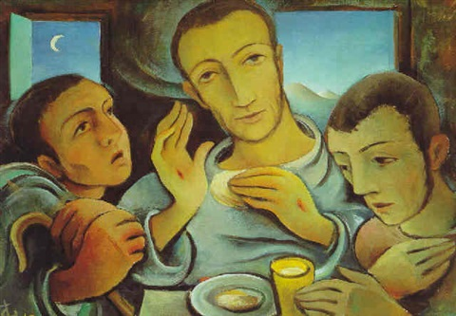
As they came near the village to which they were going, he walked ahead as if he were going on. But they urged him strongly, saying, “Stay with us, because it is almost evening and the day is now nearly over.” So he went in to stay with them. When he was at the table with them, he took bread, blessed and broke it, and gave it to them. Then their eyes were opened, and they recognized him; and he vanished from their sight. They said to each other, “Were not our hearts burning within us while he was talking to us on the road, while he was opening the scriptures to us?”

Slide 17
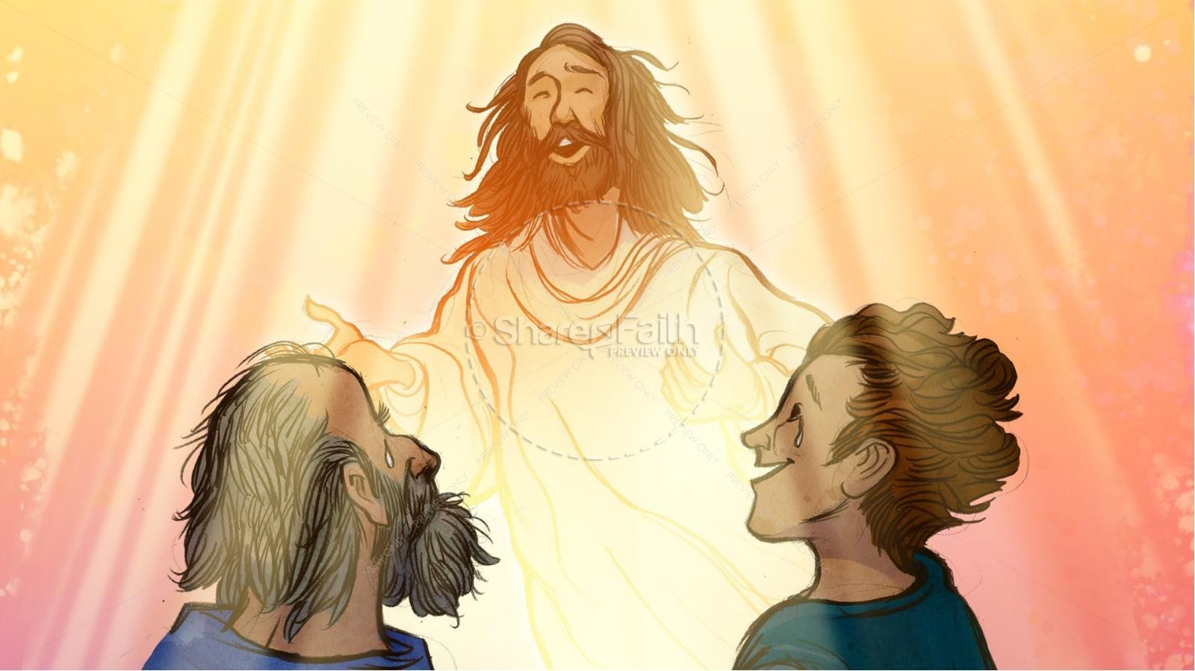
That same hour they got up and returned to Jerusalem; and they found the eleven and their companions gathered together. They were saying, “The Lord has risen indeed, and he has appeared to Simon!”

Slide 18
Notes:
How had the disciples felt as they were journeying back from Jerusalem?
Why was this?
Why did they not recognize Jesus?
Why did they invite Jesus to celebrate a meal together?
What kind of meal did they celebrate together?
How had the disciples changed by the end?
The disciples lost hope. Jesus encouraged them to deepen their beliefs and to follow him. What do you think they did then?

Slide 19
Luke 24: 13 – 35.
The Gospel of the Lord.
Praise to you, Lord Jesus Christ.

Slide 20
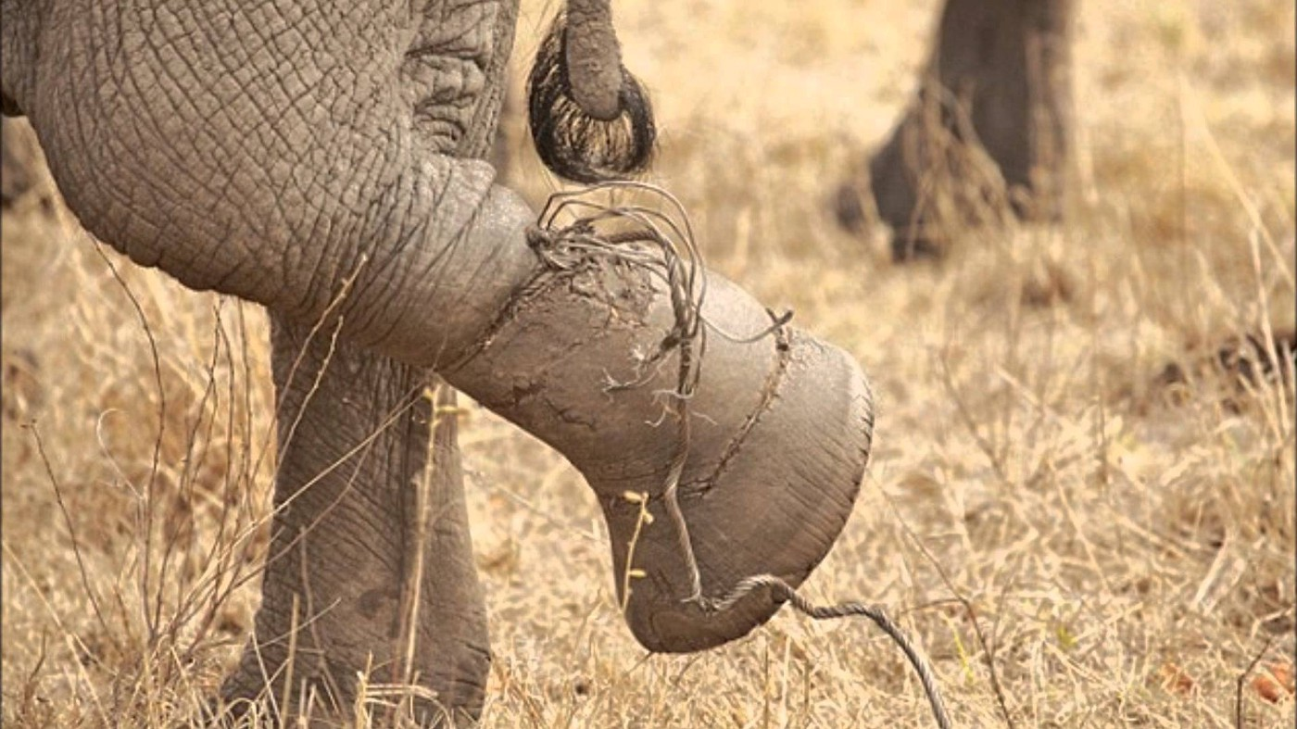
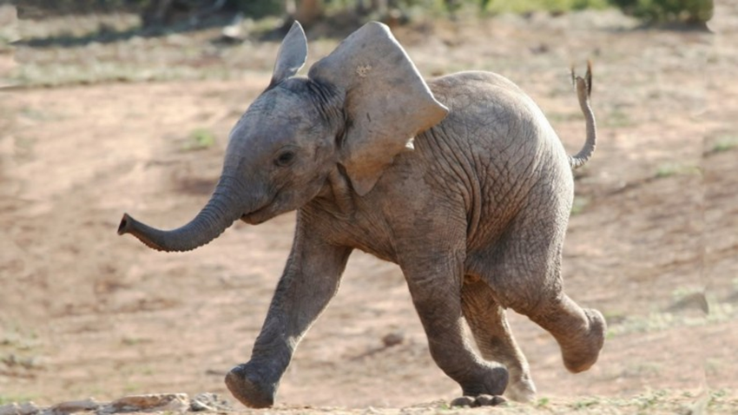
The Elephant Rope

Slide 21
Let us pray:
Dear God, we thank you for walking with us as we journey together through life. Thank you for walking with us through good times, as well as times when we might feel worried. Help us to be thankful for all good things, and to have hope each and every day.
Amen.

Slide 22
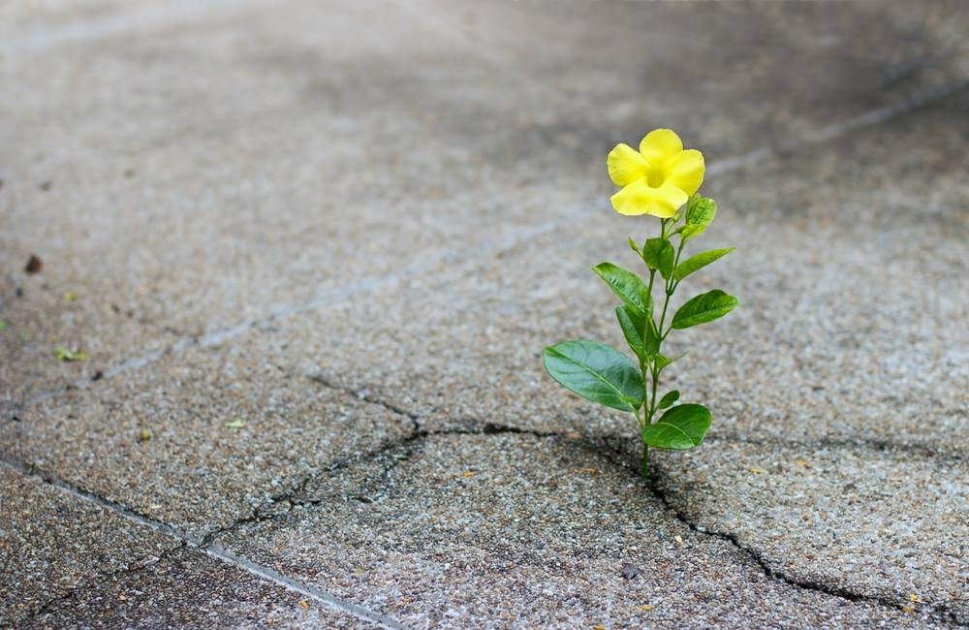
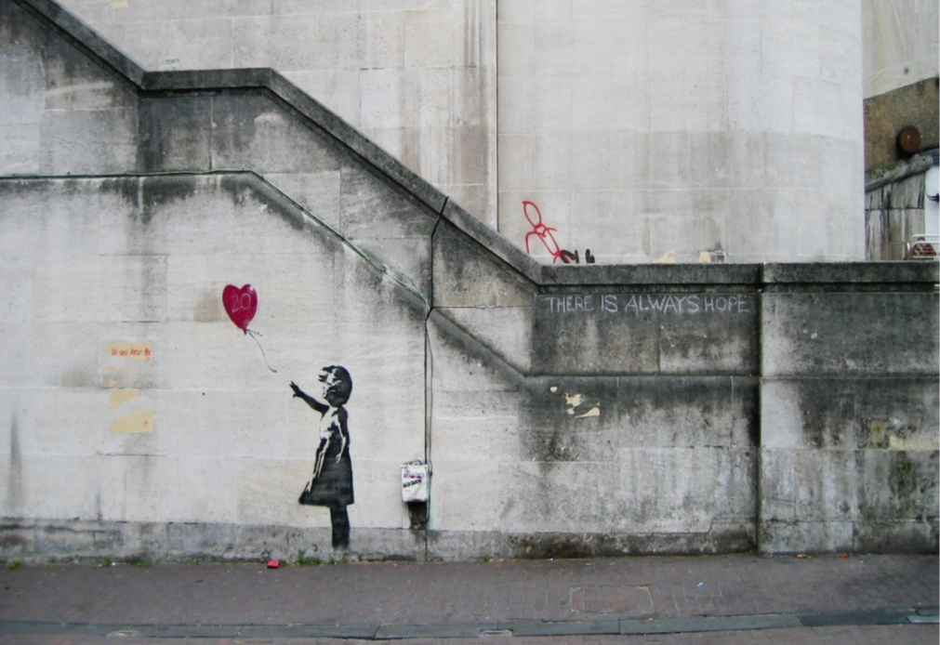
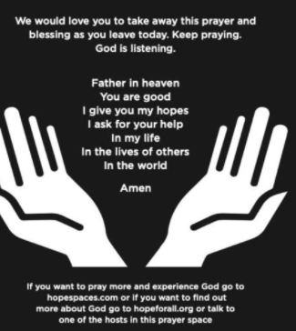
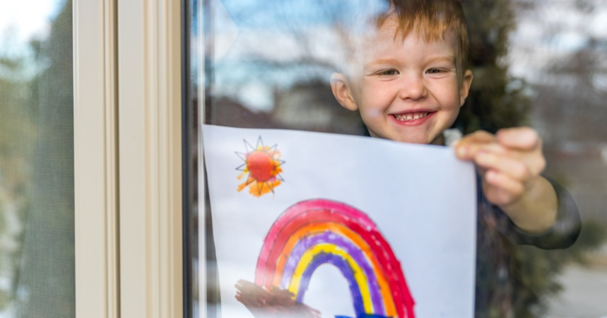
Our Mission:
Every time you take your shoes on or off this week, you might want to think about the Road to Emmaus story and the question ‘What makes me hopeful for the future?’

