Slide 1
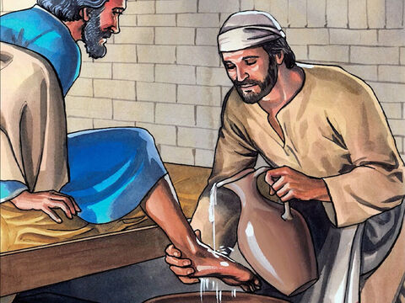
Prayer and Liturgy
Jesus said, “If anyone wants to be first, he must be last of all and servant of all.”

Slide 2
Father God (Father God)
You made me (You made me)
You made me to be (You made me to be)
A blessing to those around me.

Slide 3
Father God (Father God)
Help me to see (Help me to see)
How I can be (How I can be)
A blessing to those around me.

Slide 4
1. Your heart is full of love,
love for me.
Help me, Lord, to sing
your song of love to everyone I see.

Slide 5
Father God (Father God)
You made me (You made me)
You made me to be (You made me to be)
A blessing to those around me.

Slide 6
Father God (Father God)
Help me to see (Help me to see)
How I can be (How I can be)
A blessing to those around me.

Slide 7
2. Your grace and mercy flow,
flow for me.
Help me, Lord, to bring
your grace and mercy to everyone I see.

Slide 8
Father God (Father God)
You made me (You made me)
You made me to be (You made me to be)
A blessing to those around me.

Slide 9
Father God (Father God)
Help me to see (Help me to see)
How I can be (How I can be)
A blessing to those around me.

Slide 10
3. You welcome everyone,
you welcome me.
Help me, Lord, to be
your arms of welcome, to everyone I see.

Slide 11
Father God (Father God)
You made me (You made me)
You made me to be (You made me to be)
A blessing to those around me.

Slide 12
Father God (Father God)
Help me to see (Help me to see)
How I can be (How I can be)
A blessing to those around me.

Slide 13
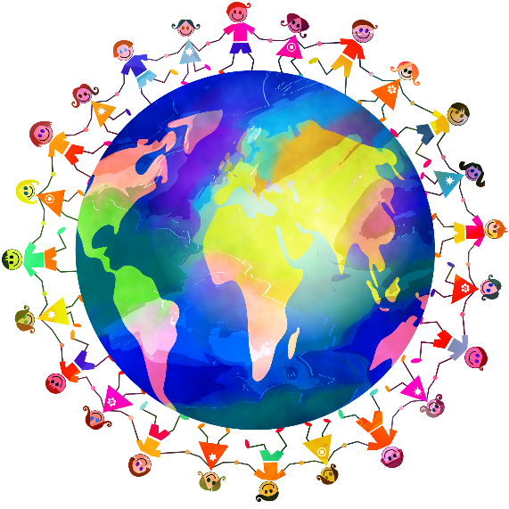
Gather together

Slide 14
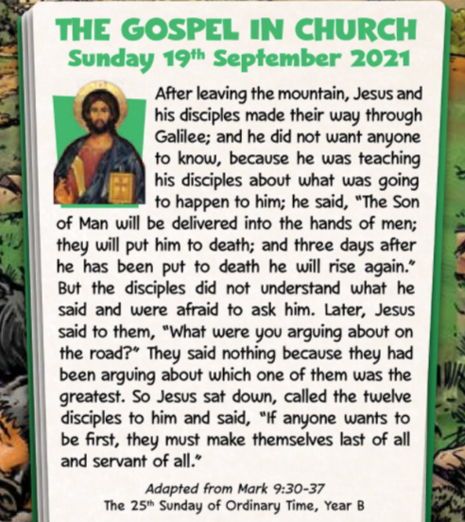
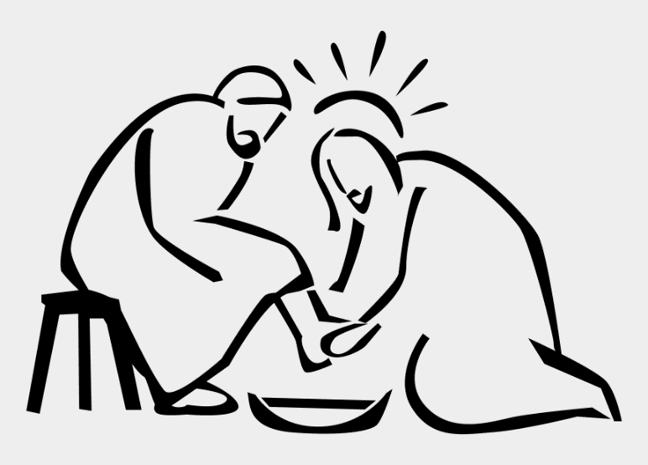

Slide 15
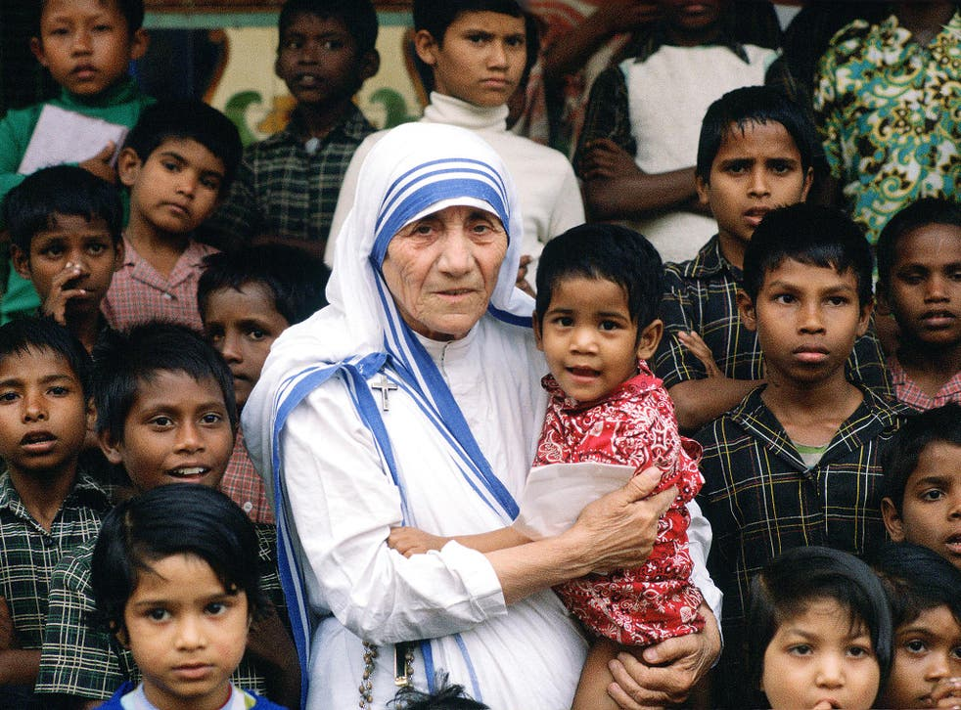
Mother Teresa

Slide 16
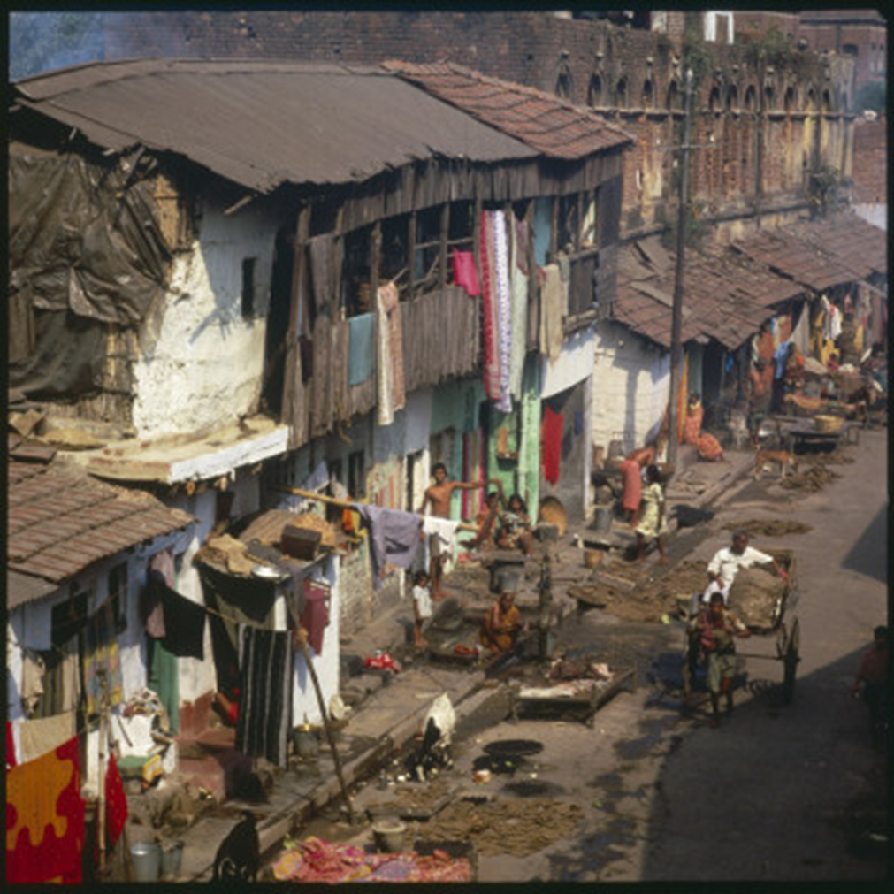

Slide 17
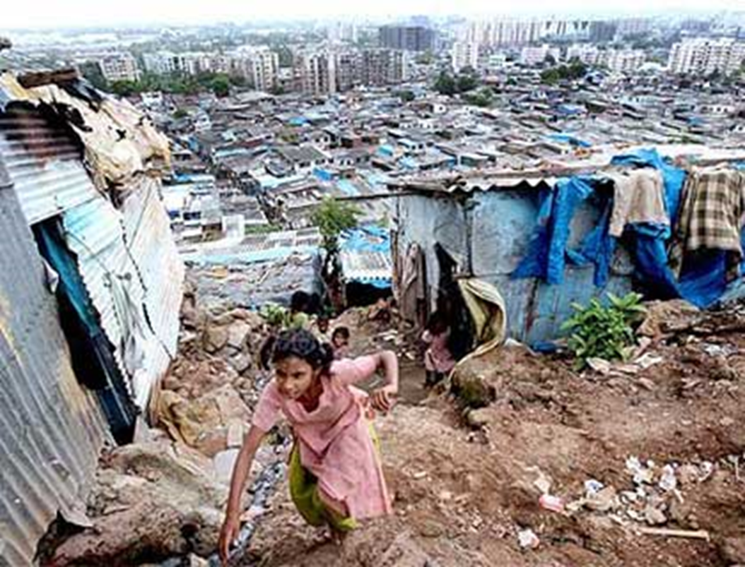
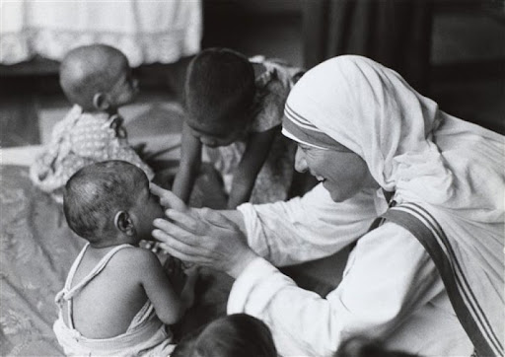

Slide 18
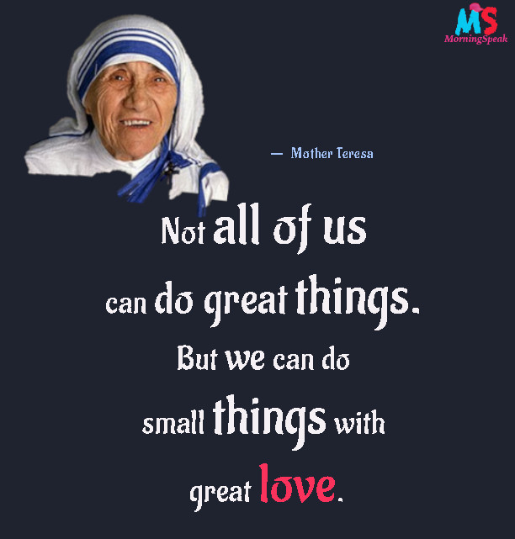
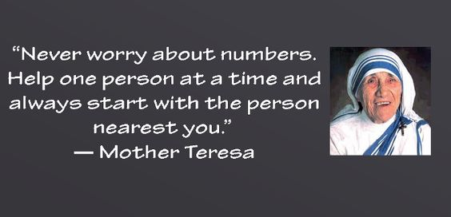
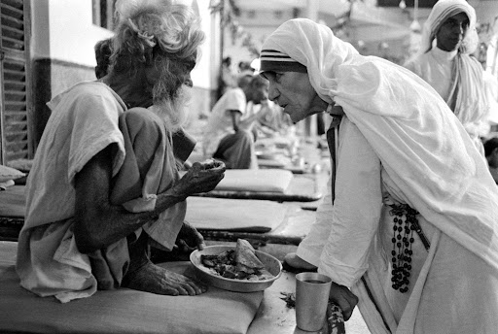
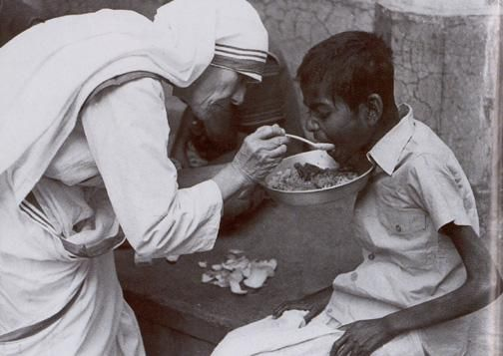
What did Mother Teresa say about serving others?
“Good works are links in a chain of love.”

Slide 19
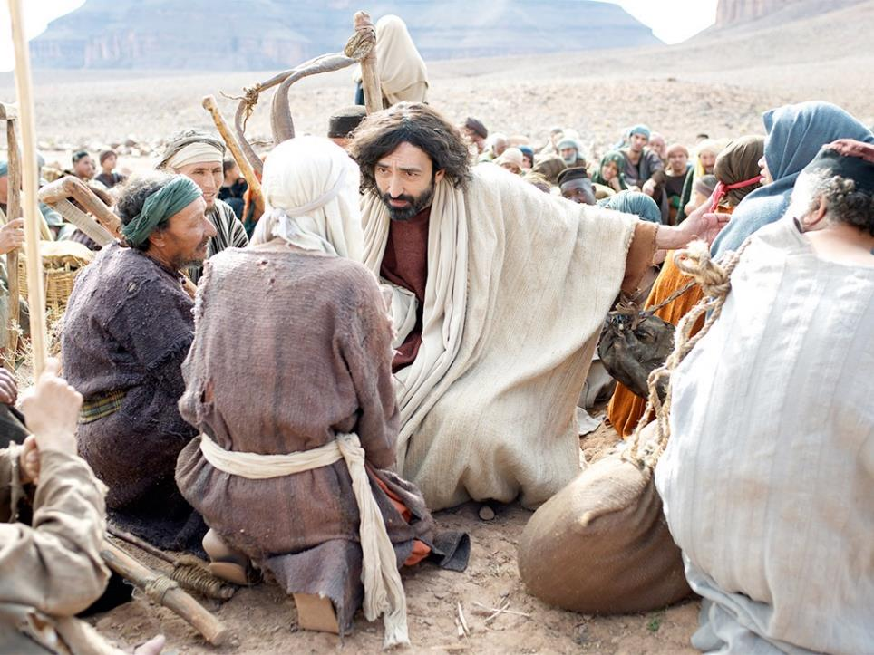
Jesus said: ‘Each time you do these things to anyone, it’s as if you’re doing them to me’.
Notes:
Slide 6: In the Bible, the special book for people who are Christians, there are many stories showing how Jesus lived his life putting other people first. Mother Teresa copied his example. Jesus spent time with sick people....and poor people, the people that no-one else were bothered with, and he taught his disciples, those people who learned from him like you learn from your teachers, to live their lives the same way. He once told them that ‘each time you do these things to anyone, it’s as if you’re doing them to me’.
Jesus’ followers did what he said, and by following his example, they did indeed change their world. The first followers of Jesus began this ‘chain of love’. It has been continued by others, including Mother Teresa, and is still circling the world today!

Slide 20

Dear Lord
We thank you for the people who are a part of our lives whom we can show love and care for.
Help us, this week, to think of ways to put others first, and to begin a chain of love that will circle the world.

Slide 21
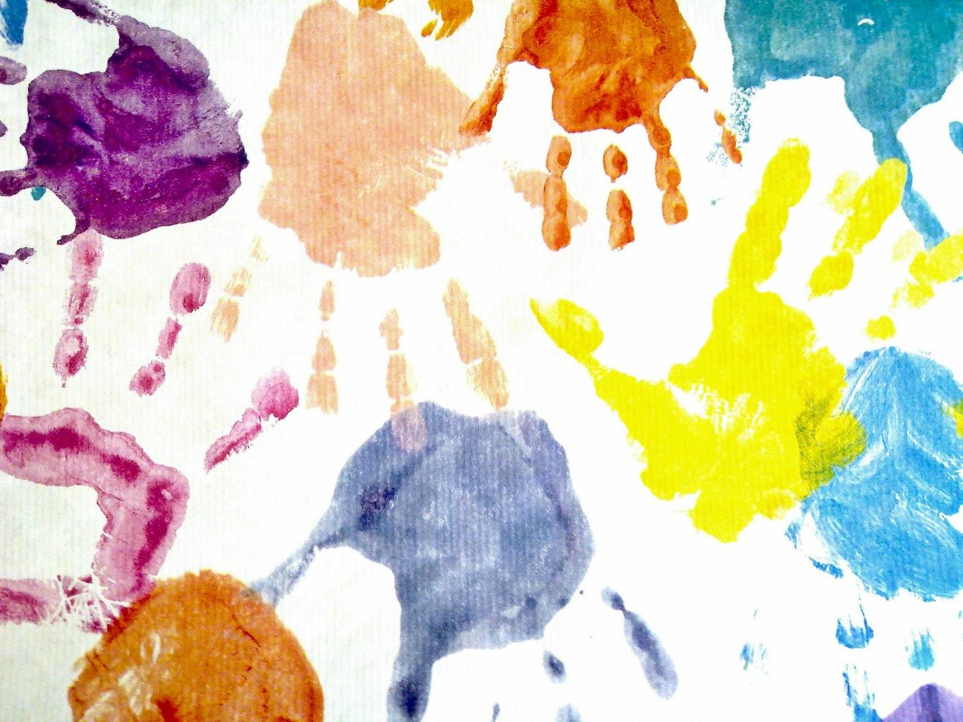
Dear Lord We thank you for the people who are a part of our lives whom we can show love and care for. Help us, this week, to think of ways to put others first, and to begin a chain of love that will circle the world. Amen.
Notes:
Slide 7: We’re going to make a picture of this together now, using lots of hands / a paper chain – thankfully, our chain CAN hold hands, unlike us at the moment!! On each hand / strip, I’ve an idea for something you might do to begin that ‘circle’ around the world. [With older children, use the blank hands / strips and take their own ideas] As you read out each, display it so that it’s touching fingers with another (or staple it into the paper chain). If you’re leaving some blanks for children to add their own ideas onto, then explain this at this point during the assembly.

Slide 22
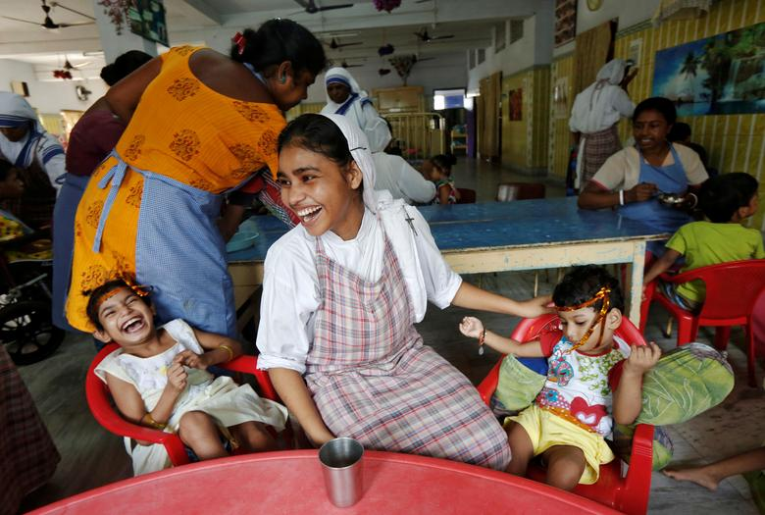
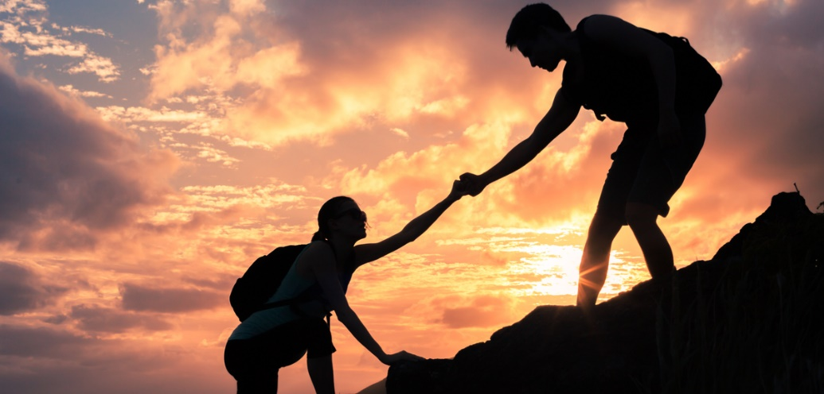
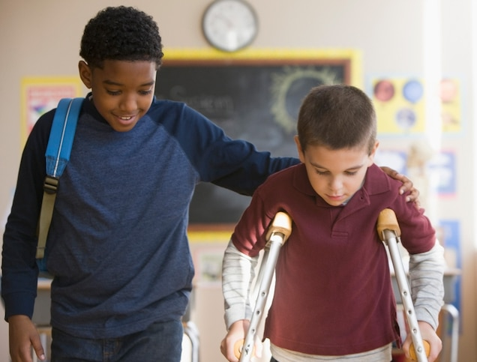
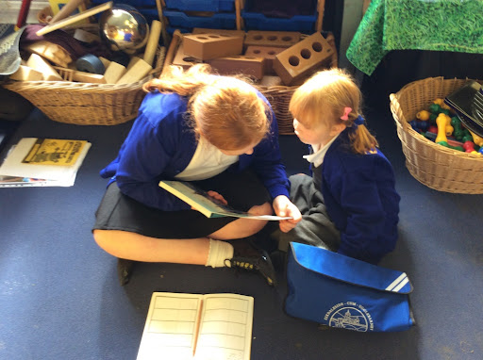
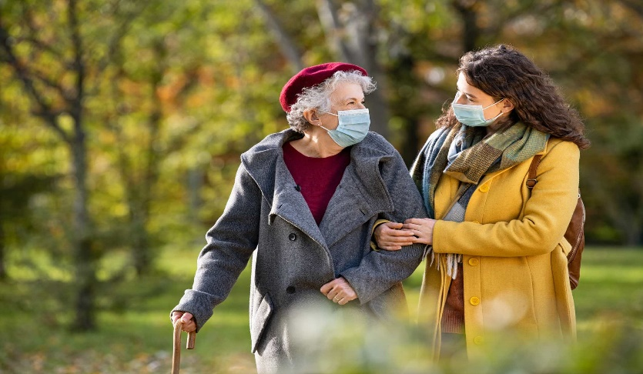
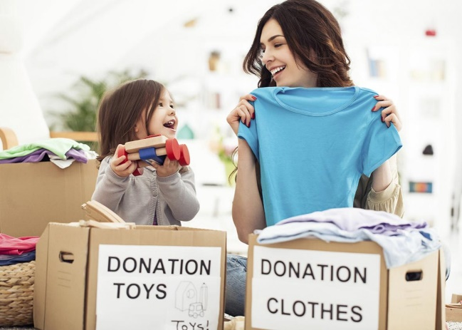
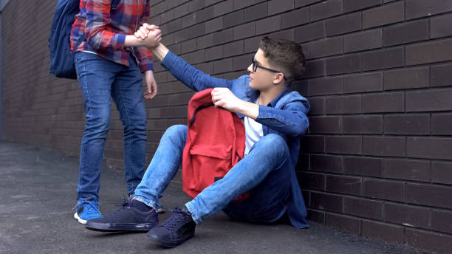
Our Mission: To serve others today.
Notes:
Slide 8: … We’re going to have some quiet, thinking time now. You might wish to close your eyes to help you think.....
I’m going to read out what’s written on our handprints / chain again now. As I do, think about how you might change the world this week, and start that chain of love circling around the world!
[read your chosen handprints / links, leaving a pause between each for children to think]
Many people believe that doing these things is not always easy – it’s often much easier to do the things that we want to do than think of ways of putting other people first. And so I’m going to pray, and ask God to help us. If you’d like to make the prayer your own, then you can join with me by saying ‘Amen’ at the end.
Prayer:
Dear God
We thank you for the people who are a part of our lives whom we can show love and care for. Help us, this week, to think of ways to put other people first, and to begin the chain of love that will circle the world.
Amen

