Slide 1
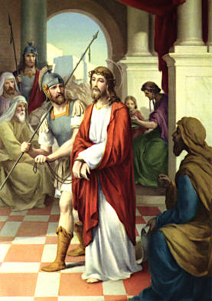
First Station:
Jesus Is Sentenced To Death
Early in the morning Jesus was brought before Pontius Pilate. Pilate was to pass judgement on Jesus. “Should I kill your king?” he asked the crowd. “Yes!” they shouted, “Crucify him!” So Pilate, wanting to make the crowd happy, allowed Jesus to be led away.

Slide 2
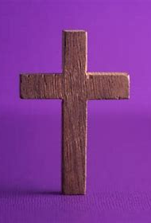
Let us reflect:
Pilate knew that Jesus didn’t deserve to be killed, but he was more interested in being popular than doing what was right and fair.
Are we a bit like Pilate sometimes?
Do we sometimes make wrong choices because we want to be liked?
Let us pray:
Lord Jesus, help me to be brave enough to make good choices.
Let us act:
Whenever you are asked to make a decision, ask God to guide you, so you choose what is right and fair.

Slide 3
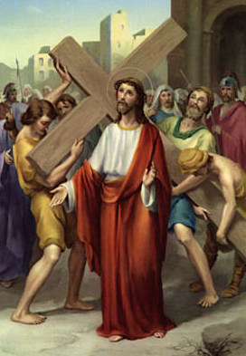
Second Station:
Jesus Accepts His Cross
The soldiers who led Jesus away made fun of him. They placed a crown of thorns on Jesus’ head then gave him a heavy, wooden cross to carry through the streets.

Slide 4
Let us reflect:
The soldiers wanted to make Jesus feel unloved. But it didn’t work. Jesus knew his friends, his mother, Mary, and most of all God the Father loved him beyond measure, and this love would never end.
Let us pray:
Lord Jesus, we pray for those people who have no family or friends to show them how precious they are. May they know your love for them through the friendship and kindness we offer.
Let us act:
Look out for children who are left out at playtime. Ask them if they would like to play.

Slide 5
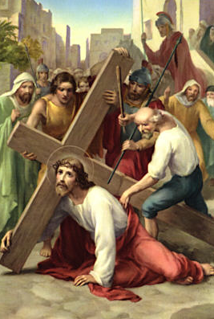
Third Station:
Jesus Falls For The First Time
Jesus struggled to carry the heavy cross and fell to the ground. The soldiers dragged him up and pushed him forward.

Slide 6
Let us reflect:
Jesus was set the difficult task of carrying his cross through the busy streets. The soldiers’ unkind behaviour made Jesus’s task even harder. He would need help to cope.
Let us pray:
Lord Jesus, sometimes people can be cruel when others are finding things difficult. Help me always to encourage those who struggle and to offer support when I can.
Let us act:
Look out for classmates who are finding things difficult. Help them to find a solution, or ask a teacher for extra support.

Slide 7
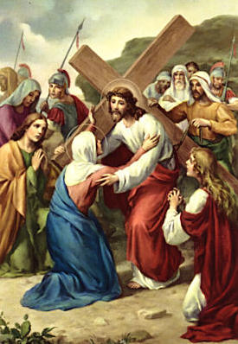
Fourth Station:
Jesus Meets His Mother, Mary
Jesus struggled on while his mother, Mary, followed close by. She was unable to help. As Mary watched Jesus suffering, she felt great pain and sorrow, too.

Slide 8
Let us reflect:
Our families also go through painful events. Loved ones get sick, move away, or argue. Sometimes we also feel unable to help. But there is one thing we can always do. Like Mary, we can pray.
Let us pray:
Lord Jesus, I place my family into your loving care. Help us to care for each other, to say sorry and forgive, and to find joy in being together.
Let us act:
Say a Hail Mary every day for your family and for all families who are suffering.

Slide 9
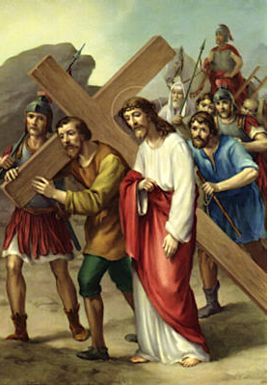
Fifth Station: Simon Helps Jesus To Carry The Cross
As the soldiers led Jesus through the crowds, they grabbed a man called Simon. They put the cross on Simon’s shoulders and made him carry it with Jesus.

Slide 10
Let us reflect:
Simon didn’t want to help at first. Carrying the heavy cross looked like hard work. Sometimes we have to do things we find hard or would rather not do – helping someone we don’t know at school, jobs at home, or being polite to someone who is unkind.
Let us pray:
Jesus, help me to accept the chores I am given gladly, and to see them as a way to love and serve you.
Let us act:
Look for ways you can work together with others to make something better at home or at school.

Slide 11
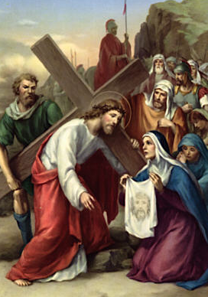
Sixth Station: Veronica Wipes Jesus’ Face
A woman called Veronica was also in the crowd. She could see that Jesus’ head was bleeding. Although afraid of what others might say to her, she reached out to gently wipe the blood from Jesus’s face.

Slide 12
Let us reflect:
Veronica risked getting into trouble for trying to help. But her pity for Jesus overcame her fear. It can be difficult to stand out from the crowd, even if that is to do something good, like help someone no one else wants to.
Let us pray:
Lord Jesus, help me never to let fear of others stop me from being kind to everyone.
Let us act:
Through Mission Together, children are reaching out with helping hands of friendship to other children around the world. By supporting Mission Together, you can reach out too.

Slide 13
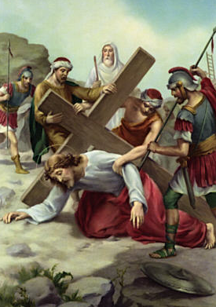
Seventh Station: Jesus Falls For The Second Time
The soldiers ordered Jesus to move on. But he didn’t get very far. Jesus was in great pain. He fell to the ground for a second time.

Slide 14
Let us reflect:
Sadly there are children in the world who, through sickness or injury, know what it is like to feel pain. Jesus understands their suffering and through the care of others, he eases their pain.
Let us pray:
Lord Jesus, we pray for children who are sick and for the people who care for them. We especially pray for doctors and nurses, and ask you to guide them in their work.
Let us act:
Mission Together and CAFOD pay for doctors and nurses in poor countries, so that sick children get the help they need. Let us help to find ways to support these charities.

Slide 15
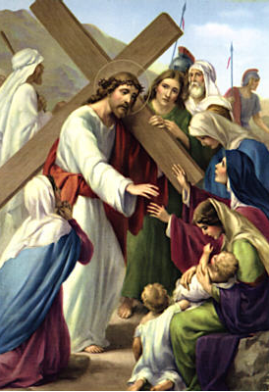
Eighth Station: Jesus Meets The Women Of Jerusalem
In the crowd that followed Jesus, there were some women and children. They stayed close to Jesus as he struggled by, they felt his sadness and cried tears for him.

Slide 16
Let us reflect:
A good friend isn’t someone who only shares our happy times. A good friend is someone who shares our sad times too. Jesus had shown the women and children how to be a good friend. Let us follow the same example and be there for others too.
Let us pray:
Lord Jesus, help me to be a caring, loyal and gentle friend to others, just as you are with me.
Let us act:
Listening is a good way of letting people know we care. Really try to listen with your ears and your heart.

Slide 17
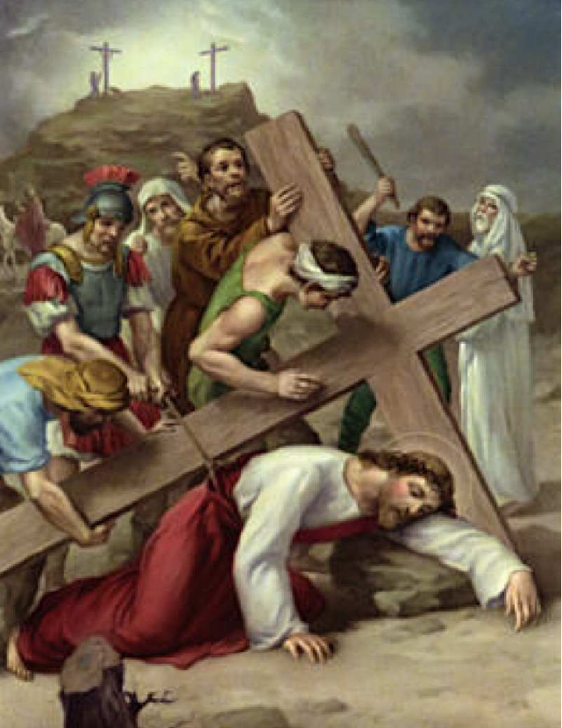
Ninth Station: Jesus Falls For The Third Time
For the third time, Jesus fell to the ground. He was sad and tired. The soldiers and the crowd watch on anxiously, unsure if Jesus will get back up.

Slide 18
Let us reflect:
Sometimes we feel knocked down and low: when we’re finding something difficult to learn; when people are unkind or when we keep getting things wrong. It is hard to pick ourselves up and carry on.
Let us pray:
Lord Jesus, help me to remember that when I feel like giving up, you are there to help me try again.
Let us act:
One way Jesus helps us to keep trying is through the support we get from others. Remember to let others help you when you are struggling with a problem.

Slide 19
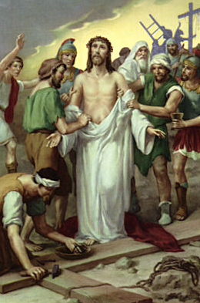
Tenth Station: Jesus Is Stripped Of His Clothes
After Jesus had picked himself up, the soldiers led him on to a hill called Calvary. It was here that Jesus would be crucified. When they finally arrived at Calvary, the soldiers pulled the clothes from Jesus’ body.

Slide 20
Let us reflect:
In front of the crowd, the soldiers humiliated Jesus by taking his clothes away. It is horrible to be embarrassed on purpose. It makes people feel unimportant and sad. Sometimes we forget this and choose to embarrass people by name calling, laughing at them, or bossing them around.
Let us pray:
Lord Jesus, you taught us that as we are all God’s children, everyone is important and should be treated well. Help me always to remember this in what I do and say.
Let us act:
Do your best to show everyone that all people are children of God.

Slide 21
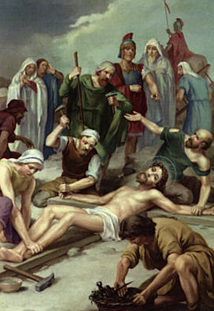
Eleventh Station: Jesus Is Nailed To The Cross
The soldiers laid Jesus on the cross and nailed his hands and feet to the wood. While they did this, Jesus prayed, ‘Father forgive them, for they do not know what they are doing’.

Slide 22
Let us reflect:
Jesus teaches us many things. One of his most important lessons is about forgiveness. It can be very hard to forgive. But like Jesus, we must try to understand why people make wrong choices and forgive them for the pain they cause.
Let us pray:
Lord Jesus, help me to be a forgiving person, especially when I am hurt and upset.
Let us act:
Sometimes when we are hurt by others we become angry. Do your best to calm down by talking to a friend, a grown-up, or through prayer, to Jesus.

Slide 23
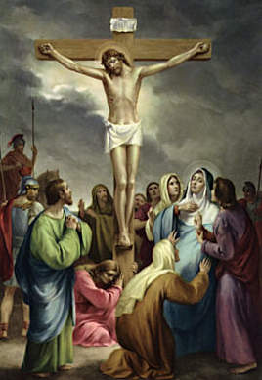
Twelfth Station: Jesus Dies On The Cross
After six hours on the cross, at around three in the afternoon, Jesus cried out, ‘Father, into your hands I place my spirit’ and he breathed his last breath.
All kneel or bow heads for a moment in silence.

Slide 24
Let us reflect:
We feel sad when someone dies, especially someone we know and love. The people around Jesus felt this sadness too. But their sadness would soon change to joy. Because in three days Jesus would rise again and his resurrection would bring new life for us all.
Let us pray:
Lord Jesus, we pray for people who are sad because someone they love has died. May they find comfort in knowing that their loved one is safe with you in heaven.
Let us act:
You can bring comfort to people who are grieving by sending a card or drawing them a picture, paying a visit, and asking God through your prayers to help them.

Slide 25
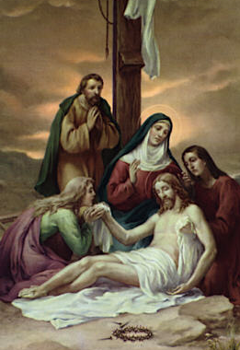
Thirteenth Station: Jesus Is Taken Down From The Cross
Joseph of Arimathea, a secret follower of Jesus, asked for permission to take Jesus’ body from the cross. With help from some other followers, Joseph gently brought Jesus down.

Slide 26
Let us Reflect:
Joseph understood that even when someone has died, we must still treat them with love and respect. That is why people lay flowers at graves, dedicate a bench, plant a tree, or ask a priest to say a Mass in memory of the person who has died.
Let us Pray:
Lord Jesus, we place in your loving arms those we have known who have died. May we continue to show our love for them through our prayers and actions.
Let us Act:
Light a candle in church for someone who has died or lay some flowers on their resting place.

Slide 27
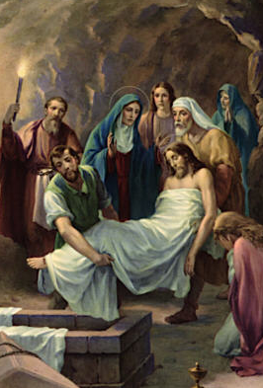
Fourteenth Station: Jesus Is Laid In The Tomb
Jesus’ friends carried his body to a tomb in a nearby garden. After they had laid the body inside, the soldiers came and sealed the entrance with a large, heavy stone.

Slide 28
Let us reflect:
The soldiers didn’t want Jesus to be seen again, so they shut his body inside the tomb. Jesus’ friends thought that he was lost to them forever. But like a seed in the ground, new life was emerging. Through the power of God’s love, Jesus was rising from the dead. He was being resurrected so that we could have new life with God too.
Let us pray:
Lord Jesus, you teach us that God’s love is so great that not even death can end it. Help me share this love, a love that brings life, in every way I can.
Let us act:
Show your love and kindness to someone today.

Slide 29


