Slide 1


Slide 2
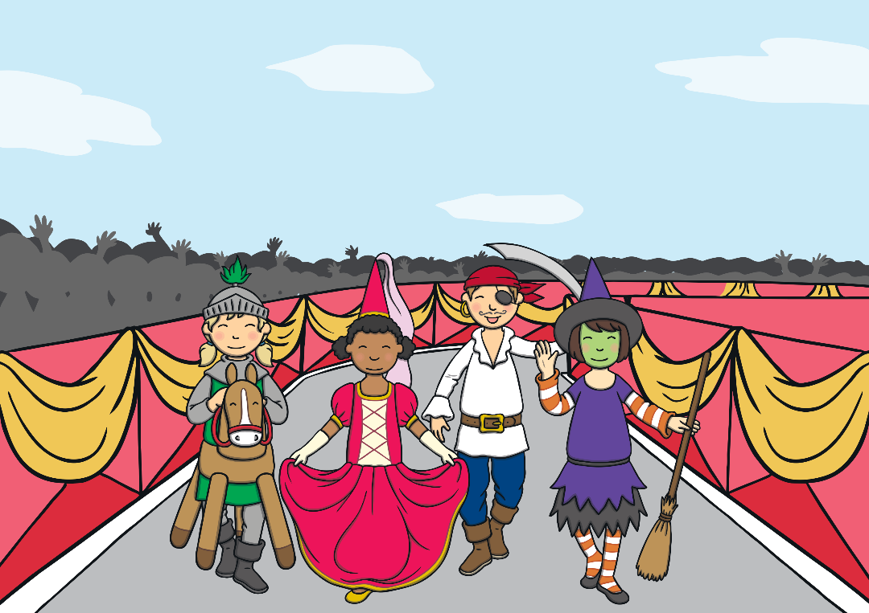
María arrived home from her Carnival party in a very happy mood. At school, they had had a party, worn very funny costumes and eaten lots of sweets and chocolate. “María, do you know what celebration takes place after Carnival?” her dad asked her. María shook her head.

Slide 3

“We celebrate Lent. And the first day of Lent is called Ash Wednesday,” explained her father.
“And why not Ash Friday? Or Saturday?” she answered.
“Ha, ha, ha,” he laughed. “It's a Wednesday because Lent begins exactly 40 days before Easter Sunday. Easter Sunday is the day that Jesus rose from the dead.”

Slide 4
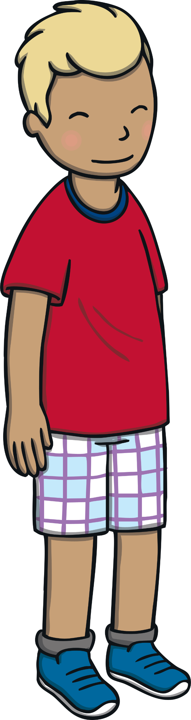

“And what do we do during Lent, Dad?” María asked.
“Lent is a period of fasting, giving up and prayer. Christians try to think about those things that we must change so that our hearts can return to God,” her dad answered.

Slide 5
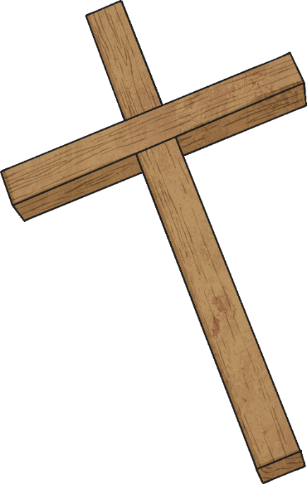
“I see… But, I still don’t understand why it is called Ash Wednesday?” María wondered.
“See, in ancient times, people who wanted to become Christians covered their heads with ashes to show they were sorry and ready to start behaving as Jesus teaches us. Now, the priest makes the sign of the cross on our foreheads.”

Slide 6
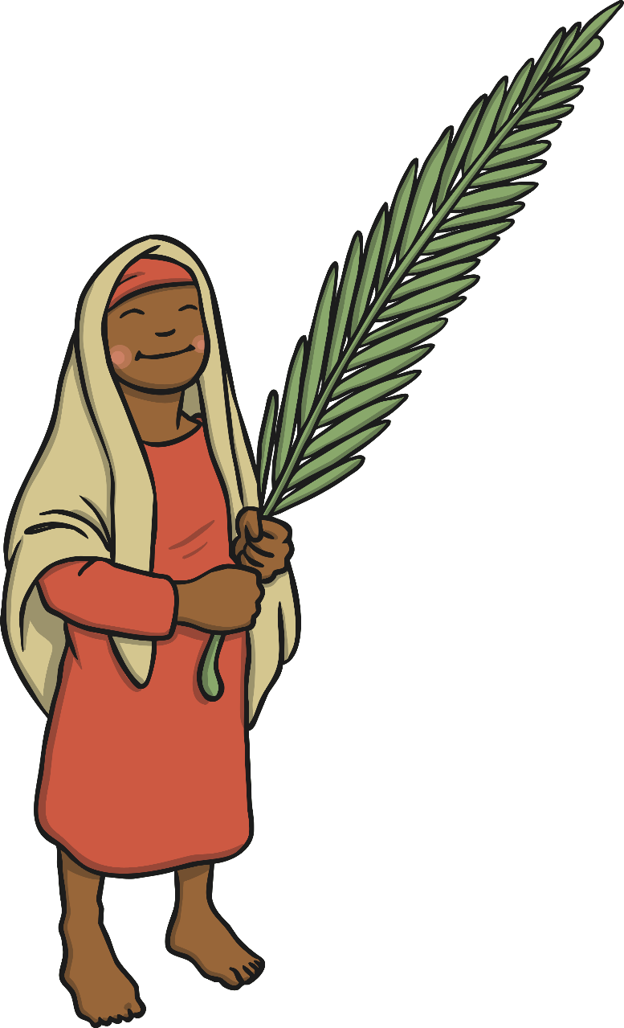
“The ashes come from the palms from the previous year’s Palm Sunday. They remind us that: You are dust and to dust you shall return,” explained María’s father.
“I don’t understand,” María looked puzzled.
“That means that we are not on Earth forever and if we want to go to Heaven, we must behave well at all times,” her dad explained as he ruffled María’s hair.

Slide 7
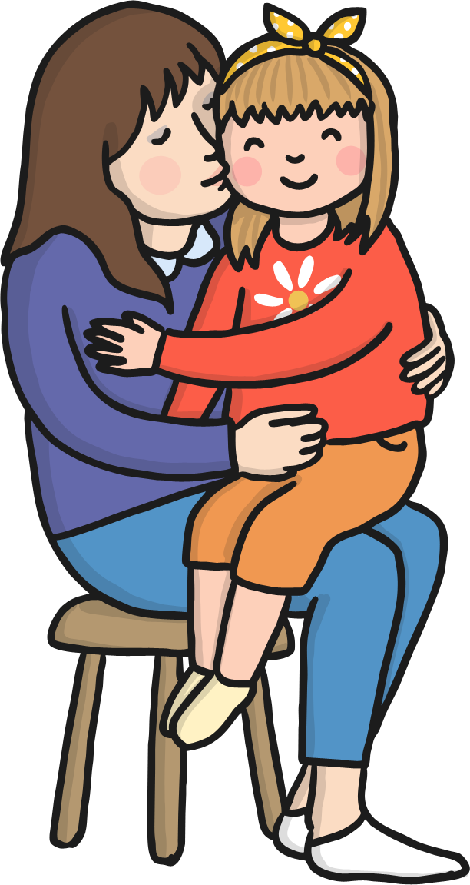
At that moment, María’s mum came in.
“Mum!” she exclaimed with enthusiasm. “Dad is telling me all about Ash Wednesday!”
“That's great, honey. Do you know what you need to do to receive the ashes?” her mum asked.

Slide 8

“But do children get a cross on their foreheads as well?” María asked in amazement.
“Well of course!” replied María’s mum. “To receive the ashes, you have to think about the things you do that keep you away from Jesus and decide what you can do better even if no one is watching you, so that your heart is ready for Him. Have you already thought about it? Tomorrow, we will go to church to receive the ashes.”
“Perhaps… I have to think about it …” María said as she went into her room.

Slide 9
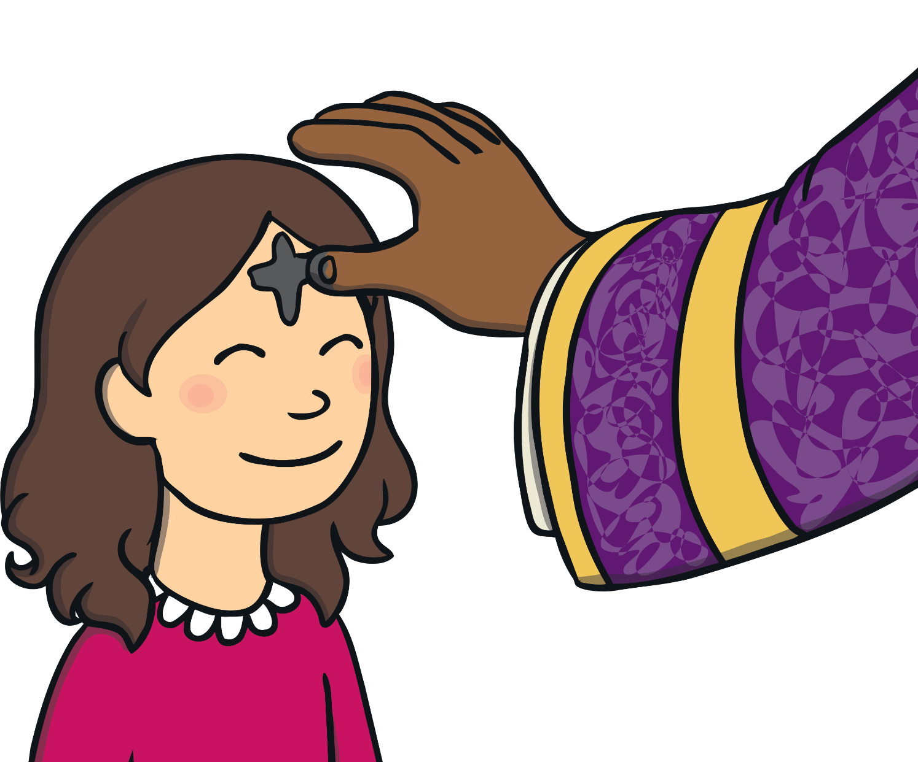
What will you do during Lent this year?

Slide 10

Lent calendar
Use this calendar to plan the good deeds
you will do during Lent.

