Slide 1
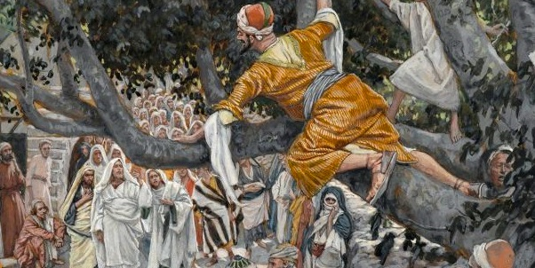
Zacchaeus – who was he?

Slide 2
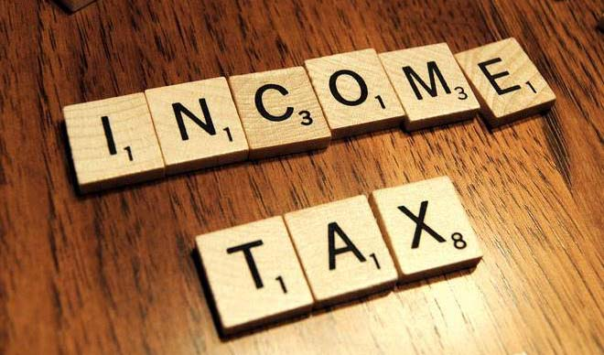
Zacchaeus
Tax – Today
Every adult over the age of 16 in employment has to pay taxes if you earn over a certain amount of money.
Income Tax, National Insurance, Council Tax
Depending on what you earn – a certain proportion of your income will go to the Government.
In basic terms -The more you earn the more tax you pay.

Slide 3
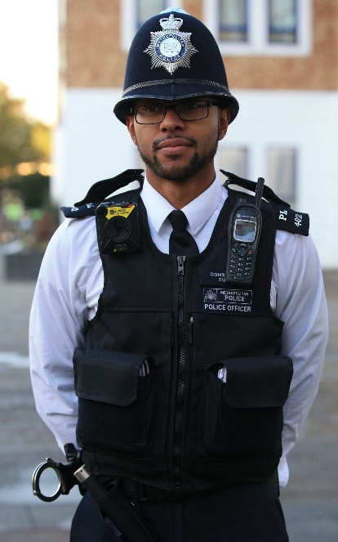
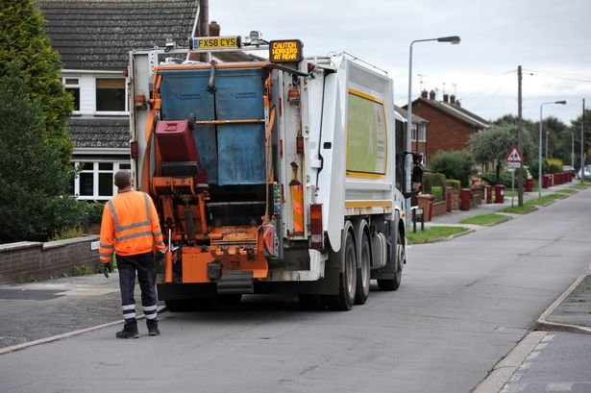


Tax
Why are we taxed?
Adults mention the ‘Tax Man’/Woman’ but there isn’t a person who knocks on your parents’ door and asks for the money it is all sorted ‘online’. The tax is automatically deducted taken away before a person receives their wages.
But in Zacchaeus’s day it was very different … He was a tax collector.

Slide 4
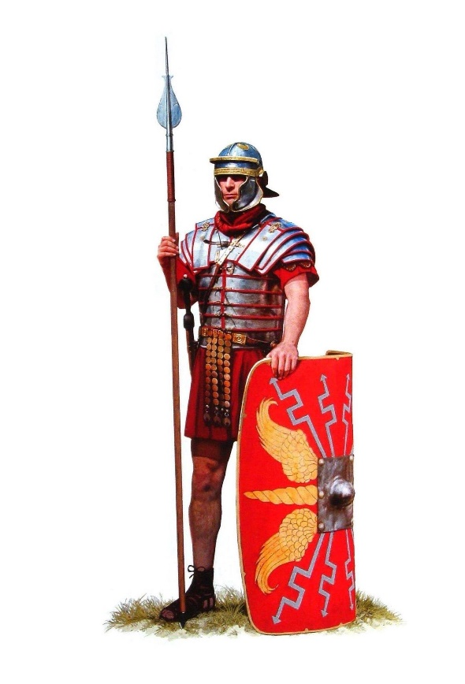
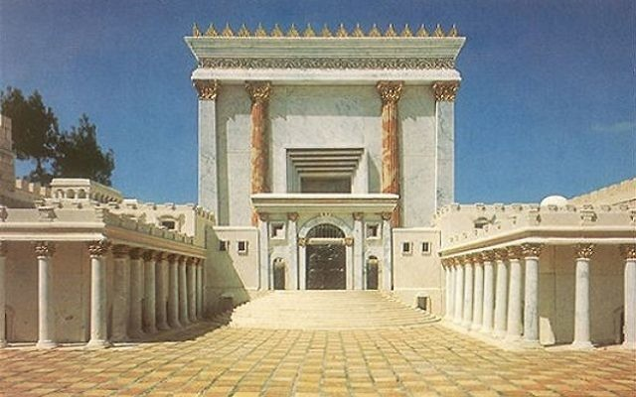
Zacchaeus
Zacchaeus collected taxes. In Jesus’s time they were under Roman rule:
The Jews of Jesus’ day paid a religious tax to the Jewish
authorities for the maintenance of the temple.
They also paid a tax to the Roman government,
a tax that was often collected by harsh methods.

Slide 5
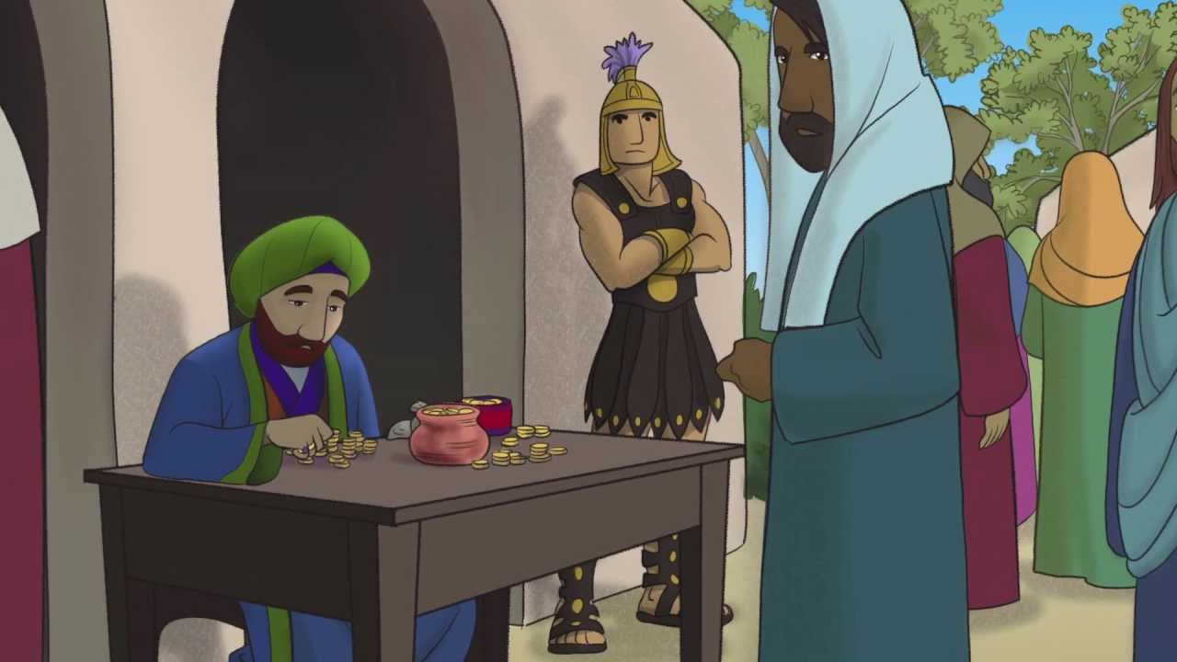
Zacchaeus
He was a Jew and an employee of the Roman Empire Under the Roman system, men bid on those positions, pledging to raise a certain amount of money. Anything they raised over that amount was their own personal profit.

Slide 6
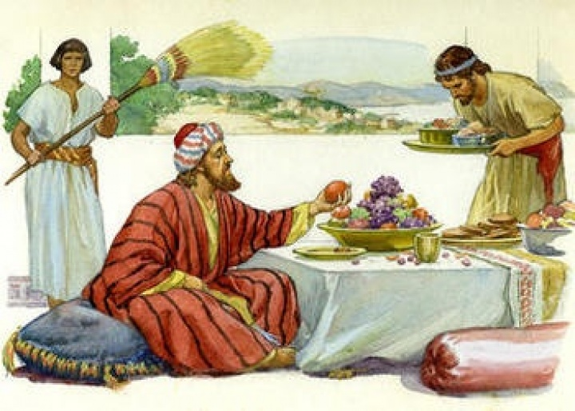
Zacchaeus
Zacchaeus was a chief tax collector. In Luke’s story he says ‘Zacchaeus was a wealthy man’, so he must have extorted (obtain by force, threats or unfair means) a great deal from the people in Jericho.

Slide 7
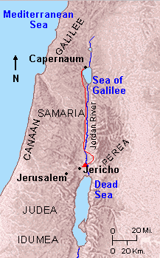

Zacchaeus
He lived in Jericho

Slide 8
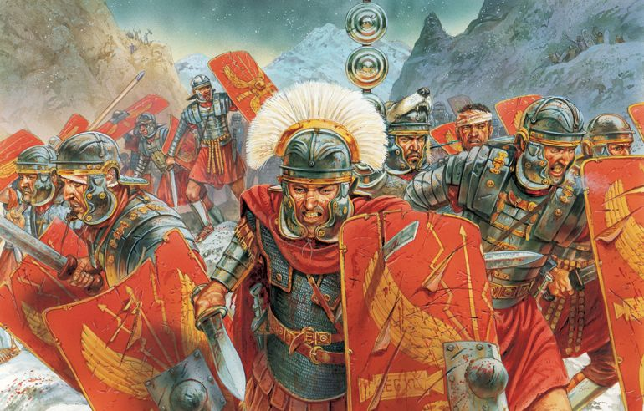
What did the Romans want the money for?
To fund the Roman army (The very people who ruled over and were extremely brutal to the Jews)
Taxes paid for Governor of a town and other important officials of that time for their lavish homes e.g palaces and expensive clothes, their food and their servants.

Slide 9

Zacchaeus – Tax Collector and extortionist!!!
Extortion obtain by force, threats or unfair means
Zaccheus was despised and hated by the Jewish people because he worked for the Romans and represented everything that was bad about Roman rule. Demo

Slide 10

Our jobs today:
What have we learnt about Zacchaeus?
Why do you think Jesus chose to have dinner with Zacchaeus – an enemy of the Jews?
What does this teach us about Jesus?
How did Zacchaeus change?
Why do you think this story comes under our topic of Reconciliation?

