Slide 1
RE lesson
18.9.19

Slide 2

What is the story of these pictures?
Who could the people be?
What is happening in each of the pictures?
What does each picture have in common? (How are they similar?)
Is there anything else you have
spotted?
Write in your jotter books your
thoughts

Slide 3
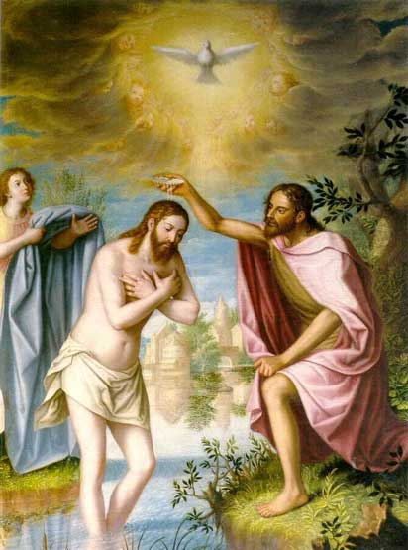
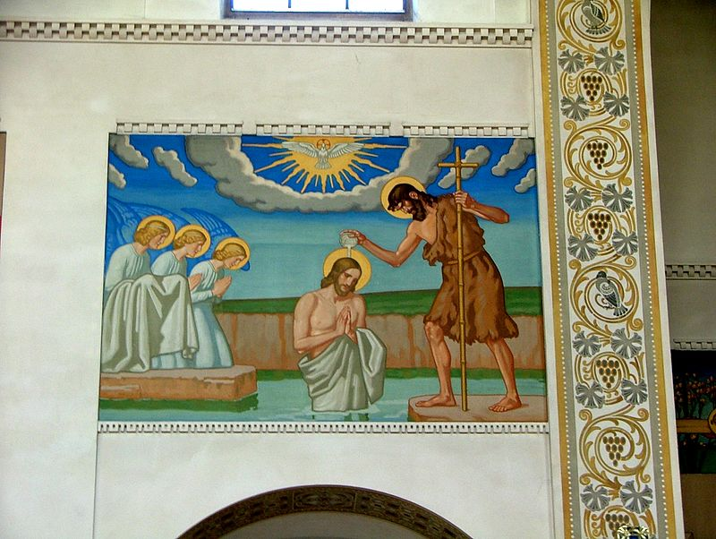
Der Täufer
Juan Sánchez Cotán

Slide 4
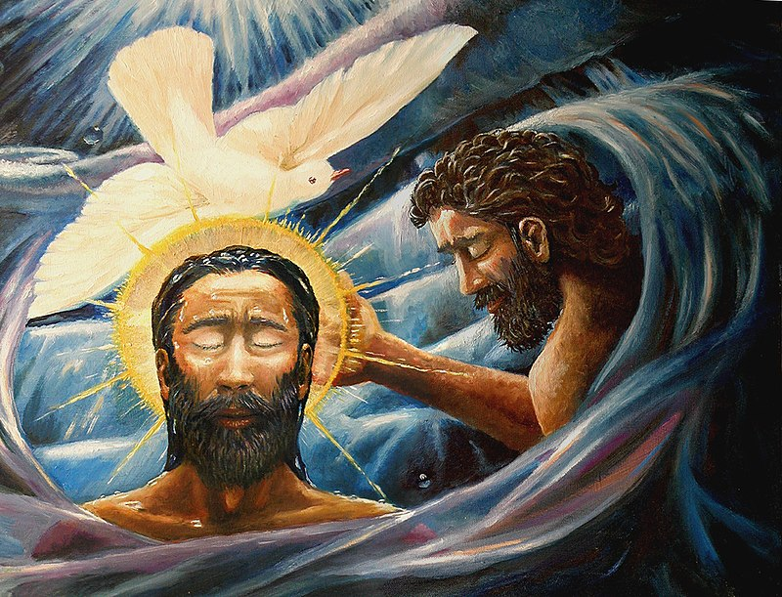
Dave Zelenka

Slide 5
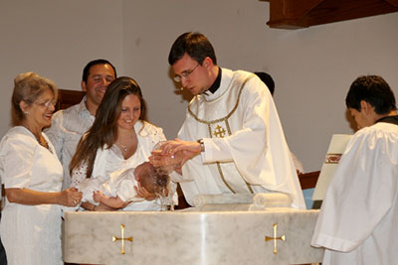
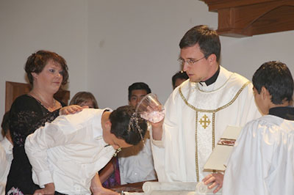
Baptism
Why are we baptised?
What is the history behind baptism?

Slide 6
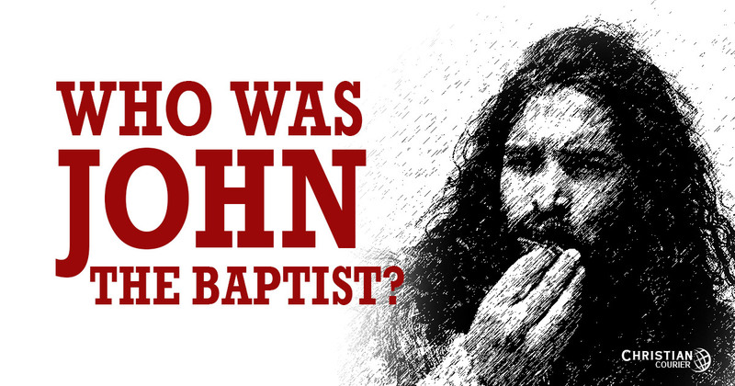

Slide 7
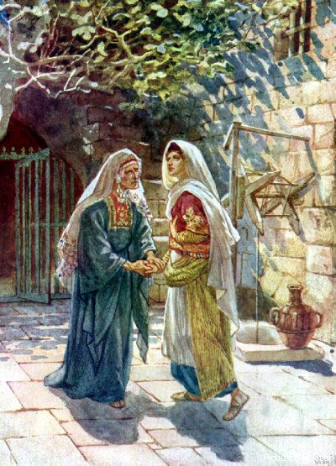
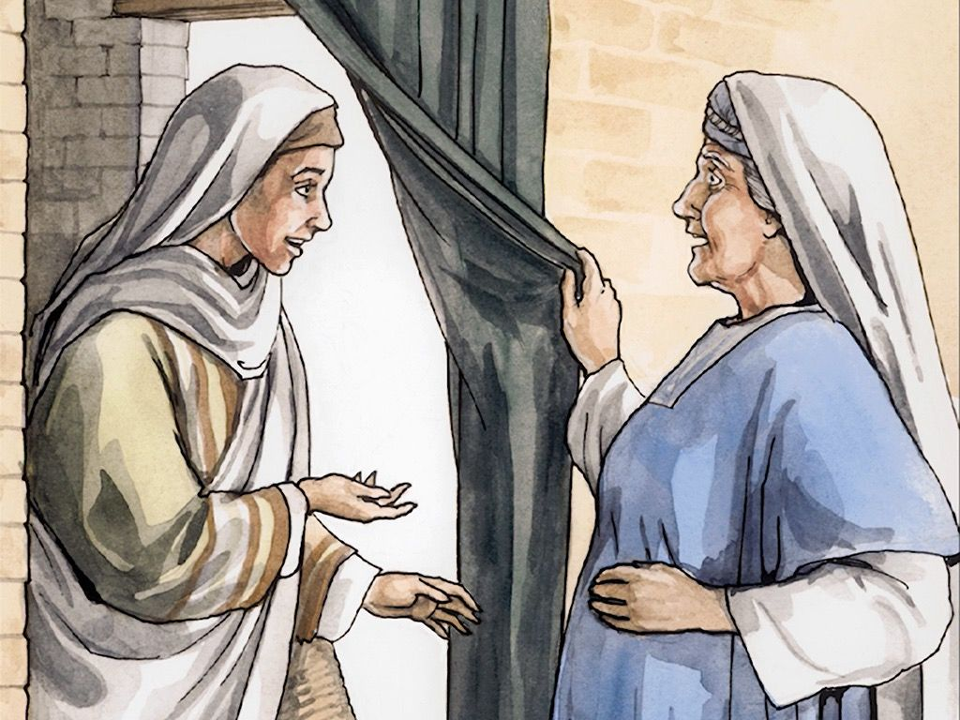
Interesting facts
Related to Jesus – John the Baptist was known
to be Jesus’s cousin.

Slide 8
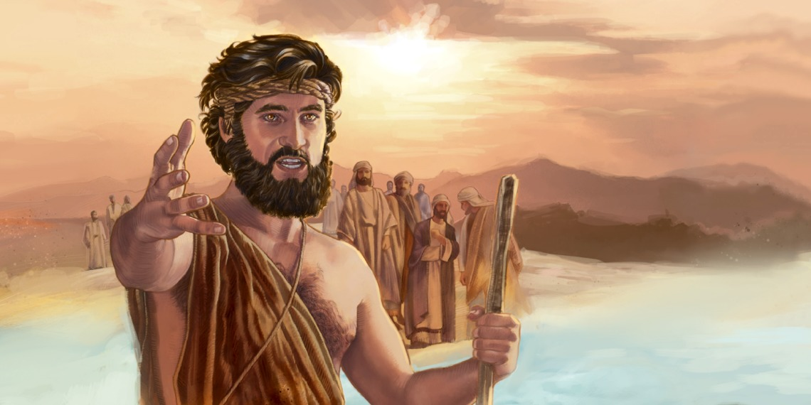
Interesting facts – John the Baptist
John the Baptist was a great prophet and he prepared the way for Jesus, and preached about the importance of being sorry for your sins and repenting.

Slide 9
Interesting facts – John the Baptist
John baptised many
people.
Water is used for cleaning/cleansing and the water was used as a sign of washing away peoples old ways of living, washing away their sins and starting a new life with God.

Slide 10
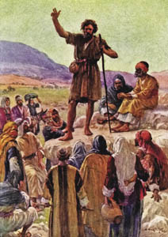
John the Baptist
He had his own disciples
He preached in the lower
Jordan Valley and had many
followers.
“He who is coming after me is mightier than I. I baptise you with water… he will baptise you with the Holy Spirit and with fire.”

Slide 11
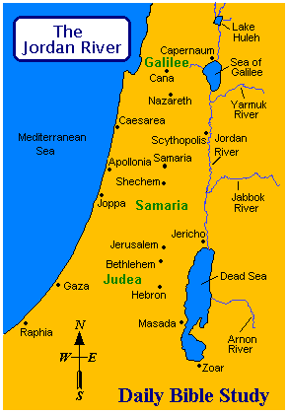
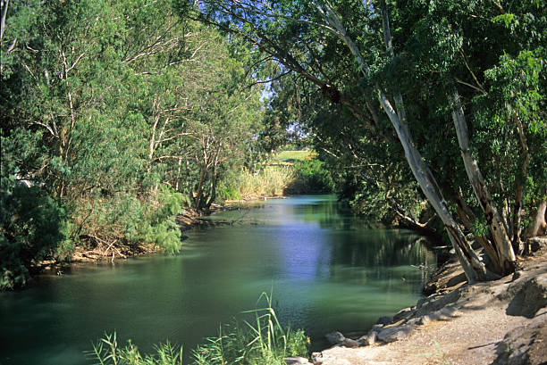
251 km long!

Slide 12


