Slide 1
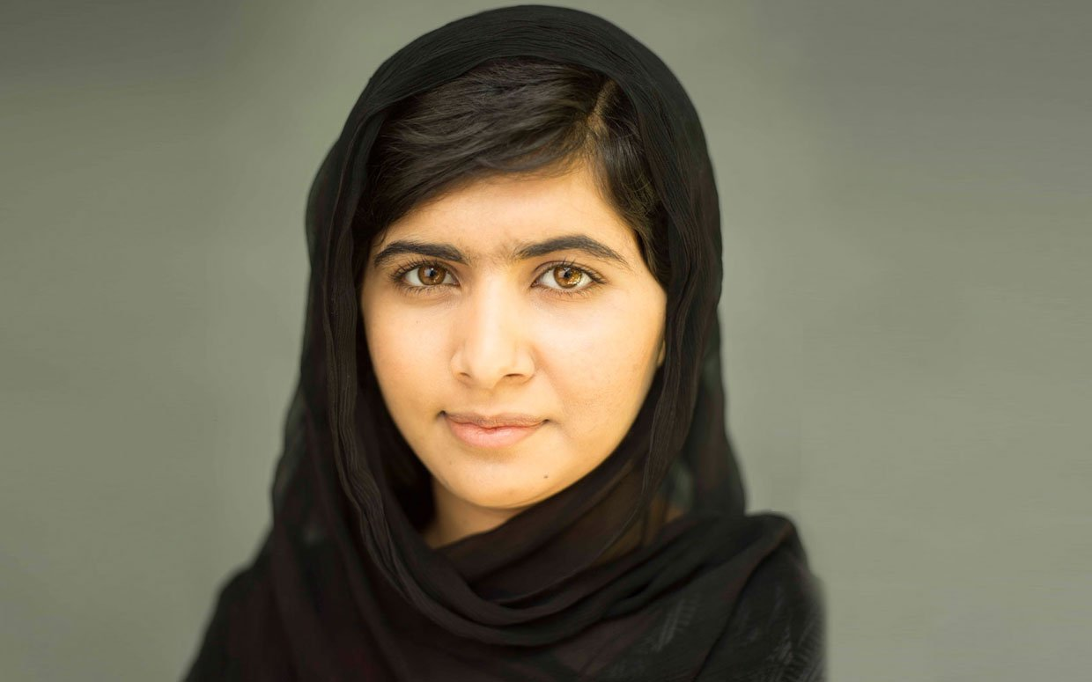


Malala Yousafzai
and Human Rights

Slide 2
What do we mean by the term “Human Rights”?
Notes:
Talk to the person next to you about the definition.

Slide 3
“Human rights are rights inherent to all human beings, whatever our nationality, place of residence, sex, national or ethnic origin, colour, religion, language, or any other status. We are all equally entitled to our human rights without discrimination. These rights are all interrelated, interdependent and indivisible.”
– United Nations Human Rights
Notes:
What do you think the last sentence of this definition means?

Slide 4
Can you think of any current events where human rights are being breached?
Notes:
Teacher note: If you wish, the class can discuss their ideas with the person next to them. Try and get the class to think in particular about issues surrounding Africa.

Slide 5
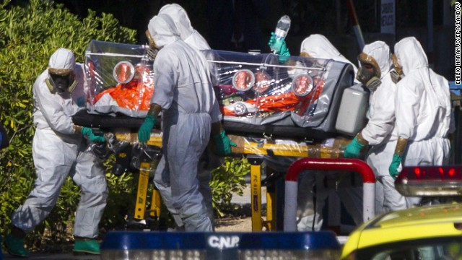
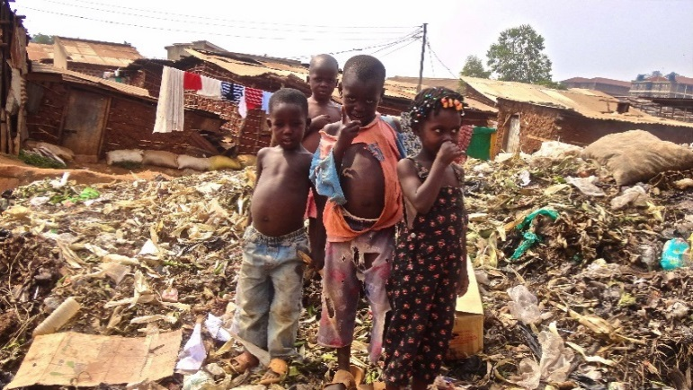
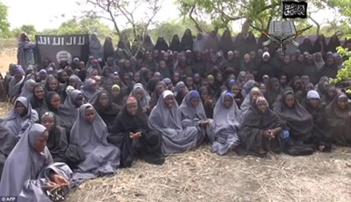
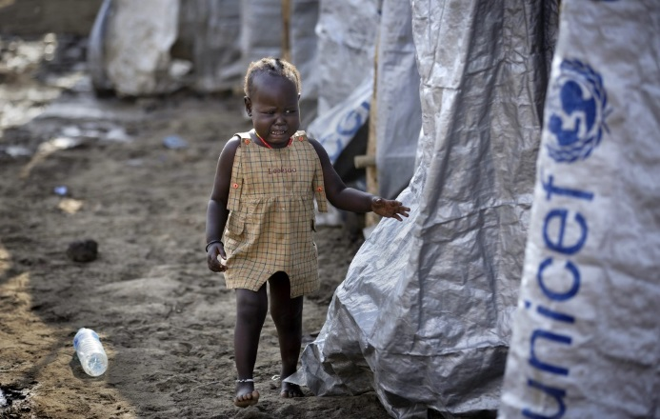
Ebola
Poverty
Nigerian School Girls
South Sudan
Notes:
These are a couple of ideas from Africa that might be discussed/raised. They may prompt new thoughts/ideas, so feel free to allow brief discussions.
What can the class say about the events?

Slide 6

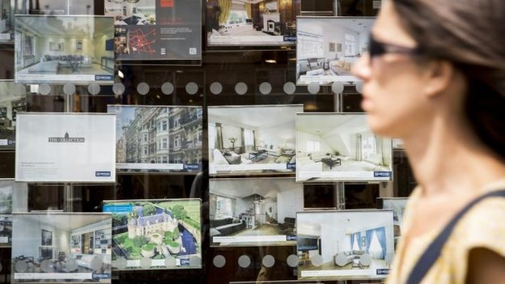
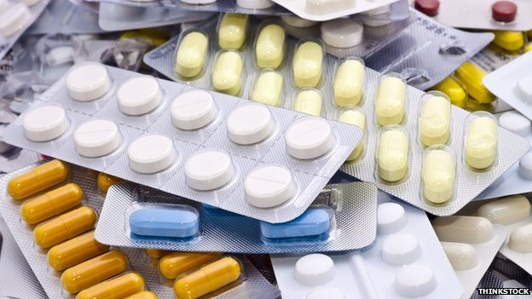
Minimum Wage
Healthcare
Housing Prices
Cancer Drugs
Fund Restriction
Notes:
Here are some current events/issues from the UK.
How do you think these events are breaching Human Rights?
Teacher note: Here is a link to an article about Cancer Drugs Fund restriction: http://www.bbc.co.uk/news/health-30022025

Slide 7
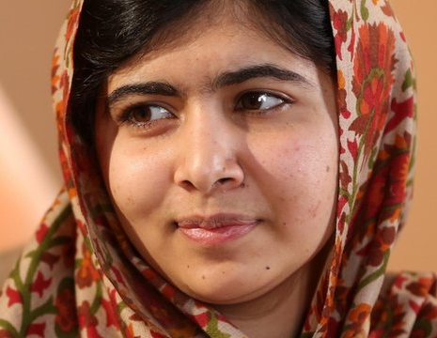
This is Malala Yousafzai.
What do you know about her?

Slide 8
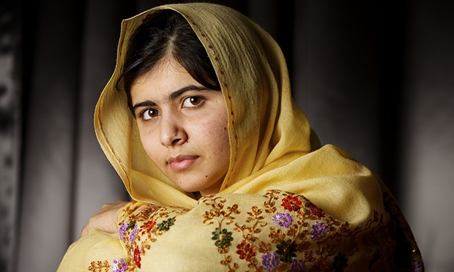
Read through Malala’s biography, section by section.
Speak to the person next to you. Really consider your answers to each of the questions.
Are there any questions of your own that you would like to ask and discuss?
Notes:
Teacher’s Note: Read through the Malala’s biography section by section, pausing to allow the class to really consider the questions asked and share answers with one another. (These questions can also be found on the following slides).
Once the class has read through and answered the questions given, get them to think of their own for discussion.

Slide 9
How would you feel if your basic right to an education was taken away?
What would your life be like?

Slide 10
If your life was at risk, would you continue to stand up for your rights/for what you believe in?

Slide 11
Was Malala right to put herself and her friends in danger for her beliefs?

Slide 12
What difficulties has Malala had to overcome so far in her life?
Do you know of other people who have had to overcome similar obstacles?

Slide 13
What change would you like to see in the world?

