Slide 1
HEADLINES
What can we learn from them?

Slide 2
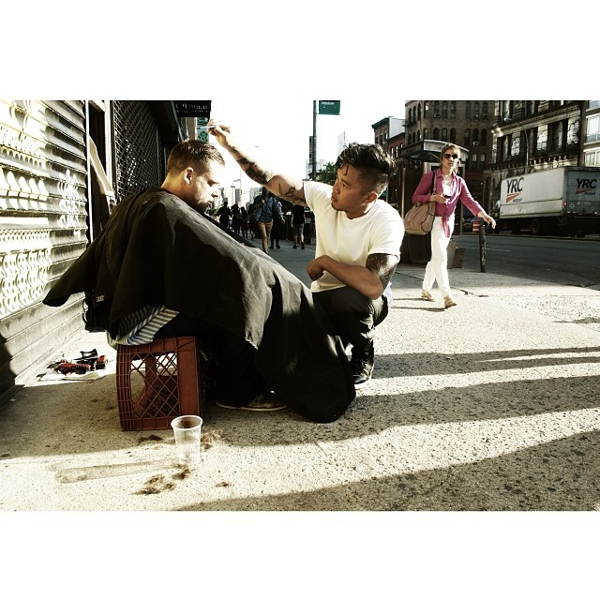
Stylist who spends every Sunday Cutting Hair for Homeless

Slide 3
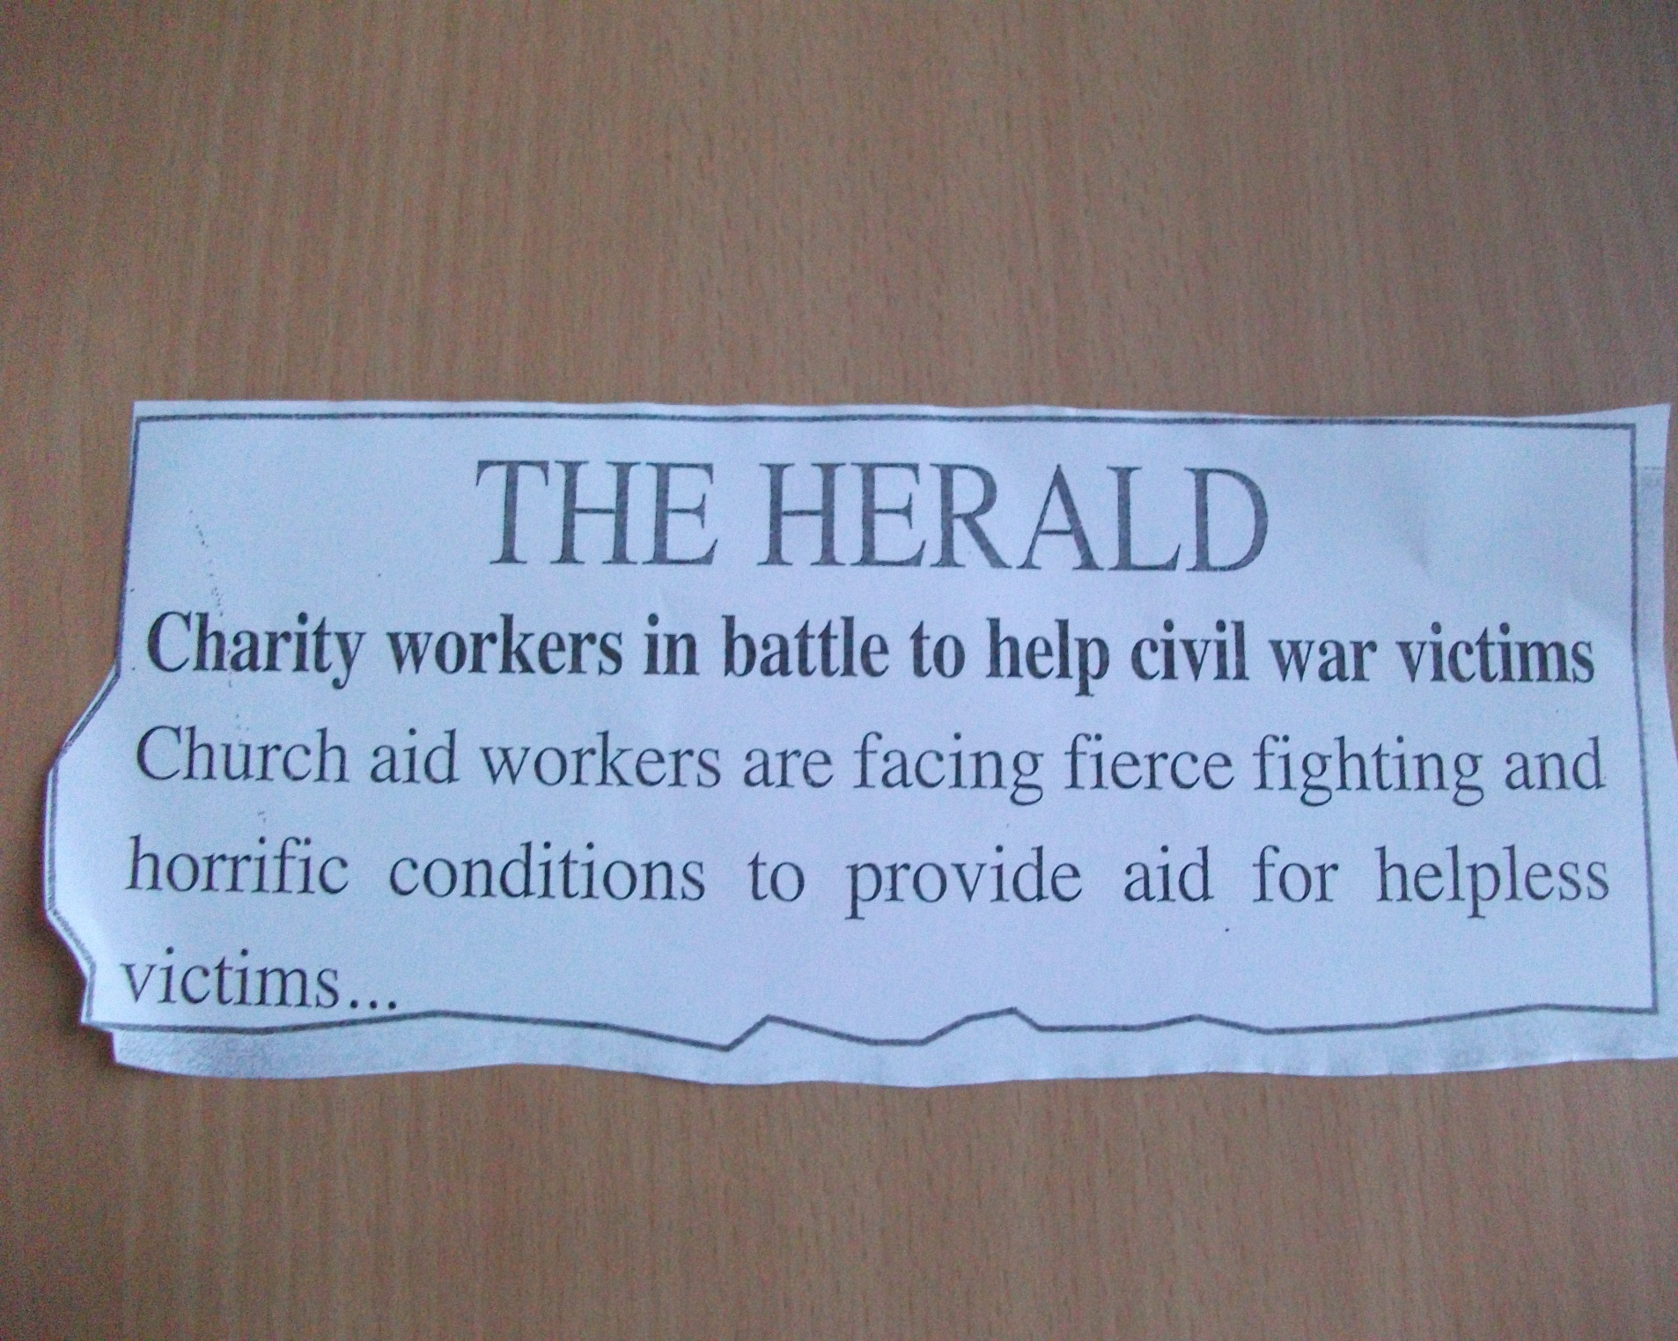

Slide 4
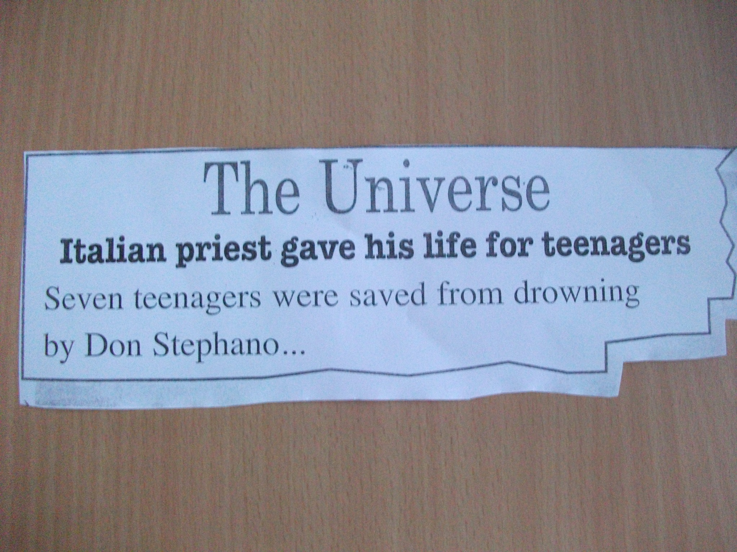

Slide 5
MULTIMILLIONAIRE GIVES FORTUNE AWAY
Daniel Garner was once worth hundreds of millions of dollars, owning 40 companies on four continents during his career. One day 15 years ago, he decided to give it all up. He is now a social activist and lives with his partner in an earthship in the New Mexico desert

Slide 6

Leader Named ‘Roosevelt’ Leads Caribbean Nation in Banning Plastics and Styrofoam

Slide 7
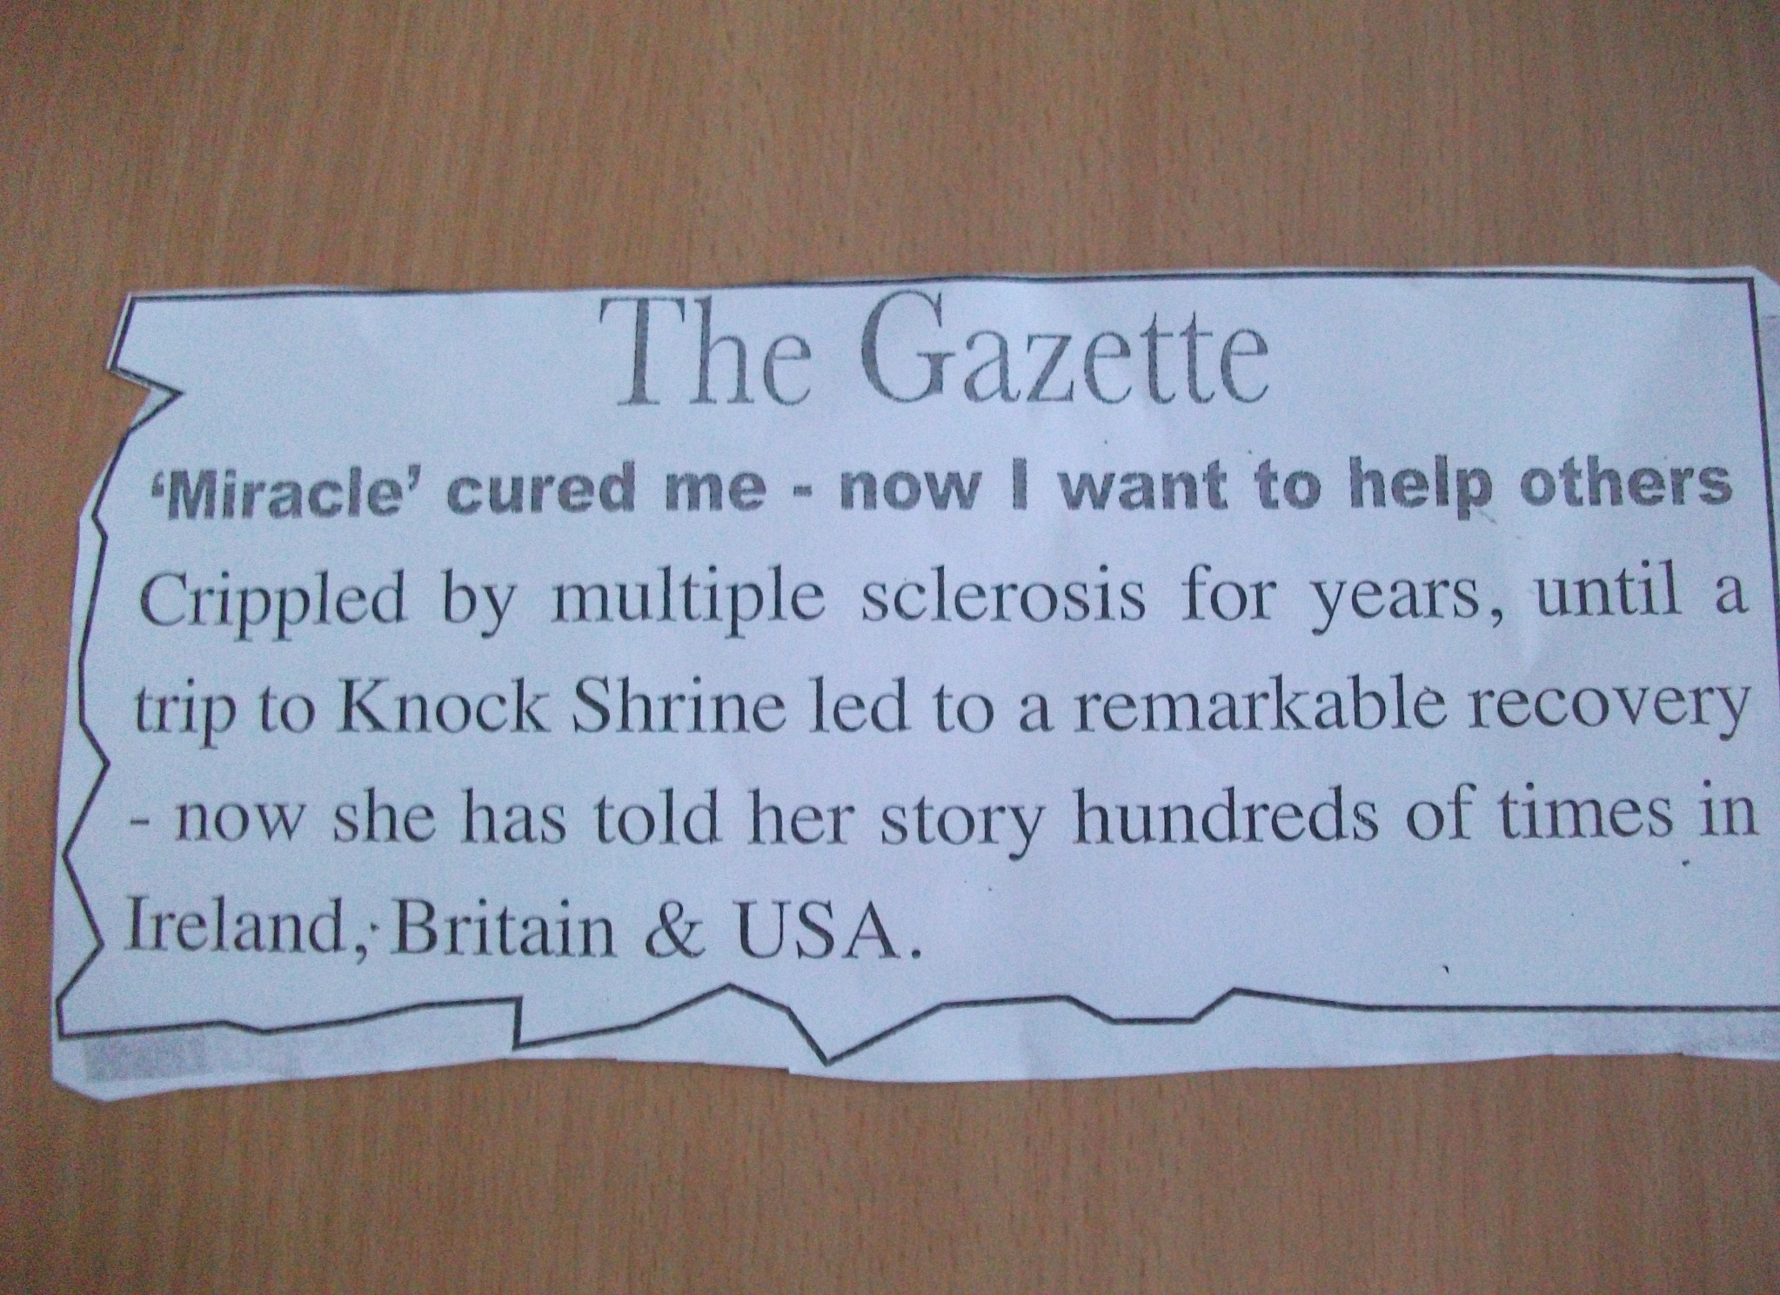

Slide 8
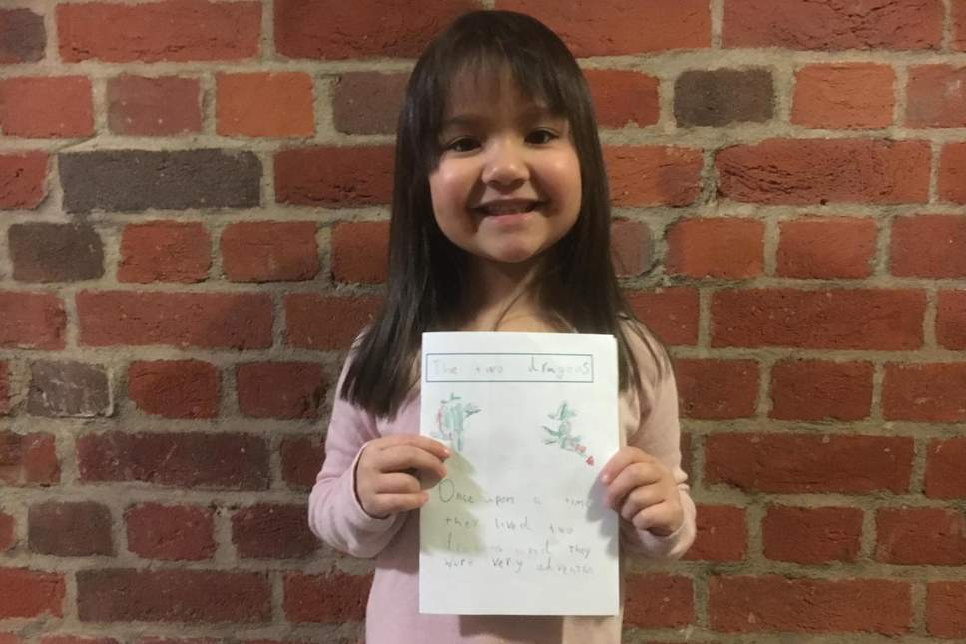
Six-year-old girl writes 'heartwarming' book to raise money for homeless
'She was really troubled by the fact there was nothing she could do because she doesn’t have much power as a child‘

Slide 9

Mystery donor gives charity £4m to help the homeless

