Slide 1

HELLO
My name is Nevaeh

Slide 2

April is autism acceptance month!!!

Slide 3

Autism definition-a developmental condition which affects our experiences and how we see and hear things, it can also affect how we communicate.

Slide 4

https://youtu.be/Ezv85LMFx2E

Slide 5

Things you can do this April :
Talk to people about autism in a NICE way
Be nice to those who see the world differently and may act different to you
Be accepting, and allow them to be themselves
Spread not only awareness but acceptance
Support your family and friends who are autistic
Educate yourself about autism

Slide 6


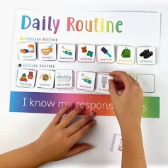

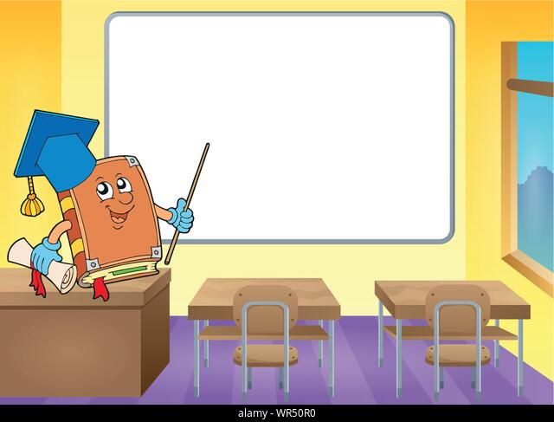

Things that can help people with autism :

Slide 7
Facts about autism :
More than one in 100 people are autistic
there are at least 700,000 autistic adults and children in the UK
People of all ages and genders can be autistic
Nearly two-thirds of autistic children between the ages of 6 and 15 have been bullied

Slide 8
How to be a good friend to someone with autism ?
https://youtu.be/iYLBYwJw-6s

Slide 9
feel free to ask any questions ☺

Slide 10


