Slide 1
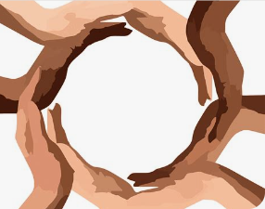
Celebration of the Word
Thursday 20th March 2025

Slide 2

The Hail Mary
Hail, Mary, full of grace,
the Lord is with thee.
Blessed art thou amongst women
and blessed is the fruit of thy womb, Jesus.
Holy Mary, Mother of God,
pray for us sinners,
now and at the hour of our death.
Amen.

Slide 3

Dear Lord,
Please bless our school
As we try to
Love, learn,
Share and respect
In the light of Jesus.
St Alban, pray for us.
Amen

Slide 4


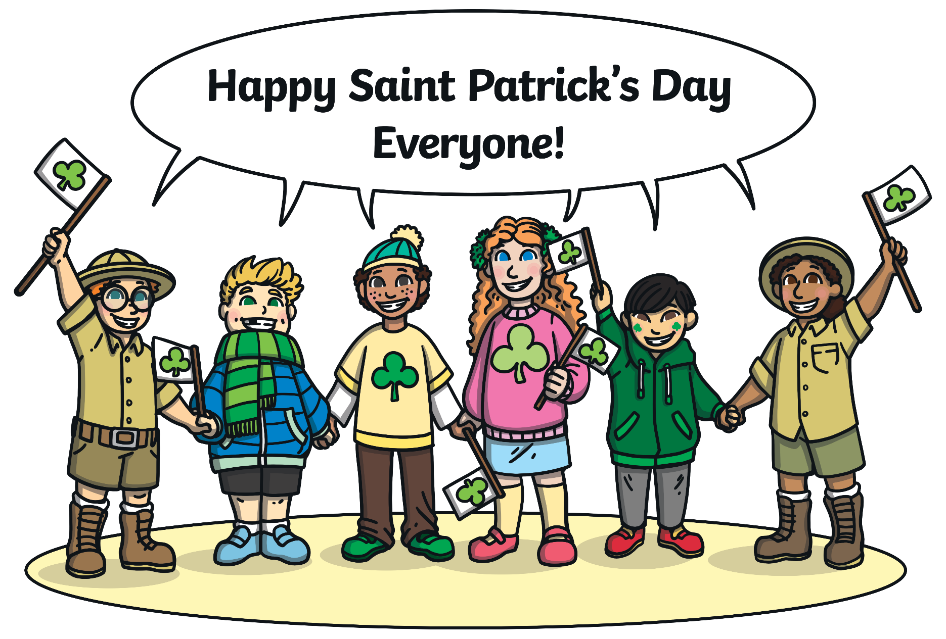
What is a tradition?
Why do we have them?

Slide 6

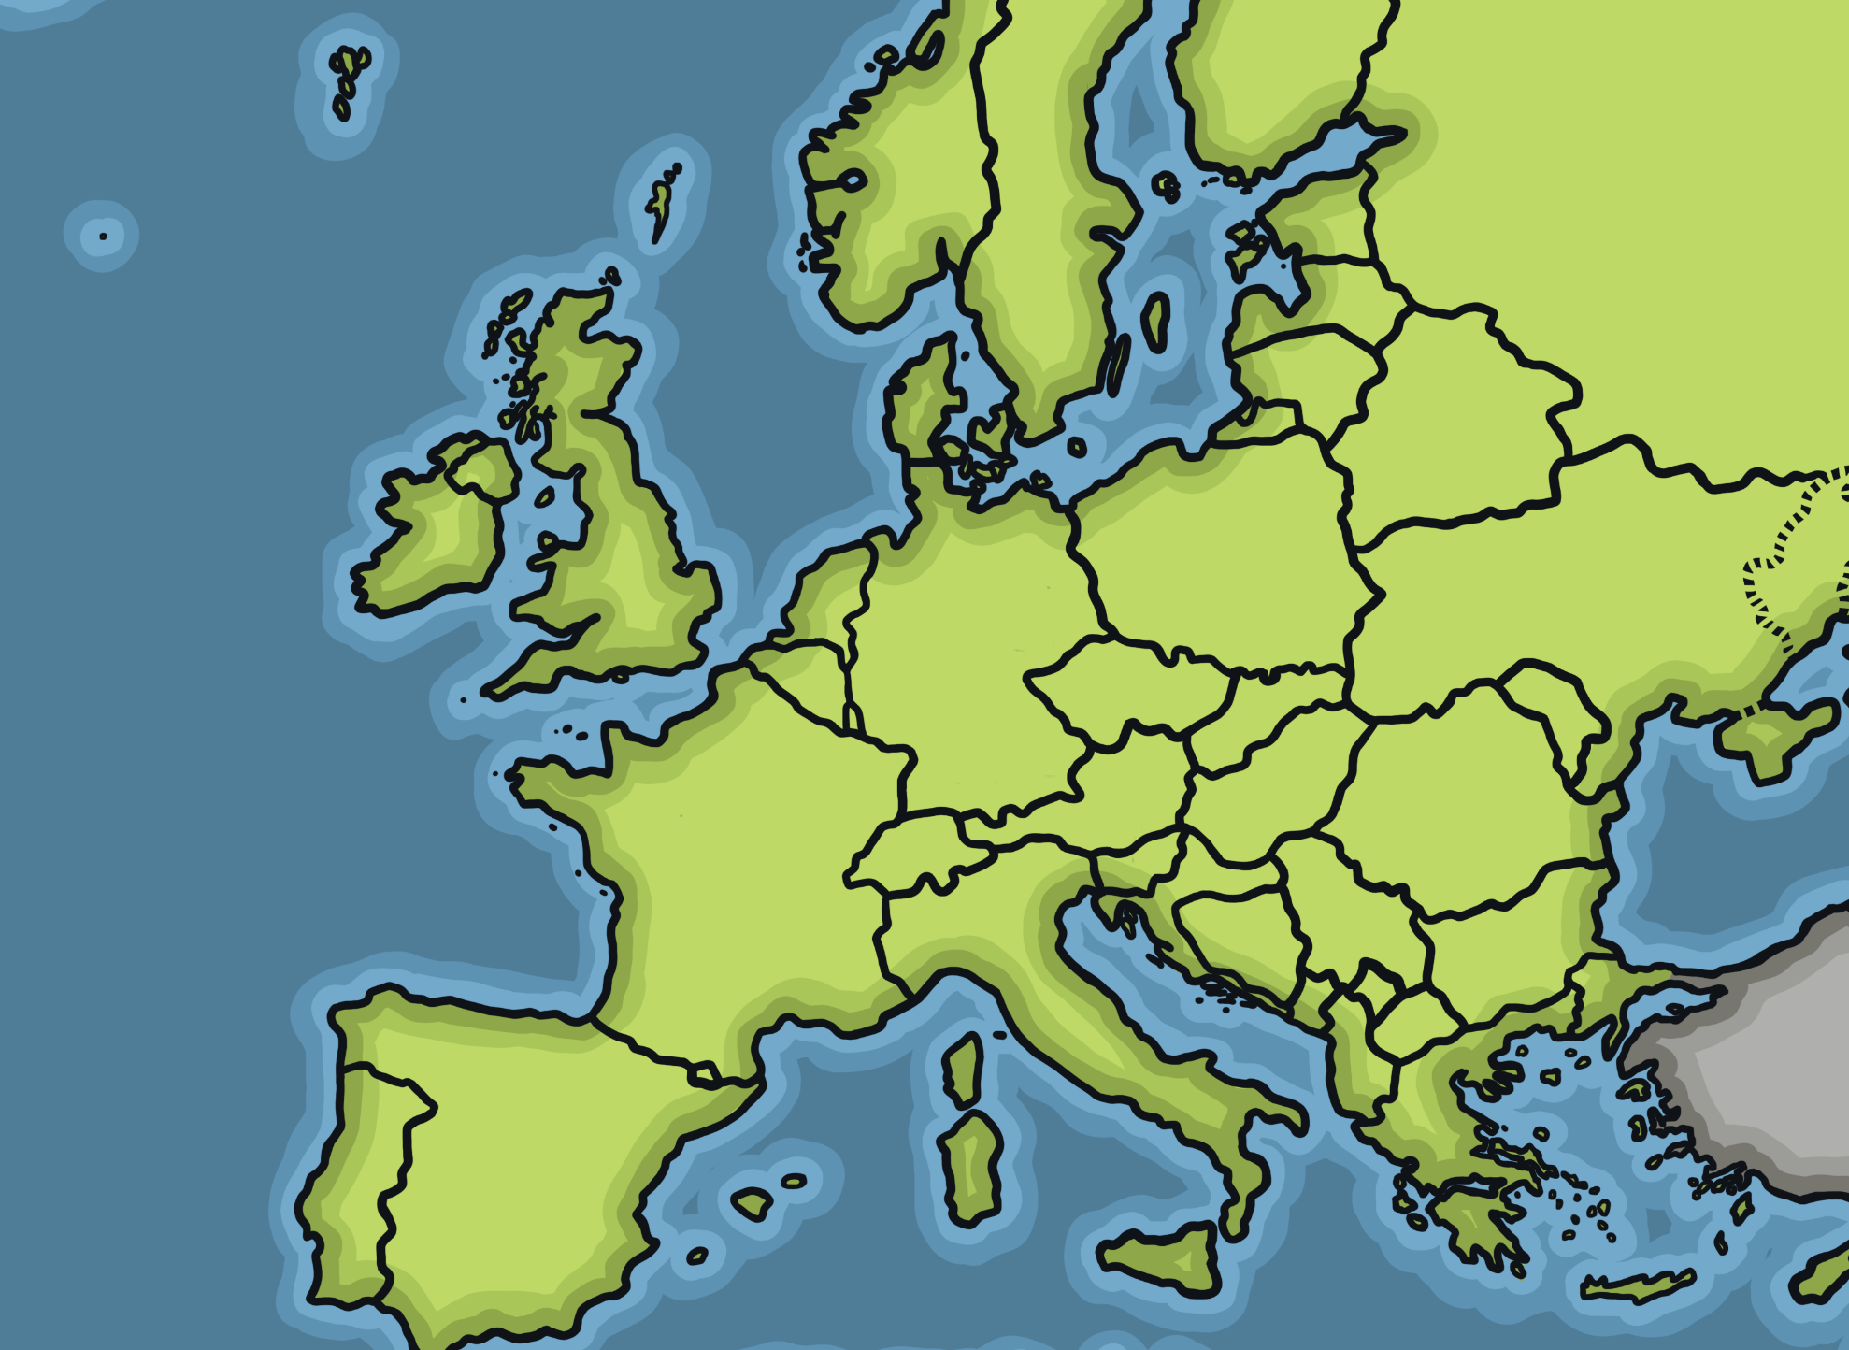
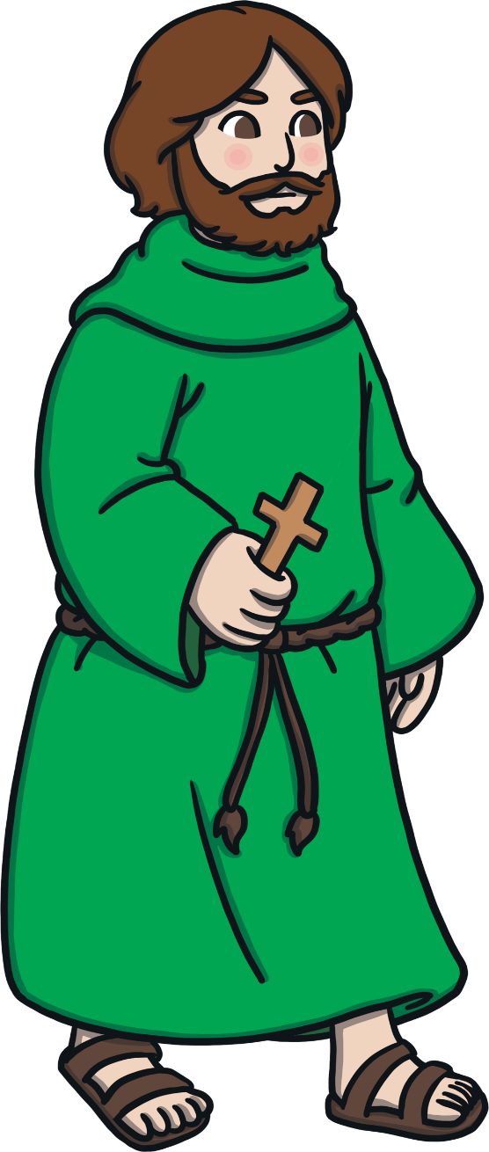
Saint Patrick
Saint Patrick is the patron saint of Ireland.
He is known for introducing Christianity to Ireland.

Slide 7
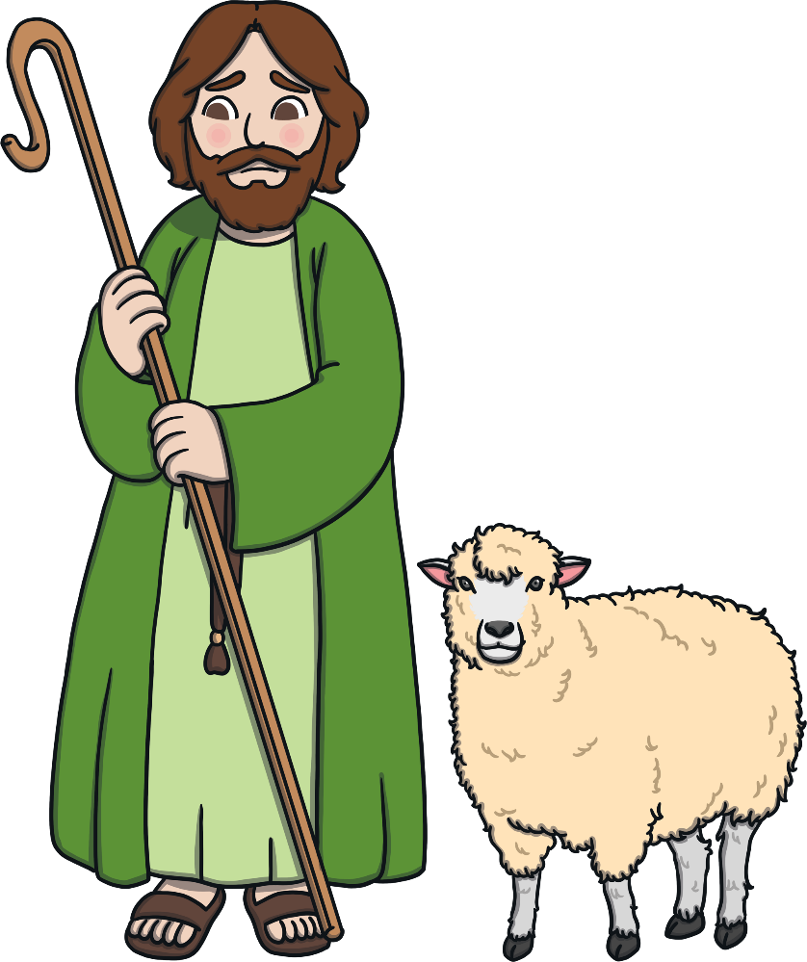
Saint Patrick’s Life
He became a Christian priest. He returned to Ireland and converted many Irish people to Christianity.
Saint Patrick was born in Britain.
Saint Patrick died on the 17th March. This is when St. Patrick’s Day is celebrated every year.
He was taken to Ireland as an enslaved person when he was 16. He escaped after six years.

Slide 8
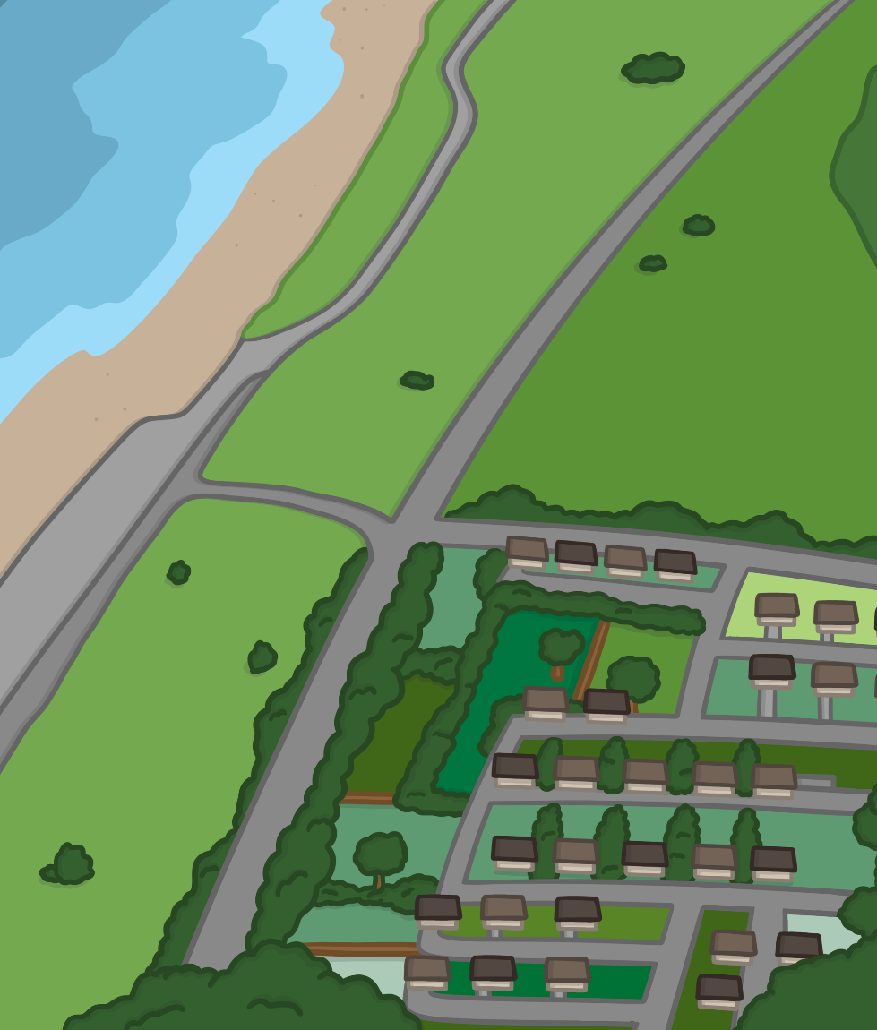
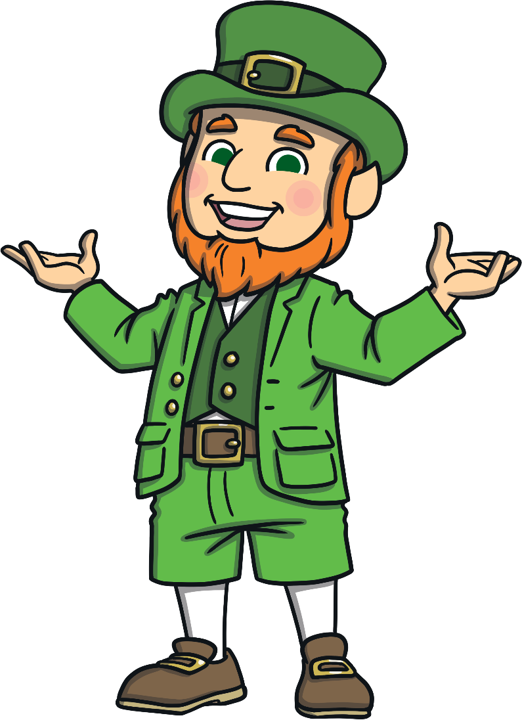
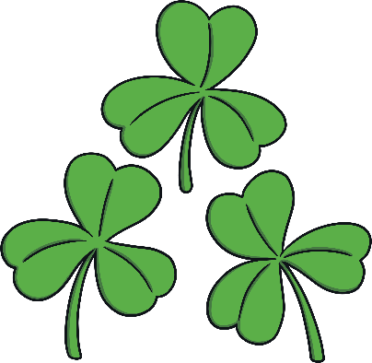
St. Patrick’s Day Traditions
St. Patrick’s Day became an official holiday in Ireland in 1903.
There are lots of different traditions for celebrating St. Patrick’s Day.
Let’s have a look at a few from Ireland and from around the world.

Slide 9
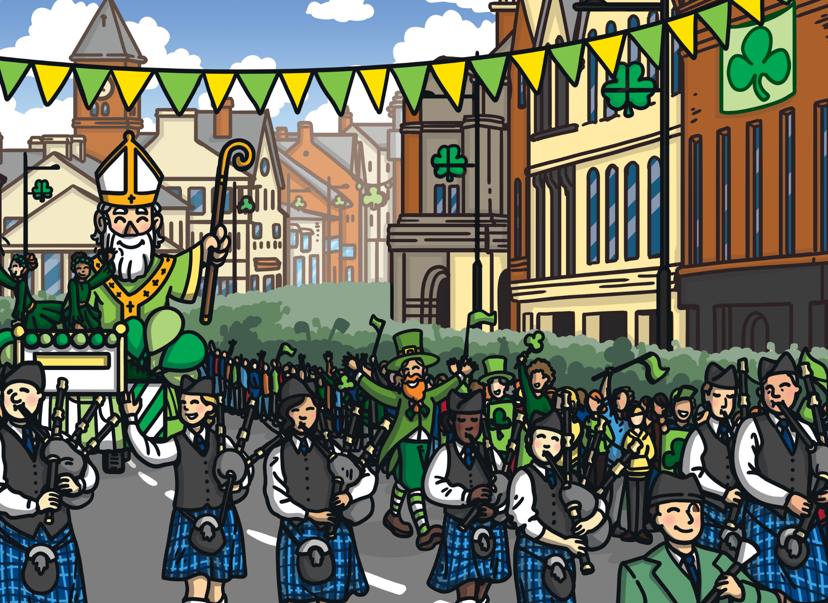
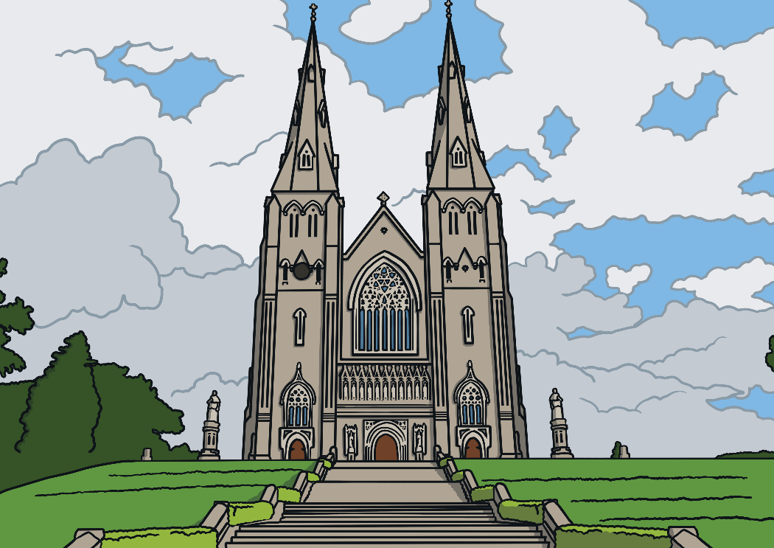
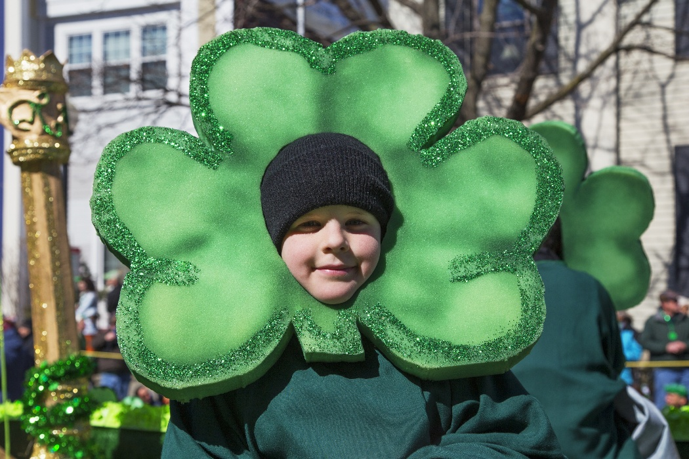
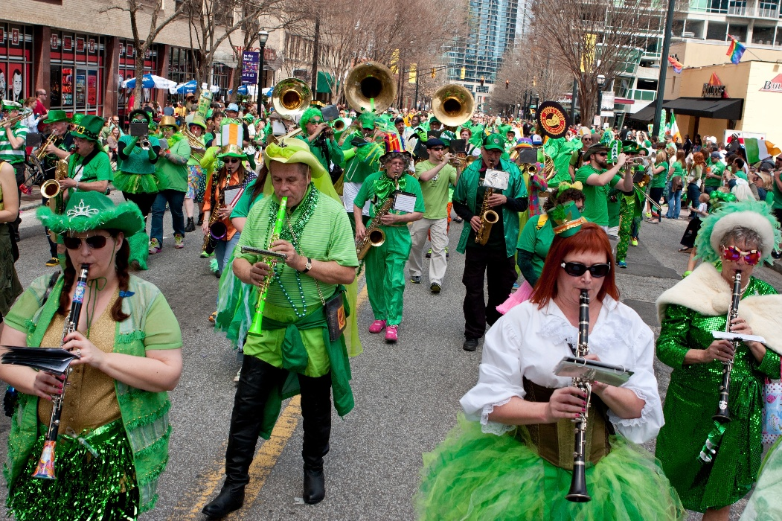
St. Patrick’s Day Traditions
People take part in special parades.
Some people go to church in the morning. In Ireland, St. Patrick’s Day has primarily been a religious festival.
People wear green on St. Patrick’s Day. Some people wear costumes or funny hats.
Joseph Sohm - Shutterstock.com
BluIz60 - Shutterstock.com

Slide 10
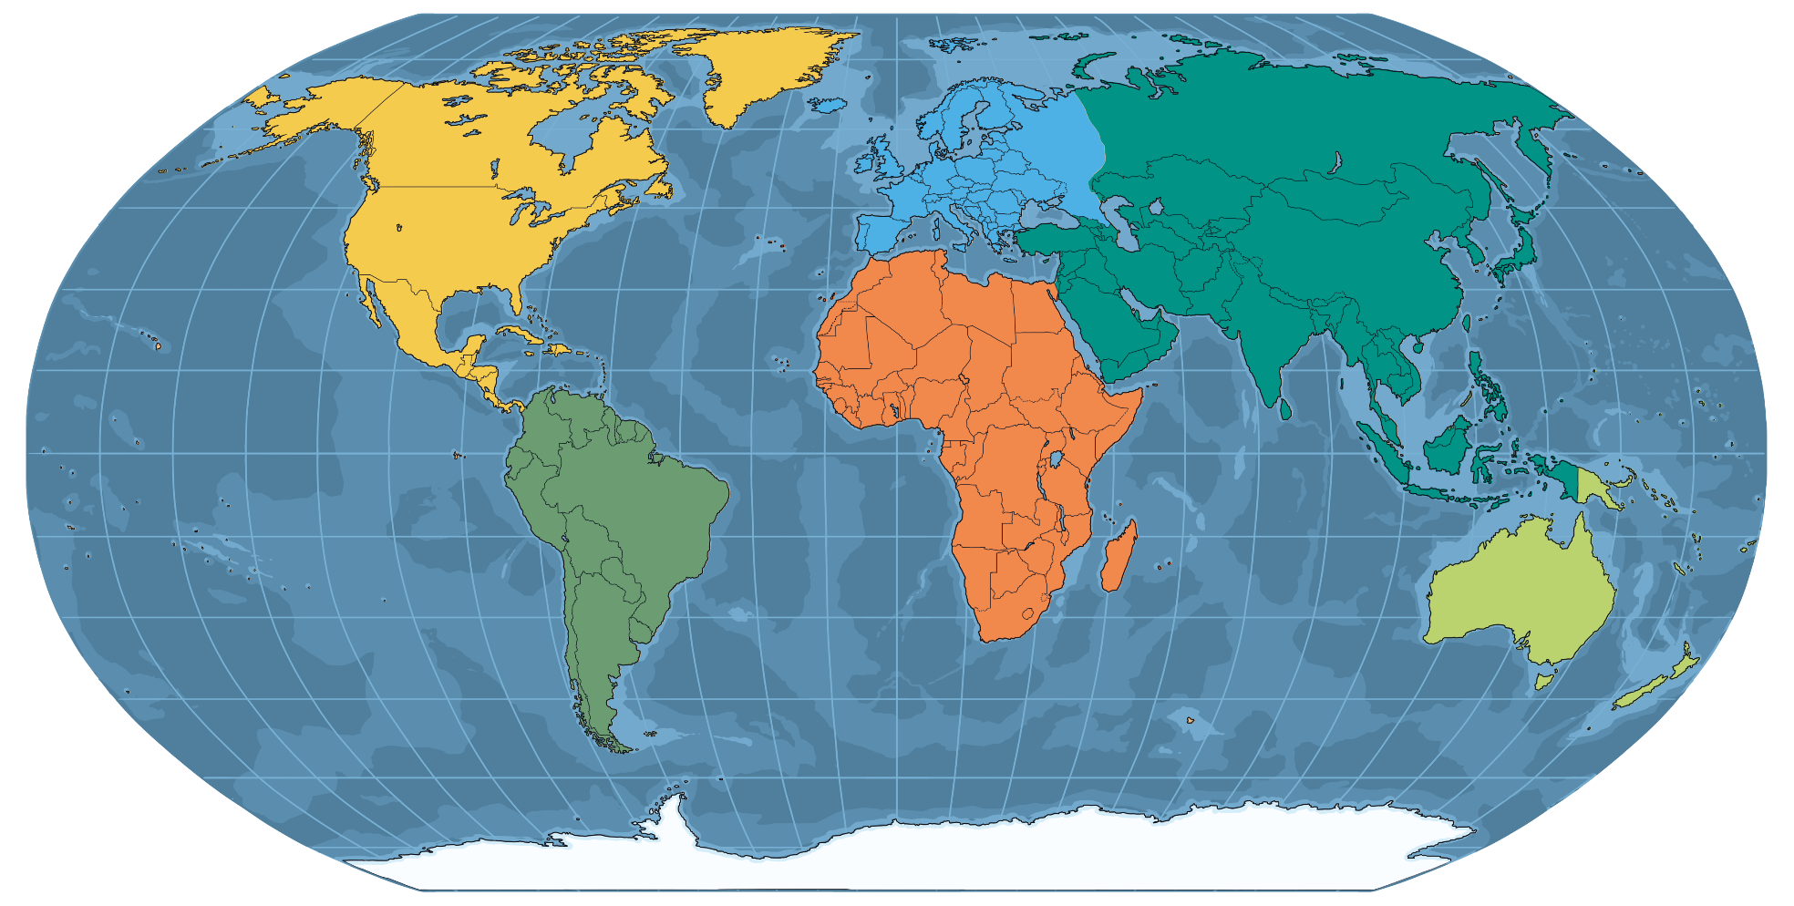
St. Patrick’s Day Traditions
UK
Canada
Ireland
USA
Australia
New Zealand
St. Patrick’s Day is an Irish national holiday but is also celebrated in UK, the USA, Canada, Australia and New Zealand.

Slide 11
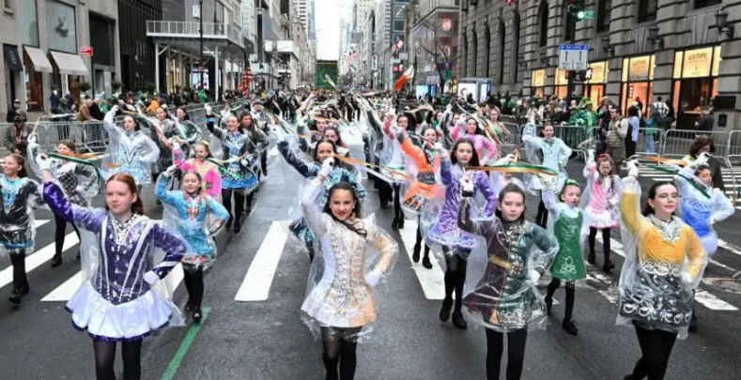
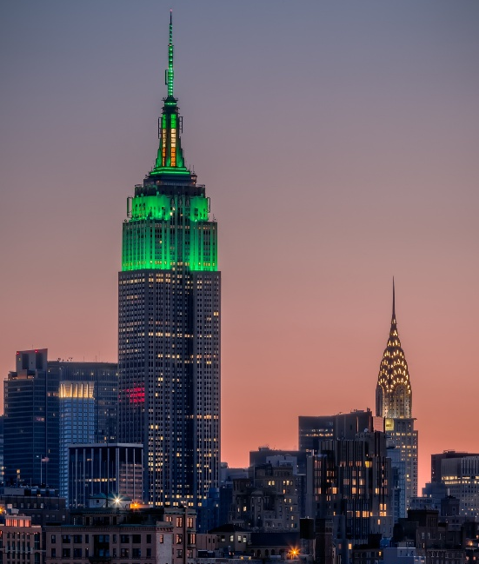
St. Patrick’s Day Traditions
The biggest St. Patrick’s Day parade is in New York.
It has been going for over 250 years.
The Empire State Building even turns on green lights for the occasion.
New York

Slide 12
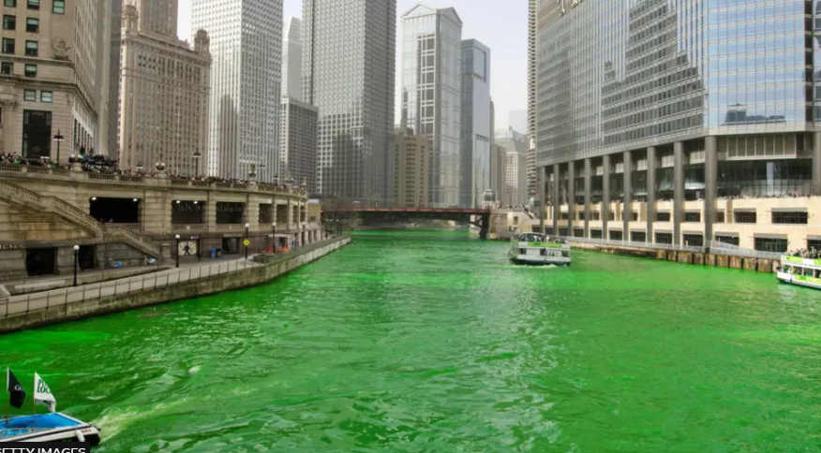
St. Patrick’s Day Traditions
Chicago have their own 63 year old tradition.
Chicago
Can you spot what it is?

Slide 13
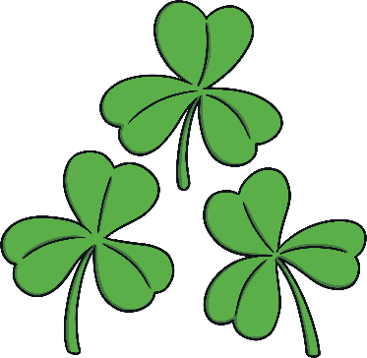
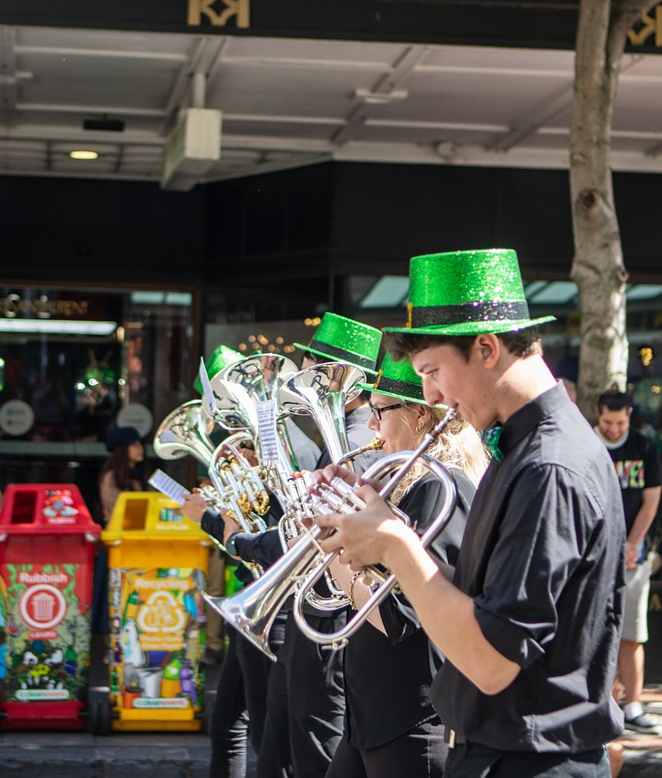
St. Patrick’s Day Traditions
Birmingham holds the largest Saint Patrick’s Day parade in the UK with a city parade that is over
2 miles long. It is the third biggest parade after
New York and Dublin.
The UK
There is also
a large parade
in Glasgow.
In Trafalgar Square, London there is a parade and festival and the water in the fountain is dyed green.

Slide 14


St. Patrick’s Day Traditions
The shamrock is a St. Patrick’s Day symbol because Saint Patrick used the shamrock to teach the concept of the holy trinity. The three leaves represent the Father, the Son and the Holy Spirit. Three in one.
The Shamrock
Shamrocks are also used to symbolise Ireland as a country.
The green colour of the shamrock represents Ireland and Saint Patrick.

Slide 15
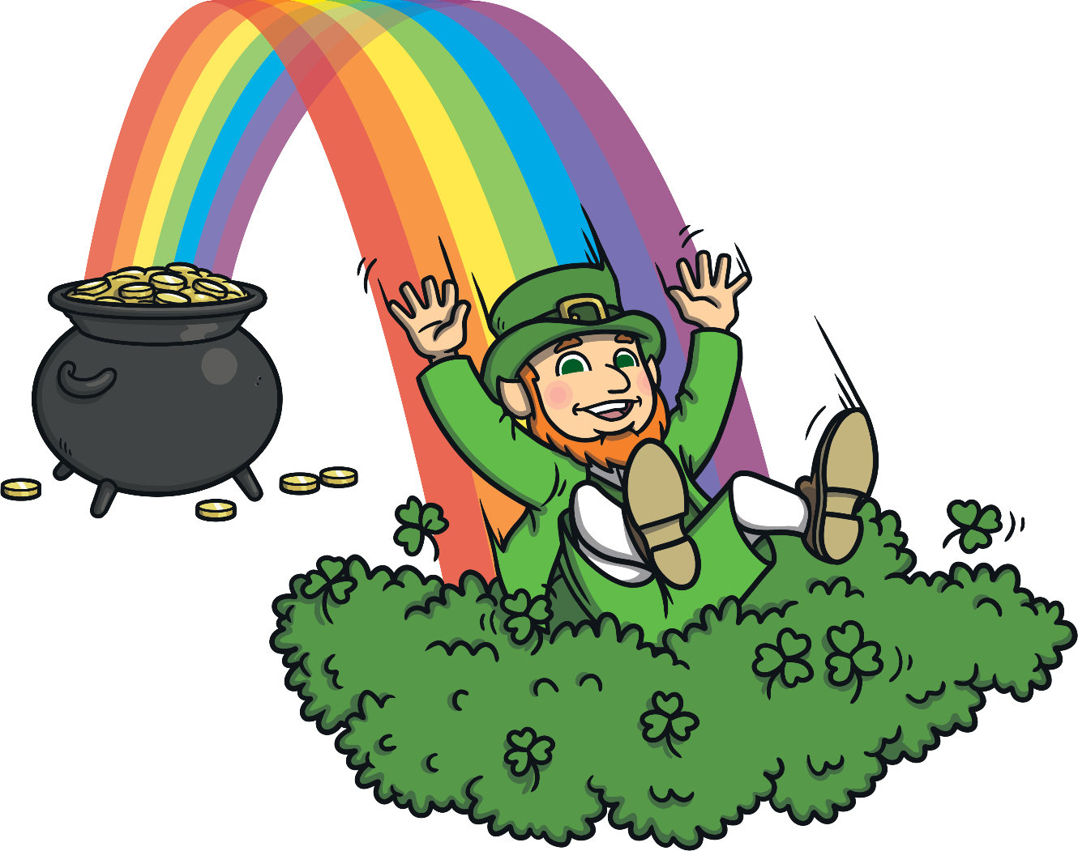

St. Patrick’s Day Traditions
They help
to symbolise
St. Patrick’s Day worldwide.
The leprechaun is a type of fairy usually taking the form of an old man who enjoys mischief.
Leprechauns are part of Irish mythology
In stories, they make shoes and store away pots of gold hidden at the end of rainbows.
Leprechauns

Slide 16

Reflection
Why is it important to learn about different celebrations from around the world?
What traditions do you have at home?

Slide 17

Mission:
John 13:34-35
³⁴ “A new command I give you: Love one another. As I have loved you, so you must love one another. ³⁵ By this everyone will know that you are my disciples, if you love one another.”

Slide 18
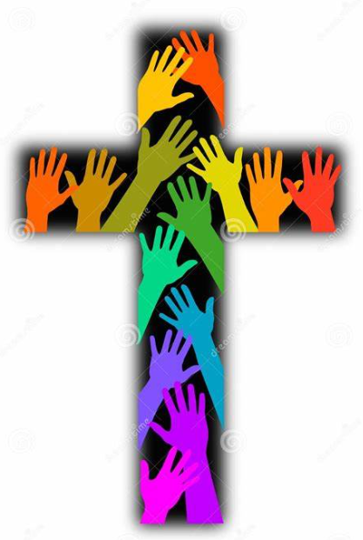
Dear God,
I pray that You would help me to love and accept others, just as You have loved and accepted me.
Please open my eyes to see people through Your eyes, with compassion and understanding.
Help me to extend grace and to those who may have hurt me or caused me pain.
Amen.

