Slide 2

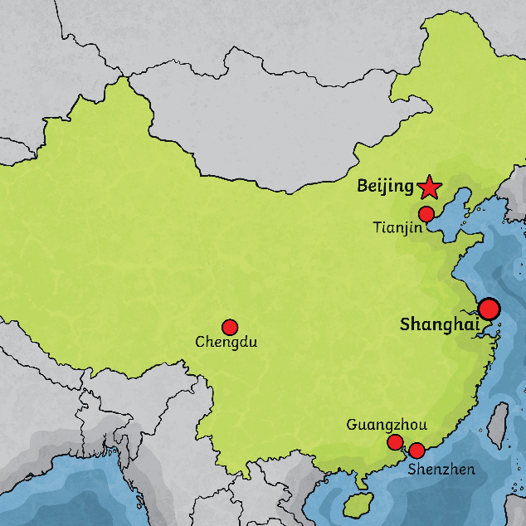
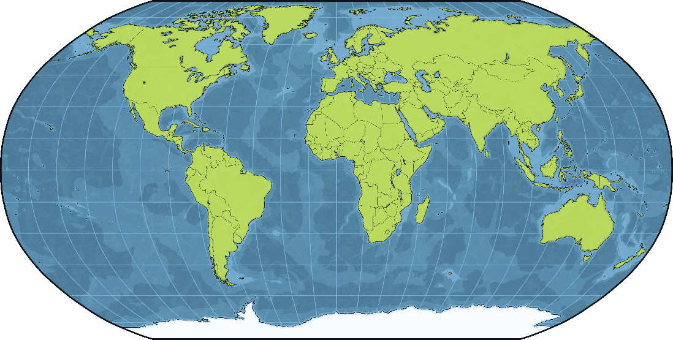
Where Is China?
The country of China is in northeast Asia.
China is the fourth biggest country in the world.
China has the largest population in the world with over 1.3 billion people!
China is divided into provinces.
The capital city of China is Beijing.

Slide 3
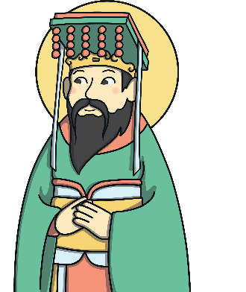
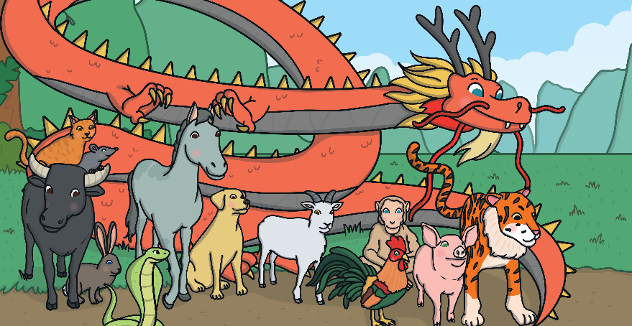
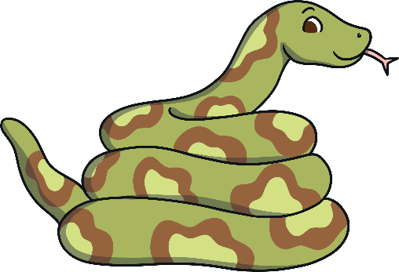
The New Year Story
The New Year Story explains how the animals in the Chinese zodiac were chosen. A long time ago, The Jade Emperor wanted to start a calendar.
He invited lots of animals to enter a race to cross the river. The first 12 animals to finish the race would have a year named after them.
The snake came sixth in the race, so the sixth year
was named after a snake.

Slide 4
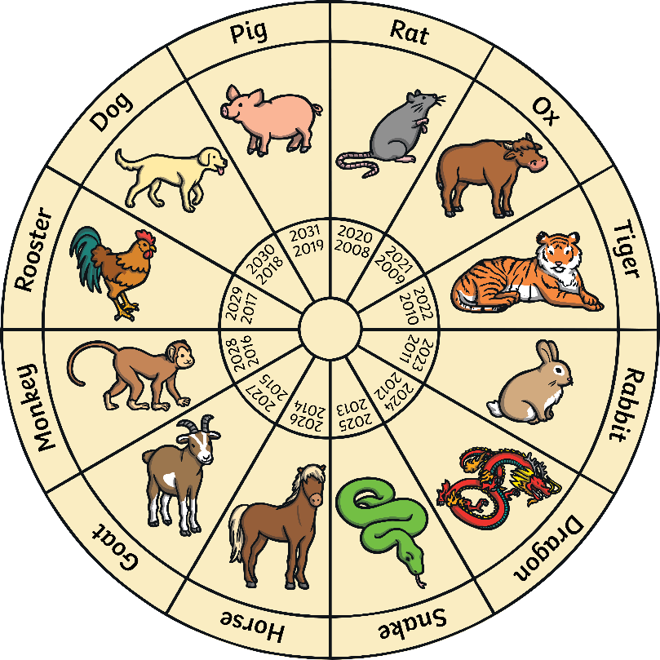
Each new year in the Chinese zodiac is named after an animal from the New Year Story. There are 12 different animals, including a snake.
Which animal was it on the year that you were born?

Slide 5
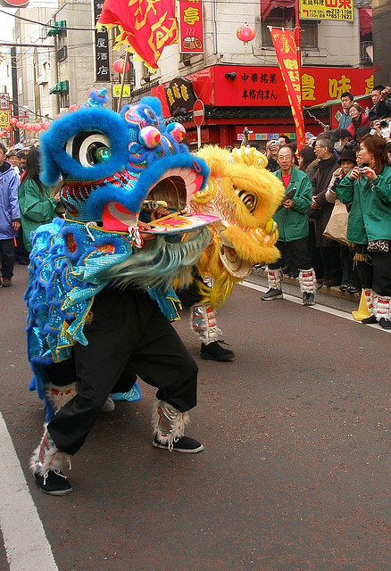
When Is Chinese New Year?
Chinese New Year is also known as Lunar New Year or the Spring Festival. It is celebrated all over the world.
Chinese New Year starts somewhere between late January and early February.
The date changes from year-to-year. It follows an ancient farmer calendar based on the phases of the moon.
This year, Chinese New Year starts today, 29th January.
Photo courtesy of tanakawho (@flickr.com) - granted under creative commons licence - attribution

Slide 6
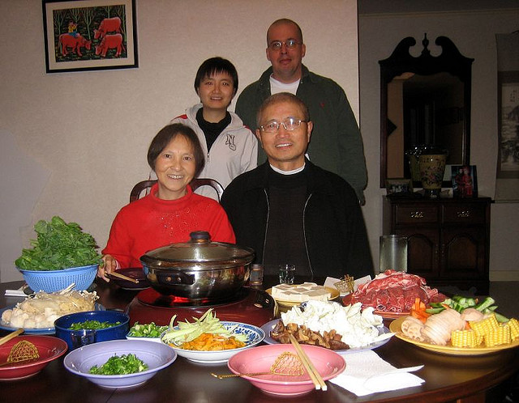
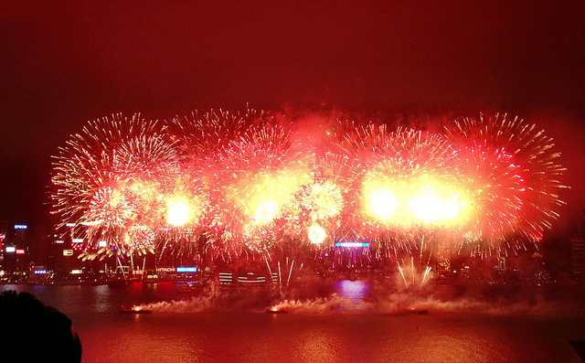
New Year’s Eve
Some Chinese people spring clean their homes and gardens to sweep away any bad luck.
Homes are decorated with paper scrolls and lanterns with good luck phrases such as “happiness” and “wealth” on them.
Families gather together and have
a large, traditional feast which might include fish, chicken or steamed dumplings.
People stay up until midnight, setting off firework to scare away evil spirits.
Photo courtesy of Prince Roy, (@flickr.com) - granted under creative commons licence - attribution

Slide 7
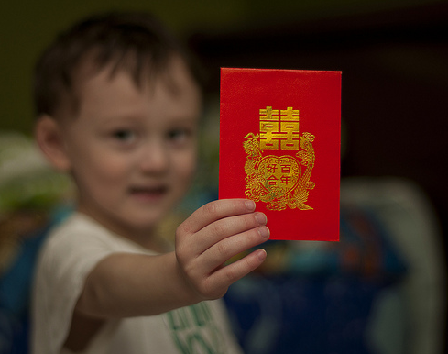
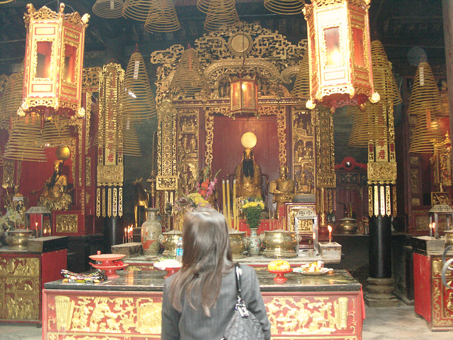
New Year’s Day
Children wake up to find red envelopes filled with money and sweets under their pillows, left by their parents or grandparents.
Each family member starts the day with brand new clothes from head to toe. Red is a very popular colour for clothing as it is considered lucky.
The first stop of the day is the temple to worship the gods and to welcome the New Year.
Most Chinese families gather together for a New Year’s banquet. Each family has their own special dish they prepare for this time.
Photo courtesy of DaMongMan, oldandsolo (@flickr.com) - granted under creative commons licence - attribution

Slide 8
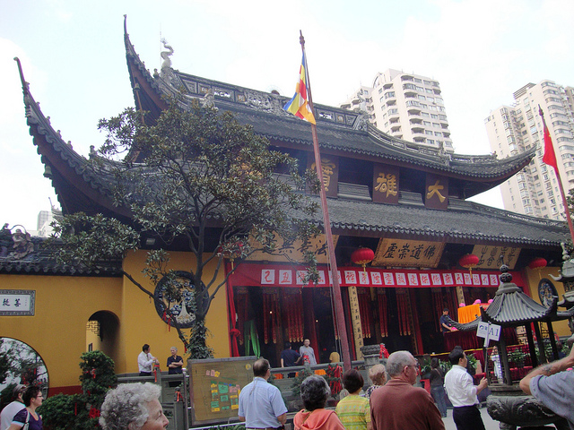
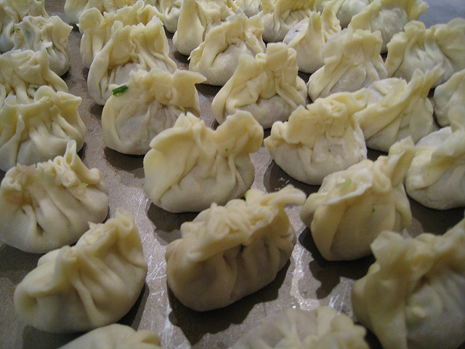
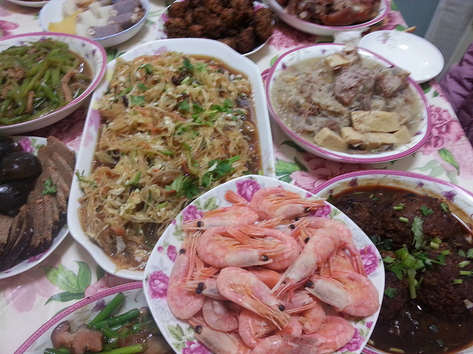
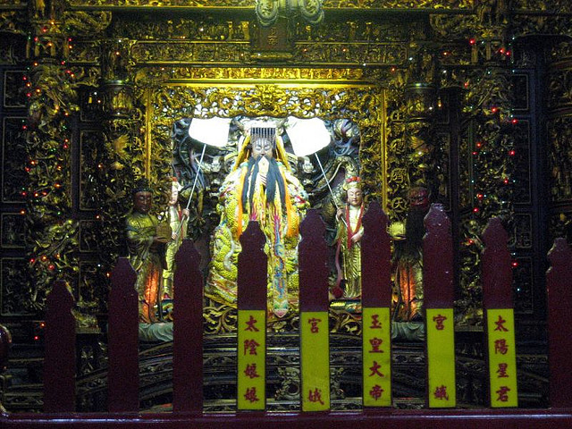
2nd – 14th Day
Photo courtesy of Bob Jagendorf, heypatrick(@flickr.com) - granted under creative commons licence - attribution

Slide 9
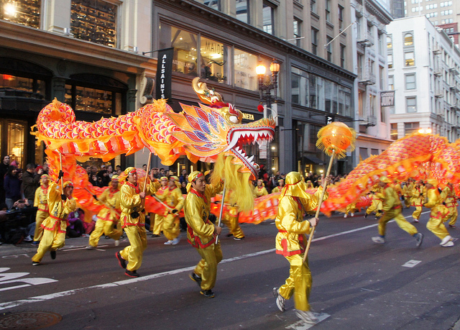
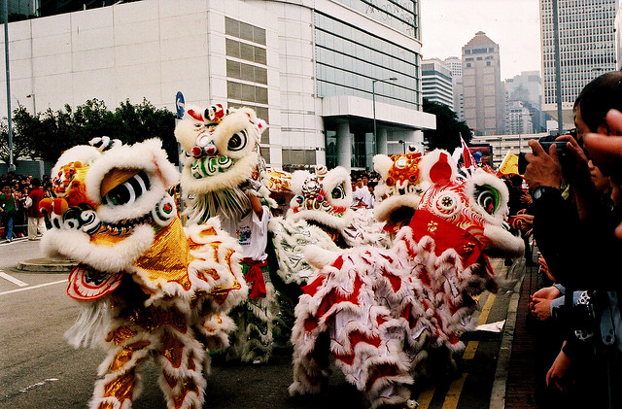
The 15th Day – Lantern Festival
The 15th Day is also known as the Lantern Festival.
Crowds of people watch dragon dancing and lion dancing parades.
Families walk the streets with their glowing lanterns.
Candles are lit outside homes to guide wayward spirits home.
Photo courtesy of MoonSoleil, Maureen lunn (@flickr.com) - granted under creative commons licence - attribution

Slide 10
Lunar New Year for Kids | Educational Video
2025 Year of Snake Ambience🏮Refreshing Chinese Lunar New Year Music🎵Happy New Year!

