Slide 1


Slide 2
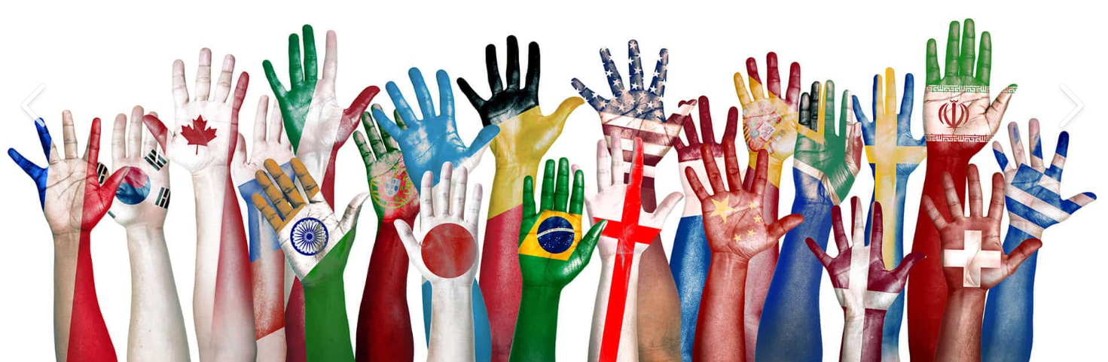
Our visit to All Hallows…
As a team, we were invited to All Hallows College to find out about a new exciting project, that all the schools in our Academy will contribute to. We were introduced to an amazing piece of art and an inspiring speaker who shared their story of racism in their life.

Slide 3
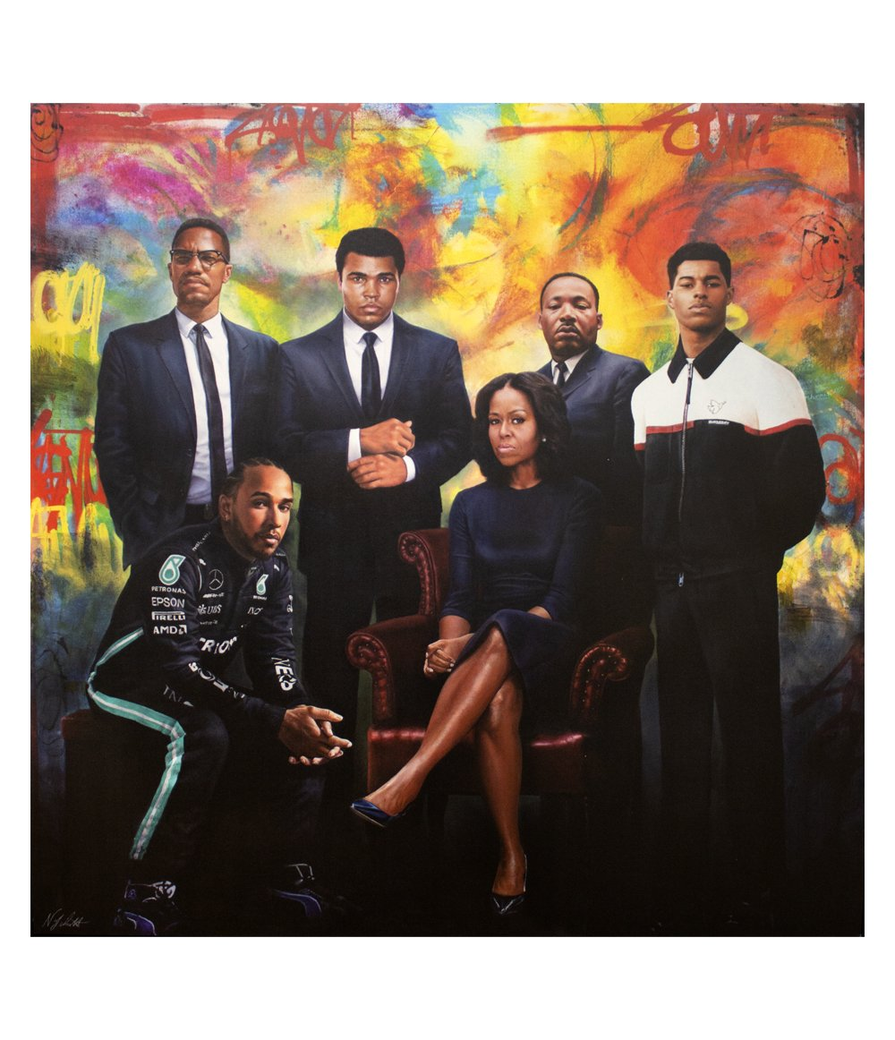
Behind Lies
More
  Commissioned by Wilmslow Art Gallery owner Graham Finch.
  He chose each person in the painting because they are inspirational to him.
  Painted by portrait painters Nicholas J Smith & James Blinkhorn and freestyle street artist Dave Moli.
  On the painting, there are quotes from each of the people, which you have to seek out, as they don’t overpower the image.
  We would like to share with you a little about each of the people and reason for being chosen and placed in the painting.

Slide 4
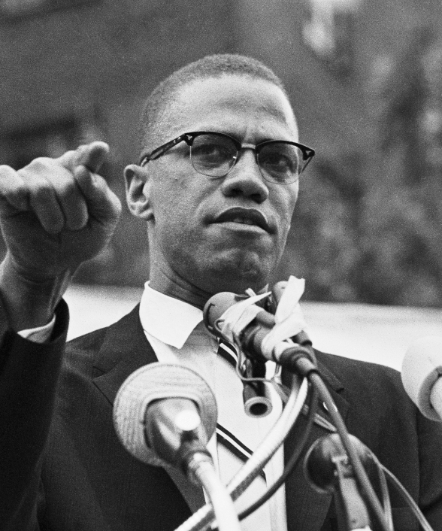
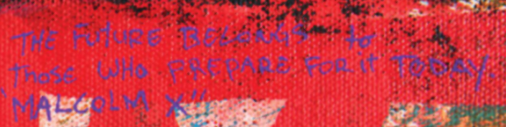
Malcolm X
American Muslim minister, originally known as Malcolm Little, changed his name after being in prison for 10 years as he didn’t want to carry his name anymore.
Being in prison changed his life, he realised he had lost his freedom, like many black people.
He therefore trained as a lawyer and became an activist for human and black people’s rights.
He fought for the use of ‘Black’ and ‘African-American’ rather than other labels that were linked to slavery.
He was sadly assassinated at 39 years old when speaking out at unity rally.
The future belongs to those who prepare for it today.

Slide 5
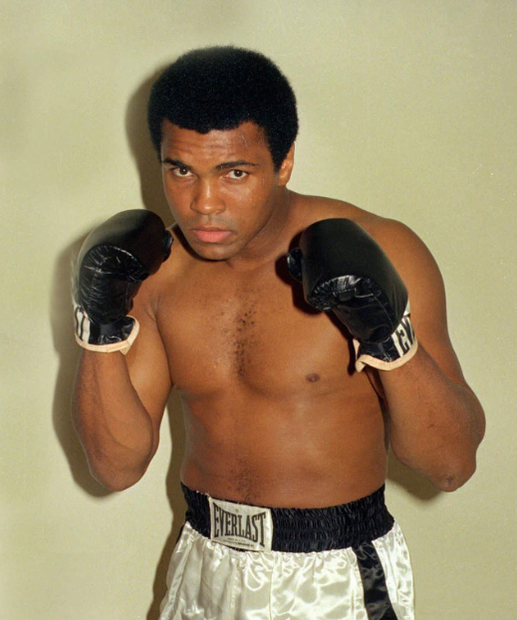
Muhammad Ali
Known as the greatest boxer of all time. He is recognised all over the world for his sportsmanship.
He grew up in South America where he lived and experienced racial prejudice and discrimination for his skin colour. He first learnt to box to protect himself.
After retiring from boxing, he travelled the world as a United Nations Messenger of Peace and received a Presidential Medal of Freedom for his work.
In the painting he is stood shoulder to shoulder to Malcolm X, as they were good friends and was also Muslim and stood and fought for black lives and rights.
Hating people because of their colour is wrong. And it doesn't matter which colour does the hating. It’s just plain wrong.

Slide 6
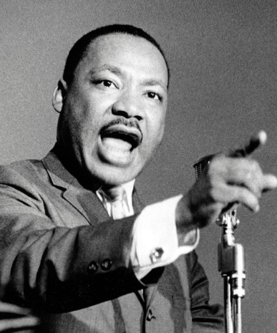
Martin Luther King
He was a black Christian minister, who also graduated with a degree in sociology and theology.
In the painting he is standing alongside, but separate to, Malcolm X and Muhammad Ali as he was fighting for equality at the same time.
However, he was a visionary. He stood for equality and inclusion of ALL, not just the Black community, by organising peaceful, non-violent protested.
Before he was assassinated in 1968, he won the Nobel Peace Prize for combating racial inequality through nonviolent acts and in his final years expanded his focus to opposition to poverty and war.
.
Darkness cannot drive out darkness; only light can do that. Hate cannot drive out hate; only love can do that.

Slide 7
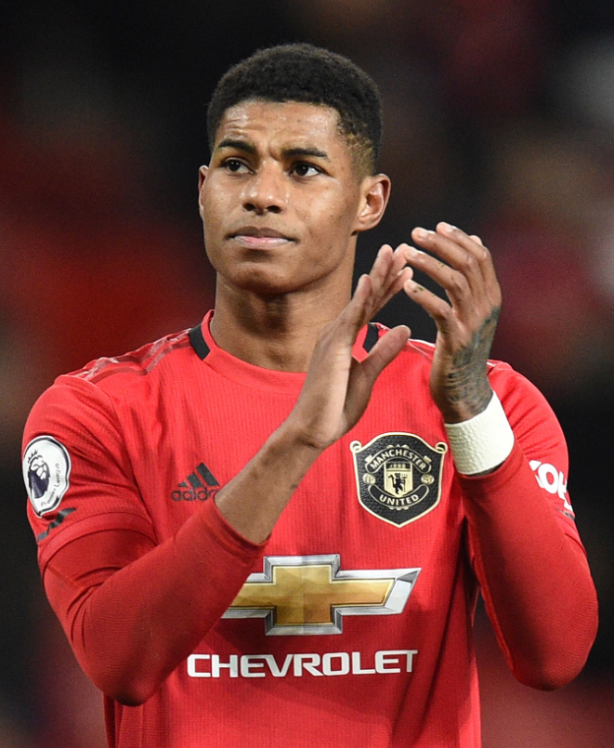
Marcus Rashford
Recognised as the Manchester United and England footballer, he is also known as an international social justice campaigner for child poverty. He is an example of how through discipline and dedication, anything is possible.
He used his fame and position to reverse the Government’s decision to provide free meals through the pandemic, raising 20 million for the Fairshare charity.
He continues to work for the provision of free school meals in England during holidays and for the support of low-income families, like his family growing up.
In the painting, he is stood next to Martin Luther King, as he also stands for equality and rights for all people. You may see, he is slightly in front also, as he presents the fight for inclusion now and future.
On his hoodie, his badge is a dove, which is the world symbol of peace.
These children matter, and as long as they don’t have a voice, they will have mine.

Slide 8
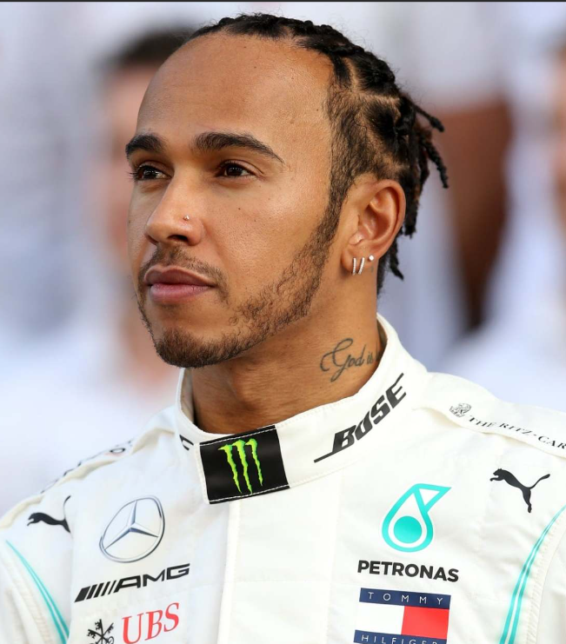
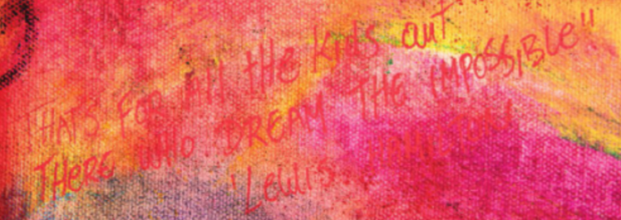
Lewis Hamilton
British born, seven-times Formula One world champion, has courageously shared his experiences of racism during his school days.
He faced traumatising racial abuse at a young age. People threw bananas at him and repeatedly called him racist names as he was one of only three kids of colour in his school.
Despite the difficulties, he persevered and has since become a powerful advocate for diversity and inclusion in motorsport.
Hamilton’s initiatives, such as Mission 44 and Ignite, aim to enhance the lives of under-represented groups and promote positive change. He is determined to fight racism and create a more inclusive world.
That’s for all the kids out there who dream the impossible.

Slide 9
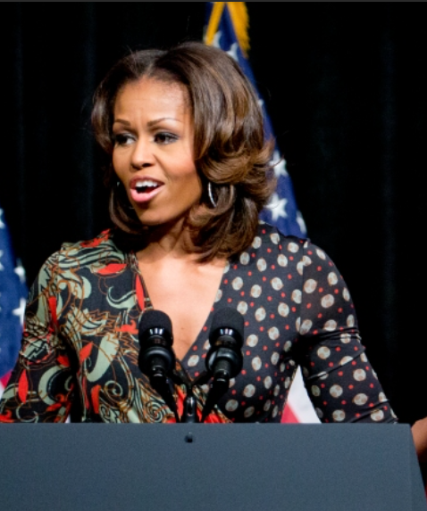
Michelle Obama
Although she is recognised as the wife of former USA President, she is also known for using her position for illuminating racism in today’s society.
She serves as a role model and campaigner for rights of women and works as an advocate for poverty awareness, education, nutrition, physical activity, and healthy eating.
In the painting, she is representing women and is interestingly seated as no one would ask Michelle Obama to give up her seat. Unlike in 1955, when Rosa Parks was asked to give up her paid seat for a white person on bus, but refused, which resulted in her arrest.
This led to the African American community boycotting the use of buses until they were treated with the level of courtesy they expected, until Black drivers were hired, and until seating in the middle of the bus was handled on a first-come basis.
Choose people who lift you up.

Slide 10
Your Turn….
Time for you to think about and share your response to the painting.
Talk to you shoulder partner;
What does it make you think about?
Does it create any emotions within you?
What do you like about it?
Why do you think it’s called
‘Beyond Lies more’?

Slide 11
Beyond Lies more
When we look at art, we are all entitled to our own opinion and thoughts that it provokes.
For Graham, the gallery owner, he wants the painting to not just be about racism, but to be a source of inspiration.
We should all embrace our differences, we are all equal.
Behind these faces, there are inspirational minds, with inspirational actions.

Slide 12
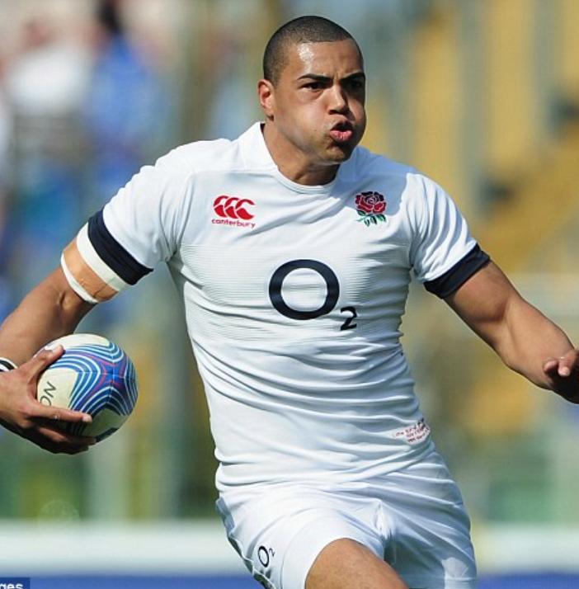
Luther Burnell
We also listened to an inspirational talk from England Rugby player, Luther Burnell, who shared the racism challenges he has faced in his life.
He was raised in Huddersfield by his Caribbean parents.
Although he never really suffered racism in school, it was on the rugby pitch when he started to face challenges. It was firstly issues of class, rich and poor, but as he travelled with the sport and became more successful, the racism started.
His parents told him not to fight back with words or violence, but show them on the pitch. His mum said, ‘Get the ball and run hard.’
Burnell believes that rugby saved his life because if he didn’t have the game, he would have made bad choices and taken the wrong path.

Slide 13
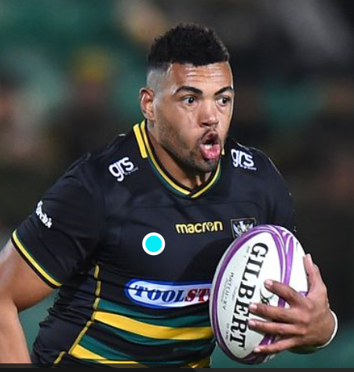
Burnell went on to describe, how as he became a professional rugby player, the racism didn’t get better. Often described as ‘just banter’ or ‘for jokes’, people he played with, or people who managed his teams would make racist comments like it was normal and okay.
Statements and actions such as;
Throwing bananas at him for breakfast.
‘Don’t give him anything else, all Black people eat is chicken.’
‘You don’t need sun cream, you need carrot oil.’
‘He does need suncream, for the lighter parts where his shackles were in slavery.’
He began to find it hard, because these people were supposed to be his friends, his team mates, who he should protect on the pitch.
In 2022, he decided to no longer stand for it, and went to the Rugby Union Governing body and then the press. After an investigation, it became clear that allegations of racism in sport were true.

Slide 14
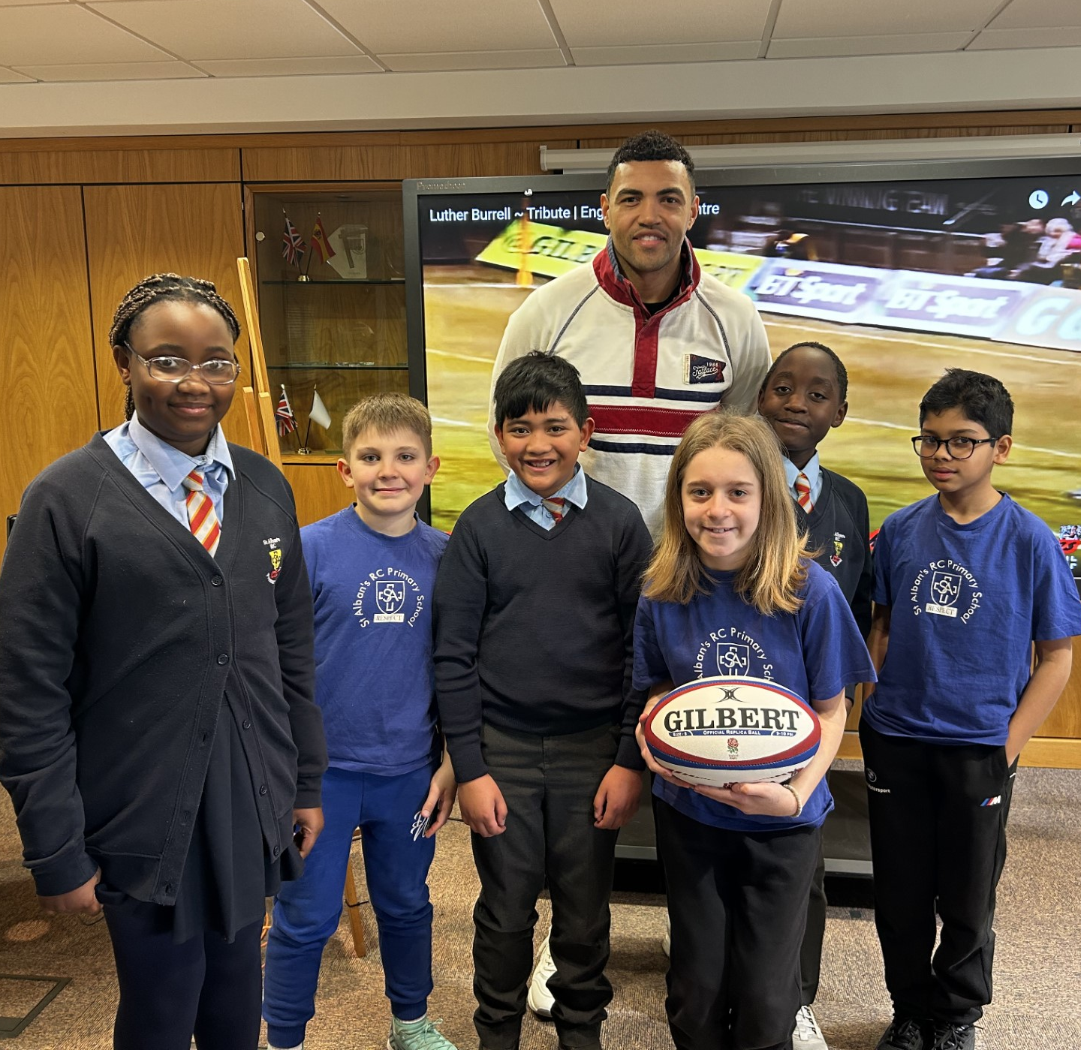
Burnell didn’t want to shine the light on individual people, but on the bigger picture - racism in sport.
Burnell was an inspiration! He encouraged us to be brave, find people we can talk to, speak out against racism and know that now is a time for change.
We are all unique, we are all special and we all have the responsibility to fight for equality.

Slide 15
Thank you for listening
Fikemi
Lily
Harry D
Harry H
Harsheel
Kieran

