Slide 1


Accelerated Reader: A Guide

Slide 2


The importance of Reading

Slide 3
Why should our children be encouraged to read books?
Research indicates one of the greatest influences upon a child’s growth as a reader and their success in school is the amount of text or words the child reads.
Therefore, the more words per day a child reads, the better reader the child becomes.
Accelerated Reader encourages students to read a large amount of text of their choice and at the desirable reading level.

Slide 4
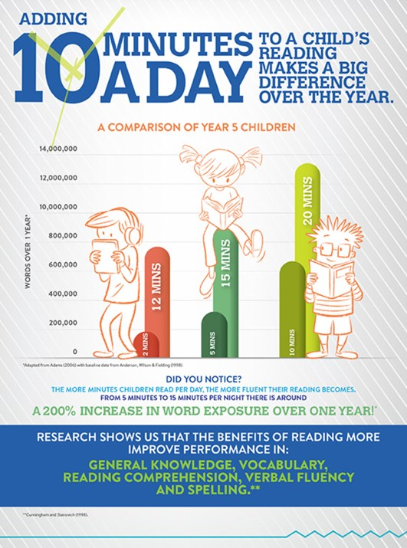
Reading

Slide 5

Accelerated Reader: A Guide
Accelerated reader is a reading programme designed to improve motivation by ensuring that books match the child’s reading ability and by building a competitive element into the reading approach.
The programme is designed to:
match books to the child’s reading level.
encourage every child to read more
improve our children’s reading ability.

Slide 6
How it works…
At the start of the year every child in KS2 will take a Star Test, which is a computer-based test that measures a student’s reading ability through a series of 34 questions.
Every test for every child is different, and the computer selects different questions for each student based on how well they answer the previous questions. Essentially, the computer adapts the test to suit each child. It measures reading growth over time.
Once the child has completed the test, they are then given a ZPD score by their teacher.
(The Zone of Proximal Development (ZPD) defines the readability range within which pupils should read to best develop their reading, while avoiding frustration.)
Notes:
https://ukhosted62.renlearn.co.uk/1892677/default.aspx If they can’t find it

Slide 7
How STAR tests work
The student must take their time. It is recommended that each child should spend up to 20 minutes on their tests. The STAR test is about concentration, focus and careful reading.
Tests are done in exam conditions without any help from other students or the teacher. (Probably half a class at a time.)
3) Questions have time limits.
4) The test is computer adaptive.
5) The results will allow us to track/monitor data– standardised scores, reading ages, scaled score, ZPD, compare classes and year groups.

Slide 8
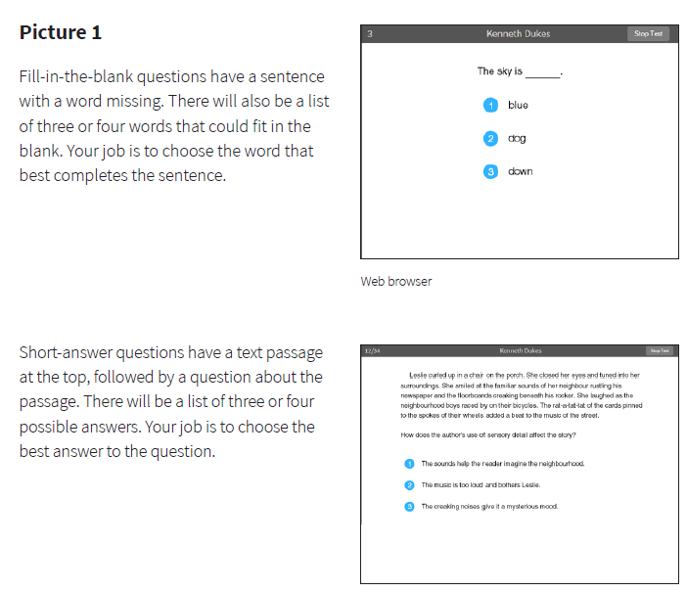
Example Questions:

Slide 9

A ZPD score is given to the child after completing the STAR test
3.2 – 4.6
ZPD is made up of two numbers that the child uses to choose their next reading book.
The lowest number is the lowest level of book the student should be choosing.
The highest number is the highest level of book the student should be choosing.
The children need to keep a record of all their ZPDs in their reading logs.
A new STAR test will take place every term, so the children can see improvements in their reading ability, but also choose more challenging books.
Lowest number
Highest number

Slide 10

All the Accelerated Reader books will be levelled on the spine. The label will also tell the child how many points he/she will earn.
0.0 to 1.9
6 and above
Students should only choose books within their number range to make it easier for them to choose the right book. We recommend children begin reading books from the start of their reading level.
2 to 2.9
3 to 3.9
4 to 4.9
5 to 5.9

Slide 11

An example book

Slide 12

AR Quizzes
A quiz is different to a STAR test because students only take a quiz after they have finished a book.
There are usually about 10 questions on the book that has been read. At the end of the quiz the students are given a percentage to show them how well they have done. Therefore there is instant feedback and monitoring.
There are some important rules for taking quizzes:
The book the child is quizzed on must be a book they have read in the last two weeks. AR is not a memory test but rather measuring reading ability.
A student cannot take a quiz until they have read the entire text.
Quizzes must be done individually, not with anyone’s help.
Students should not guess answers to questions. Instead, they should wait for the question to time out. This is to ensure the computer is not given a false impression of the student’s reading ability.
Generally pupils need to gain 80% or higher to gain the points from their books.

Slide 13

“How much should our children be reading each day?”
According to research, children who read at least 30 minutes a day with a 90% comprehension rate on AR quizzes see the greatest gains.
Therefore, we must set aside at least 30 minutes for reading every day.
Guided reading will be additional reading to this.

Slide 14
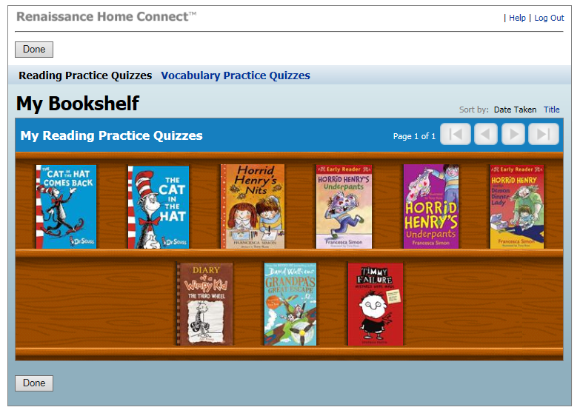
A child’s bookshelf

Slide 15
REWARDS
Weekly Book Raffle
Every child who finishes a book and completes the book quiz can enter the raffle.
Names are filled in on raffle tickets.
Raffle drawn on a Friday.
‘Be in it , to win it!’
Million Word Readers
Certificates will be awarded for children meeting key milestones such as 500,000 words.
Special book prizes will be awarded to our most active readers.
The most well read classes will have the chance of winning the ‘Golden Ticket’ and individual prizes.

