Slide 1



Slide 2
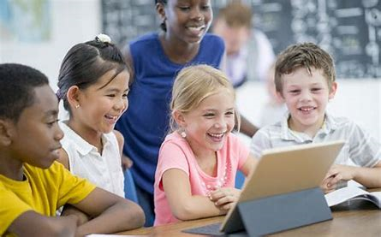
KEEPING SAFE ON THE INTERNET
Notes:
To introduce the Powerpoint you could talk about some stats regarding how much the internet has grown over the years.
In 1993 there was 130 websites- there were over 1 billion in 2014
1998 – 9.8 thousand Google searches per day NOW 3.5 BILLION per day 40,0000 every second
1st email was sent in 1971
In 2002 – 31 billion emails were sent
Now 300 billion emails are sent per day

Slide 3
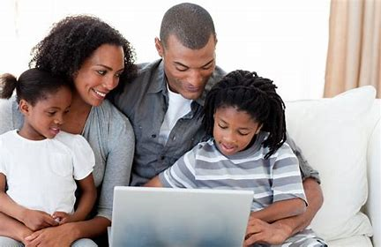
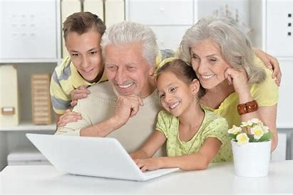
Who uses the Internet?
Kids
Grandparents
Adults
Hackers
People in other countries
Trolls
Strangers
4.57 Billion people!!!

Slide 4
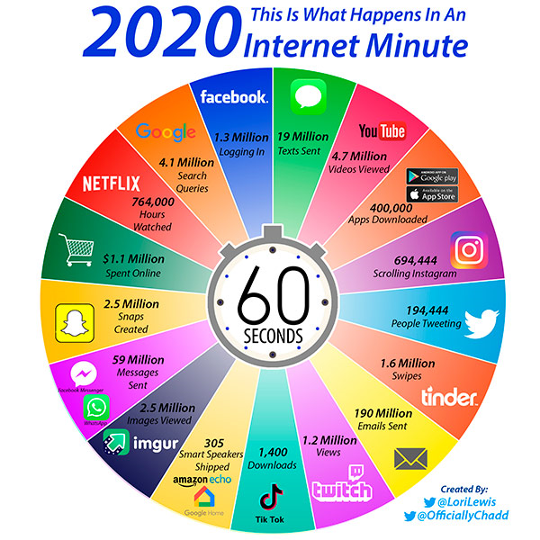

Internet in 60 seconds!

Slide 5



Slide 6
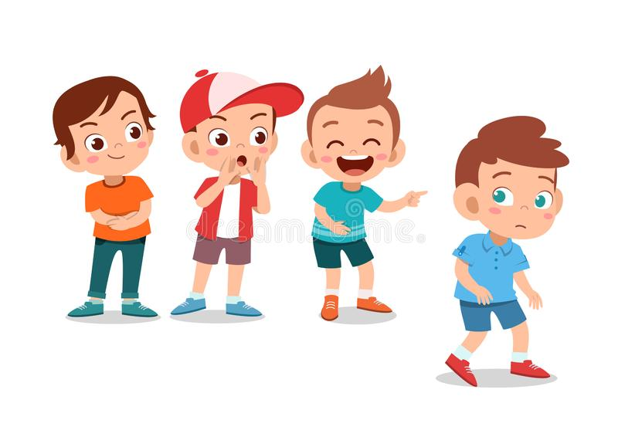
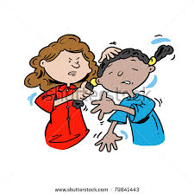
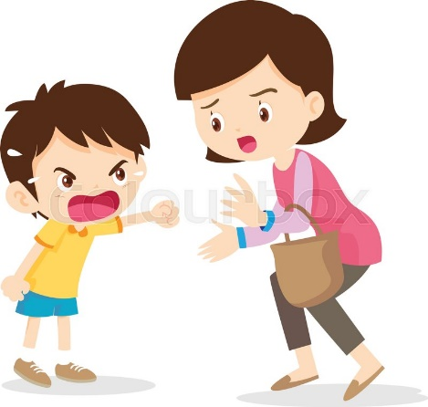
Lets have a chat about Bullying
What does Bullying
LOOK LIKE
&
SOUND LIKE
Notes:
Please encourage the children to speak about this topic, spend as much time on this as possible.

Slide 7
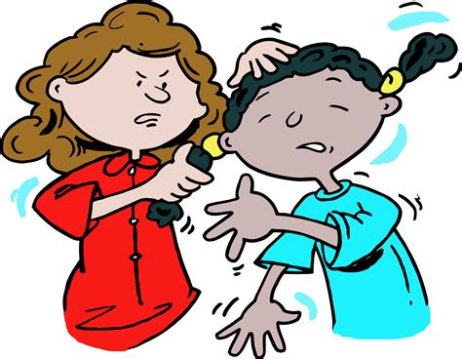
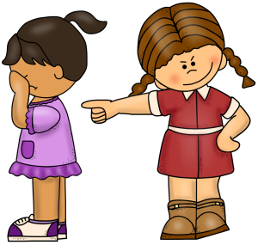
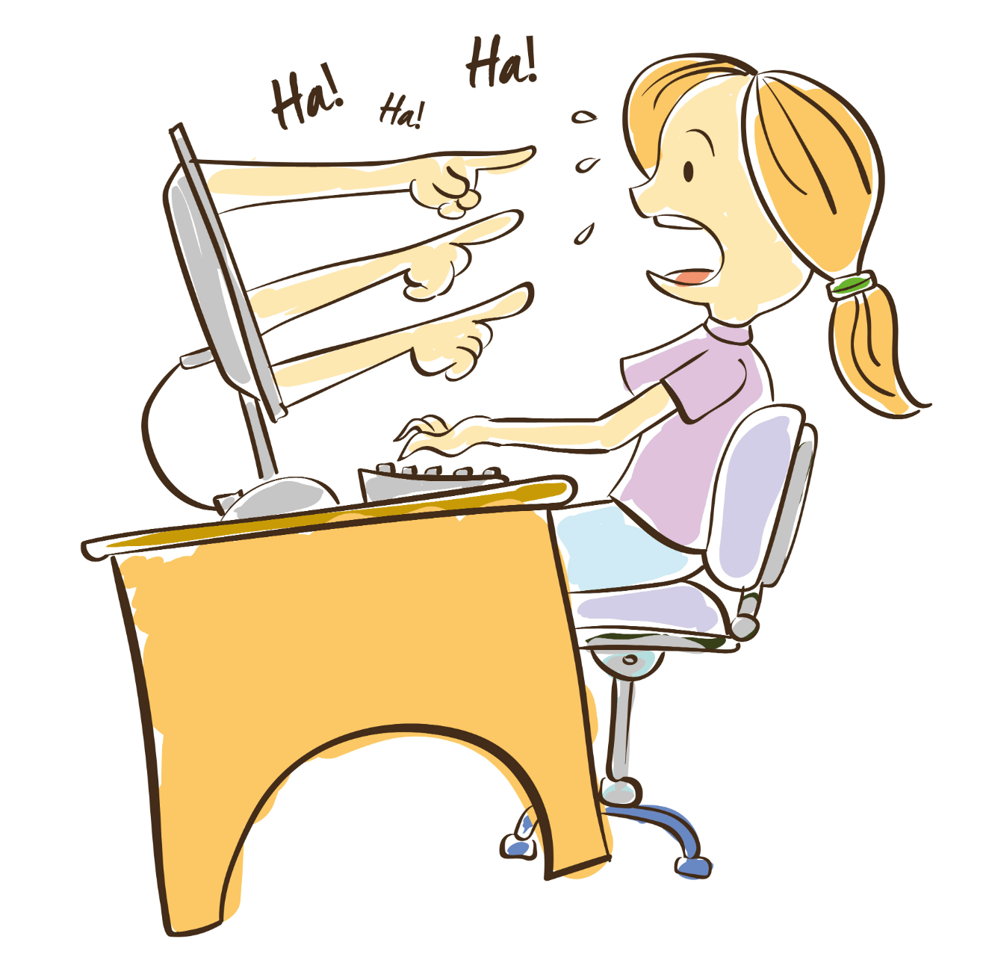
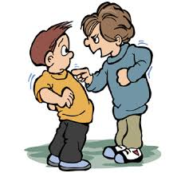
Different types of Bullying?
VERBAL BULLYING
This could be calling someone a nasty name, telling other people not to speak to someone, picking on someone because of who they are.
PHYSICAL BULLYING
This could be pushing, punching, kicking, biting or anything that would physically hurt someone else.
EMOTIONAL BULLYING
This could be some saying if you don’t do something, I won’t be your friend. Or Ignoring someone.
CYBER BULLYING
Any bullying that happens online.
This could be sending mean messages, sharing photos of someone else, posting unkind comments.

Slide 8


How Does Bullying make us feel
SAD
ANGRY
EMBARRASSED
SCARED
HURT
FRIGHTENED
UNWELL
ISOLATED
ALONE
UPSET
Notes:
If possible get the children to write down there feels or as the PCSO could you write them on a board

Slide 9

Scenario
James and Sarah are in the same class. They used to be best friends but fell out during a game of “Fortnite”.
Sarah has now told everyone in class that they cannot speak to James anymore.
Ten of their classmates now ignore James and this morning, their friend Lizzie moved seats when James sat next to her.
Is this bullying?
Who could make a difference?
How could the situation change to make things better?
#IfYouJoinIn
YouAreABullyToo

Slide 10
Who could you speak to if you knew someone was being bullied?
Family
People who care about us.
Teachers
Midday Assistants
Friends
PCSO’s
Or other Police Officers
Grandparents
Childline
https://www.childline.org.uk
Get help and advice about a wide range of issues, call us on 0800 1111, talk to a counsellor online, send Childline an email or post on the message boards

Slide 11
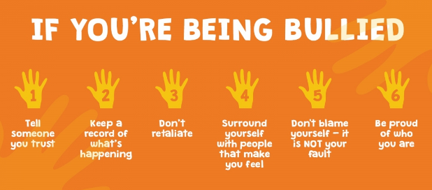




Slide 12
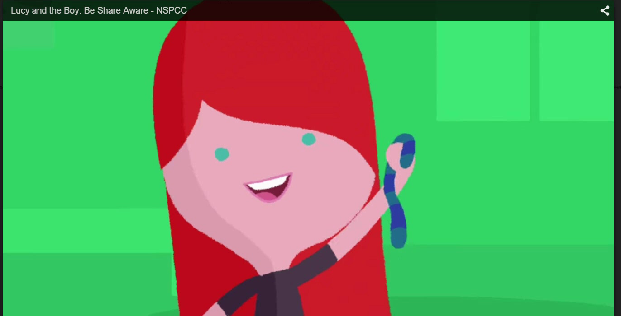
Let’s have a look at Lucy’s story……
Notes:
To play press arrow.

Slide 13

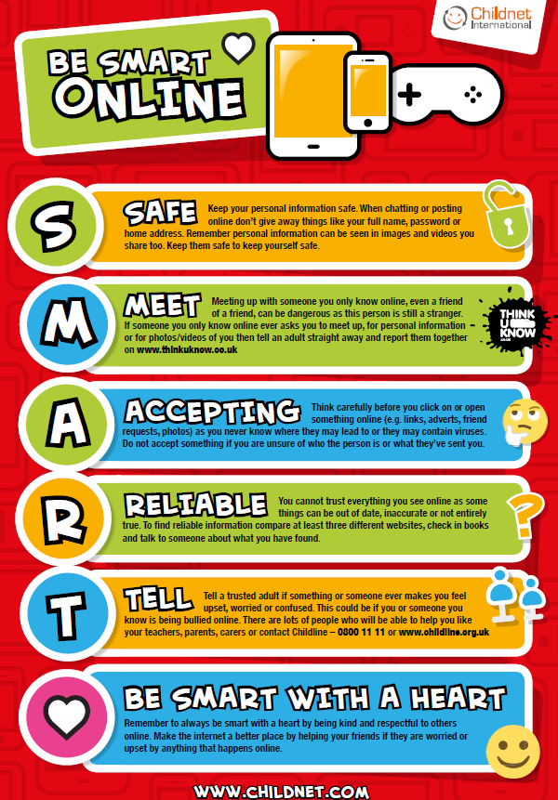
Keep your personal information safe
Never meet up with someone you have met online. You have no idea who they really are.
Only accept friend requests from people that you know in real life.
Information on the internet isn’t always true – check it before you use it.
Tell an adult if something or someone ever makes you feel upset.
Be respectful to others online.
Notes:
Go through the SMART rules, encourage schools to put the posters in their schools as a reminder.

Slide 14


