Slide 1
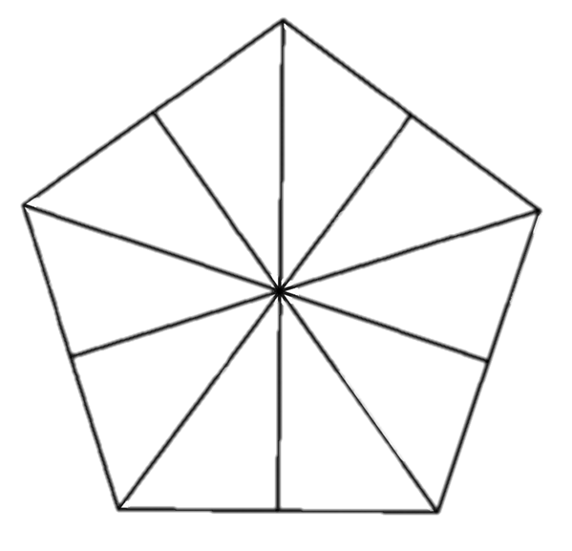
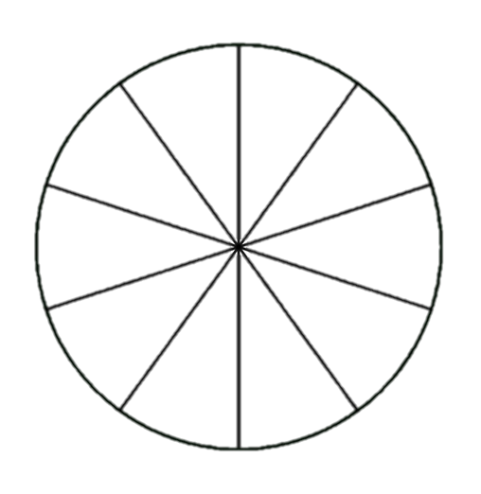
Describe and write decimal numbers with tenths in different ways
Task A: Tenths can label parts of a whole divided into ten equal parts
Label each tenth in the wholes and shade in.
Label in decimal numbers and shade 6 tenths.
Label in fractions and shade 12 tenths.
Task B: Tenths can label parts of a whole divided into ten equal parts
Fill in the boxes as tenths using decimal numbers or fractions.
0
0.2
0.3
0.4
0.5
0.6
0.7
0.8
1
1.2
1.3
1.6
1.8
1.9
1.5
1.7
2. Choose two of your own consecutive numbers. Place them on the number line and write each interval as a fraction and decimal number.

Slide 2


Describe and write decimal numbers with tenths in different ways
Task C: Tenths can be recorded as fractions or decimals
Write the number represented as a decimal number and a mixed number.
1,000s
100s
10s
1s
tenths
.
.
.
2. Write the amounts as a decimal number and a mixed number.
After a party, there are three whole pizzas and four tenths of a pizza left over.
Andeep drinks two litres and eight tenths of a litre of water in one day.
.
.
3. Complete the table.
 | 0.7
2.0
408
1,037.9
Mathematics in Education and Industry
v2.1

