Slide 1
Describe and write decimal numbers with tenths in different ways
Understand tenths as part of a whole, represent and calculate mentally

Slide 2
how to use Oak lessons

Slide 3
I can describe and write decimal numbers with tenths in different ways.

Slide 4
tenth
decimal number
fraction
mixed number

Slide 5
A tenth is the name you give to one part of ten equal parts.
A decimal number has a decimal point followed by digits that show the fractional part.
A fraction shows us how many equal parts in a whole.
A number which combines both a whole number and a fraction is known as a mixed number.

Slide 6

Describe and write decimal numbers with tenths in different ways
Tenths can label parts of a whole with 10 equal parts
Tenths can have their own positions on a number line
How to record tenths

Slide 7
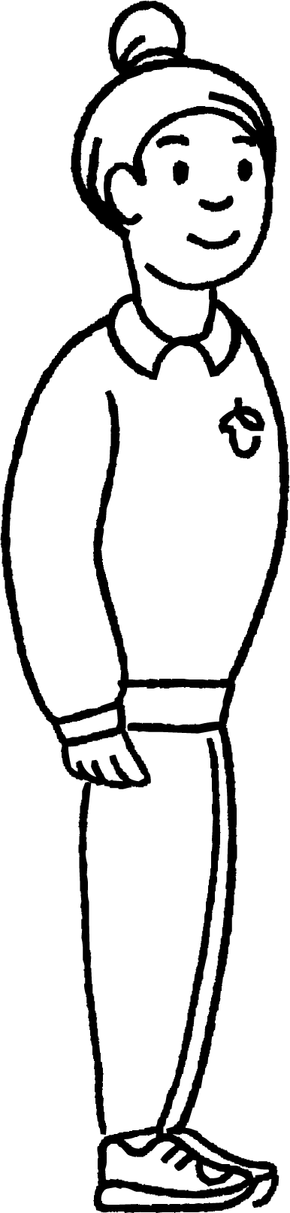
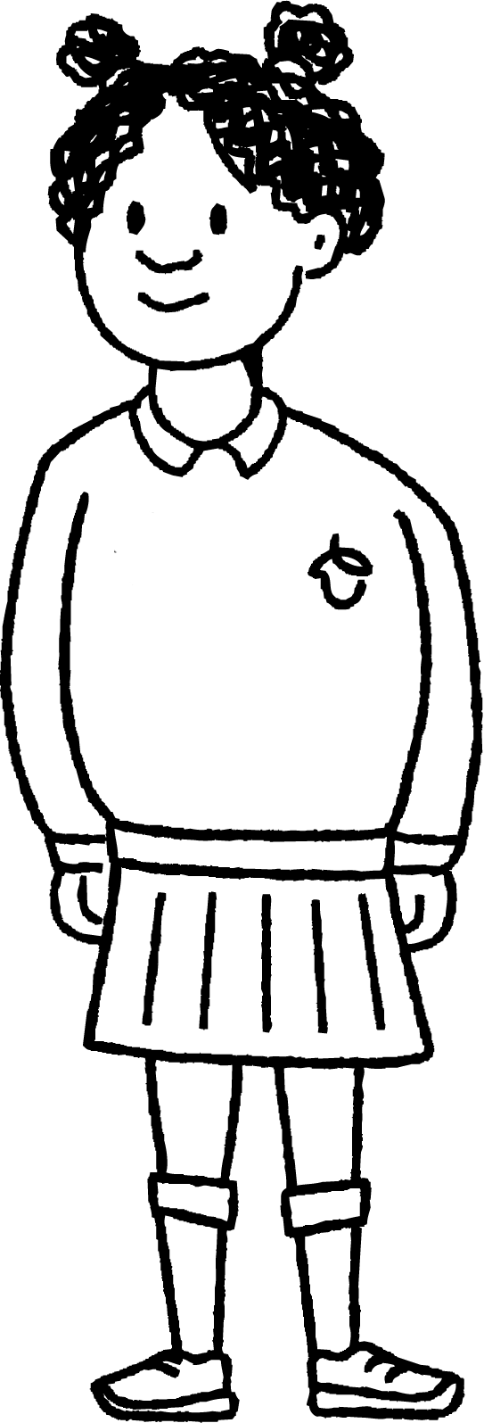
Tenths can label parts of a whole divided into ten equal parts
In this lesson you will meet:
Andeep
Izzy

Slide 8
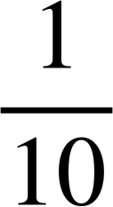
Tenths can label parts of a whole divided into ten equal parts
Each part in a whole, which has been divided into ten equal parts, can be called one tenth.
one whole
0.1
0.1
0.1
0.1
0.1
0.1
0.1
0.1
0.1
0.1
You can label each part as decimal numbers.
Or you can label each part as fractions.

Slide 9
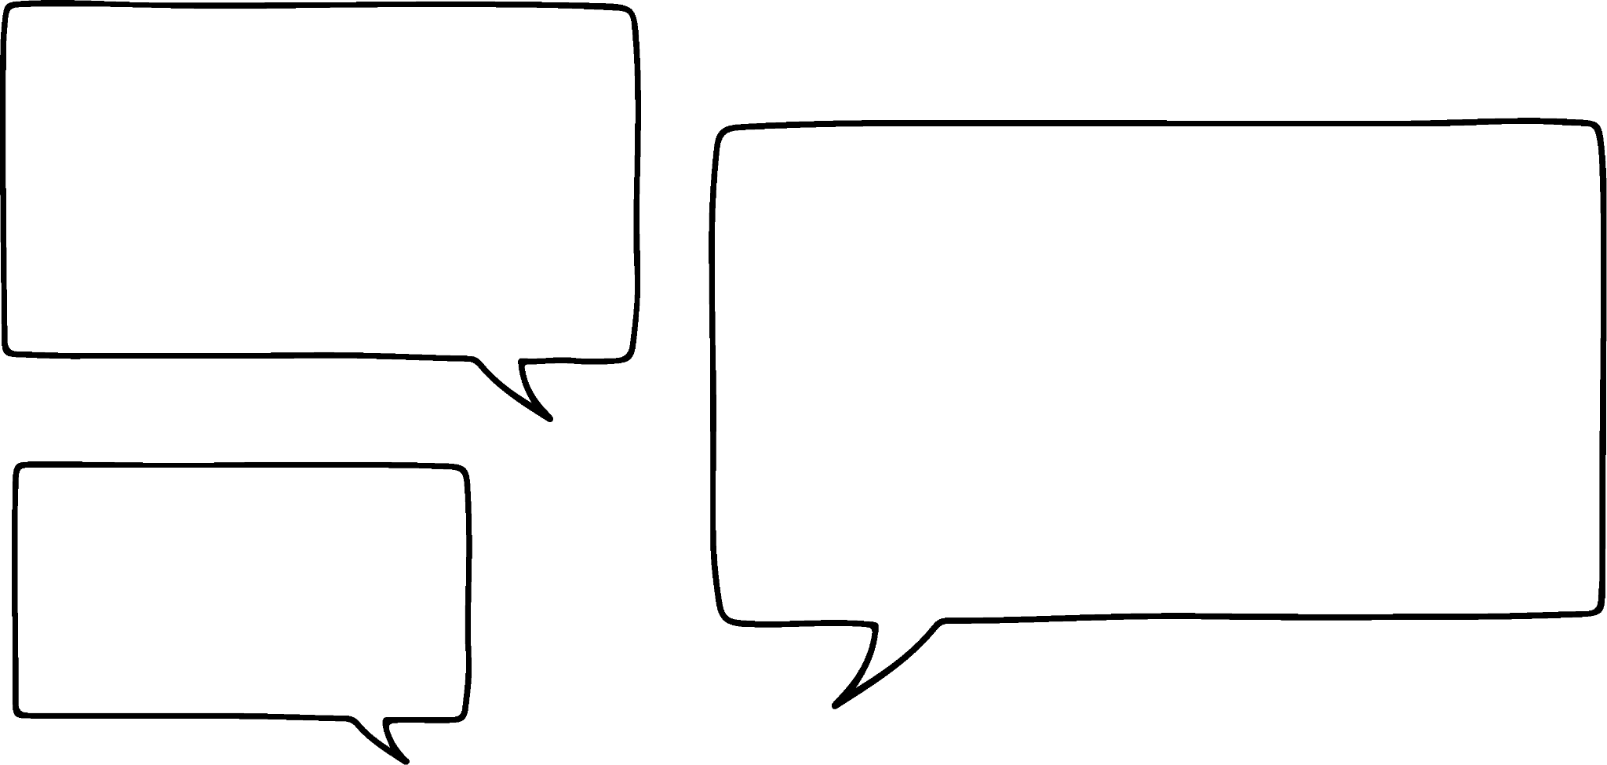
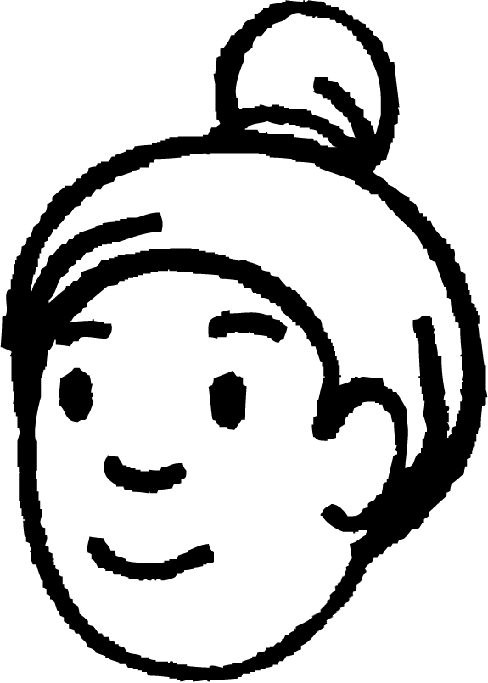
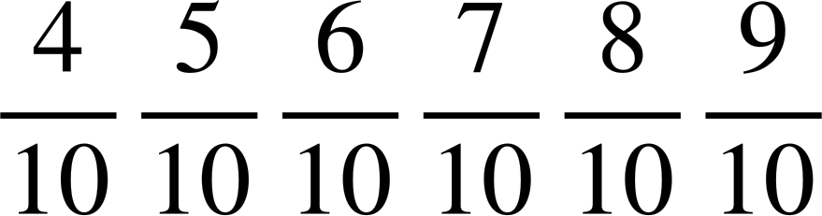
Tenths can label parts of a whole divided into ten equal parts
Each one tenth can be counted together.
You can count these tenths in multiple ways.
point
or
one
two
zero
three
four
three
one
two
four
tenth
tenths
0.3
0.1
0.4
0.2

Slide 10


















Tenths can label parts of a whole divided into ten equal parts
Each one tenth can be counted together.
You can count these tenths in multiple ways.
point .
or
tenths
Each part still has a value of one tenth.
0.4
0.5
0.6
0.7
0.8
0.9
1.0
1.1
1.2
1.3
1.4
1.5
1.6
1.7
1.8
1.9
2.0

Slide 11
Tenths can label parts of a whole divided into ten equal parts
Continue counting from 7 tenths.
point .
or
tenths
Each part still has a value of one tenth.
0.7
0.8
0.9
1.0
1.1
1.2
1.3
1.4
1.5
1.6
1.7
1.8
1.9
2.0
You can count these tenths in multiple ways.

Slide 12


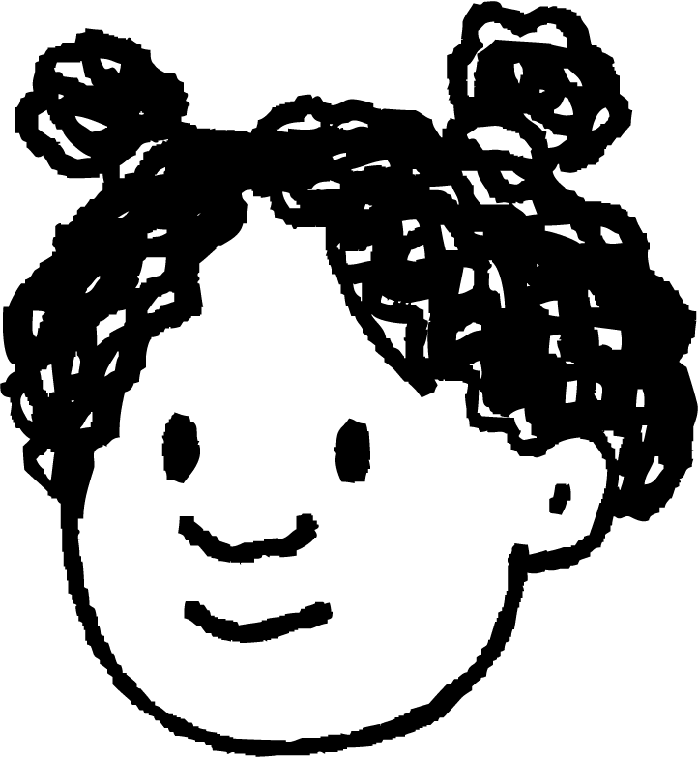
Tenths can label parts of a whole divided into ten equal parts
Which does not represent fourteen tenths?
Why does this not represent 14 tenths?

Slide 13
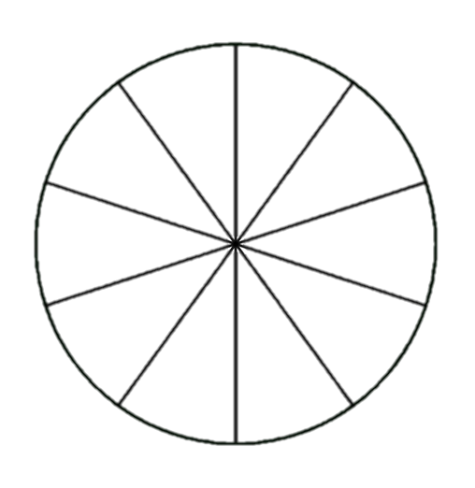
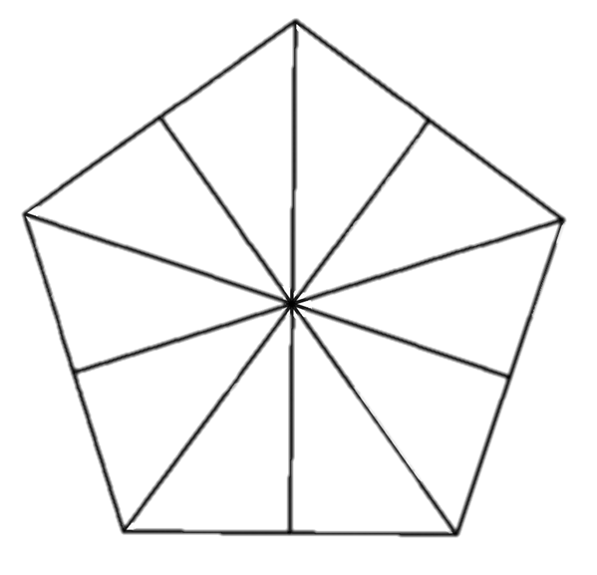
Tenths can label parts of a whole divided into ten equal parts
Label each tenth in the wholes and shade them in.
Label in decimal numbers and shade 6 tenths.
Label in fractions and shade 12 tenths.

Slide 14
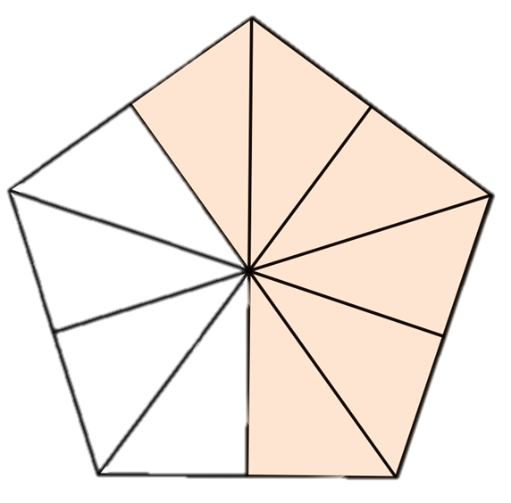
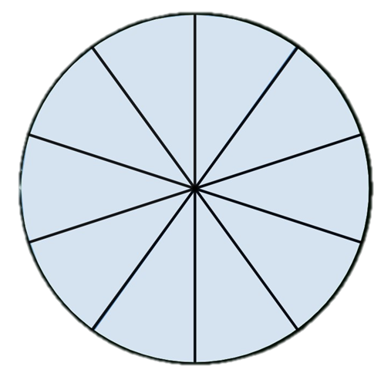
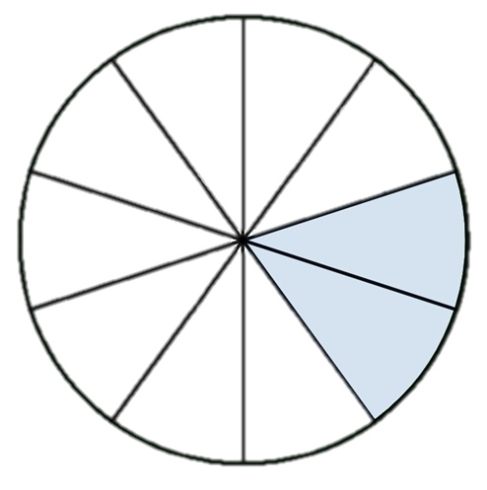
Tenths can label parts of a whole divided into ten equal parts
Label in decimal fractions and shade 6 tenths.
Label in fractions and shade 12 tenths.
0.1
0.1
0.1
0.1
0.1
0.1
0.1
0.1
0.1
0.1

Slide 15
Describe and write decimal numbers with tenths in different ways
Tenths can label parts of a whole divided into ten equal parts
Tenths can have their own positions on a numberline
How to record tenths

Slide 16
Tenths can have their own positions on a number line
You can place tenths on a number line.
0
0.1
0.2
0.3
0.4
0.5
0.6
0.7
0.8
0.9
1
1.1
1.2
1.3
1.4
1.5
1.6
1.7
1.8
1.9
2

Slide 17
Tenths can have their own positions on a number line
Look at the number lines.
0
0.1
0.2
0.3
0.4
0.5
0.6
0.7
0.8
0.9
1
The number of tenths stay the same but the ones digit has changed.
What is the same? What is different?
1
1.1
1.2
1.3
1.4
1.5
1.6
1.7
1.8
1.9
2

Slide 18
Tenths can have their own positions on a number line
What is the same? What is different?
This time the second number line starts at two wholes instead of one.
0
0.1
0.2
0.3
0.4
0.5
0.6
0.7
0.8
0.9
1
What do you notice this time?
2
2.1
2.2
2.3
2.4
2.5
2.6
2.7
2.8
2.9
3

Slide 19













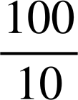
Tenths can have their own positions on a number line
What is the same? What is different?
Can the distance between two consecutive numbers always be divided into tenths?
Yes, any two consecutive numbers can always be divided into ten equal parts.
0
0.1
0.2
0.3
0.4
0.5
0.6
0.7
0.8
0.9
1
What do you notice this time?
9
9.1
9.2
9.3
9.4
9.5
9.6
9.7
9.8
9.9
10

Slide 20
Tenths can have their own positions on a number line
Can you help me correct my number line?
We need to group ten tenths to make a whole.
0.9 1.0 1.1
0.2
0.3
0.4
0.5
0.6
0.7
0.8
0.9
0.10
1.0
0.11
0.12
1.2
0.13
1.3
1.4
0.14
0.15
0.17
1.9
0
0.1
1.1
1.5
0.16
0.19
1.6
1.7
1.8
0.18
0.20
2.0

Slide 21
Tenths can have their own positions on a number line
Fill in the missing numbers.
How did you work out the missing numbers?
How could I write them as fractions?
7
7
7
7.1
7.2
7.3
7.4
7.5
7.6
7.7
7.8
7.9
8

Slide 22
Tenths can have their own positions on a number line
1) Fill in the boxes as tenths using decimal numbers or fractions.
0
0.2
0.3
0.4
0.5
0.6
0.7
0.8
1
1.2
1.3
1.5
1.6
1.7
1.8
1.9

Slide 23
Tenths can have their own positions on a number line
2) Choose two of your own consecutive numbers. Place them on the number line and write each interval as a fraction and decimal number.

Slide 24
Tenths can have their own positions on a number line
1) Fill in the boxes as tenths using decimal numbers or fractions.
0
0.1
0.2
0.3
0.4
0.5
0.6
0.7
0.8
0.9
1
1.1
1.2
1.3
1.4
1.5
1.6
1.7
1.8
1.9
2.0

Slide 25
Tenths can have their own positions on a number line
2) Choose two of your own consecutive numbers. Place them on the number line and write each interval as a fraction and decimal number.
You might have tried…
8
8.1
8.2
8.3
8.4
8.5
8.6
8.7
8.8
8.9
9

Slide 26
Describe and write decimal numbers with tenths in different ways
Tenths can label parts of a whole divided into ten equal parts
Tenths can have their own positions on a number line
How to record tenths

Slide 27
How to record tenths
How would I write the next interval?
Can the distance between two consecutive numbers always be divided into tenths?
We have three hundred and forty and one additional tenth.
340
341
340.1
340

Slide 28
How to record tenths
342
342.1
343
1,000s
100s
10s
1s
tenths
3
4
2
1
This is three hundred and forty two and one tenth.
You can also say three hundred and forty two point one.

Slide 29
How to record tenths
100
100
1
0.1
1
0.1
100
100
0.1
0.1
1
0.1
1,000s
100s
10s
1s
tenths
4
0
3
5
This is four hundred and three and five tenths.
You can also say four hundred and three point five.

Slide 30
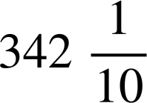

How to record tenths
If my number has some tenths, I could also write this as a mixed number.
I say three hundred and forty two point one,
but I think three hundred and forty two wholes and one tenth.

Slide 31
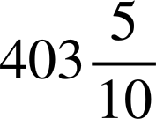

How to record tenths
Watch out for the zero when recording the whole number.
I say four hundred and three point five,
but I think four hundred and three wholes and five tenths.

Slide 32
How to record tenths
My turn
Your turn
I say six thousand, two hundred and four point three,
but I think .
wholes
and tenths.
but I think six thousand, two
hundred and four wholes
and three tenths.
6,204
6,204.3

Slide 33
How to record tenths
1) Write the number represented as a decimal number and a mixed number.
1,000s
100s
10s
1s
tenths
.
.
.

Slide 34


How to record tenths
2) Write the amounts as a decimal number and a mixed number.
After a party, there are three whole pizzas and four tenths of a pizza left over.
Andeep drinks two litres and eight tenths of a litre of water in one day.

Slide 35
How to record tenths
3) Complete the table.
 | 0.7
2.0
408
1,037.9

Slide 36
How to record tenths
1) Write the number represented as a decimal number and a mixed number.
1,000s
100s
10s
1s
tenths
312.4
312
304.4
304
300.2
300

Slide 37
How to record tenths
2) Write the amounts as a decimal number and a mixed number.
After a party, there are three whole pizzas and four tenths of a pizza left over.
3.4
3
Andeep drinks two litres and eight tenths of a litre of water in one day.
2.8 l
2 l

Slide 38
How to record tenths
3) Complete the table.
0.3
0.7
2.0
408
408.8
1,037
1,037.9

Slide 39
Describe and write decimal numbers with tenths in different ways
Each part of a whole, that have been divided into ten equal parts, can be labelled as one tenth.
Tenths can be placed in their own position on a number line.
Tenths can be recorded as decimal numbers, fractions or mixed numbers.

Slide 40

© Oak National Academy 2023.
Produced in partnership with Mathematics in Education and Industry.
Licensed on the Open Government Licence v3.0, except where otherwise stated. See Oak terms and conditions.

