Slide 1
Dividing whole numbers by powers of ten.
Wednesday 8th January.

Slide 2
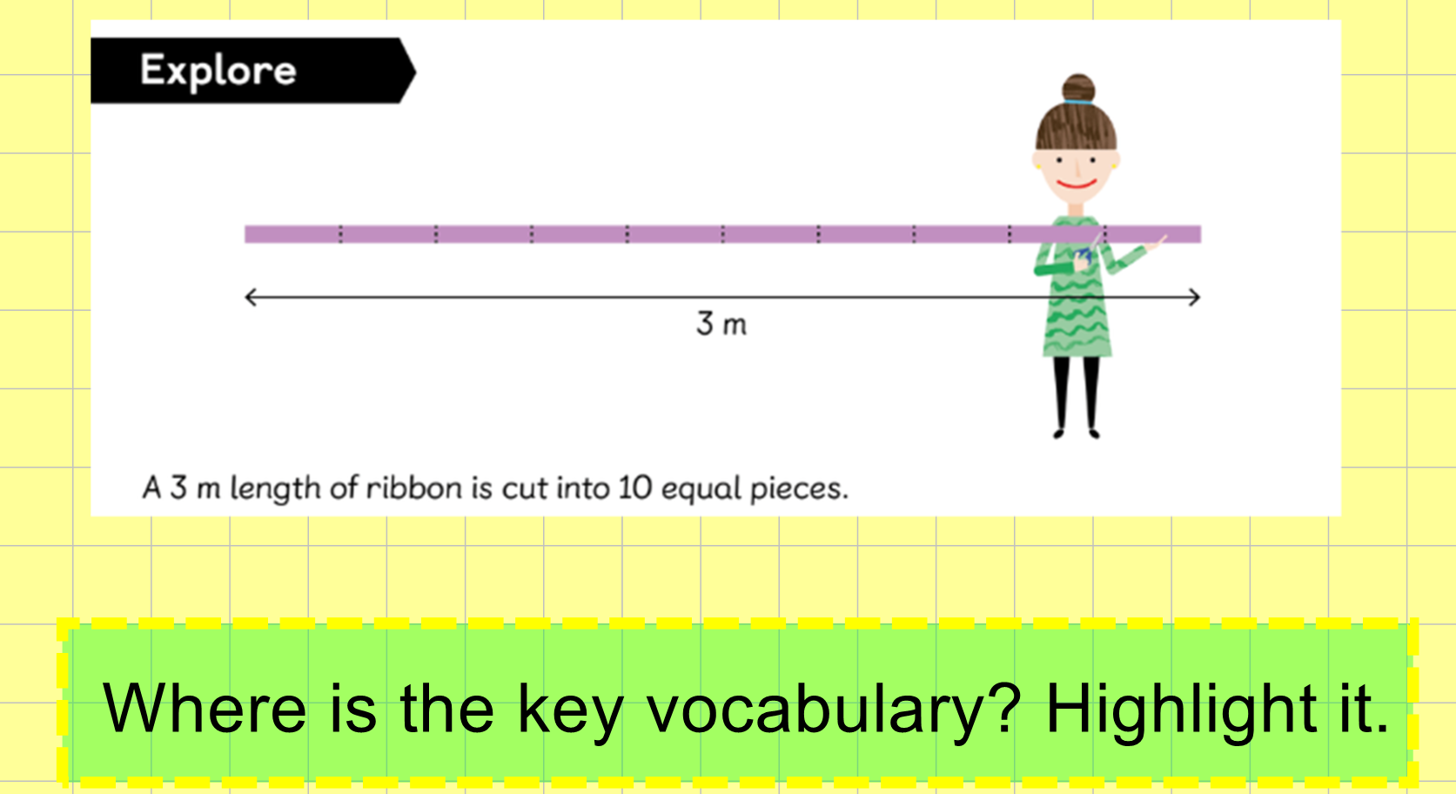

Slide 3
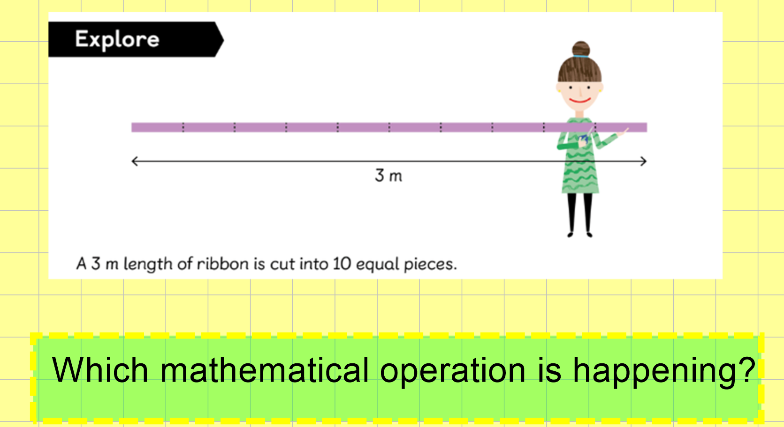

Slide 4
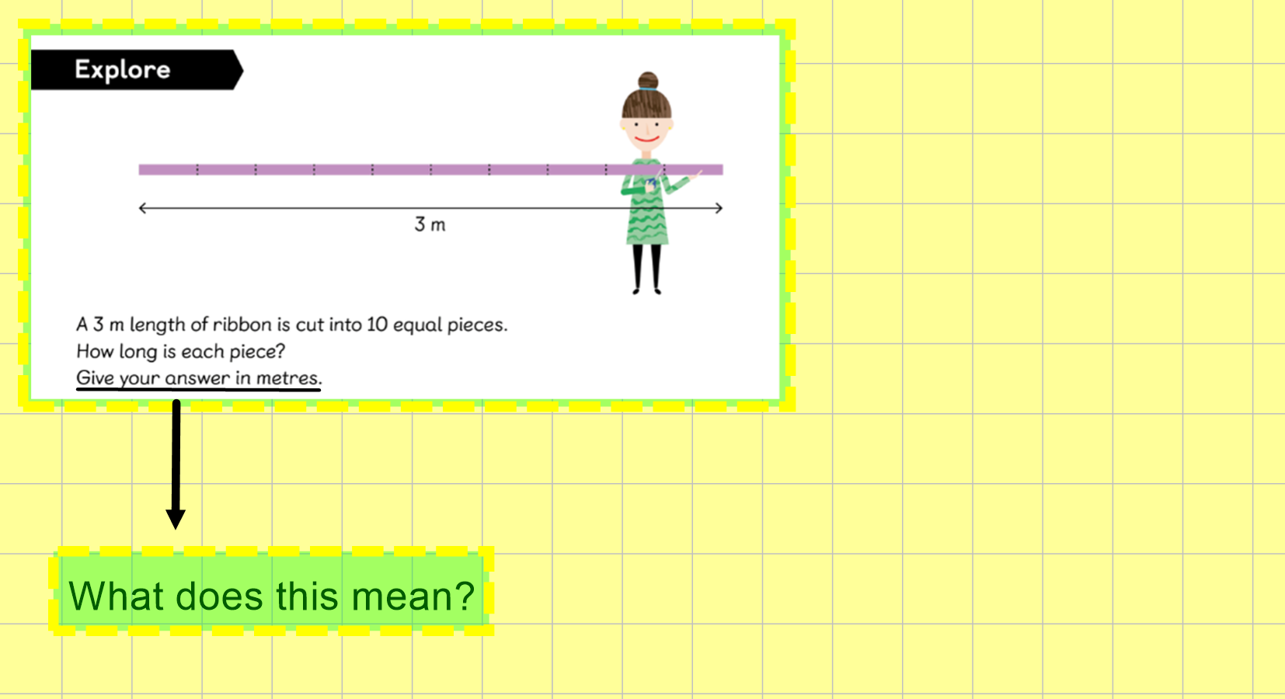

Slide 5
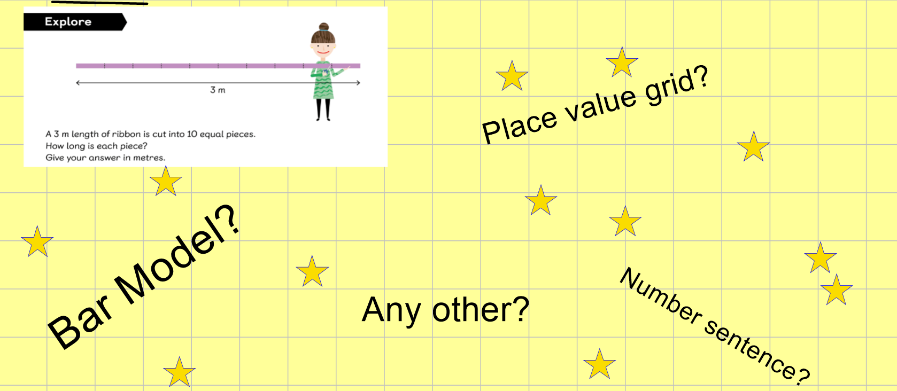
Have a go at showing your working in a variety of ways.
What answer did you get each time? How would you know if you are correct?

Slide 6
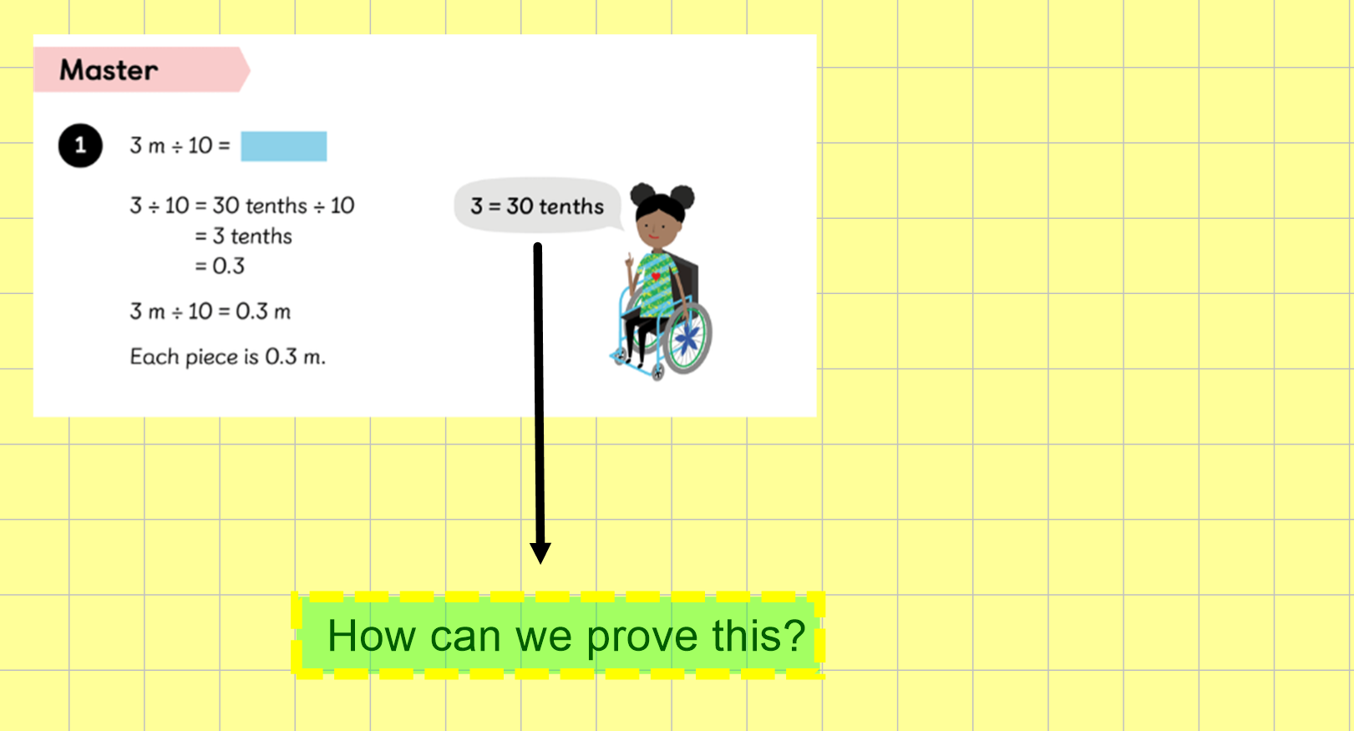

Slide 7
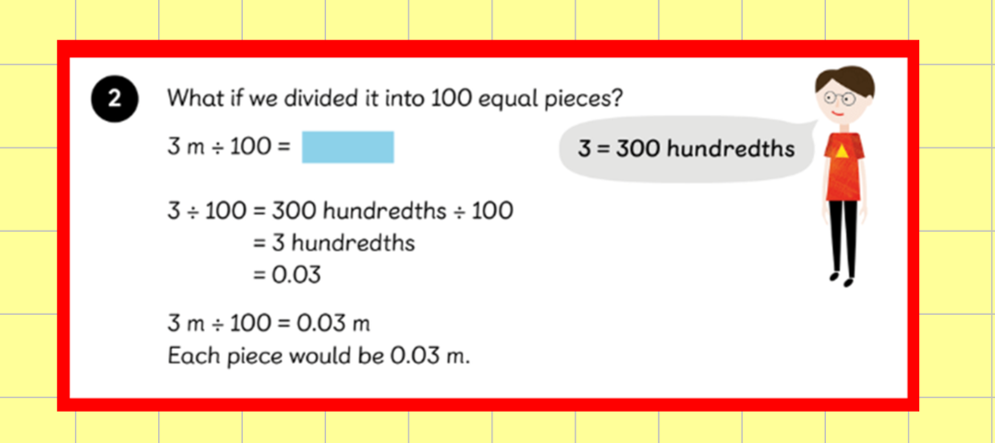

Slide 8
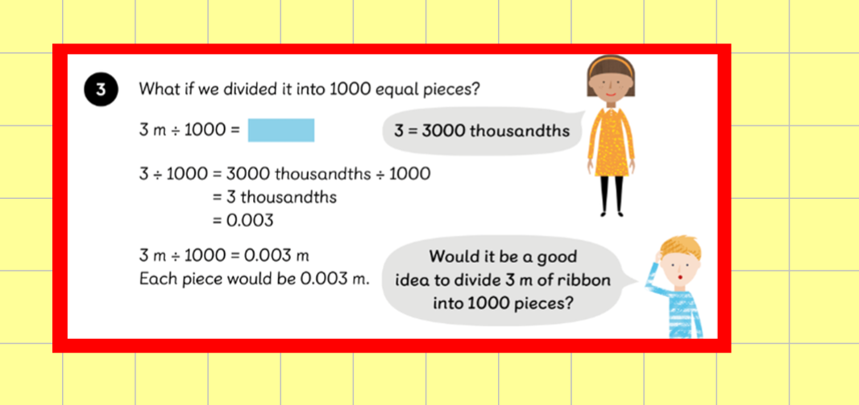

Slide 9
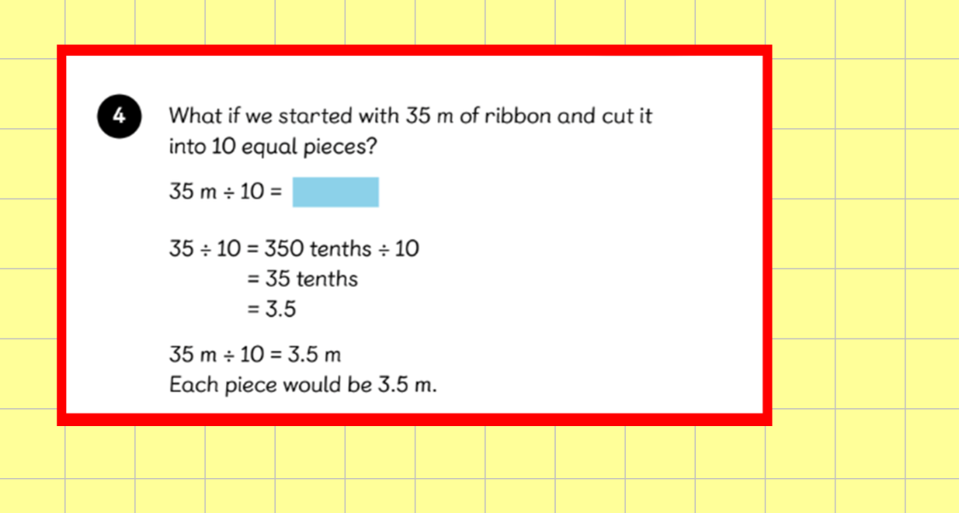

Slide 10
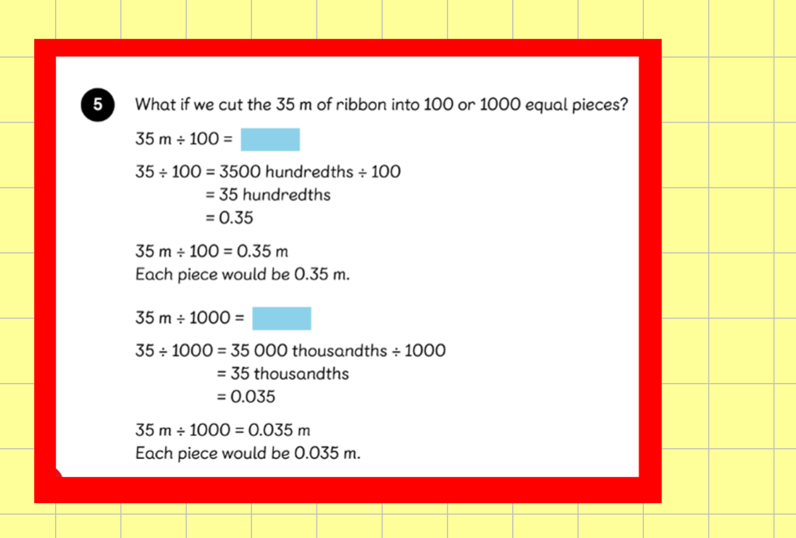

Slide 11


