Slide 1
PART 1

Slide 4
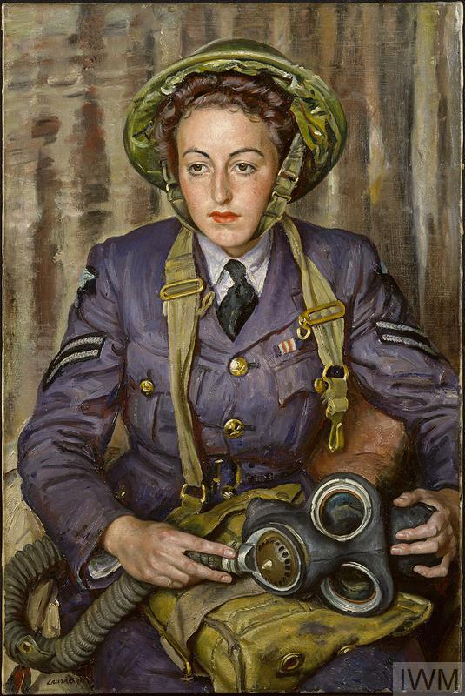
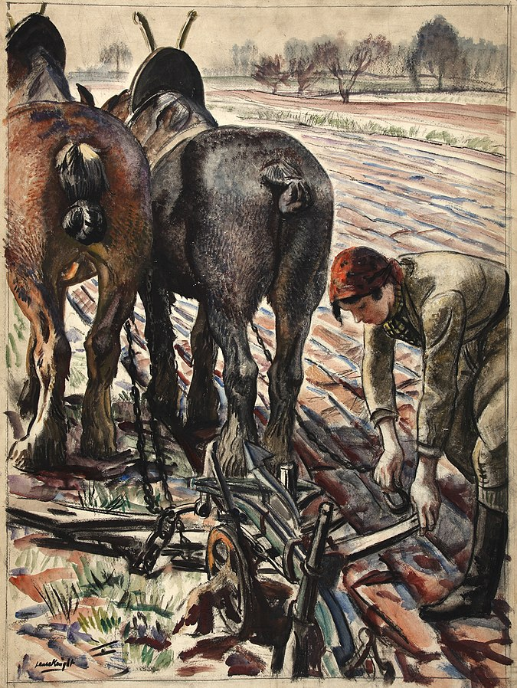
Women’s Wartime Roles
When the Second World War started, women in Britain answered the call in their tens of thousands, just as they had in the First World War.

Slide 5
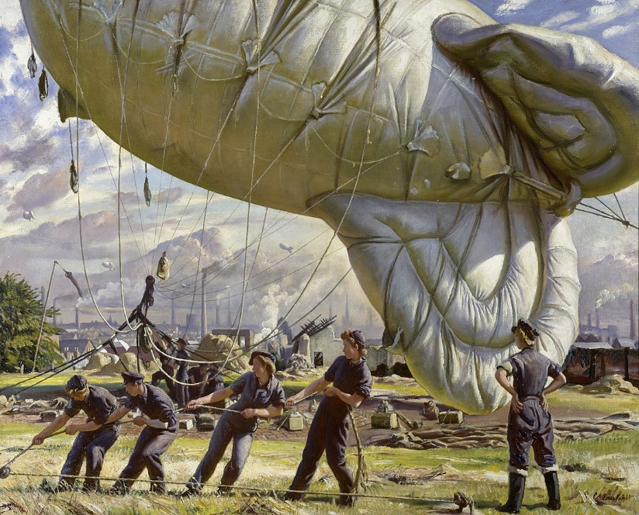
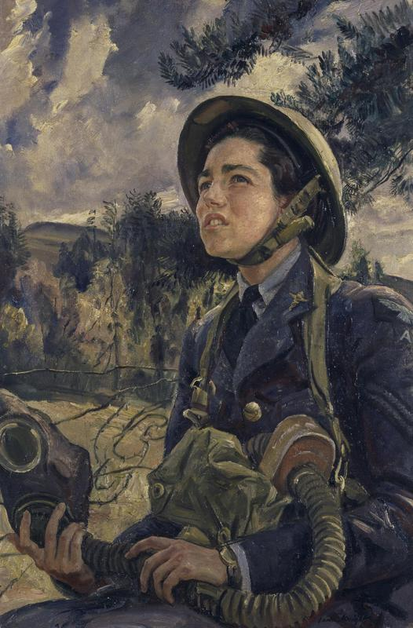
Women’s Wartime Roles
They took on a variety of duties and tasks in the women’s armed services, the factories, on the land and in voluntary roles.
Some jobs were tiring and some dangerous but there were many new opportunities open to women.

Slide 6
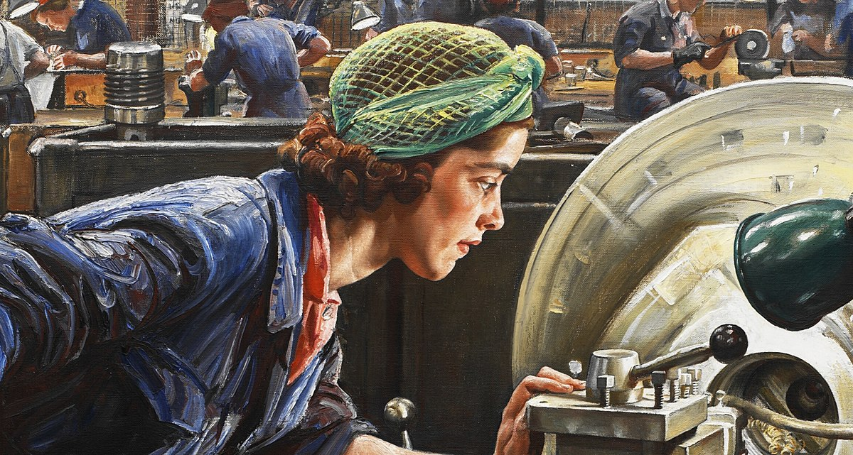
Women’s Wartime Roles
They took on a variety of duties and tasks in the women’s armed services, the factories, on the land and in voluntary roles.
The government used careful messaging to mobilise as many women as possible into the wartime workforce or to persuade them to do voluntary work.
mobilise – To organise a group of people to achieve something.
X
Did you Know…?
Britain is said to have been the most successful country in the way it mobilised its nation’s women to help the war effort.

Slide 7



Your Country Needs You!
Click the arrows to view the different poster campaigns.
Click ‘Next’ when you want to move on.
Throughout the war, different poster campaigns were used to help recruit women. The government needed to get as many women as possible into the wartime workforce or persuade them to do voluntary work.
Next

Slide 8

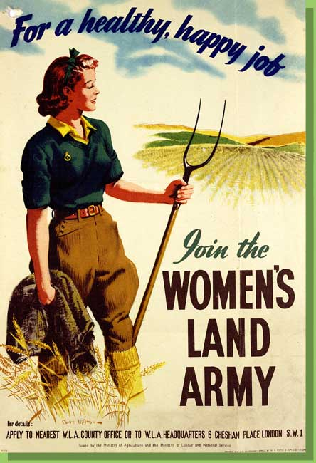
Your Country Needs You!
Next

Slide 9
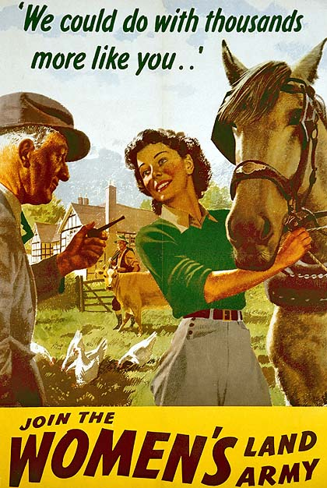
Your Country Needs You!
Next

Slide 10
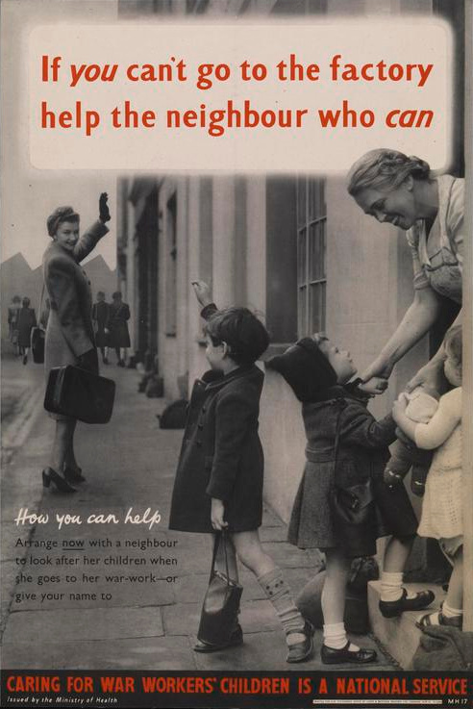
Your Country Needs You!
Next

Slide 11
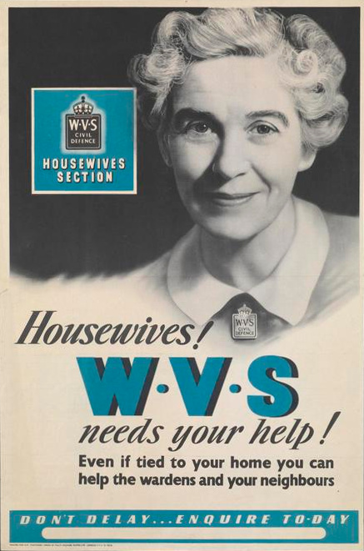
Your Country Needs You!
Next

Slide 12
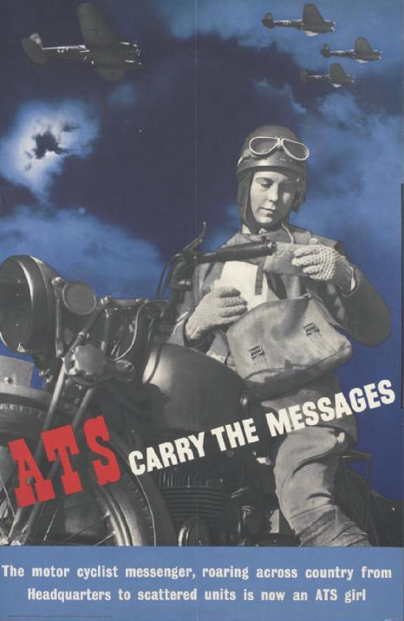
Your Country Needs You!
Next

