Slide 2
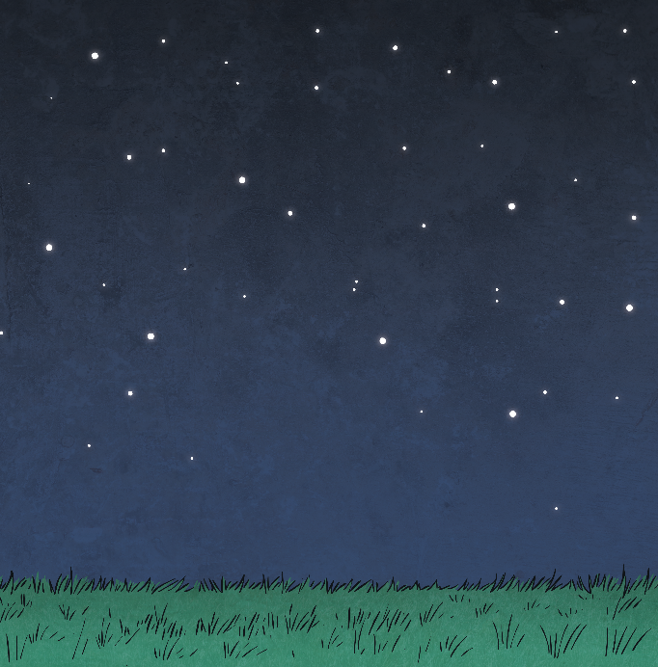
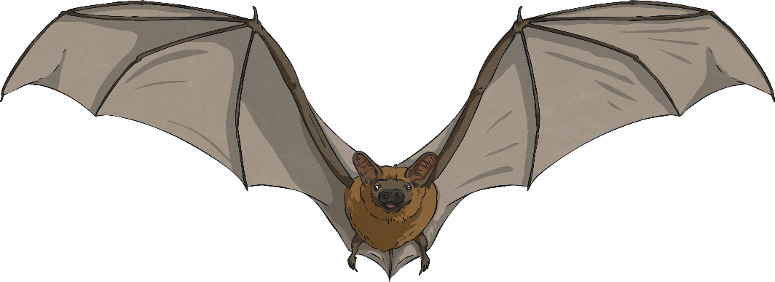
What Is a Main Clause?
A main clause is a group of words that make sense on its own as a sentence. It includes a subject and a verb.
The subject is the bat.
The verb is flew.
The bat flew.

Slide 3
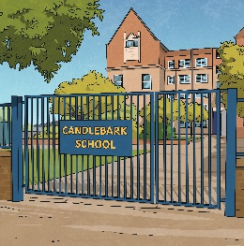
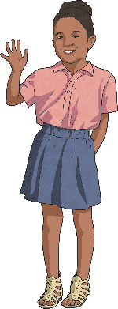
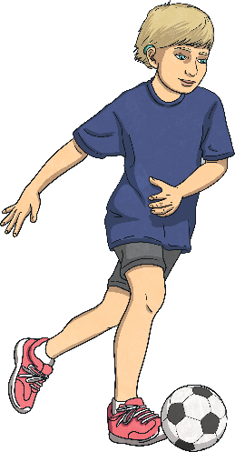
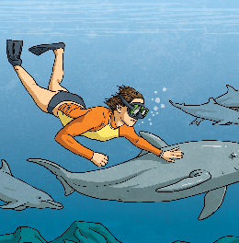
Main Clause Examples
Here are some examples of main clauses:
Amy goes to school.
All these sentences make sense on their own and are a complete thought.
Laura likes to play football.
Main clauses are also known as independent clauses.
Ollie swims in the sea.

Slide 4



Subordinate Clauses
A subordinate clause is a group of words that contain a subject and a verb. A subordinate clause does not make sense on its own and usually depends on the main clause to make sense.
The subordinate clause can appear at the beginning, middle or end of a sentence and usually begins with
a subordinating
conjunction.
Although it was raining, the bats flew across the evening sky.
The bats, although it was raining, flew across the evening sky.
The bats flew across the evening sky although it was raining.

Slide 5

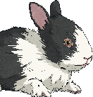
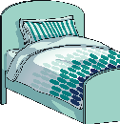

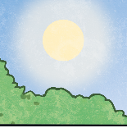
Subordinate Clause Examples
Sophie likes to visit her friend Amy because she has a rabbit in the garden.
All the subordinate clauses in bold are dependent on the main clause to make sense. They do not make sense on their own. Each of these subordinate clauses begin with a subordinating conjunction.
My mum came into my bedroom as
I was jumping up and down on the bed.
When Logan goes to the tennis courts, he always takes a big bottle of juice.
Subordinate clauses are also known as dependent clauses.
If it is a sunny day, I like to go to
the park with my sister.

Slide 6
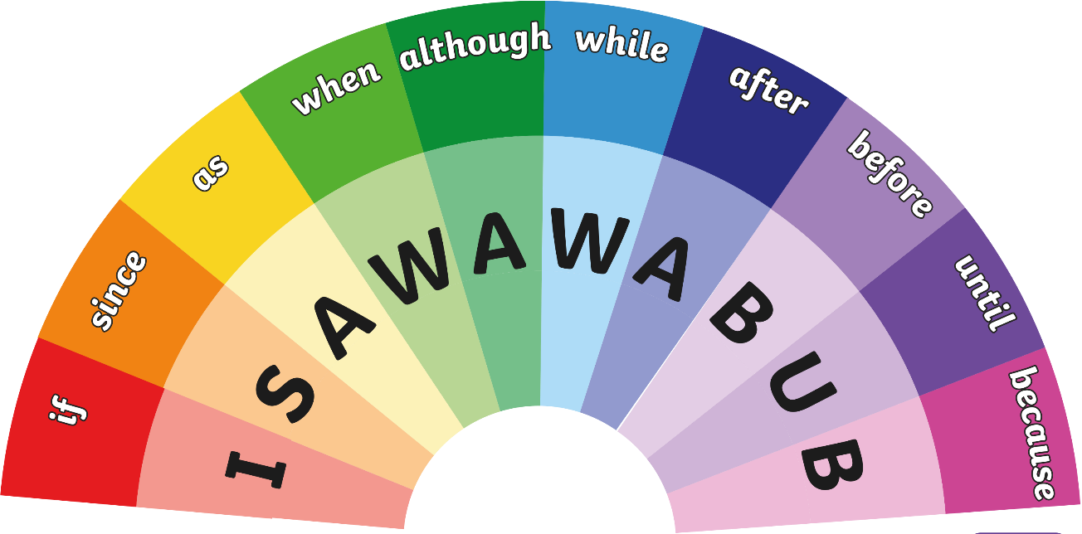
I SAW A WABUB
We use this acronym to identify the subordinating conjunctions that begin a subordinate clause. Remember, we can find a subordinate clause at the beginning, middle or end of a sentence. Subordinating conjunctions link the independent and the dependent clause.

Slide 7
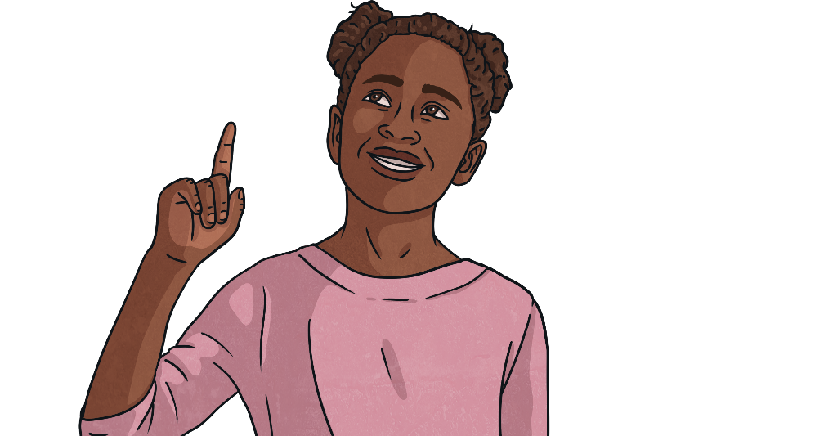
Quiz Time!
?
You are going to see a number of sentences and you must decide if the underlined cause is a main clause or a subordinate clause.
Each answer will be on the next slide.

Slide 8
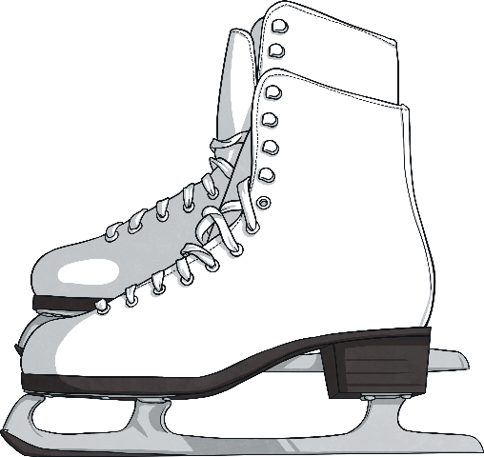
Question 1
Although I love going to the cinema, my favourite activity is going ice skating.

Slide 9
Answer
Although I love going to the cinema, my favourite activity is going ice skating.
It is a subordinate clause.

Slide 10
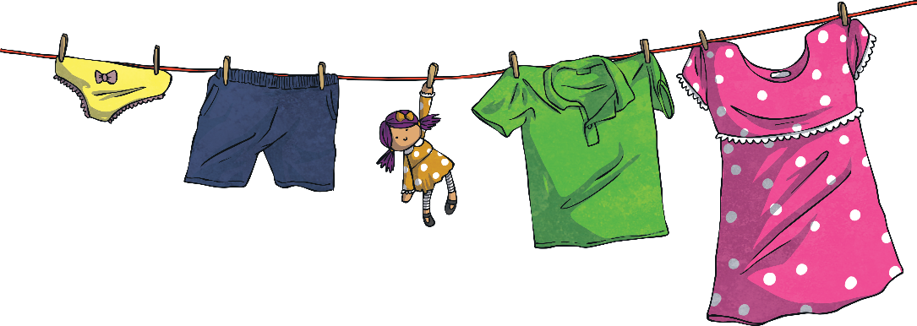
Question 2
Hang the washing on the line
before it rains.

Slide 11
Answer
Hang the washing on the line
before it rains.
It is a main clause.

Slide 12
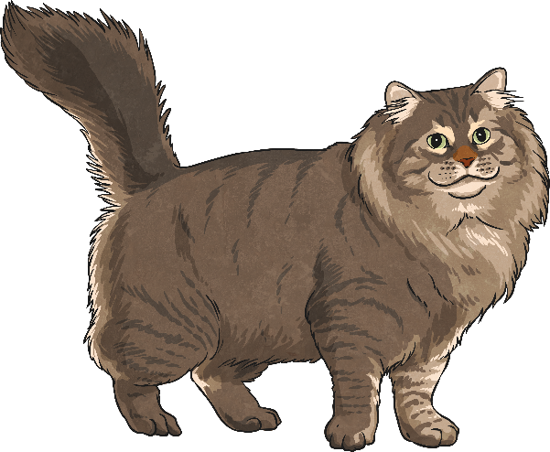
Question 3
The daring cat balanced on the window ledge because he saw his owner eating fish and chips.

Slide 13
Answer
The daring cat balanced on the window ledge because he saw his owner eating fish and chips.
It is a subordinate clause.

Slide 14
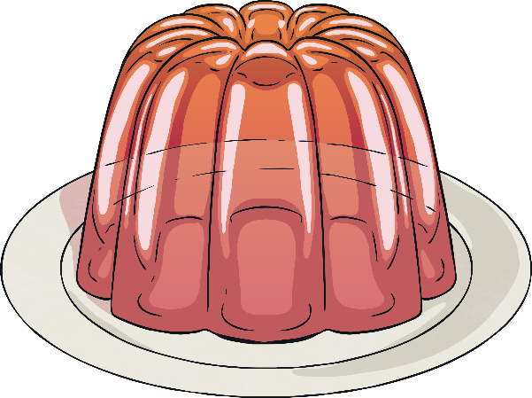
Question 4
The tightrope walker wobbled as he balanced the jelly on his head.

Slide 15
Answer
The tightrope walker wobbled as he balanced the jelly on his head.
It is a subordinate clause.

Slide 16
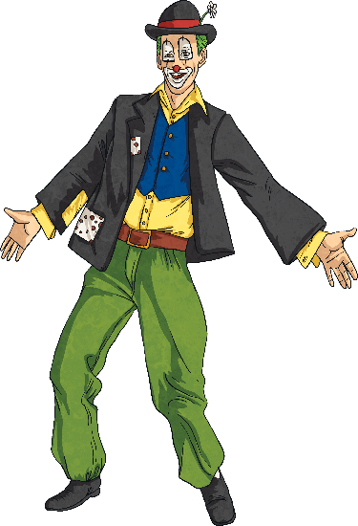
Question 5
The circus clown slipped on the banana skin before he had even had a chance to perform.

Slide 17
Answer
The circus clown slipped on the banana skin before he had even had a chance to perform.
It is a main clause.

Slide 18
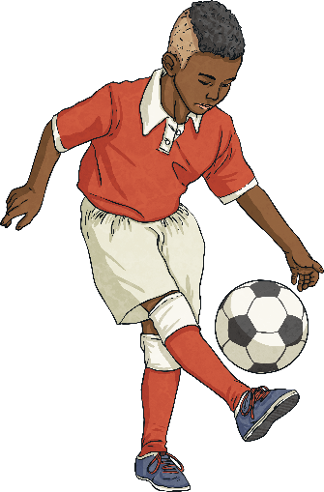
Question 6
The footballer loved to hear the crowd cheering while he played.

Slide 19
Answer
The footballer loved to hear the crowd cheering while he played.
It is a main clause.

Slide 20
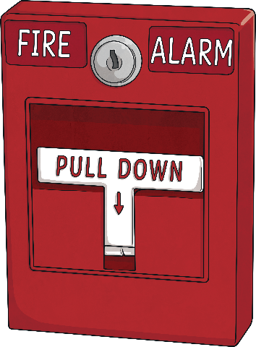
Question 7
If the fire alarm rings in the school, the children have to leave the building.

Slide 21
Answer
If the fire alarm rings in the school, the children have to leave the building.
It is a subordinate clause.

Slide 22
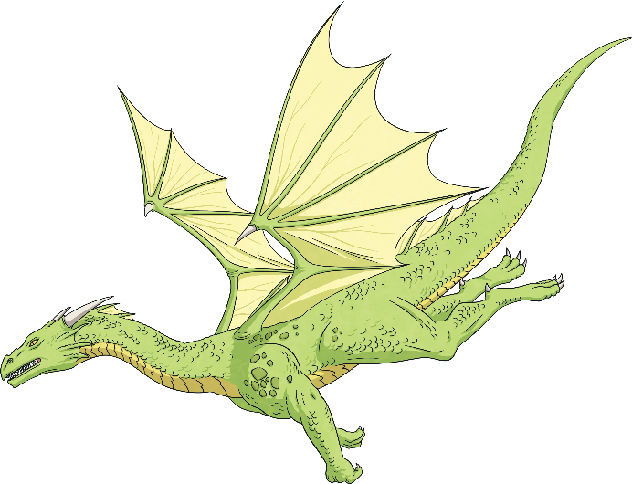
Question 8
The twins asked for a story about dragons since it was nearly bedtime.

Slide 23
Answer
The twins asked for a story about dragons since it was nearly bedtime.
It is a subordinate clause.

Slide 24
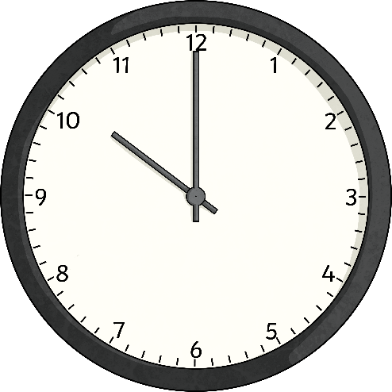
Question 9
The teacher, because it was late, decided to finish the lesson early.

Slide 25
Answer
The teacher, because it was late, decided to finish the lesson early.
It is a subordinate clause.

Slide 26
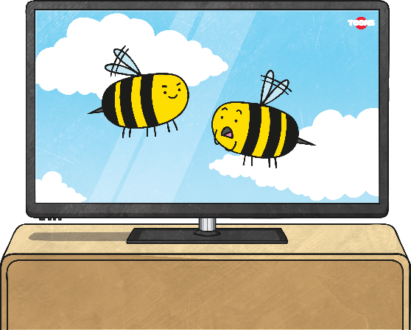
Question 10
After he had finished his book, Josh decided to go and watch some television.

Slide 27
Answer
After he had finished his book, Josh decided to go and watch some television.
It is a main clause.

Slide 28
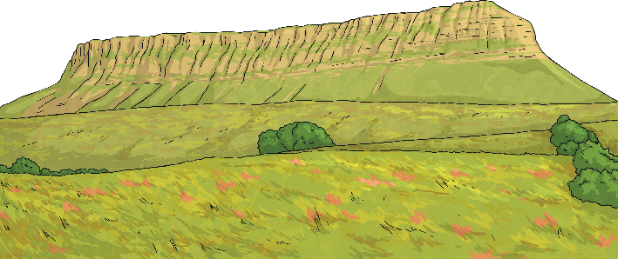
Question 11
Although the mountain was high, the climber knew that he would climb it by sunset.

Slide 29
Answer
Although the mountain was high, the climber knew that he would climb it by sunset.
It is a subordinate clause.

Slide 30
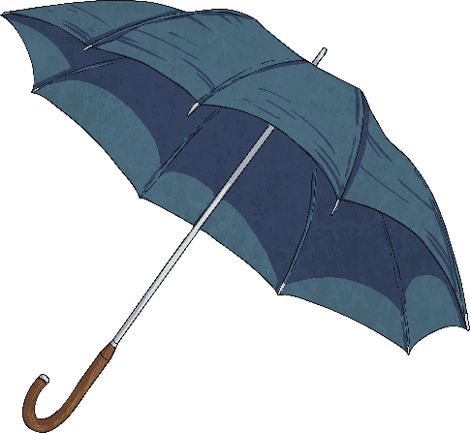
Question 12
We might be able to go for a walk in the country park when it stops raining.

Slide 31
Answer
We might be able to go for a walk in the country park when it stops raining.
It is a main clause.

Slide 32
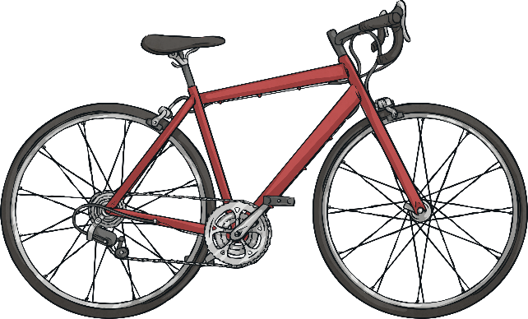
Question 13
The cyclist won the race after his opponent fell off his bike.

Slide 33
Answer
The cyclist won the race after his opponent fell off his bike.
It is a main clause.

Slide 34
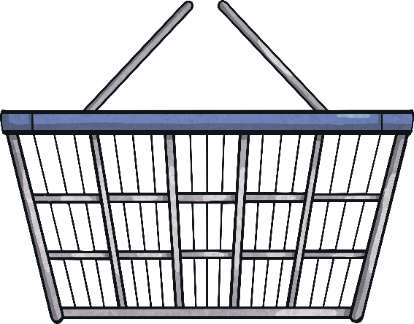
Question 14
If it is sunny tomorrow, we will go to the beach while my mum shops for groceries.

Slide 35
Answer
If it is sunny tomorrow, we will go to the beach while my mum shops for groceries.
There are two subordinate clauses.

Slide 36
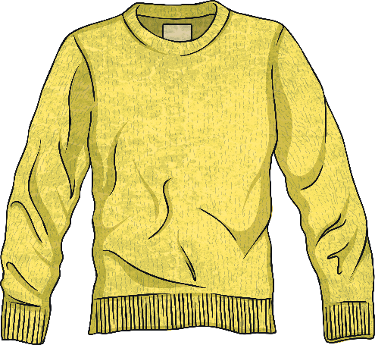
Question 15
Before I went on the aeroplane, I put on my warm, fleecy jumper because I knew the flight would be cold.

Slide 37
Answer
Before I went on the aeroplane, I put on my warm, fleecy jumper because I knew the flight would be cold.
It is a main clause.

