Slide 1
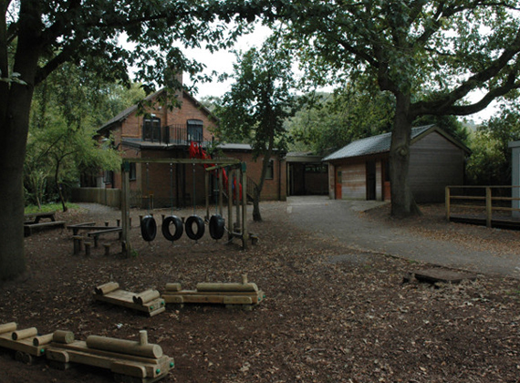
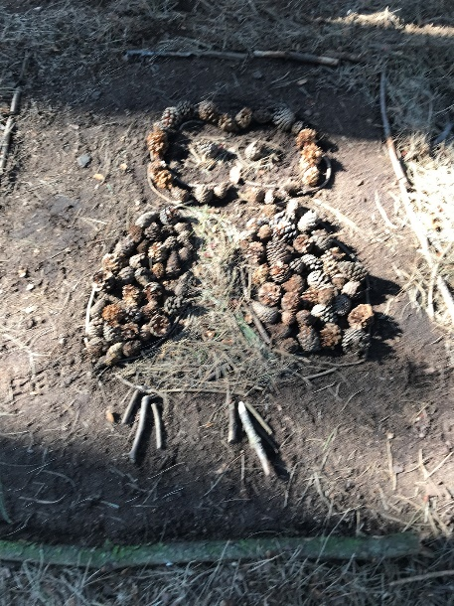
Year 4
Delamere Forest Trip 2026
Mrs Webb (St Augustine) Monday 9th – Tuesday 10th February
Mr. Fitzgerald (St Leoba) Tuesday 10th – Wednesday 11th February

Slide 2
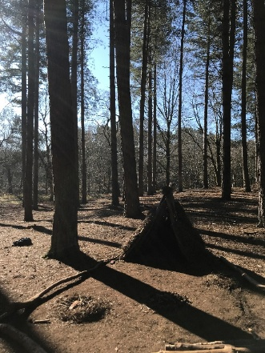
The Delamere residential trip aims to encourage our pupils’ physical and emotional health and wellbeing, having a positive effect on self-esteem, confidence and their ability to interact successfully with others, whilst offering a unique opportunity for them to claim their independence, make their own decisions and build new friendships. They will take away so much more than just fantastic memories!
The children will partake in various activities including walking, orienteering, den building, bonfire - marshmallow toasting and night walking! Some activities will be warden led by the staff of the centre and some by our school staff.
Mr. Fitzgerald
Mrs Webb
Mrs Ceuppens
Children will depart from school at 9.20am and arrive in Delamere at 10am.
Children will be picked up the following day at 1.20pm and return to school by 2pm.

Slide 3
Equipment
Hat/scarf/gloves – 2 sets.
3 changes of old “play” clothing which is warm and comfortable.
An outdoor coat (waterproof if possible).
Walking shoes/trainers.
Indoor shoes (pumps or slippers).
Wellington boots – essential
Wash bag containing: toothbrush, toothpaste, soap and a comb.
Suitable nightwear.
Plastic bags for dirty clothes and shoes/wellies.
A torch for the night walk.
A pack of cards or a reading book.
Please do not send any sweets or electrical items with the children.

Slide 4

The children will need a packed lunch in a disposable bag for the first day, please inform the office if you would like our catering provider to provide a packed lunch. All other meals are catered for on site and offer a range of wonderful, home cooked meals.

Slide 5
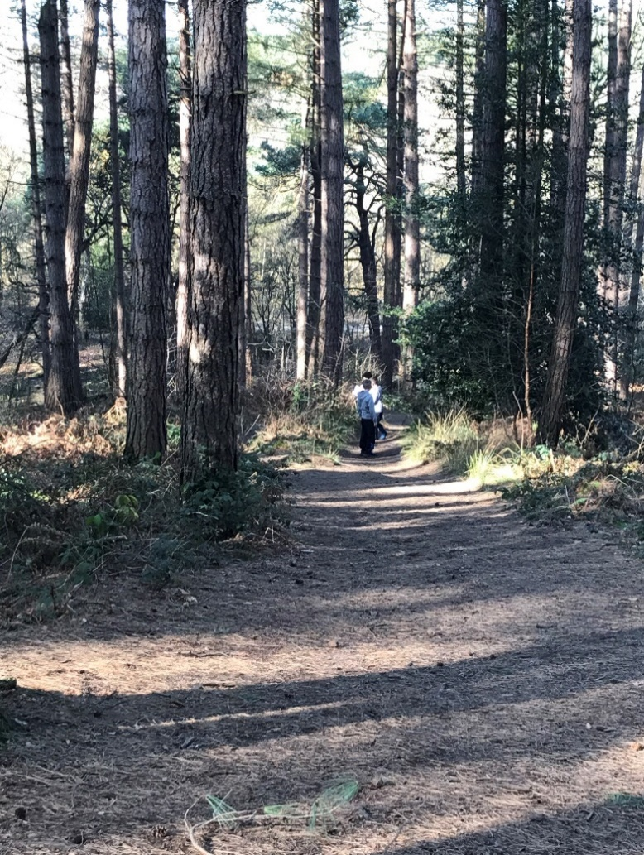
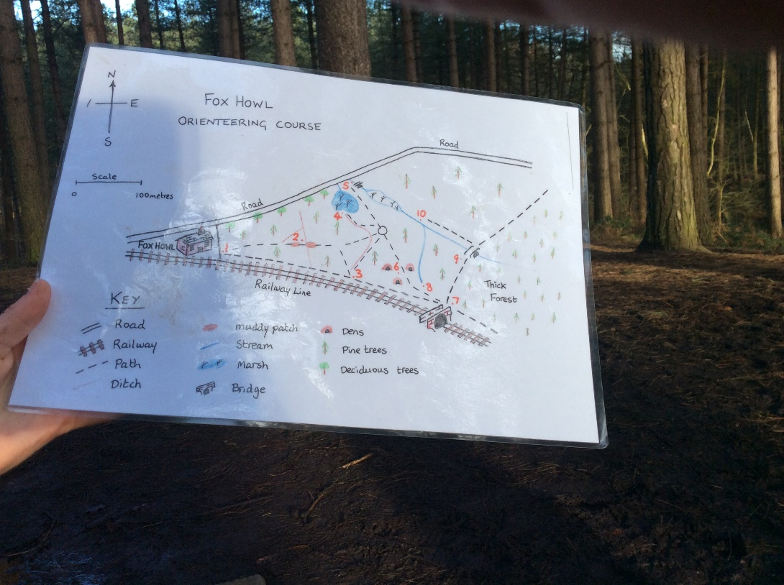
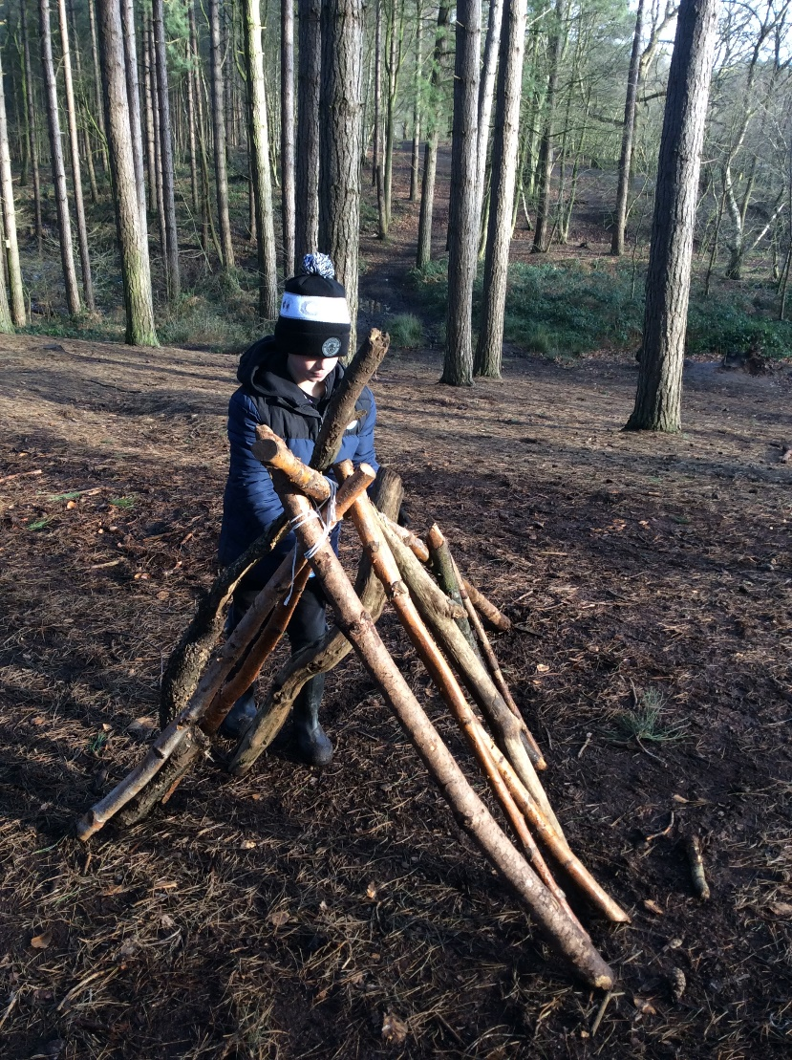
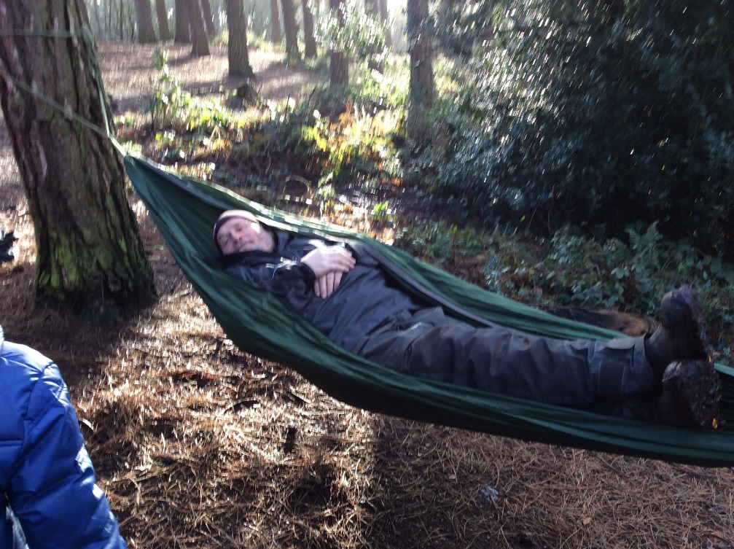

Slide 6


