Slide 1
Monday 6th January 2025

Slide 2
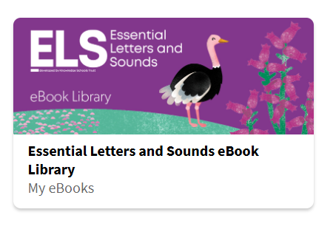
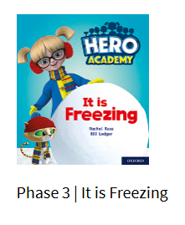
Phonics and Reading
1. Review the flashcards of all the sounds we have learnt so far. (If you don’t have the full set, the sound mats are included on Slide 4.)
2. Read the e-book on the ebook library: https://www.oxfordowl.co.uk/for-pupils/pupil-home
Click on "Students." Username: reception2024-25 Password: Reading. ELS Library > Search "It is Freezing."

Slide 3
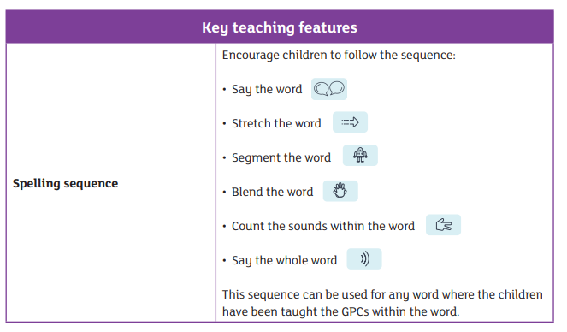

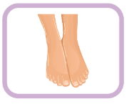
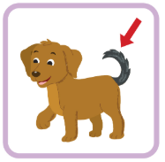
Phonics and Writing
Using a pencil on paper, can you write the words to match the following pictures? When writing a word, sound out the word first (use the spelling sequence below). You can then use the sound mats (Slide 4) to help you write the word.

Slide 4
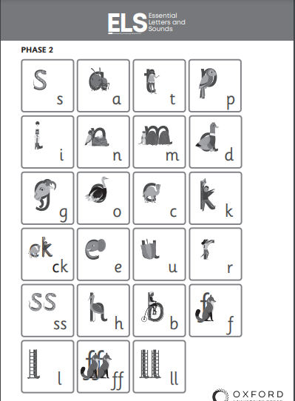
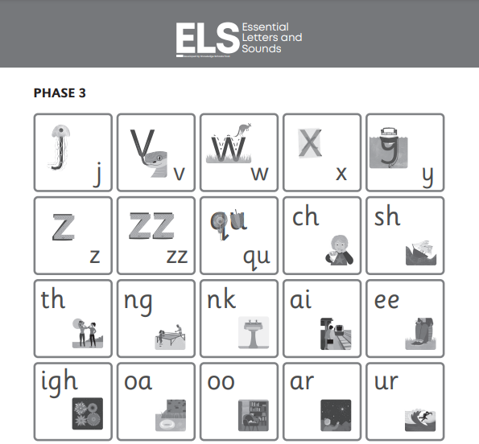
Phonics Resources

Slide 5
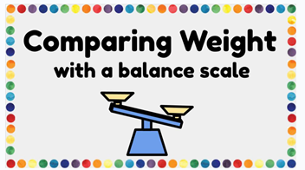
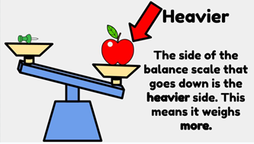
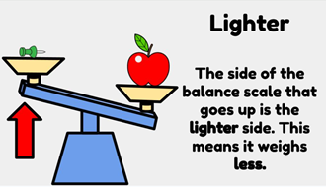
Maths
Please watch video to introduce heavy and light concept.
https://www.youtube.com/watch?v=qUOQrXmfwDM
Can children think of some examples of heavy or light things?
Go around the house and find objects you can sort into heavy or light.
We can use balance scales when we compare the weight of things to find out which object is heavier or lighter. One side will lower to show which object is heavier...
Have a go yourself using this interactive game!
https://www.iknowit.com/lessons/a-measurement-heavier-lighter.html

Slide 6
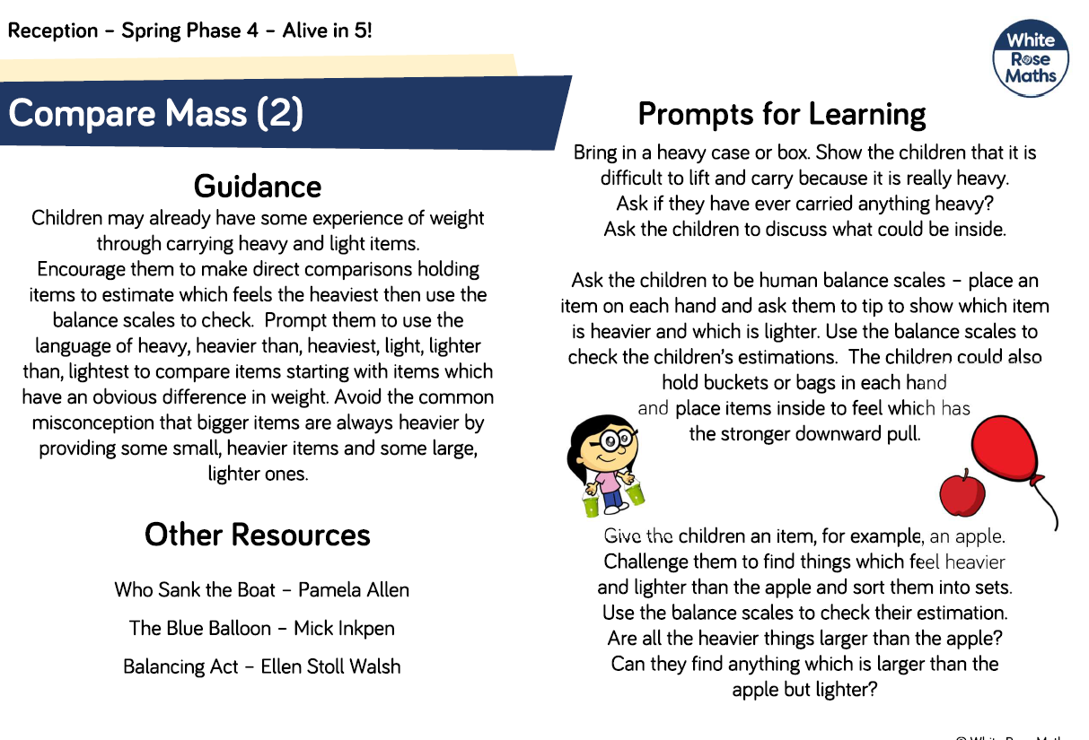

Slide 7
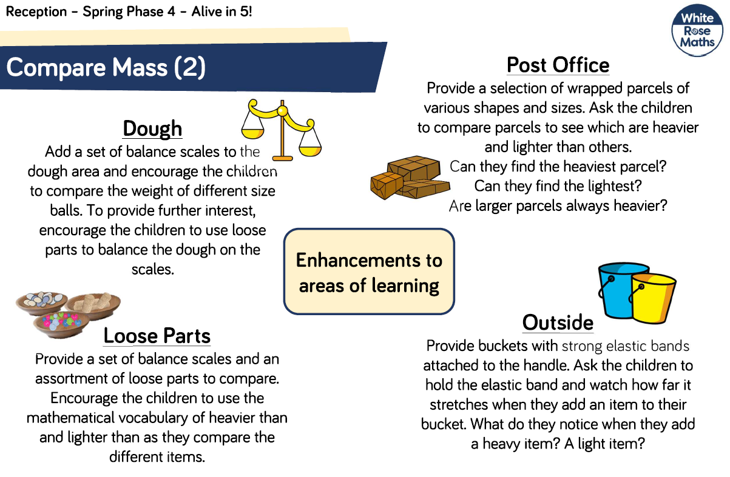

Slide 8
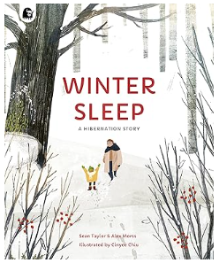
Understanding the World
Do you know what season we are in? Spring, Summer, Autumn or Winter?
In Winter, some animals hibernate. Have you heard the word “hibernation” before? What do you think it means? Do you know animals might hibernate over the cold months?
Watch the story:
Winter Sleep by Sean Taylor & Alex Morss. Themes: Winter, cold weather and hibernation. https://www.youtube.com/watch?v=G7I5_1SkfcI
Can you tell your grown up something you have learnt about hibernation? You may choose to draw a picture to show your understanding.

