Slide 1
Tuesday 7th January 2025

Slide 2
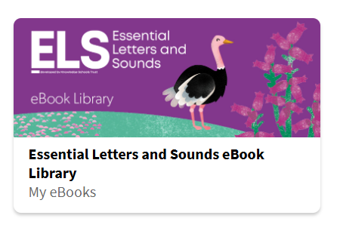
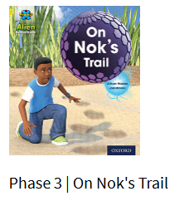
Phonics and Reading
Review the flashcards of all the sounds we have learnt so far. (If you don’t have the full set, the sound mats are included on Slide 4.) Pay particular attention to any that your child is not sure of and return to them during the day. Say the sound for your child to repeat back to you. A video of the ELS Phase 3 sound pronunciation can be found here: https://www.youtube.com/watch?v=gDInVjBUGC0
2. Apply your blending skills to read the e-book on the ebook library: https://www.oxfordowl.co.uk/for-pupils/pupil-home
Click on "Students."
Username: Reception2024-25
Password: Reading
ELS Library > Search “On Nok’s Trail” or any of the Little Blending Books 1 – 9.

Slide 3



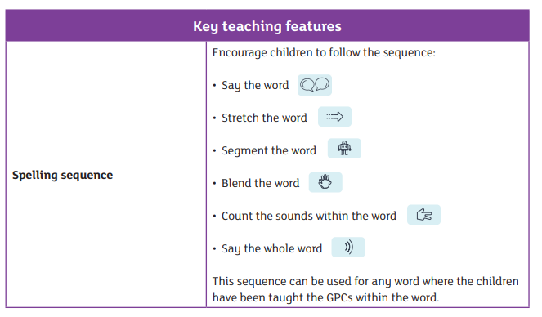
Phonics and Writing
Using a pencil on paper, can you write the words to match the following pictures? When writing a word, sound out the word first (use the spelling sequence below) e.g. “road” would be sounded out as “r – oa – d.” You can then use the sound mats (Slide 4) to help you write the word.
Remember to use correct letter formation for each letter – Slides 5, 6, 7, 8 have the letter formation families to help you!

Slide 4
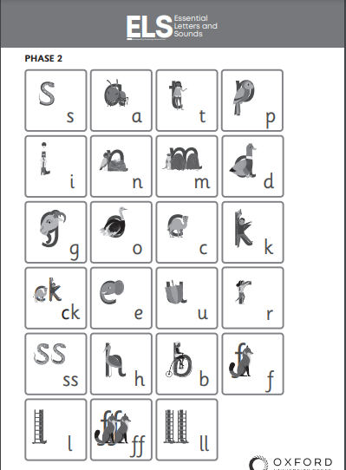
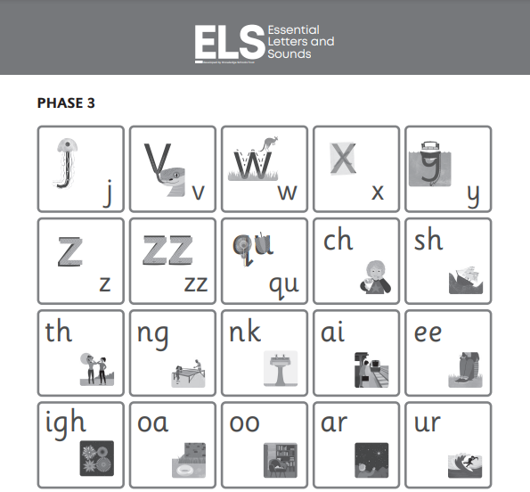
Phonics Resources – Sound mats

Slide 5

Letter Formation / Handwriting Resources

Slide 6
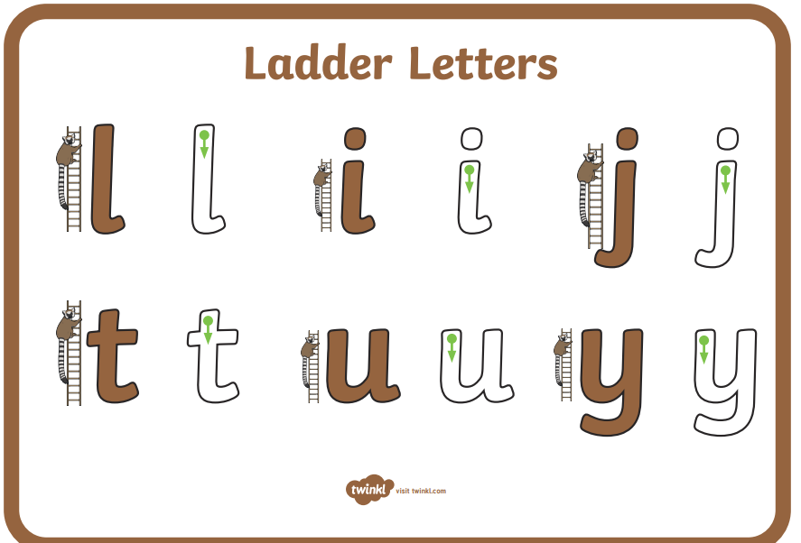
Letter Formation / Handwriting Resources

Slide 7
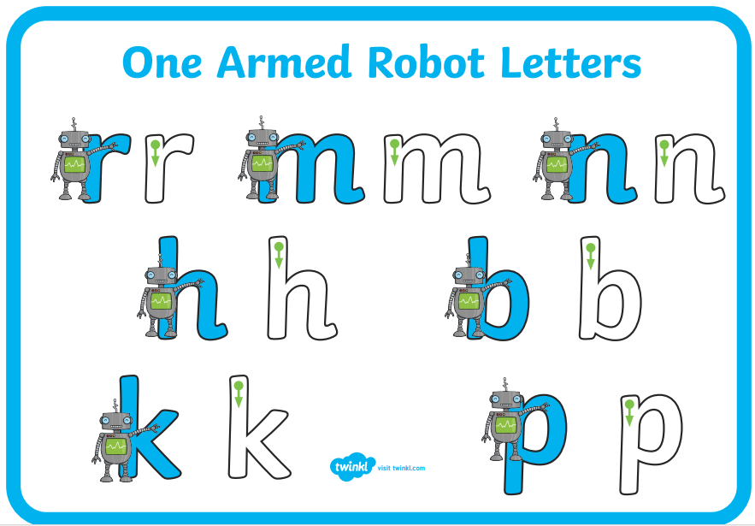
Letter Formation / Handwriting Resources

Slide 8
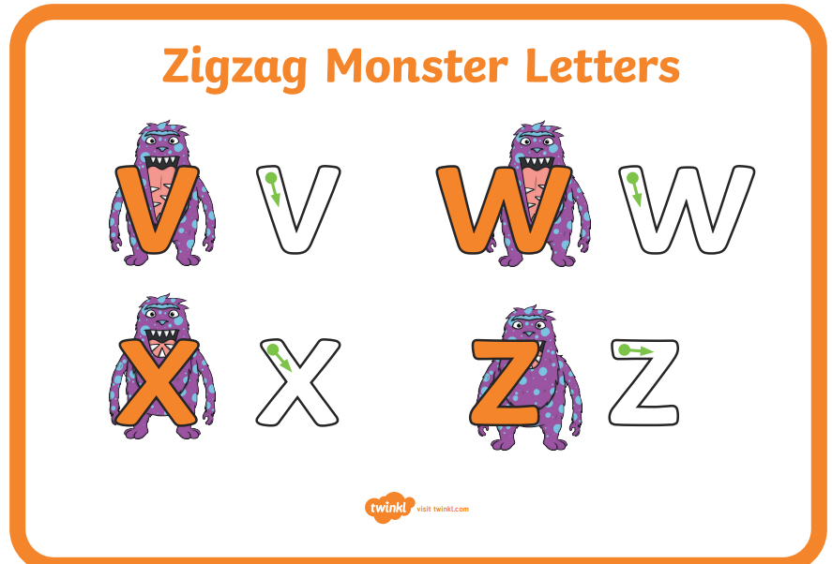
Letter Formation / Handwriting Resources

Slide 9
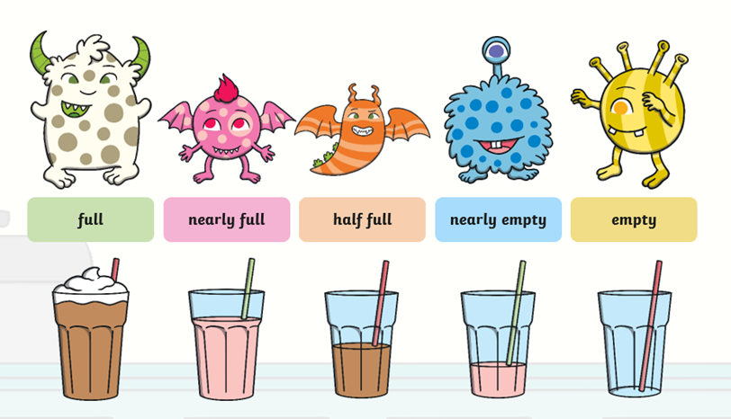
Maths
Today's focus is on capacity. We will be focusing on how much liquid is in a glass or container. This can also be done having lots of fun at home using things around the home to fill containers. Please watch these videos to introduce capacity concept:
https://www.youtube.com/watch?v=Ez7q6_RrMxU
https://www.youtube.com/watch?v=3m8989ddAd0
Key words:

Slide 11
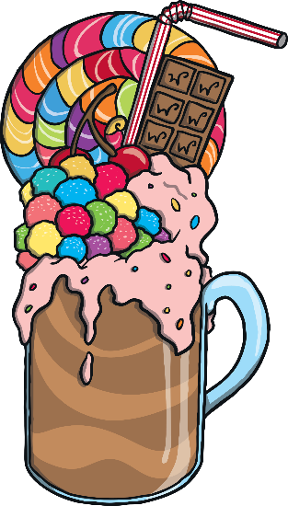



The Cafe Is Open
Monsters just love milkshakes! They drink them all day long. Let’s see which milkshakes the monsters have been drinking at the cafe today.
Yum yum! Which delicious milkshake shall I order today?
Which one would you order?

Slide 12



Milkshake Mix Up!
The monsters have mixed up their milkshakes. Can you help them to find which milkshake is theirs?
Hello! My favourite milkshake is chocolate. My milkshake is full. I wonder which one is mine.
Well done! You found my milkshake. My milkshake is full.

Slide 13


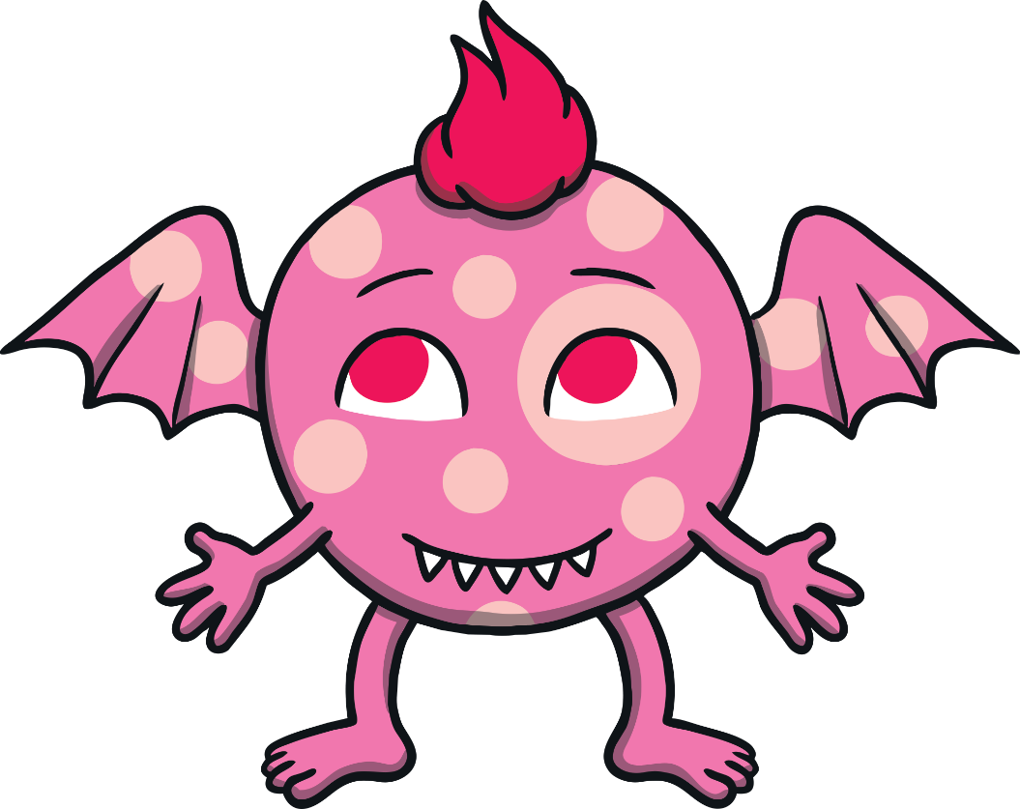
I love strawberry milkshakes so much that I have drunk all of mine! My milkshake is empty. Which glass is mine?
Great job! My milkshake is empty. I need to buy another one!

Slide 14


I’m not sure which milkshake is mine. I have drunk some of my milkshake. My milkshake is half full.
Can you find it?
Thank you for finding my milkshake. My milkshake is half full.

Slide 15





Yes, that’s my milkshake. My milkshake is nearly empty.
I have nearly finished my milkshake. My milkshake is nearly empty. I wonder which one is mine.

Slide 16






I drink my milkshake very slowly. My milkshake is nearly full. Which milkshake is mine?
Super! I have only had a little bit of my drink. My milkshake is nearly full.

Slide 17

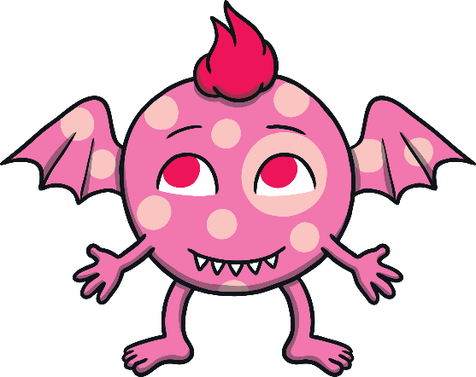



Oh no! They have mixed them up again.
My milkshake has the most. Which one is mine?
My milkshake has the least. Which one is mine?
Talk about which milkshake has the most and the least. When you are ready, click on me

Slide 18



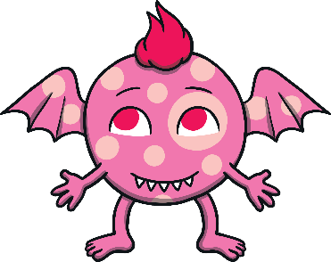






Thank you for helping the monsters with their milkshake mix up.
full
nearly full
half full
nearly empty
empty

Slide 19
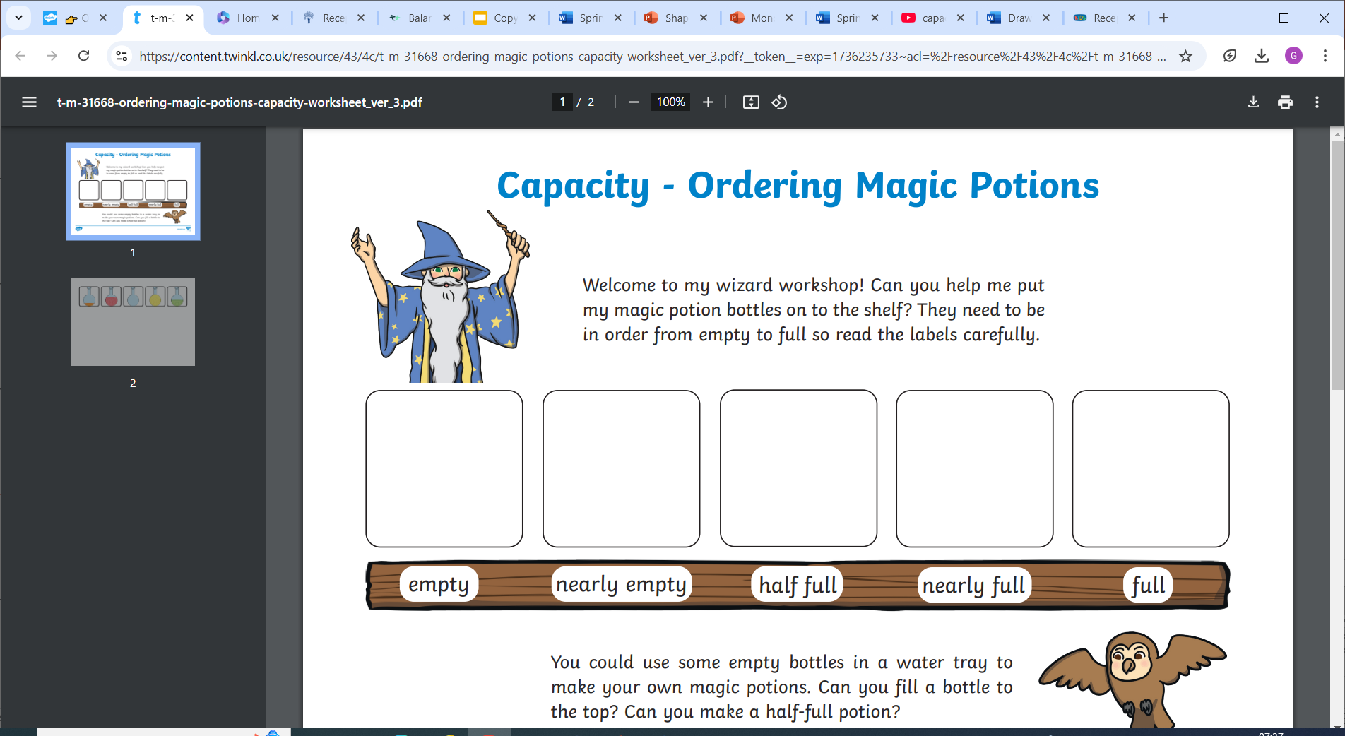
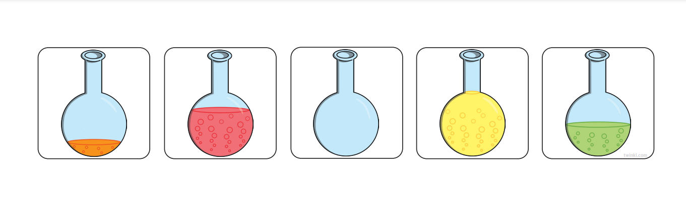
Maths
Check your knowledge by playing this interactive capacity game!
https://kids.classroomsecrets.co.uk/resource/reception-identifying-capacity-game/

Slide 20
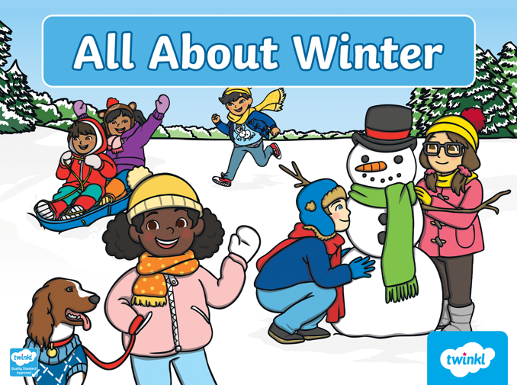
Understanding the World
Today, we are learning about the season of Winter!

Slide 21
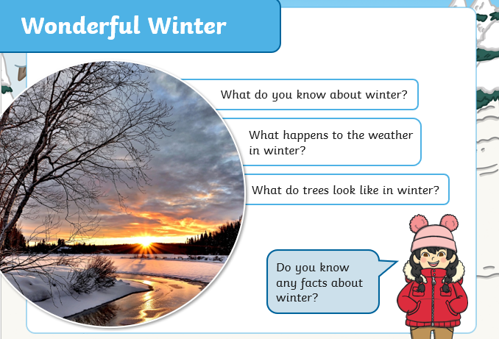
Understanding the World
Talk to your grown up and answer the following questions:
Then, watch the following short video from BBC Bitesize all about Winter:
https://www.bbc.co.uk/bitesize/articles/zmgf3j6

Slide 22
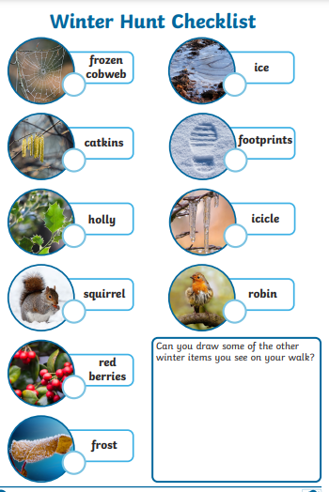
Understanding the World
Choose one of the following “Winter” themed activities:
Create a winter picture or piece of artwork
Make or create a snowman! What does he need to keep warm outside?
Go on a Winter Scavenger Hunt in your garden – What signs of Winter can you see? Collect items, draw pictures or take photographs.
Have fun!

