Slide 1
Wednesday 8th January 2025

Slide 2
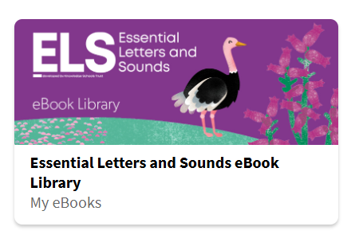
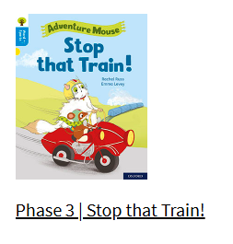
Phonics and Reading
Review the flashcards of all the sounds we have learnt so far. (If you don’t have the full set, the sound mats are included on Slide 4.) Pay particular attention to any that your child is not sure of and return to them during the day. Say the sound for your child to repeat back to you. A video of the ELS Phase 3 sound pronunciation can be found here: https://www.youtube.com/watch?v=gDInVjBUGC0
2. Apply your blending skills to read the e-book on the ebook library: https://www.oxfordowl.co.uk/for-pupils/pupil-home
Click on "Students."
Username: Reception2024-25
Password: Reading
ELS Library > Search “Stop that Train”
Alternatively, choose any of the Little Blending Books 1 – 9 or any e-book up to Reception Autumn 2, Week 6

Slide 3
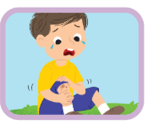
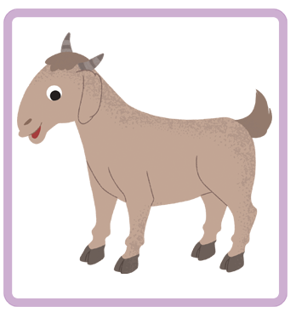
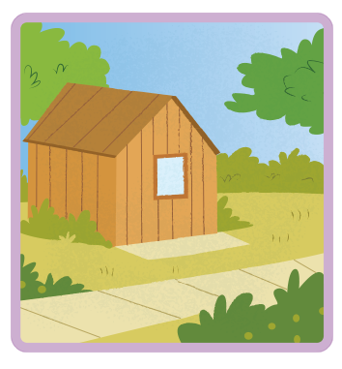
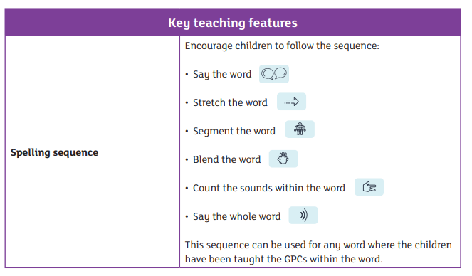
Phonics and Writing
Using a pencil on paper, can you write the words to match the following pictures? When writing a word, sound out the word first (use the spelling sequence below) e.g. “pain” would be sounded out as “p - ai - n.” You can then use the sound mats (Slide 4) to help you write the word.
Remember to use correct letter formation for each letter – Slides 5, 6, 7, 8 have the letter formation families to help you!
{Word answers: pain, goat, shed}

Slide 4
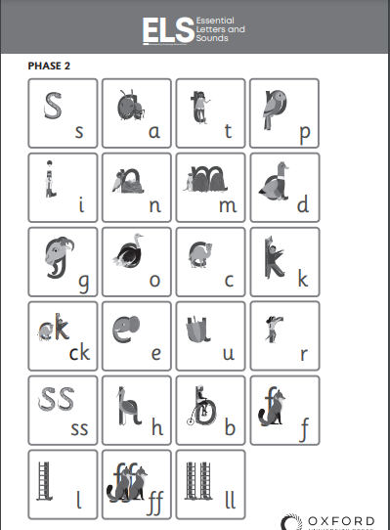
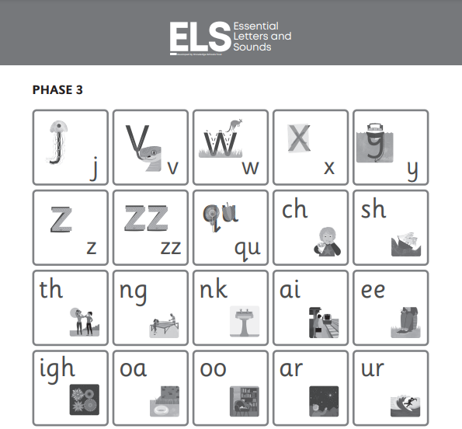
Phonics Resources – Sound mats

Slide 5
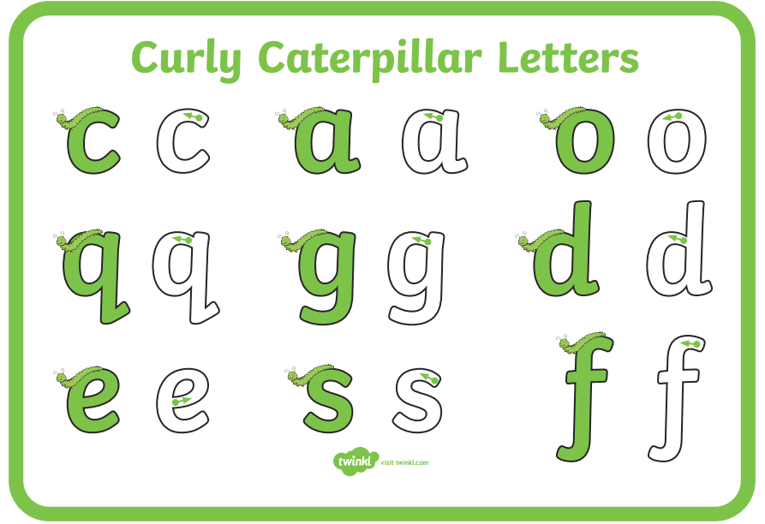
Letter Formation / Handwriting Resources

Slide 6
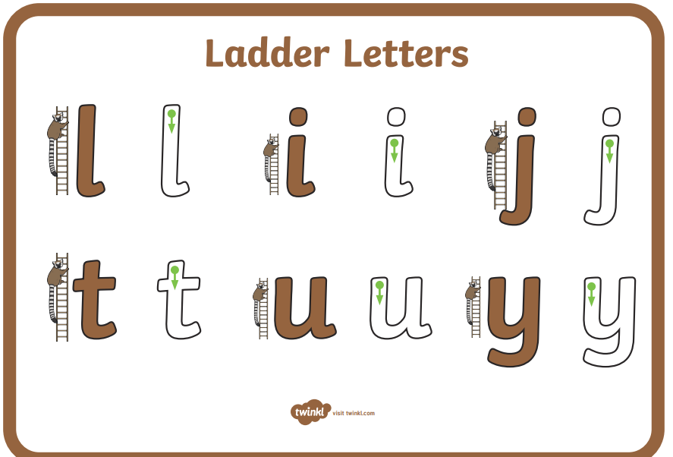
Letter Formation / Handwriting Resources

Slide 7
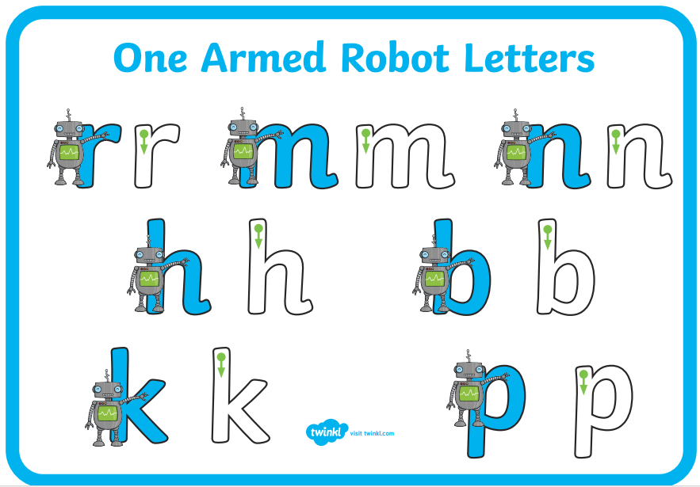
Letter Formation / Handwriting Resources

Slide 8
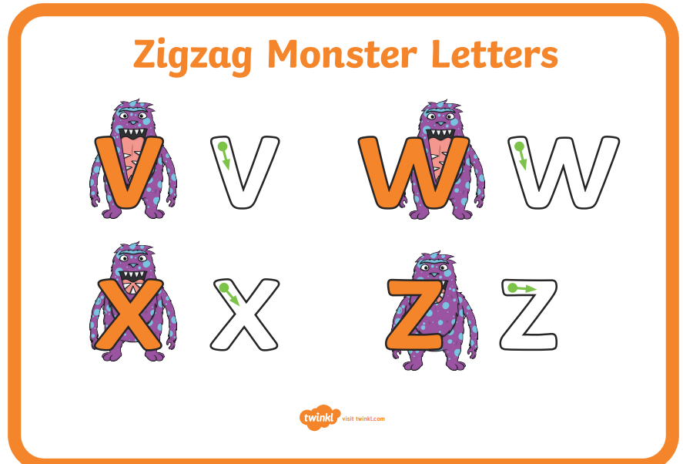
Letter Formation / Handwriting Resources

Slide 9
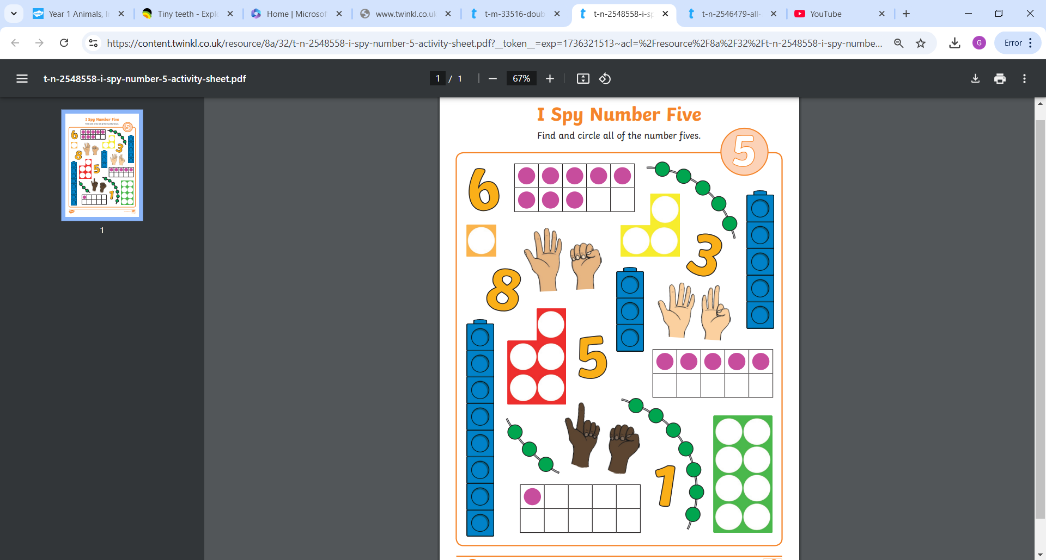
Maths
Today's focus is on the number 5! We will be focusing on the composition of the number 5. Please begin by doing the Eye Spy number 5 worksheet to warm up our brains!

Slide 10
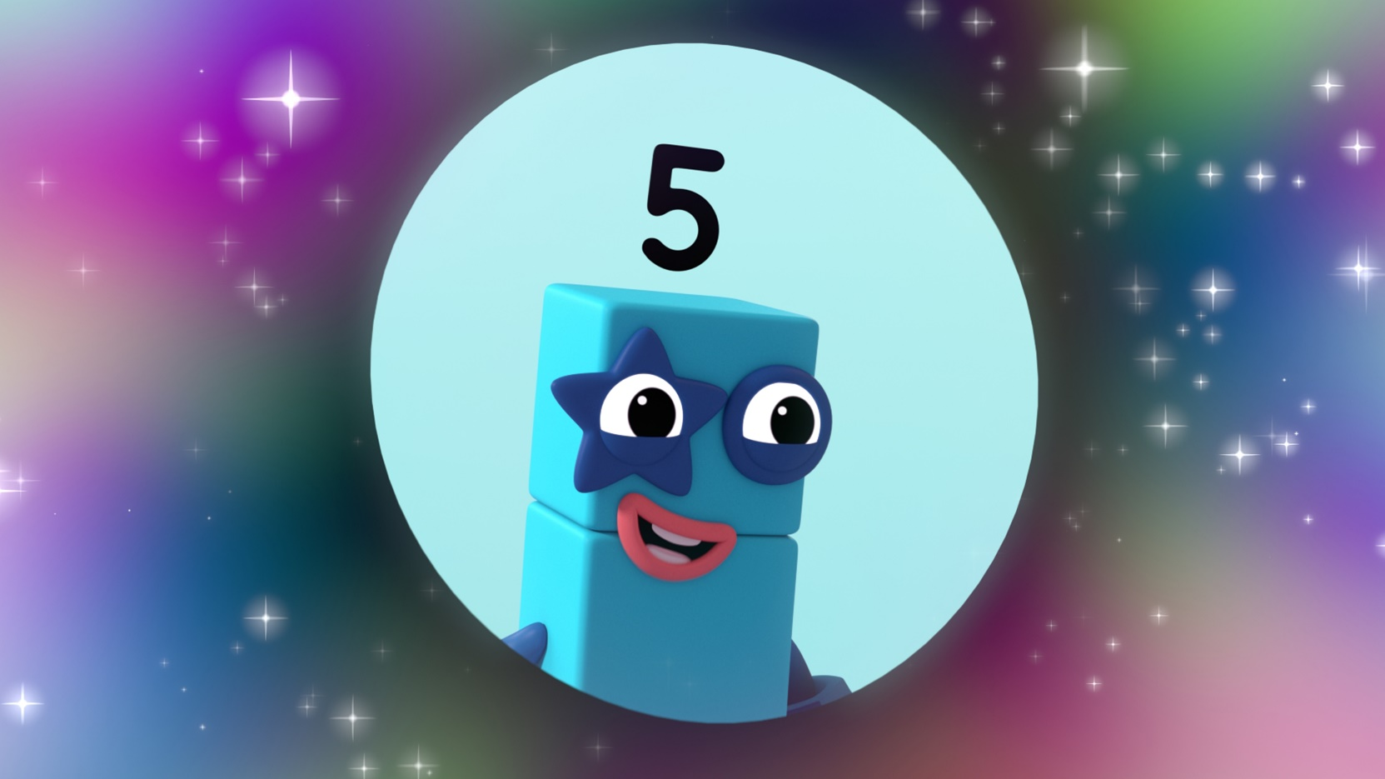
Maths
Please watch this NumberBlock video on Number 5:
https://www.bbc.co.uk/iplayer/episode/b08dmjsk/numberblocks-series-1-holes
Did you notice that when Numberblock Five loses her head she is made from Four and One?

Slide 11
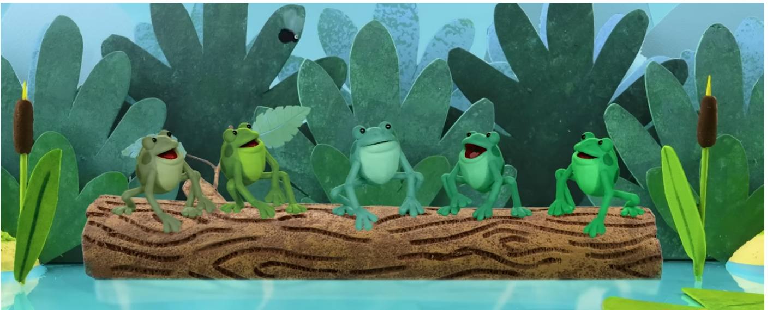
Maths
Today we are focusing on what number five is made up from. Let’s begin by singing 5 speckled frogs!
https://www.youtube.com/watch?v=8VCpa4blanQ
I’ve brought in some little speckled frogs today!
Here’s a log for them to sit on. [Place the 5 frogs onto your log where all the children can clearly see them.]
Here we have a pool for them. [Place your piece of blue cloth or paper near the log.]
Let’s sing our song again!
Sing the whole of ‘5 Little Speckled Frogs’ encouraging the children to join in. As you sing about each frog jumping into the pool, place them on the cloth/paper. At the end of each verse, draw attention to the composition of the group:
How many frogs are on the log? How many are in the pool?
How many are there altogether? [Use gestures to indicate the different groups and the whole amount.]
Can you show me on your fingers?

Slide 12
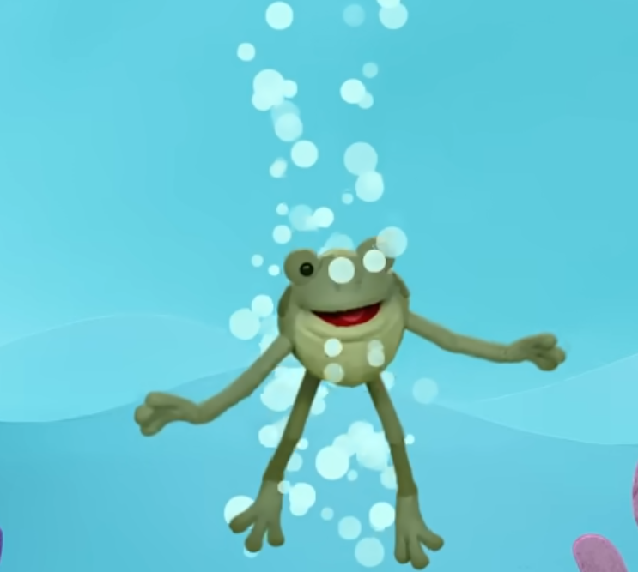
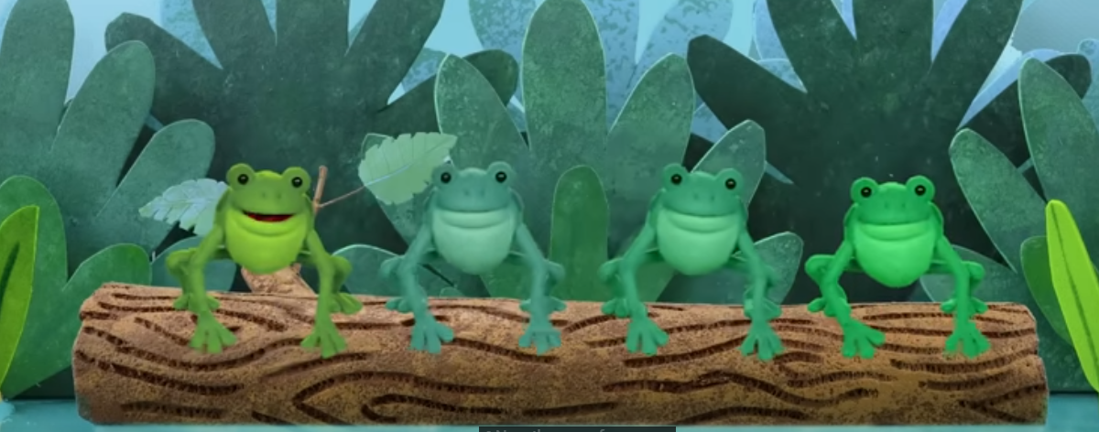
Maths
5 frogs altogether.
1 jumped into the pool.
4 were left on the log.
4 and 1 make 5.

Slide 13
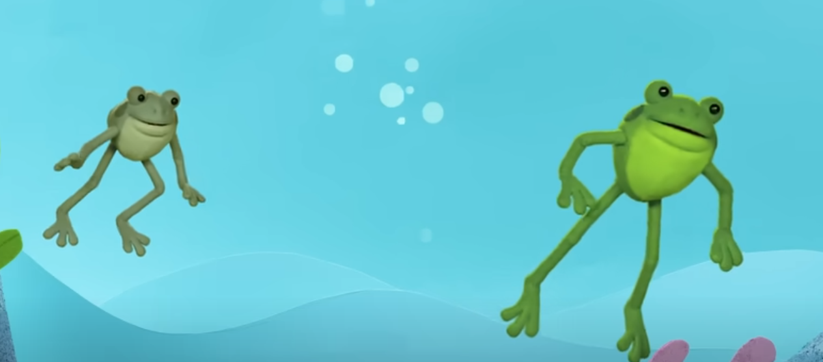
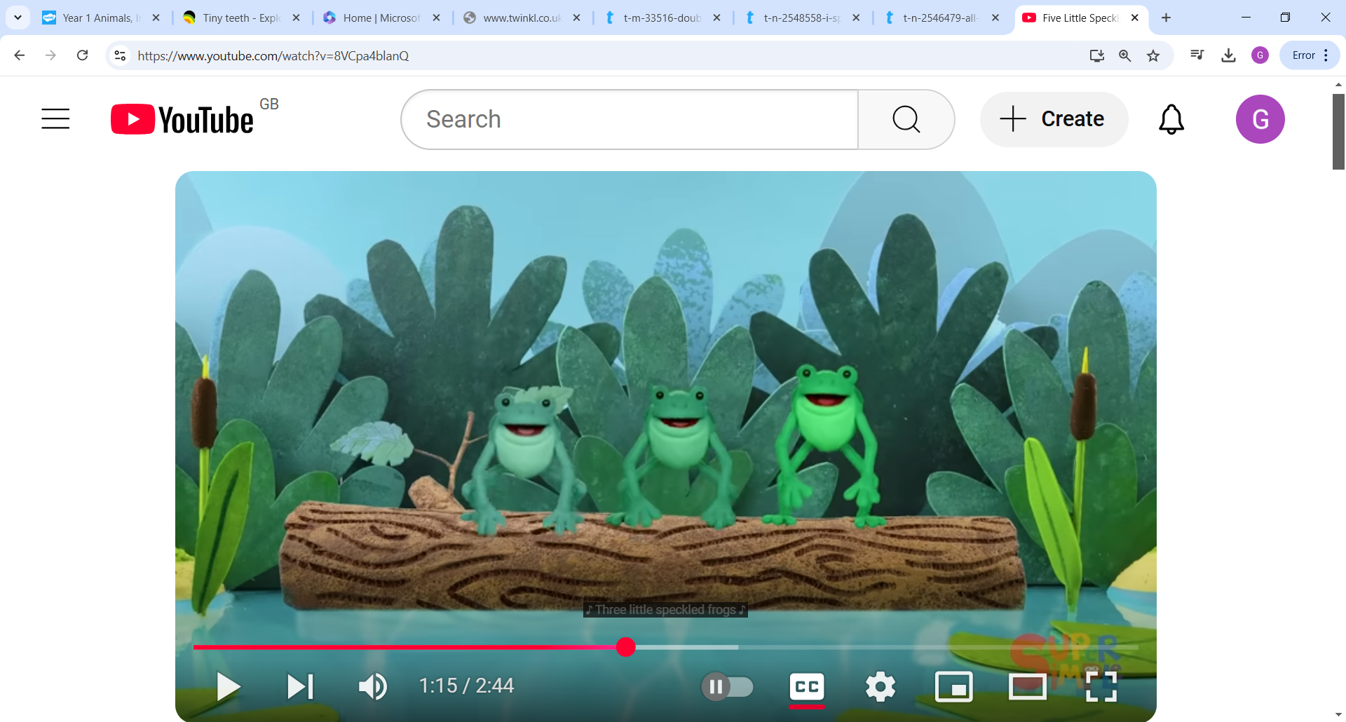
Maths
5 frogs altogether.
2 jumped into the pool.
3 were left on the log.
3 and 2 make 5.

Slide 14
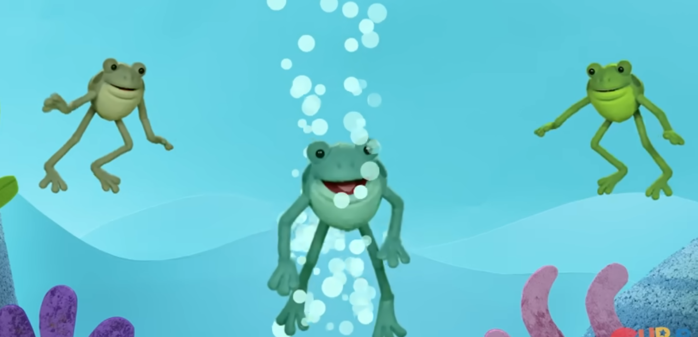
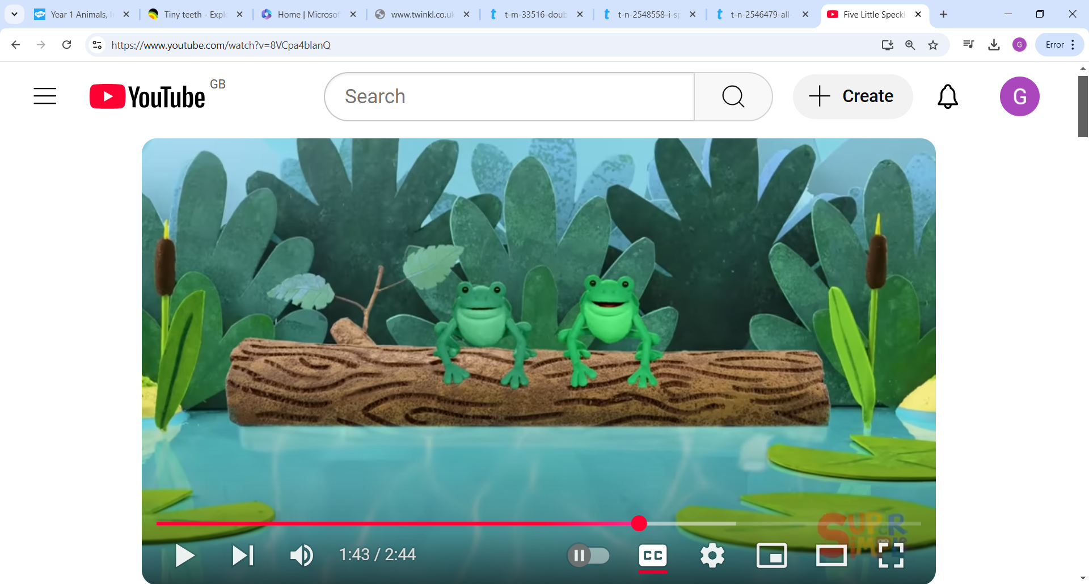
Maths
5 frogs altogether.
3 jumped into the pool.
2 were left on the log.
2 and 3 make 5.

Slide 15
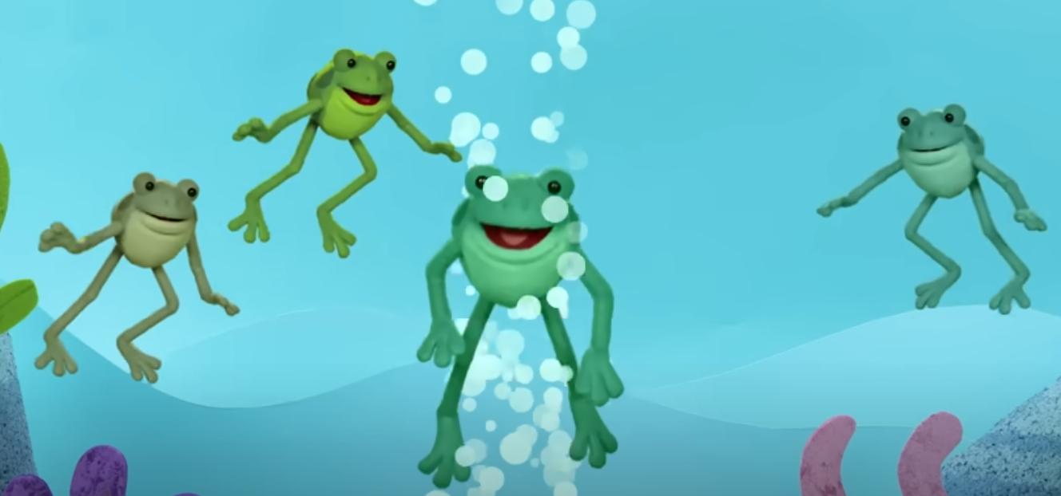
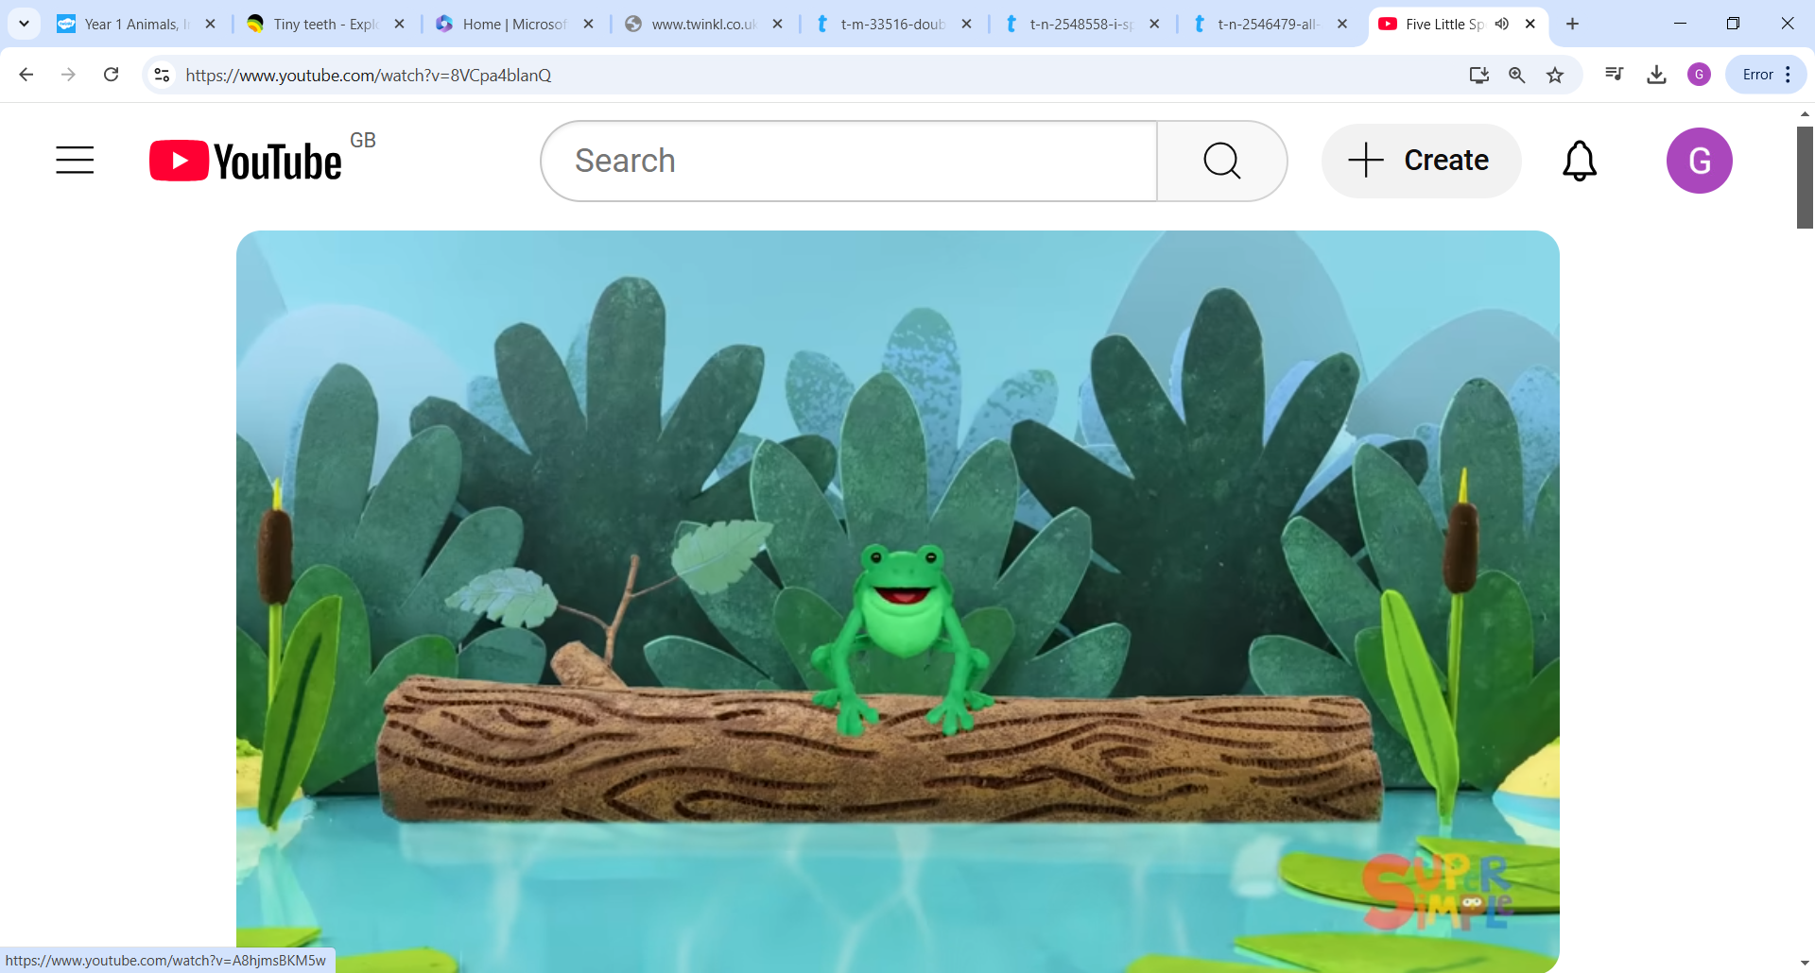
Maths
5 frogs altogether.
4 jumped into the pool.
1 was left on the log.
4 and 1 make 5.

Slide 16
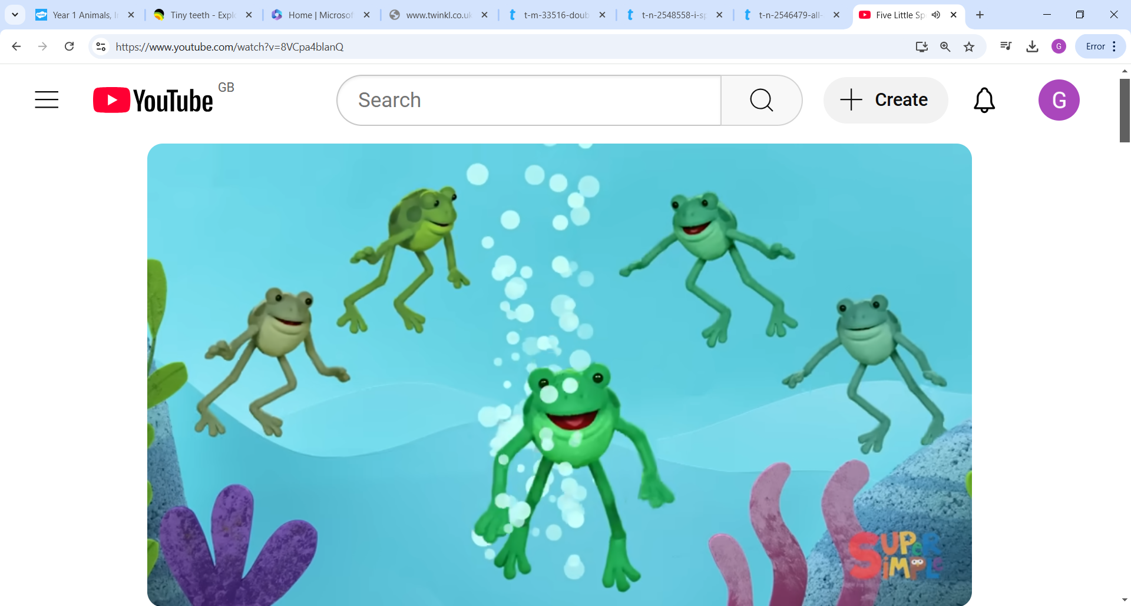
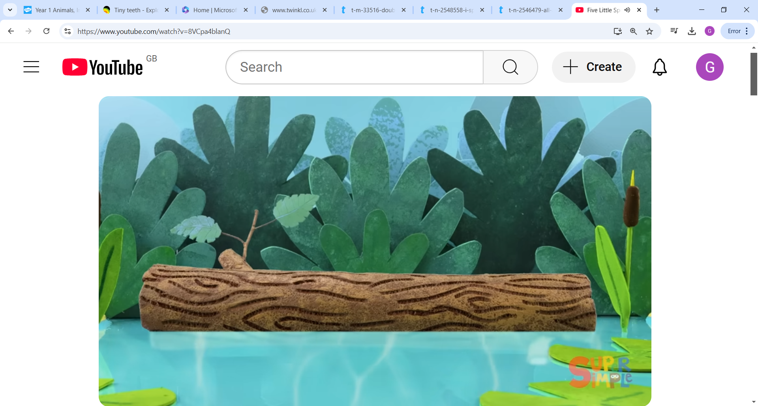
Maths
5 frogs altogether.
5 jumped into the pool.
0 were left on the log.
5 and 0 make 5.

Slide 17
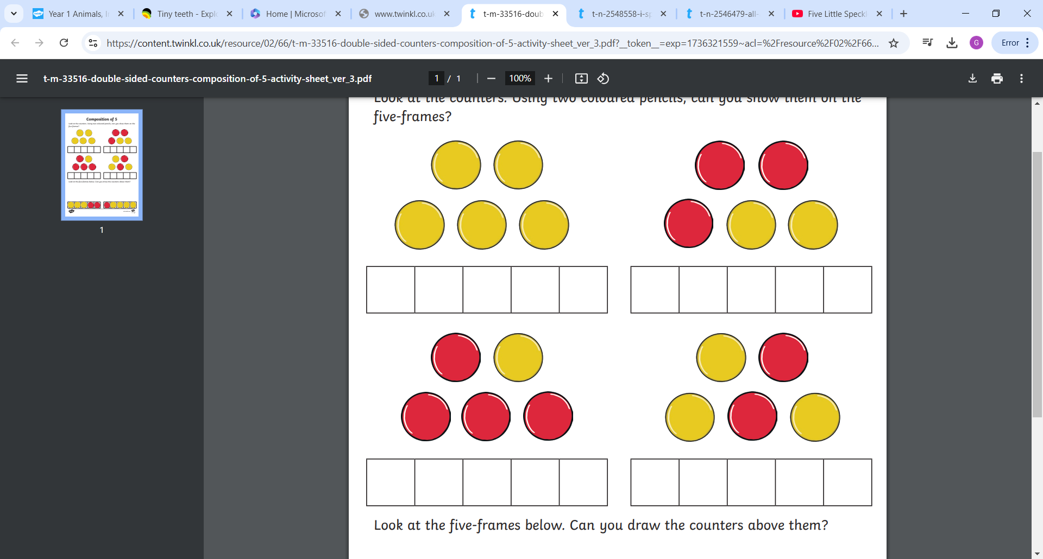
Maths
Please now have a go at this worksheet to reinforce composition of 5 using a 5s frame.

Slide 18
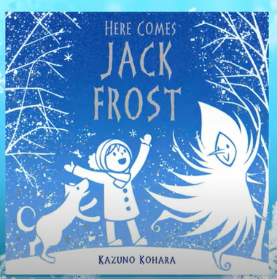
Understanding the World
Today, we are continuing to learn about what happens in winter by exploring the concept of freezing and melting.
Read the story “Here comes Jack Frost”
by Kazuno Kohara
https://www.youtube.com/watch?v=sQVhVUEgDUk

Slide 19
Wrap up warm and try a freezing and melting science experiment…
Can you collect a small amount of snow in a see-through container? Bring it inside – what do you think will happen? Will it freeze, melt or stay the same? Observe the container of snow over time. How long does it take to melt?
If you have a pot of bubbles at home, try blowing them outside (or create a little pot of bubbly water) – is it cold enough to make the bubbles freeze?
Place some cold water and some warm water in two small trays and pop them outside – what do you think will happen?

