Slide 1
Thursday 9th January 2025

Slide 2
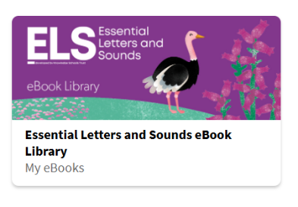

Phonics and Reading
1. Lay out a selection of grapheme cards in front of you / around the room (include ones that your child is confident with and less confident with). Call out a sound for your child to find as quickly as they can.
2. Apply your blending skills to read the e-book on the ebook library: https://www.oxfordowl.co.uk/for-pupils/pupil-home
Click on "Students."
Username: Reception2024-25
Password: Reading
ELS Library > Search “Tiger’s Fish”
Alternatively, choose any of the Little Blending Books 1 – 9 or any e-book up to Reception Autumn 2, Week 6

Slide 3

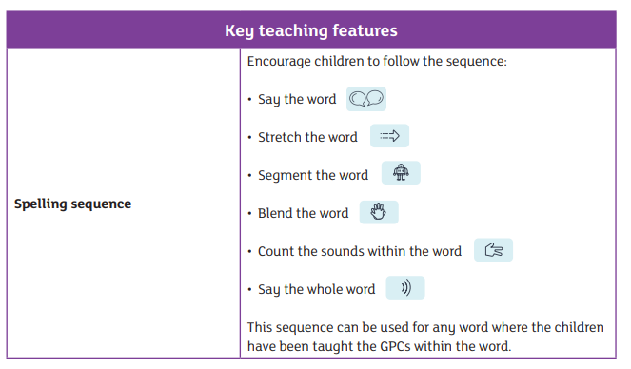


Phonics and Writing
Using a pencil on paper, can you write the words to match the following pictures? When writing a word, sound out the word first (use the spelling sequence below) e.g. “light” would be sounded out as “l - igh - t.” You can then use the sound mats (Slide 4) to help you write the word.
Remember to use correct letter formation for each letter – Slides 5, 6, 7, 8 have the letter formation families to help you!
{Word answers: sheep, light, zip}

Slide 4
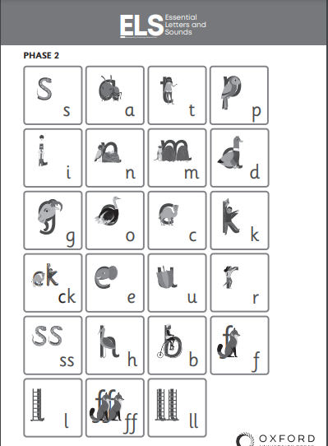
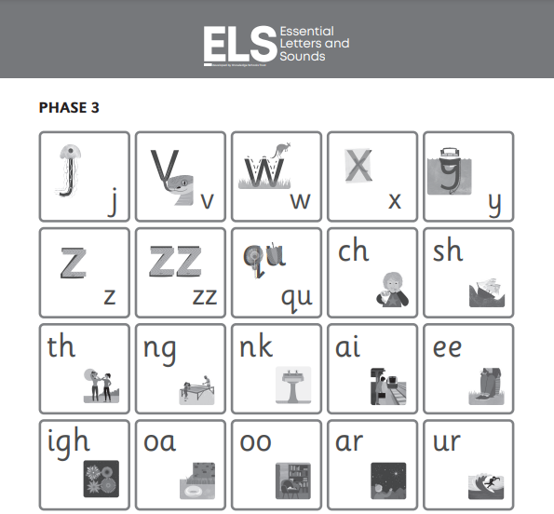
Phonics Resources – Sound mats

Slide 5

Letter Formation / Handwriting Resources

Slide 6
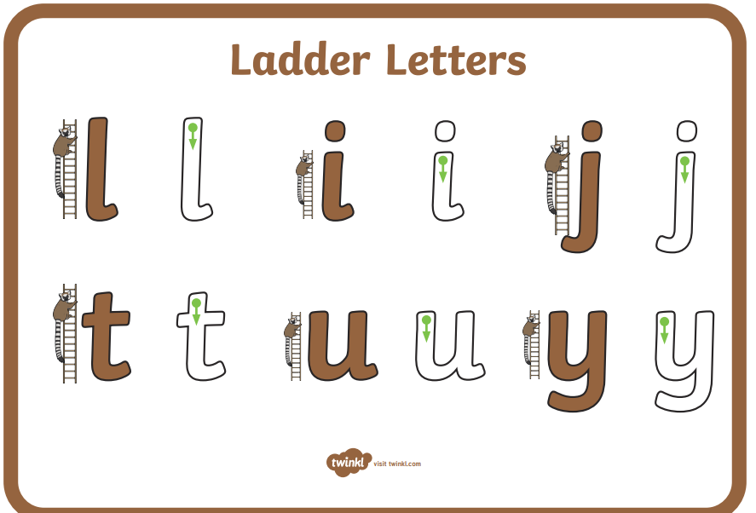
Letter Formation / Handwriting Resources

Slide 7
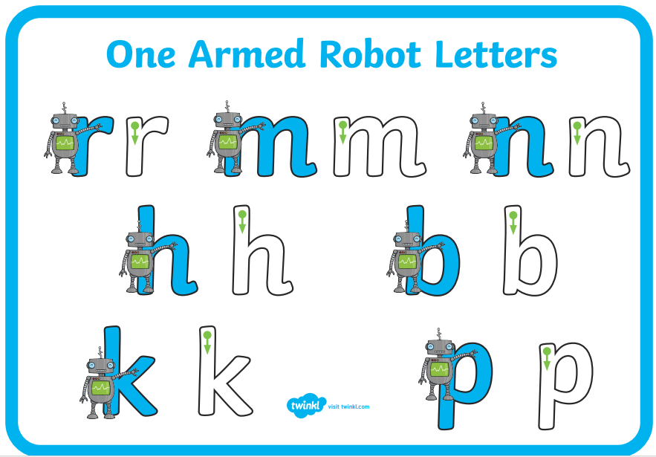
Letter Formation / Handwriting Resources

Slide 8
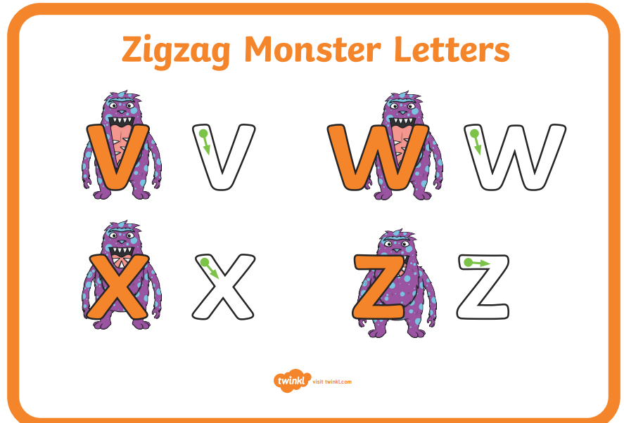
Letter Formation / Handwriting Resources

Slide 9
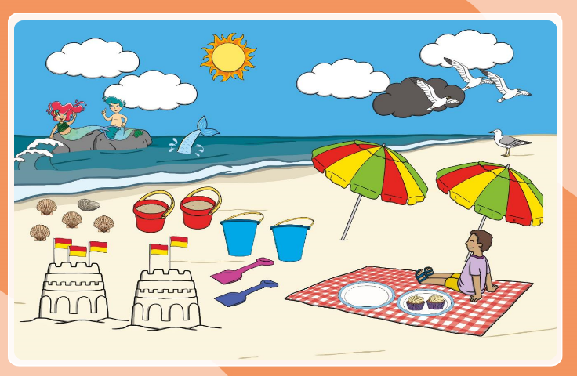
Maths
Today's focus is continuing with deepening our understanding of the number 5!
Can you do 5 jumps?
Can you find 5 objects around your house?
Can you clap 5 times?
Can you show 5 with your fingers?
Can you give your grown up a high 5?
Look at this picture, can you find
5 things that are the same?

Slide 10
All about the Number…
5

Slide 11



All about the Number 5
The number 5 can be shown in lots of different ways.
five
Next

Slide 12

Number Fingers
How many fingers are being shown?
Can you hold up 5 fingers?
back

Slide 13
Number Words
Do you know what this word says?
five
back
This is the number 5, written as a word.

Slide 14

Number Shapes
This is a number shape for the number 5.
The number shape has 5 holes or circles.
back

Slide 15

Dotty Dice Numbers
Dice sometimes have numbers on them written as a pattern of dots.
This is the number 5.
back

Slide 16

Number Lines
Can you spot the number 5 on the number line?
Which numbers are next to number 5?
Click the hand to reveal the answer!
0
1
2
3
4
5
6
7
8
9
10

Slide 17
Number Lines
10
How about this number line?
Can you spot the number 5?
Is it in the same place?
9
8
7
6
5
4
3
2
1
Click the hand to reveal
the answer!
0

Slide 18







Let’s Try Together!
Amy wants to take 5 books home. Can you help her?
Click on 5 books to add them to the book bag.

Slide 19






Hannah needs to find the jar of sweets with 5 sweets. Can you help her?

Slide 20


Well done!
Next

Slide 21


Try Again!
back

Slide 22

Try Again!
back

Slide 23

Numbers as Labels
5
Have you noticed how numbers can be used for labels too? For example, the number on a bus or the number on a door.
Have you ever seen a house with a number 5 on the door?

Slide 24




Number 5 Challenges
Are you ready for a challenge?
Click on the stars to make a challenge appear.
Finished

Slide 25


Challenge
5
Quickly, find something in the classroom that shows the number 5.
five
back

Slide 26

Challenge
Quickly, find 5 items and bring them back.
5
back

Slide 27

Challenge
Can you stretch up high 5 times?
back

Slide 28

Challenge
Can you show me 5 fingers?
back

Slide 29




Congratulations!
You are now an expert on the number 5.
Can you give yourself 5 pats on the back?
Can you give yourself 5 claps?

Slide 31
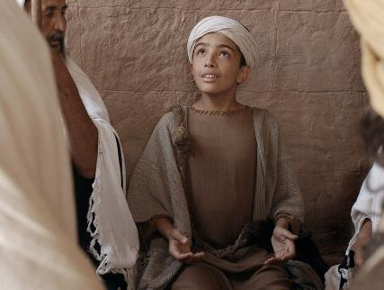
RE
Today, we are learning about when Jesus was 12 years old and He went to the temple!
This story can be found in the Bible, Luke 2: 41-52

Slide 32
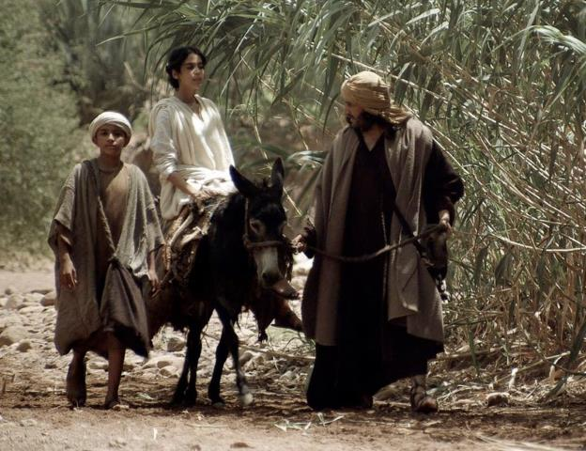
When Jesus was twelve years old, Mary and Joseph took Him to Jerusalem for the Festival of the Passover.

Slide 33
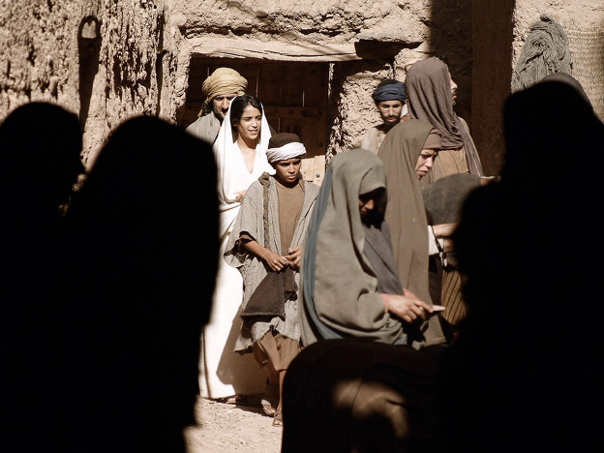
It was a holiday celebration they attended every year. Thousands of people from all over the country were in the city and the narrow streets were very crowded.

Slide 34
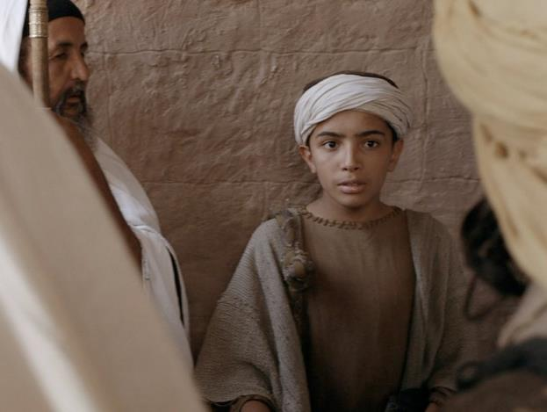
At the end of the festival Mary and Joseph joined others from Galilee making the trip home. They thought Jesus was with their relatives and friends in the crowd heading home, but He was in the Temple sitting with the teachers, asking questions

Slide 35
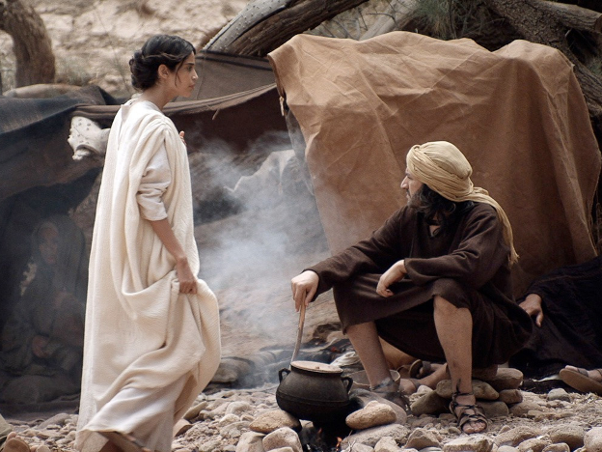
That evening Mary and Joseph set up camp and rested.

Slide 36
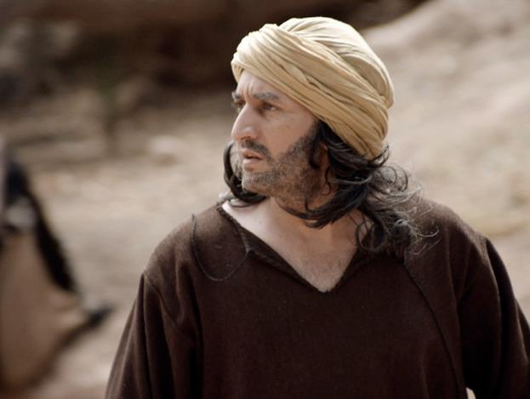
But when they looked for Jesus they could not find Him.

Slide 37
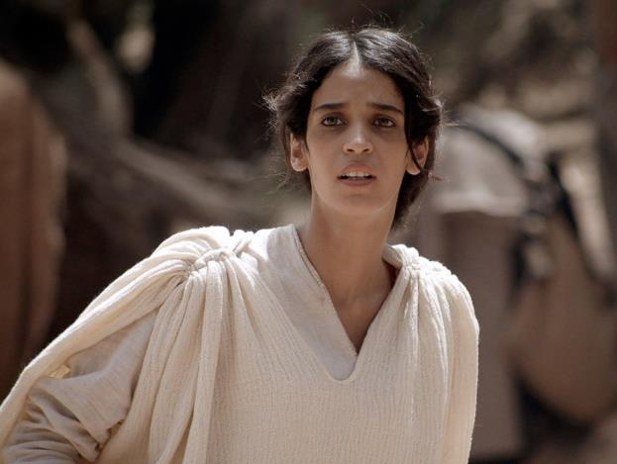
After a frantic search they realised Jesus was not with their relatives or friends. Immediately they set off back to Jerusalem to find Him.

Slide 38
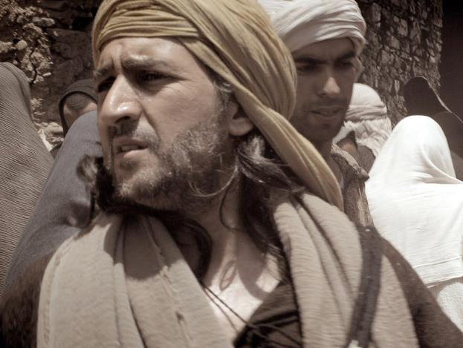
They searched the city for three days. But they could not find Jesus.

Slide 39
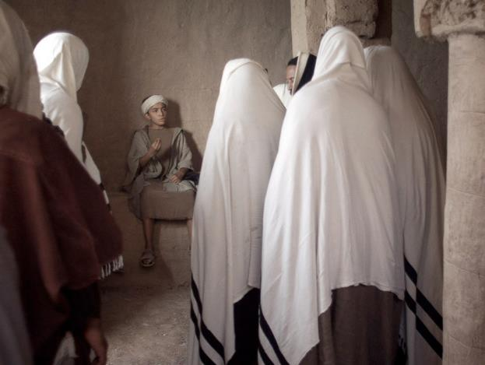
Having searched and searched they went into the Temple and suddenly ...

Slide 40
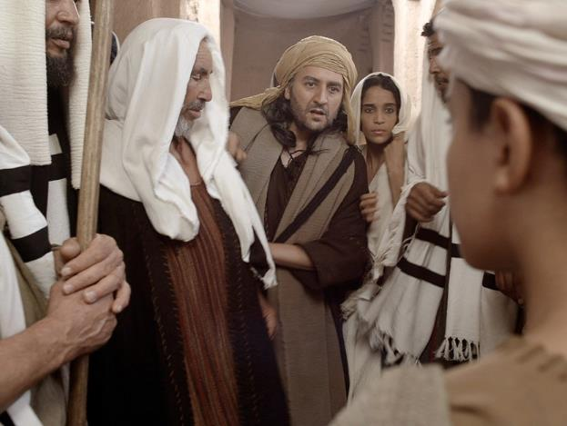
... they saw Jesus sitting with the teachers of God’s law.

Slide 41
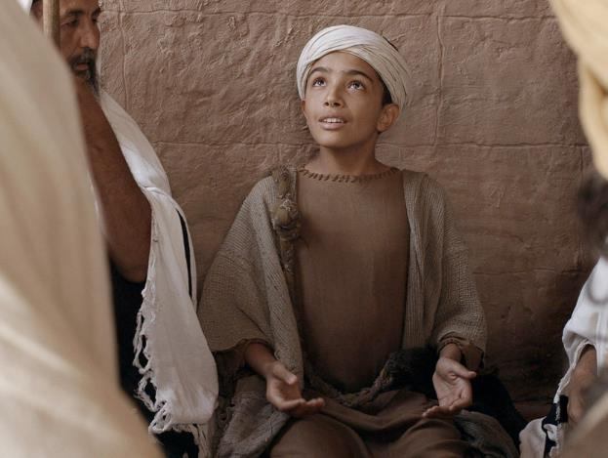
Those listening to Jesus were amazed at the questions He asked and the answers He gave.

Slide 42
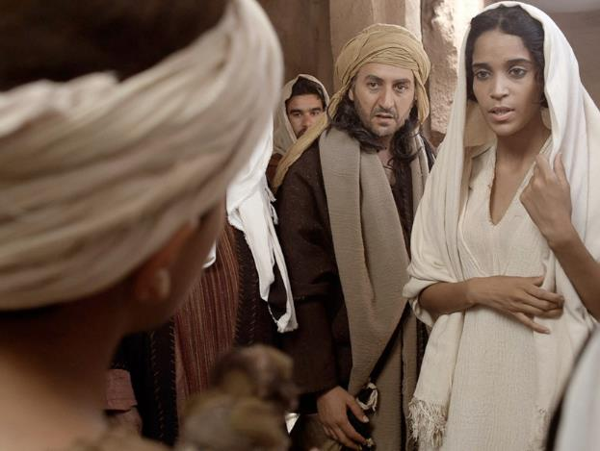
‘Son, why have you treated us like this?’ asked Mary. ‘Joseph and I have been anxiously searching for you.’

Slide 43
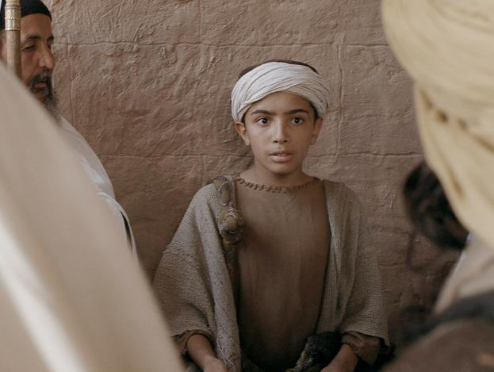
‘Why were you searching for me?’ Jesus asked. ‘Didn’t you know I had to be in my Father’s house doing what He wants me to do?’
Mary and Joseph did not understand what He was saying to them.

Slide 44
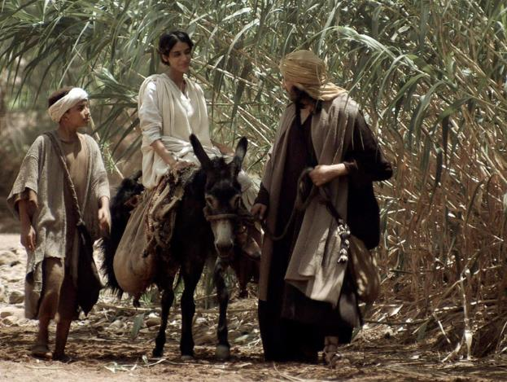
Jesus returned to Nazareth with His parents and was obedient to them. Mary treasured all these things in her heart. And Jesus grew in wisdom and stature, and in favour with God and man.

Slide 45
Questions to discuss:
Have you ever been lost?
How did you feel?
How do you think Mary and Joseph felt when they thought that they had lost Jesus?
Why did Jesus say that Mary and Joseph should have known that he was in His Father's House?

