Slide 1
Staff Share

Slide 2
Contents
What are end of key stage 2 assessments?
When do they happen?
What are the children tested on?
How are the tests administered?
What happens with the results?
How can I help my child?

Slide 3
What are end of key stage 2 assessments?
What you might know as SATs, or standard attainment tests, are national curriculum tests that are usually taken by children at the end of key stage 2.
All children are assessed during the last term of year 6; for 2025, this is in the week beginning 12th May.
The aim of the tests is to establish whether pupils are working at an expected level in English and maths for the end of primary school and the start of secondary school.
The results of the tests do not tell us how accomplished children are in other areas, such as sport, music or art.
Pupils sit six different tests in three subject areas: Maths, English reading and English grammar, punctuation and spelling.
English writing and science judgements are made by the pupils’ teachers through teacher assessment, based on evidence of independent writing and work gathered over the course of year 6.

Slide 4
When do they happen?
Every primary school will test their pupils on the same subject at the same time during the week beginning 12th May 2025. The schedule of tests for this year looks like this:
Assessment week 2025
Tests
Monday 12th May
English grammar, punctuation and spelling
Paper 1: questions, paper 2: spelling
Tuesday 13th May
English reading
Wednesday 14th May
Mathematics
Paper 1: arithmetic, paper 2: reasoning
Thursday 15th May
Mathematics
Paper 3: reasoning

Slide 5
What are the children tested on?
English grammar, punctuation and spelling
Paper 1: questions (45 minutes) 50 marks
A combined question and answer booklet which assesses pupils’ understanding of the grammar, punctuation and spelling elements of the national curriculum English programmes of study for key stage 2.
Paper 2: spelling (15 minutes but not strictly timed) 20 marks
The paper that pupils receive has 20 sentences, each with a missing word. The teacher reads the sentences one at a time and pupils write in the missing word on their paper.
English reading
(1 hour) 50 marks
Pupils will have a reading booklet with three different texts to read and a corresponding question and answer booklet. The texts are presented in increasing levels of difficulty. Pupils’ comprehension skills will be assessed against the comprehension elements of the English programme of study for key stage 2.

Slide 6
What are the children tested on?
Mathematics
Paper 1: arithmetic (30 minutes) 40 marks
Pupils will have a booklet of arithmetic questions based on the national curriculum programmes of study for maths at key stage 2.
Papers 2 and 3: reasoning (40 minutes each) 35 marks each
Both papers will ask children to reason and solve problems, again based on the national curriculum maths programmes of study.

Slide 7
What happens with the results?
For 2025, school results in the end of key stage assessments will be published on the Key Stage 2 Performance Measures Website.
School results will be shared with the school, their local authority or academy trust and Ofsted to support school improvement.
Scans of marked pupil test papers and test results are published online in July and can be accessed by the school.
Each child will receive a scaled score for their performance on the tests. This is a score between 80 and 120, where a score of 100 is considered to be working at the expected level of attainment at the end of primary school.
We will share pupils’ results in their end of year written report, which is sent home in July.

Slide 8
Scaled Scores
What is meant by ‘scaled scores’?
It is planned that 100 will always represent the ‘national standard’.
Each pupil’s raw test score will therefore be converted into a score on the scale, either at, above or below 100. For example: in a previous year’s reading test a score of 26/50 was deemed 100 on the scale.
The scale will have a lower end point of 80 and an upper end point of 120.
A child who achieves the ‘national standard’ (a scaled score of 100 or higher) will be judged to have demonstrated sufficient knowledge in the areas assessed by the tests.
Each pupil receives:
a raw score (number of raw marks awarded);
a scaled score in each tested subject
confirmation of whether or not they attained the national standard.
chapter
menu
next page

Slide 9
Scaled Score Examples
On publication of the test results in July:
a child awarded a scaled score of 100 is judged to have met the ‘national standard’ in the area judged by the test. (Expected Standard)
a child awarded a scaled score of 110 – 120 is judged to have exceeded the national standard and demonstrated a higher than expected knowledge of the curriculum for their age.
(Greater Depth within the Expected Standard)
a child awarded a scaled score of less than 100 is judged to have not yet met the national standard and performed below the expectation for their age. (Working towards the Expected Standard)
chapter
menu
next page

Slide 10
The Tests
There are no tests to be administered in Science this year – as far as we know. (Schools are spot-checked every few years.)
All tests are externally marked.
As in recent years, writing will be teacher assessed internally with some external moderation.
chapter
menu
next page

Slide 11
Reading
The reading test consists of a single test paper with three unrelated reading texts. Children are given 60 minutes in total to read the texts and answer the questions.
A total of 50 marks are available.
Questions are designed to assess the comprehension and understanding of a child’s reading.
During the reading paper, a child’s inference and deduction skills are thoroughly tested. They will also be expected to answer questions on authorial choices: explaining why an author has chosen to use particular vocabulary, grammar and text features.
Some questions are multiple choice; others require short answers and some require an extended response or explanation.
In the spring term, we will give the children more reading tests to allow them to practise their exam technique and help them to understand how the tests work. However, this will only help to support your child if they work hard at independent reading at home.
chapter
menu
next page

Slide 12
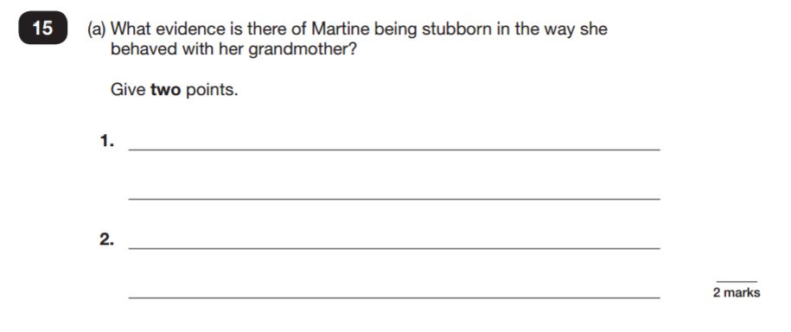
Sample Questions
Reading Paper
chapter
menu
next page

Slide 13
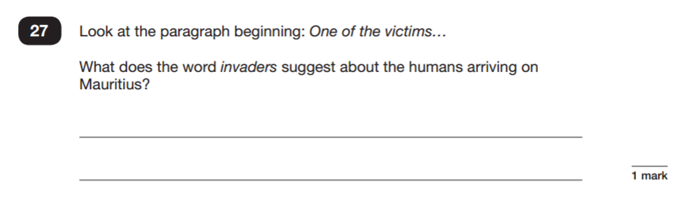
Sample Questions
Reading Paper
chapter
menu
next page

Slide 14
How to Help Your Child with Reading
First and foremost, focus developing an enjoyment and love of reading. There is a wealth of fantastic literature that will help your child. (See Recommended Booklist sent out previously.) Visit Macclesfield library – it’s free and the librarians can recommend new titles. Please encourage your child to read longer/more challenging reads. For example: fans of The Wimpy Kid series should be encouraged to try more challenging reads. (The Reading test is in 3 parts and the third is either a classic novel or stretching text.)
Enjoy stories together – reading stories to your child in year 6 is equally as important as listening to your child read. (You can pick more challenging reads to share with them than they could access on their own.)
Ensure your child reads for at least 30 minutes a day on free reading. Extra time should be allocated to guided reading.
Talk about the story before, during and afterwards – discuss the plot, the characters, their feelings and actions, how it makes you feel, predict what will happen and encourage your child to have their own opinions.
Look up definitions of words together – use a dictionary.
All reading is valuable – it doesn’t have to be just stories. Reading can involve anything: fiction, non-fiction, poetry, newspapers, magazines, football programme etc. but to build stamina children should aim to read a book every two weeks.
chapter
menu
next page

Slide 15
Grammar, Punctuation & Spelling
A spelling test is administered containing 20 words, which lasts approximately 15 minutes.
A separate test is given on grammar, punctuation and vocabulary.
This test lasts for 45 minutes and involves short answer questions including some multiple choice.
Marks for these two tests are added together to give a total for grammar, punctuation and spelling.
chapter
menu
next page

Slide 16
Grammar, Punctuation and Spelling
The spellings which are set as homework each week will help prepare your child for the spelling test.
Practising these spellings on a nightly basis for a few minutes is preferable to simply cramming them the night before the test.
We will cover the grammar aspects of the test in class and will be sending home grammar exercises to help prepare them. We have already purchased revision booklets to help you with this.

Slide 17
Sample Questions Gaps
Tick one box in each row to say whether the underlined word is an adverb or adjective.
Sentence | Adjective | Adverb
It is a direct flight to Spain.
He needed to move directly to his seat.
I hate arriving late.
The door opened fast.
chapter
menu
next page

Slide 18
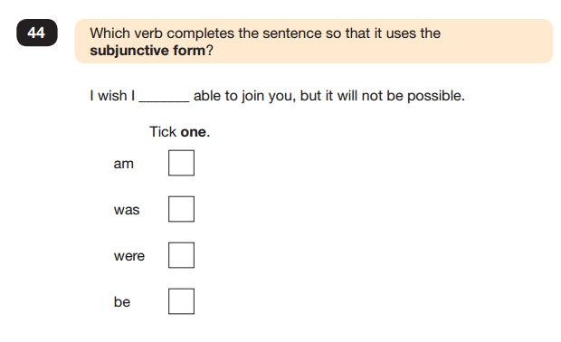
Sample Questions
Grammar, Punctuation and Spelling Paper 1
chapter
menu
next page

Slide 19
How Writing will be assessed this year
Unlike other subjects, writing is assessed in school and moderated by external moderators.
Each child will be given the opportunity to write several significant pieces over the course of the year across all subjects. E.g. a diary entry as an evacuee, a short story, instructions for Science, a balanced argument for RE, a letter as a wise man etc. This bank of work is assessed throughout the year against set criteria.
E.g. can they use punctuation (./?/!/””/-/ : /;/ ,) accurately 90% of the time?
Is handwriting always fully joined and readable?
Do the sentences show variation in length and complexity? Do they make sense? Are they using subordinate clauses?
Have they edited them independently for spellings?
Are they choosing interesting vocabulary and phrasing?
Does the piece match the requirements of the task.
By the end of June, each child’s best 6+ pieces are assessed to ascertain an overall level so it is vital that the children work extremely hard and give every piece their best effort during the year. The work begun in autumn builds the necessary skills for better pieces in the spring.

Slide 20
How to Help Your Child with Writing
Practise and learn weekly spelling lists – All children will be learning the same rule but with differentiated spellings. E.g. adding ing to verbs ending in e. Plus years 3 – 6 tricky words.
When your child is doing written homework, encourage them to check punctuation and capital letters really thoroughly. Also use a dictionary/spell checker to check spellings. Invest in a thesaurus to expand vocabulary.
Encourage opportunities for writing at home. For example: letters to family or friends, shopping lists, notes or reminders, stories and poems.
We will be covering most of the grammar work in school. The key terms such as noun, verb, adverb, adjective, determiner, passive tense etc. will be covered in school during lessons. But we will send home revision books to recap and practise the skills. Please support your child with this.
Remember that good readers become good writers! Identify good writing features when reading (e.g. vocabulary, sentence structure and punctuation).
chapter
menu
next page

Slide 21
Mathematics
The Mathematics tests:
Children will sit three tests: paper 1, paper 2 and paper 3.
Paper 1 is for arithmetic lasting for 30 minutes, covering calculation methods for all operations, including fractions, percentages and decimals.
Questions gradually increase in difficulty. Not all children will be expected to access some of the more difficult questions later in the paper.
Papers 2 and 3 cover problem solving and reasoning, each lasting 40 minutes.
Pupils will still require calculation skills but will need to answer questions in context and decide what is required to find a solution.
chapter
menu
next page

Slide 22
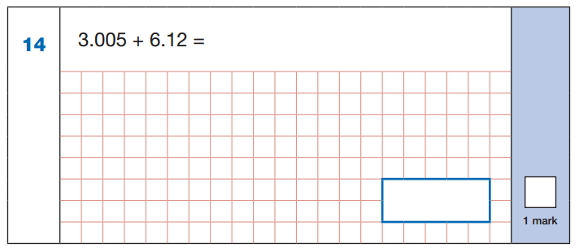
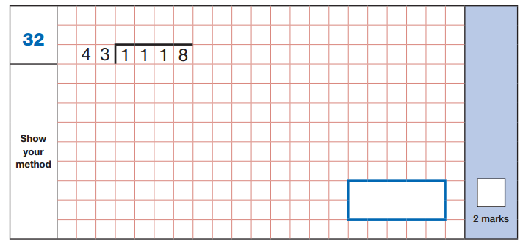
Sample Questions
Maths Paper 1: Arithmetic
chapter
menu
next page

Slide 23
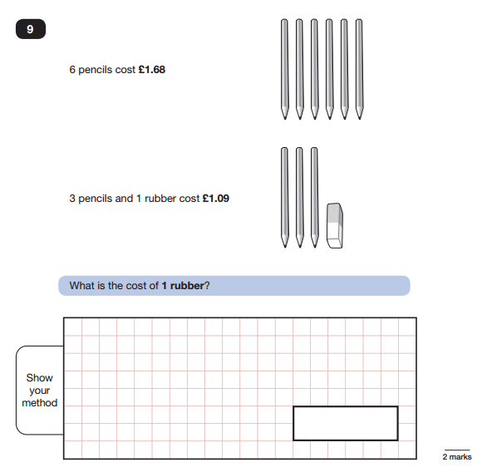
Sample Questions
Maths Paper 2 / Paper 3 : Reasoning
chapter
menu
next page

Slide 24
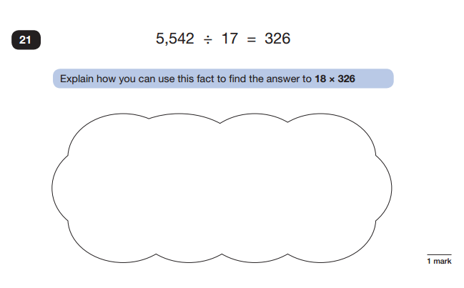
Sample Questions
Maths Paper 2 / Paper 3 : Reasoning
chapter
menu
next page

Slide 25
How to Help Your Child with Maths
Learn all the times tables. Responses should be automatic.
Play mental maths games including counting in different amounts, forwards and backwards.
Encourage opportunities for telling the time. (How many minutes between?)
Encourage opportunities for counting coins and money; finding amounts or calculating change when shopping.
Look for numbers on street signs, car registrations and anywhere else! Biggest? Smallest?
Look for examples of 2D and 3D shapes around the home. Can they name them?
Identify, weigh or measure quantities and amounts in the kitchen or in recipes.
Play games involving numbers or logic, such as dominoes, card games, darts, draughts and chess.
CGP Maths Homework book: Please help with this as much as you can. (You can of course purchase other revision books and find extra information online.)
chapter
menu
next page

Slide 26
How can I help my child?
Support your child to complete any home learning tasks sent home, such as spelling activities, reading comprehensions and maths sheets.
Use online activities to practise maths, spellings etc.
Make sure they go to bed at a reasonable time, have a good breakfast and arrive at school on time every day.
Encourage them to try their best, commend their efforts and plan to celebrate their hard work at the end of the testing week, rather than focusing on the test results.

