Slide 1
Year 6 Curriculum Overview
2025 – 2026

Slide 2

RE – The Vine and The Branches
Our Topics
Autumn 1: Creation and Covenant
Autumn 2: Prophecy and Promise
Spring 1: Galilee to Jerusalem
Spring 2: Desert to Garden
Summer 1: To the Ends of the Earth
Summer 2: Dialogue and Encounter

Slide 3
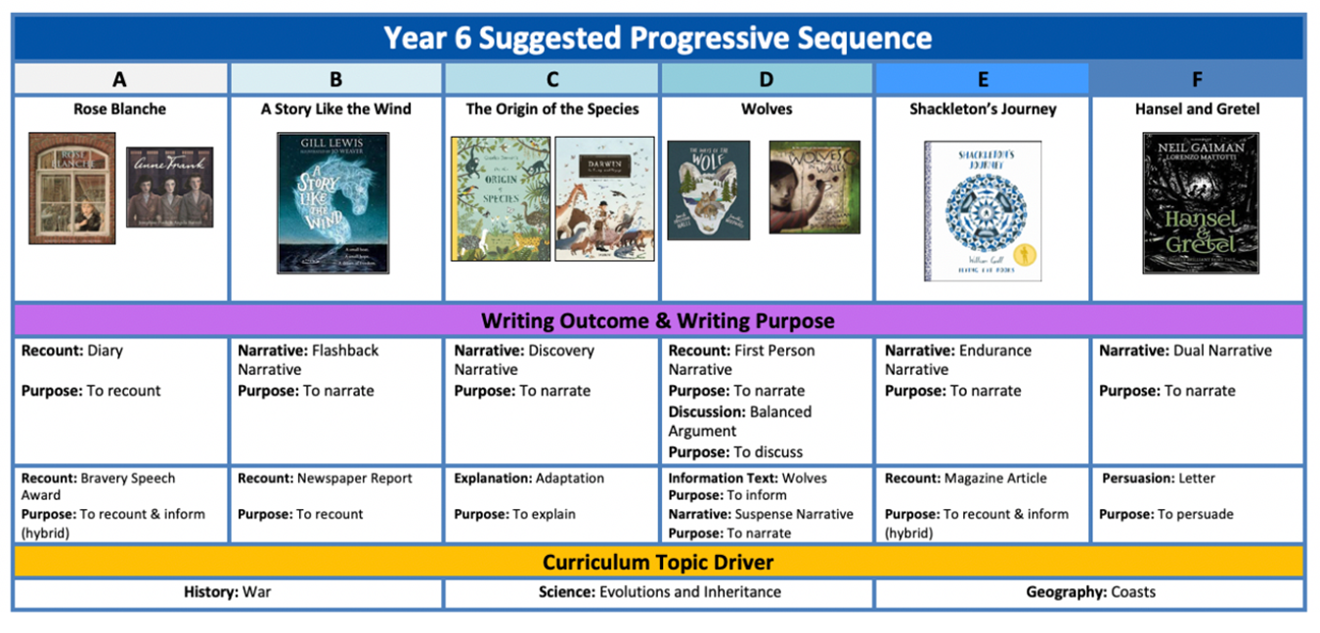
English Overview:
Book order may change.

Slide 4
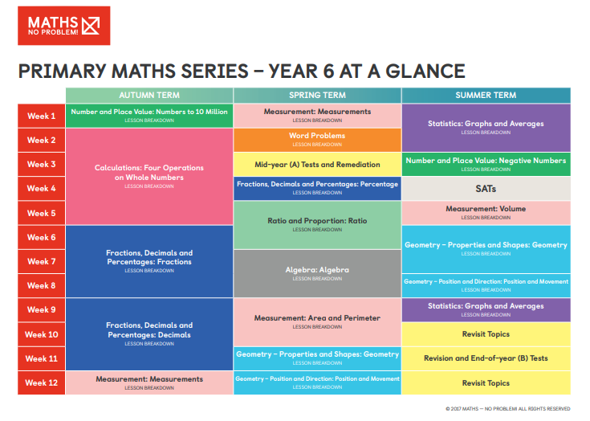
Maths
Maths – No Problem! Scheme

Slide 5

Science – Rising Stars
‘Classifying Critters’
‘Staying Alive’
‘Chemistry with Cabbages’
‘We’re Evolving’
‘Let it shine’
‘Electrifying’

Slide 6


History and Geography- Rising Stars
Subject | Autumn 1 | Autumn 2 | Spring 1 | Spring 2 | Summer 1 | Summer 2
History |  | Second World War |  | The Mayans |  | Ancient Greece
Geography | South America: The Amazon |  | Protecting the Environment |  | Our World in the Future

Slide 7

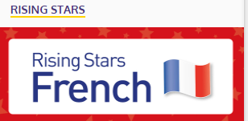
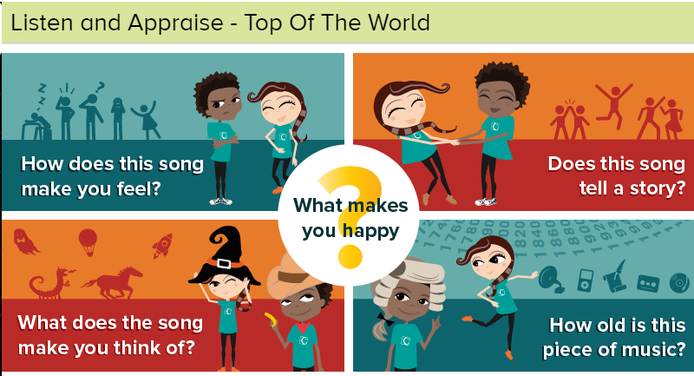

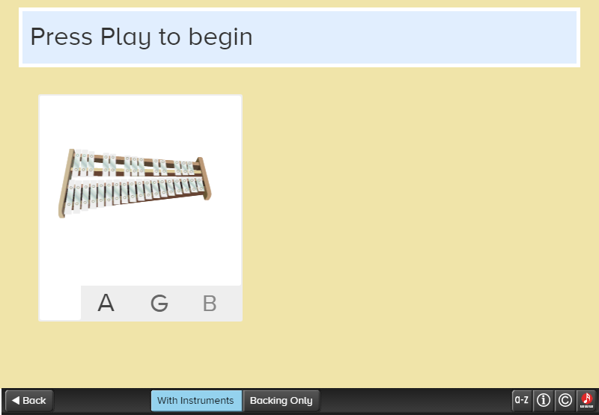
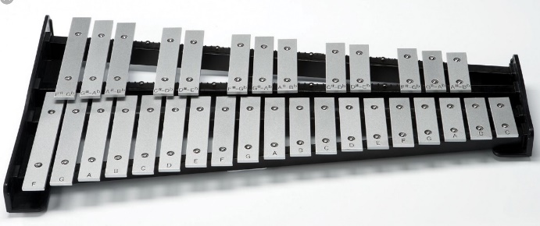
French and Music
End of Year Musical Production
FRENCH
MUSIC – CHARANGA

Slide 8
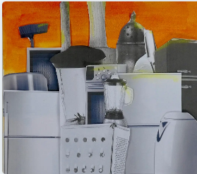
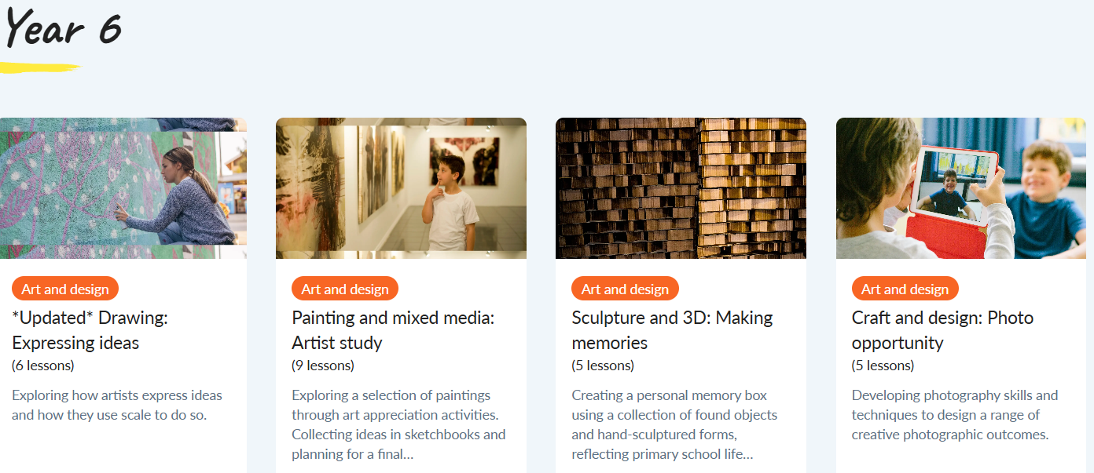
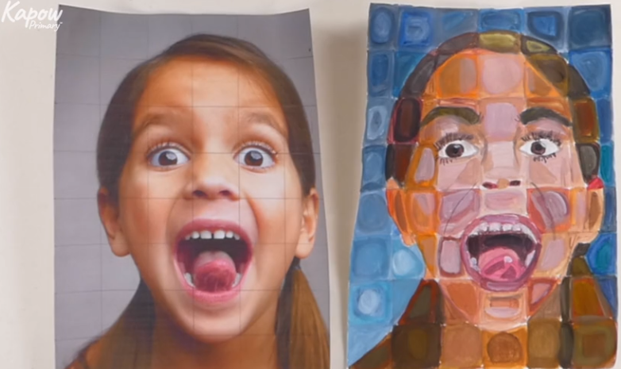
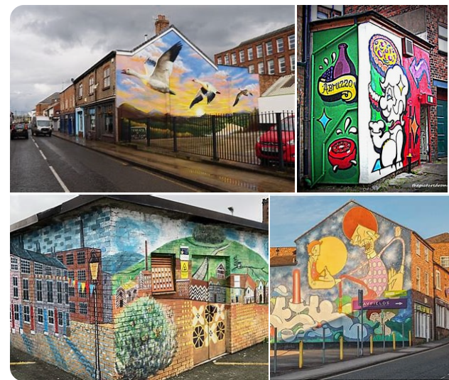
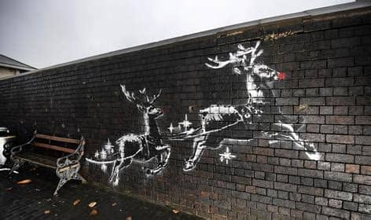

Art from the Kapow Scheme

Slide 9
Design Technology from Kapow
PLAYGROUNDS
MECHANICAL SYSTEMS
DIGITAL WORLD
ELECTRICAL
COOKING AND NUTRITION

